Slide 1
How Microsoft Talent can Digitize a Forgotten HR Department
Malin Donoso Martnes

Slide 2


About the speaker
CRM as a user 2009-2014
Consultant Dynamics CRM from 2014
Talent from March 2018
#2 worldwide to pass the Talent certification
Microsoft Dynamics 365 Community Contributor
Finalist «Enthusiast 2018» Microsoft Partner Awards Norway
Malin Donoso Martnes
Senior consultant Dynamics 365
Point Taken AS

Slide 3
Ecosystem Dynamics 365
A huge benefit for Talent

Slide 4



Dynamics 365
Office 365
Microsoft Flow
PowerApps
Power BI
Connectors and
Gateways
Common Data
Service
Pro dev extensibility

Slide 5
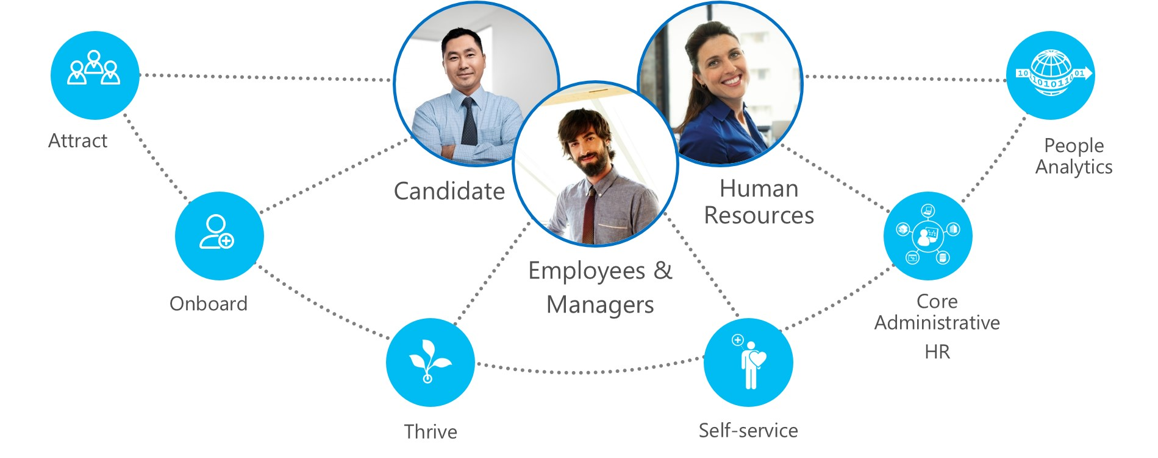
For the entire company

Slide 6



Attract
Candidate
HR
Manager

Slide 7
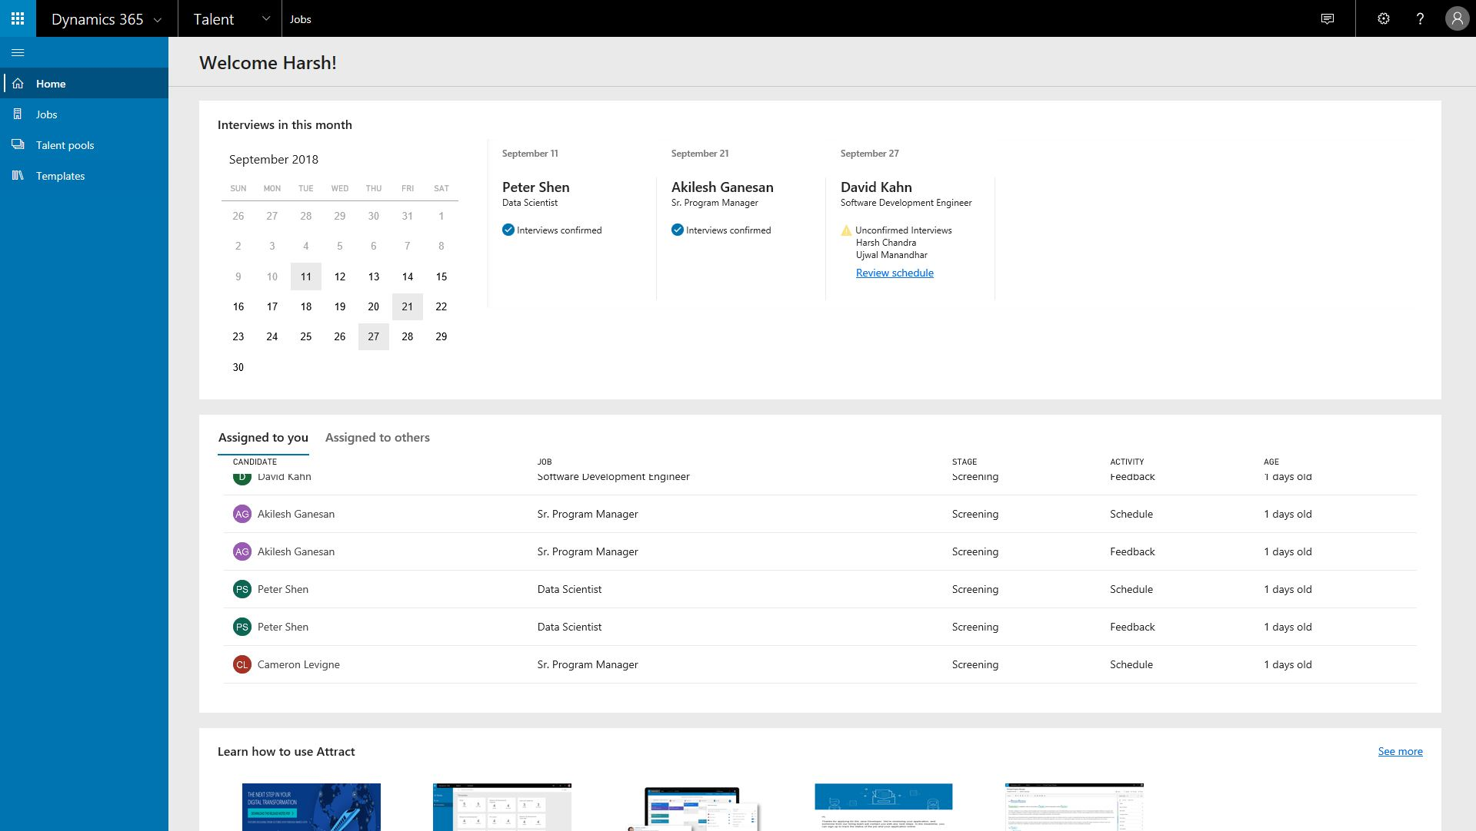
HR
Manager

Slide 8
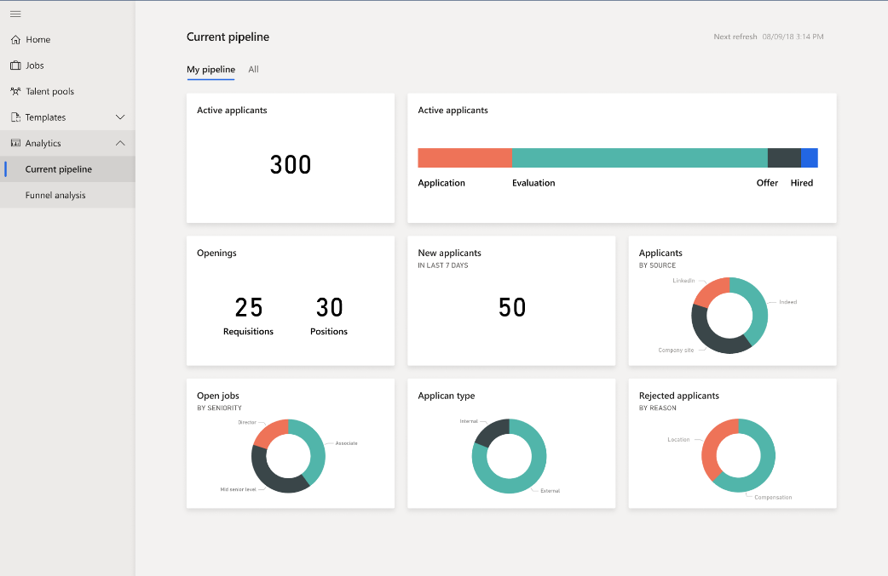
HR
Manager
Notes:
Unlock intelligence + extensibility
Facilitate smarter decisions by combining human and machine intelligence to get analytics + action.
Analytics and Actions: Improve dashboards and user interface to provide recruiters and hiring managers with insight into the health of candidate pipelines and onboarding. Dashboards will also include suggested actions to keep the hiring process moving and ensure you deliver the best possible candidate and onboarding experience.
Employee data in CDS for Apps: Utilize Power Apps + Power Flow + Power BI to unlock the next level of talent success. Expand extensibility through additional entities within CDS, including competencies, job, benefits, compensation, organization management and tasks.
Intelligence on time and absence: Enhancements will allow the configuration of leave and absence plans to meet regulatory policies and provide additional insight into employee time off.

Slide 9
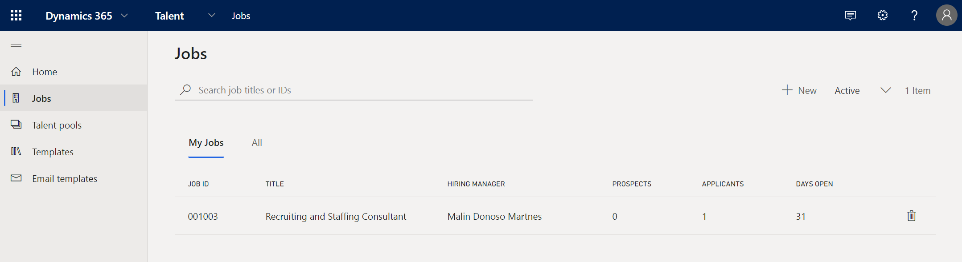
HR

Slide 10
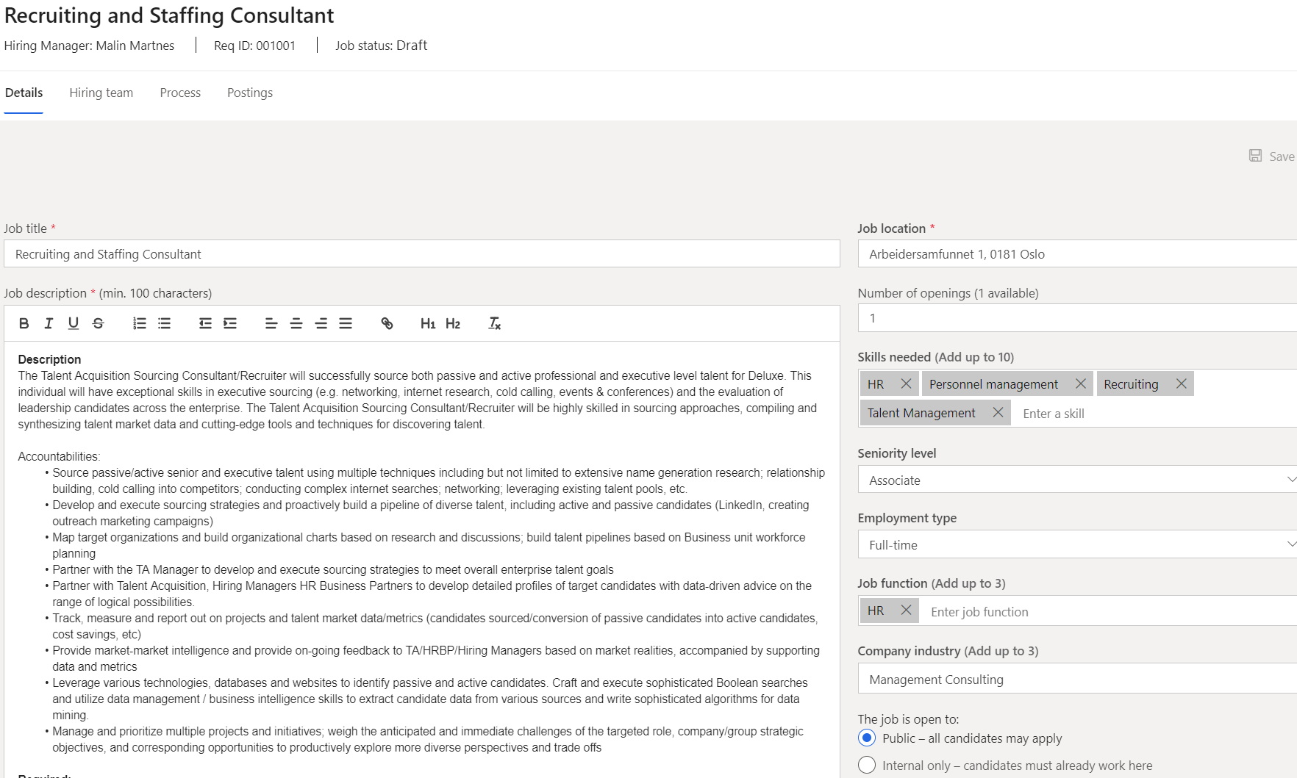
HR

Slide 11
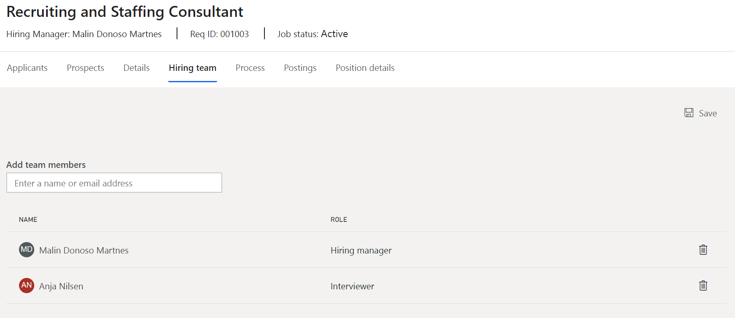
HR

Slide 12
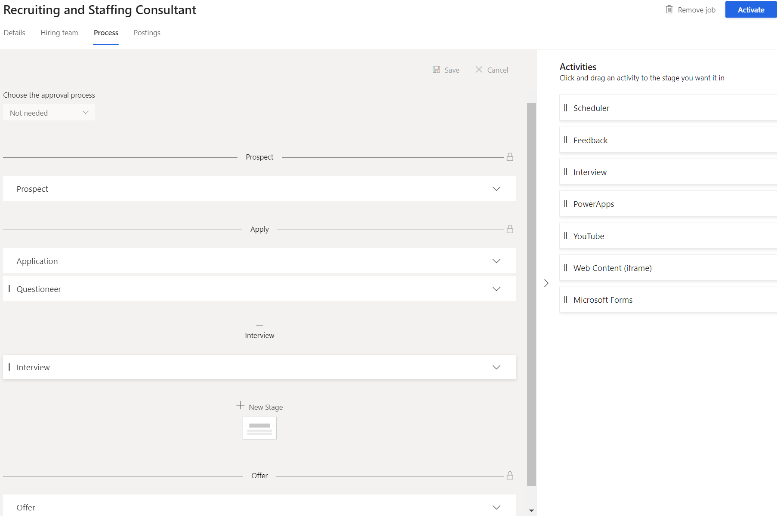
HR

Slide 13
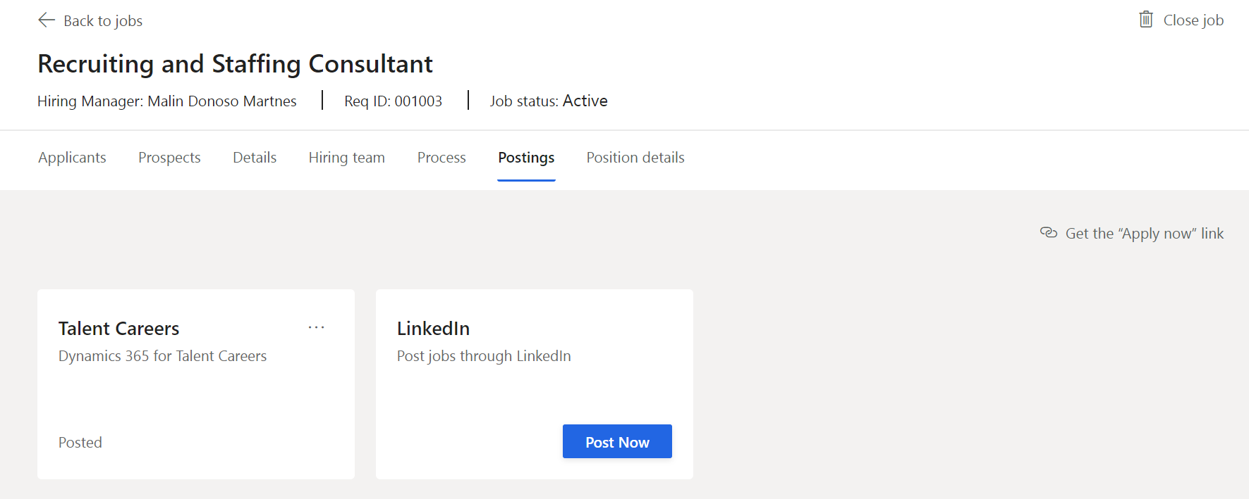
HR

Slide 14
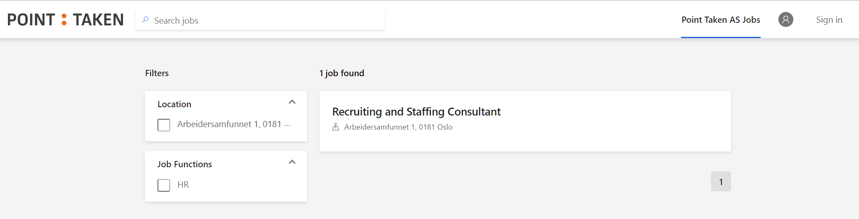
Candidate

Slide 15
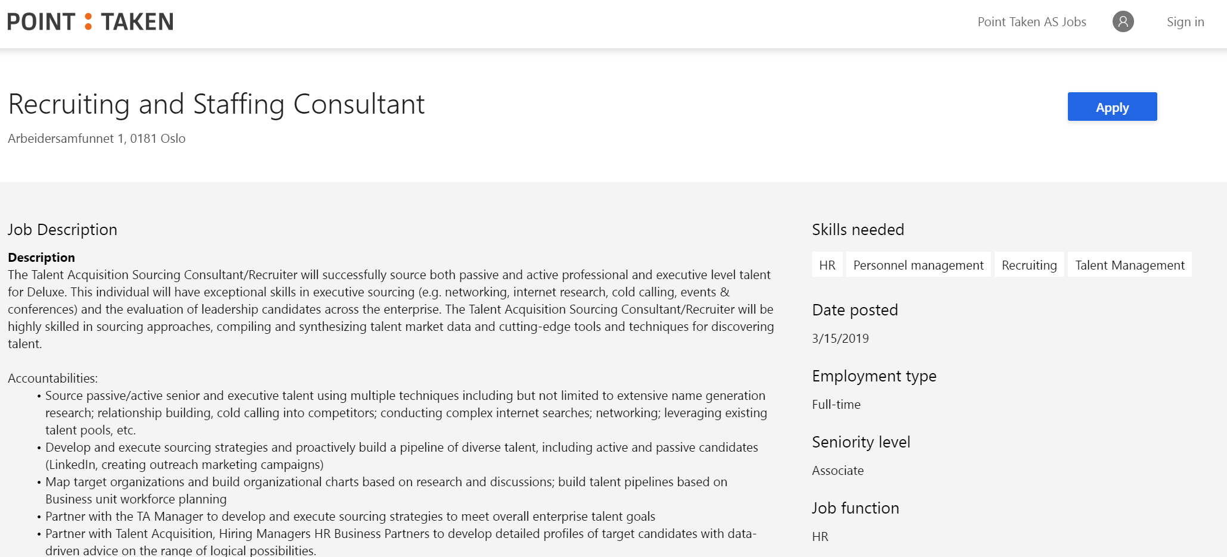
Candidate

Slide 16
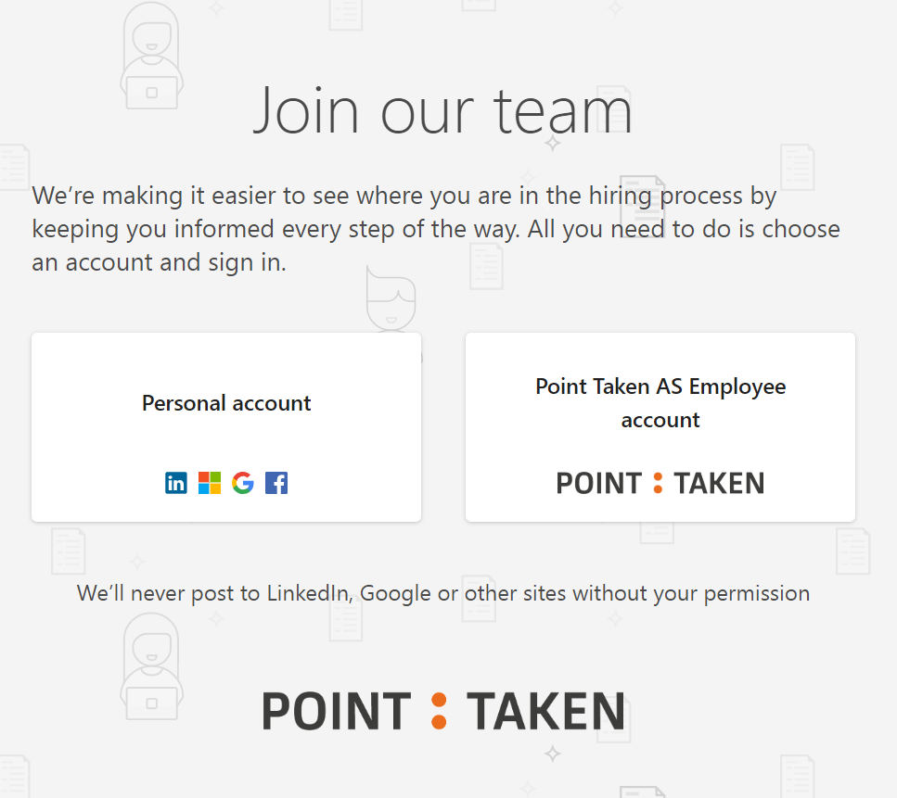
Candidate

Slide 17
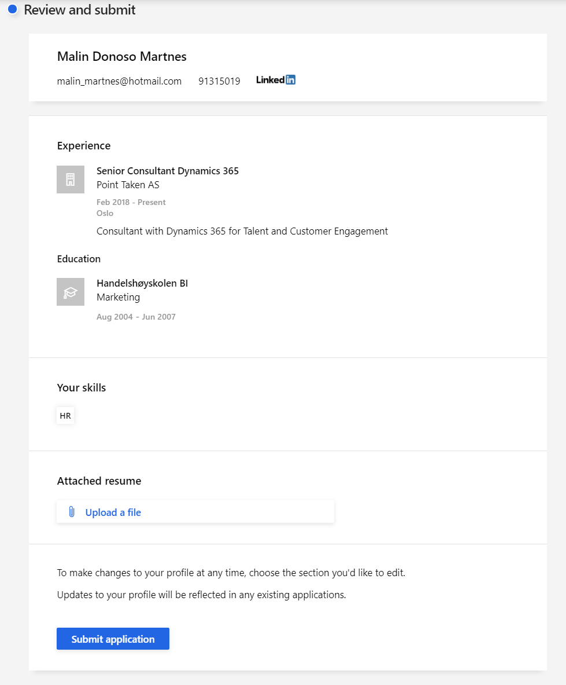
Candidate

Slide 18
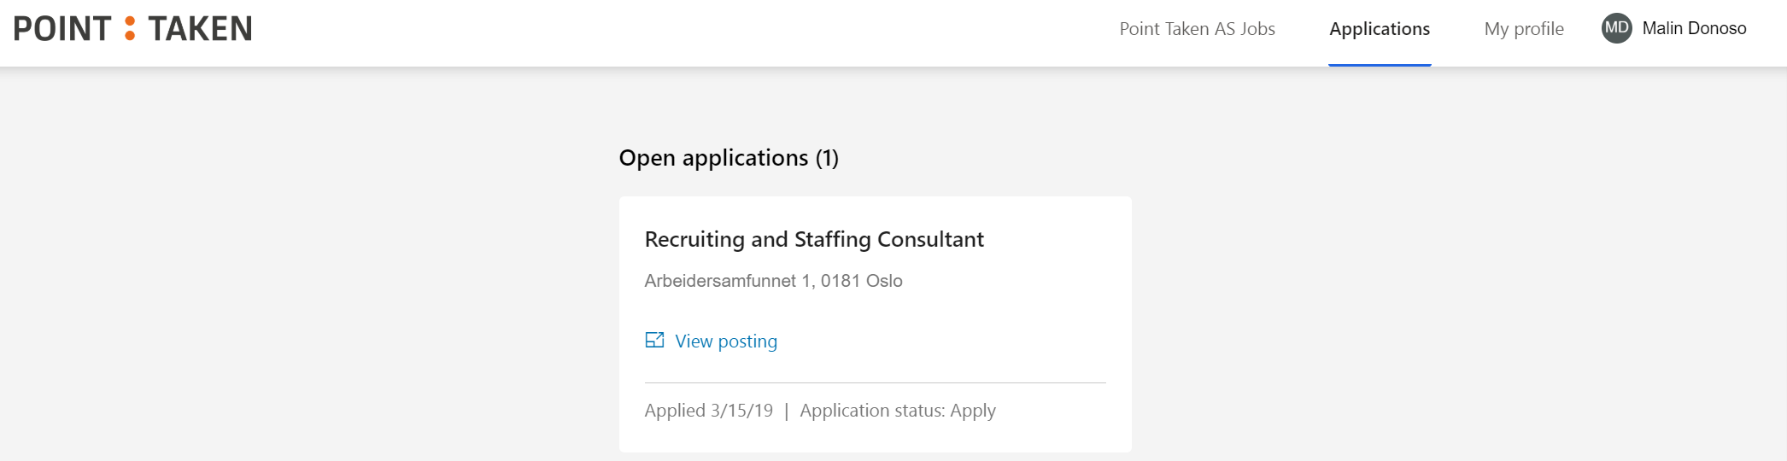
Candidate

Slide 19
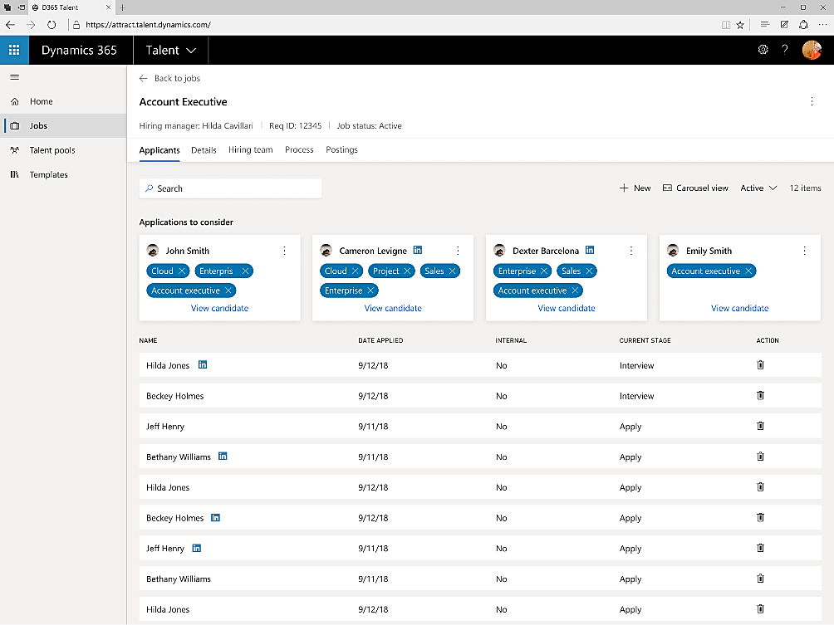
HR

Slide 20
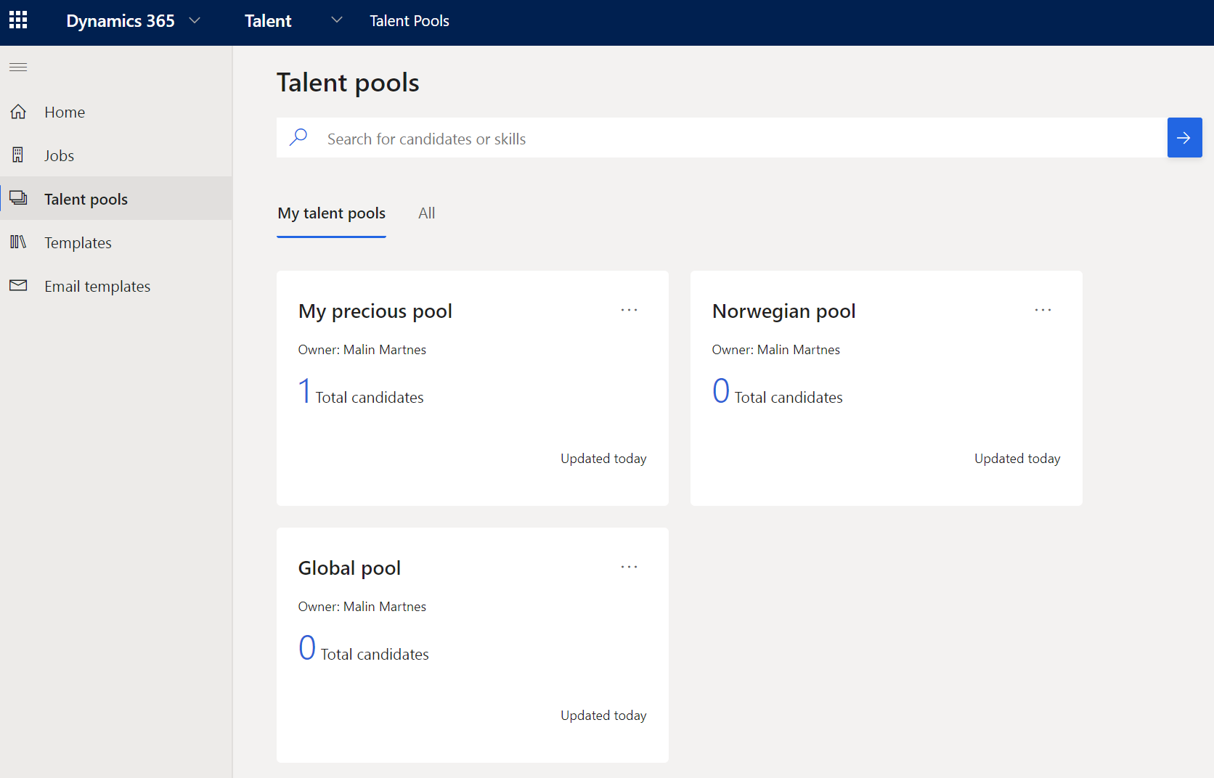
HR

Slide 21
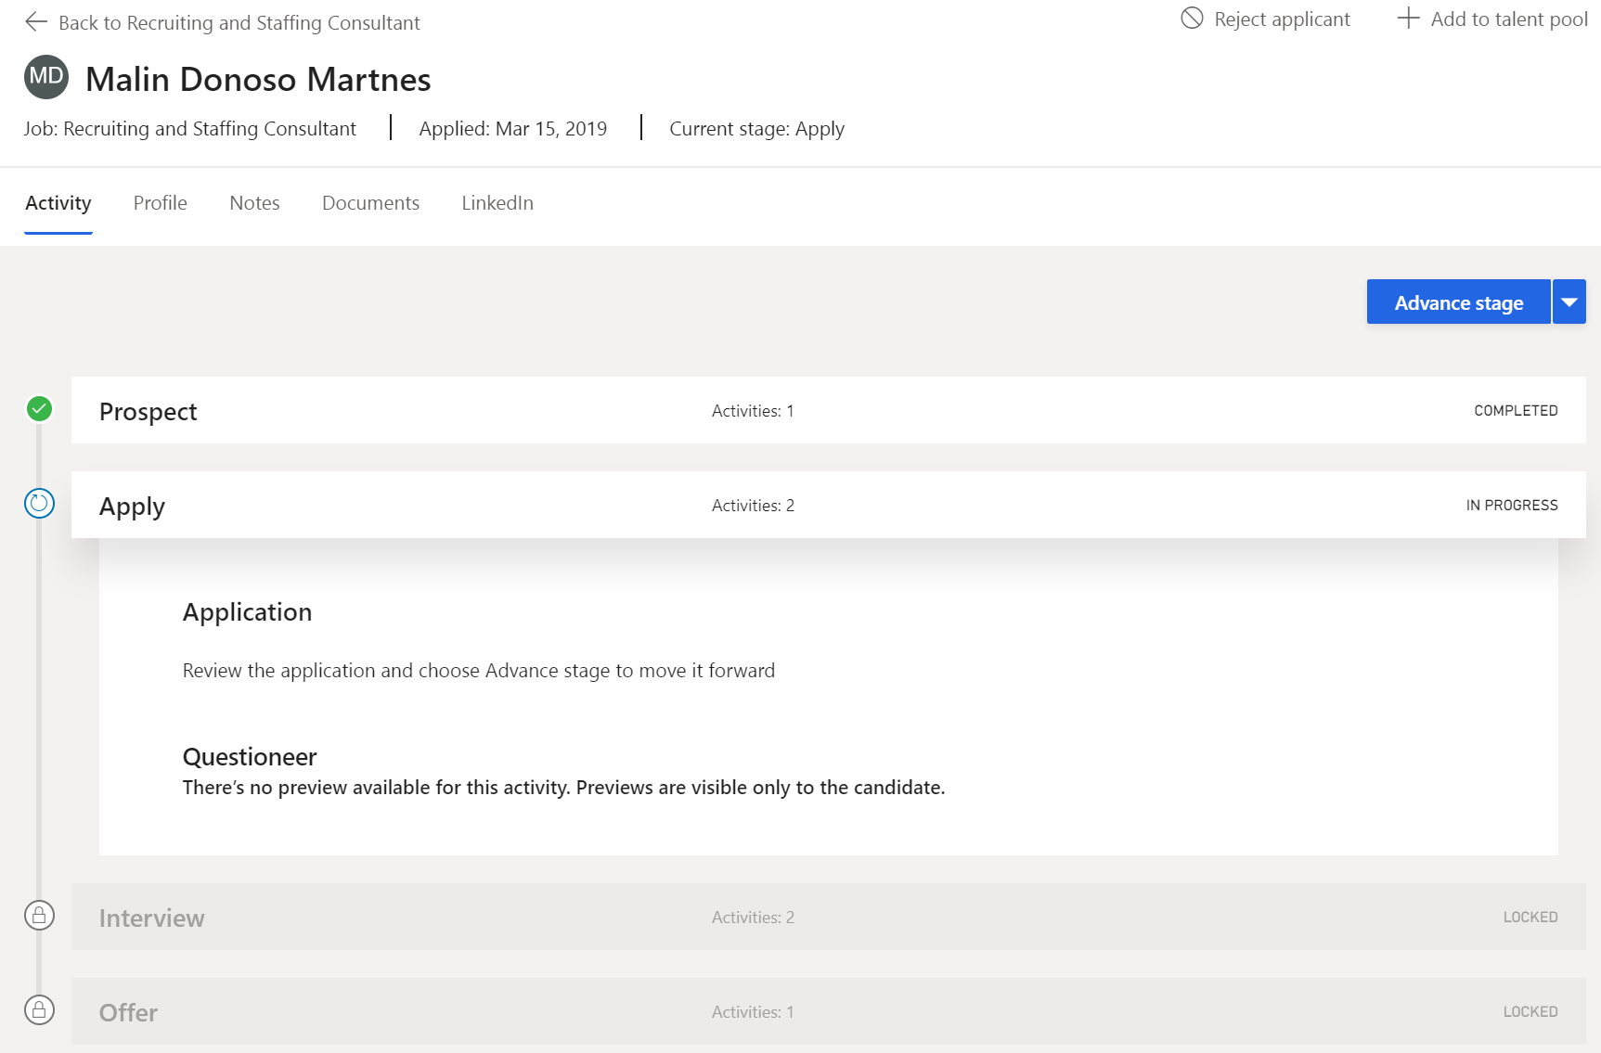
HR
Manager

Slide 22
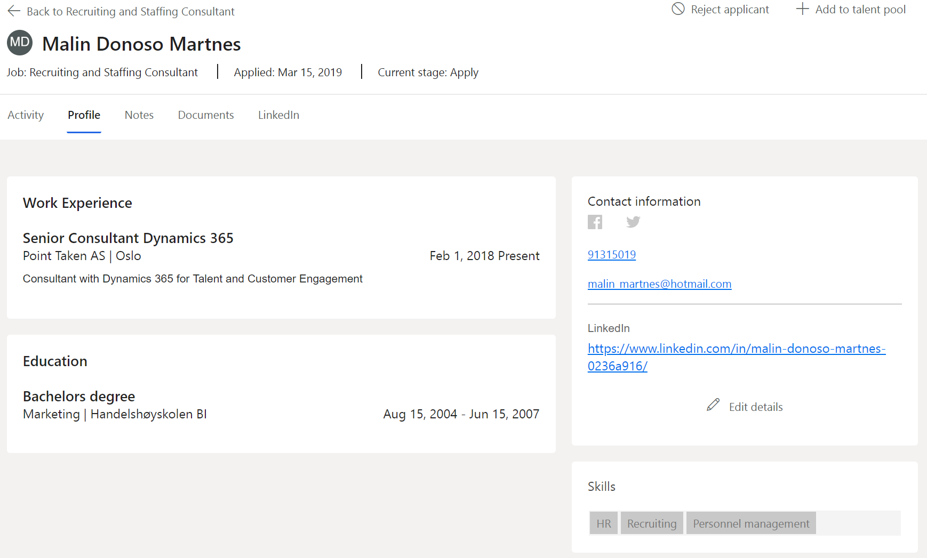
HR
Manager

Slide 23
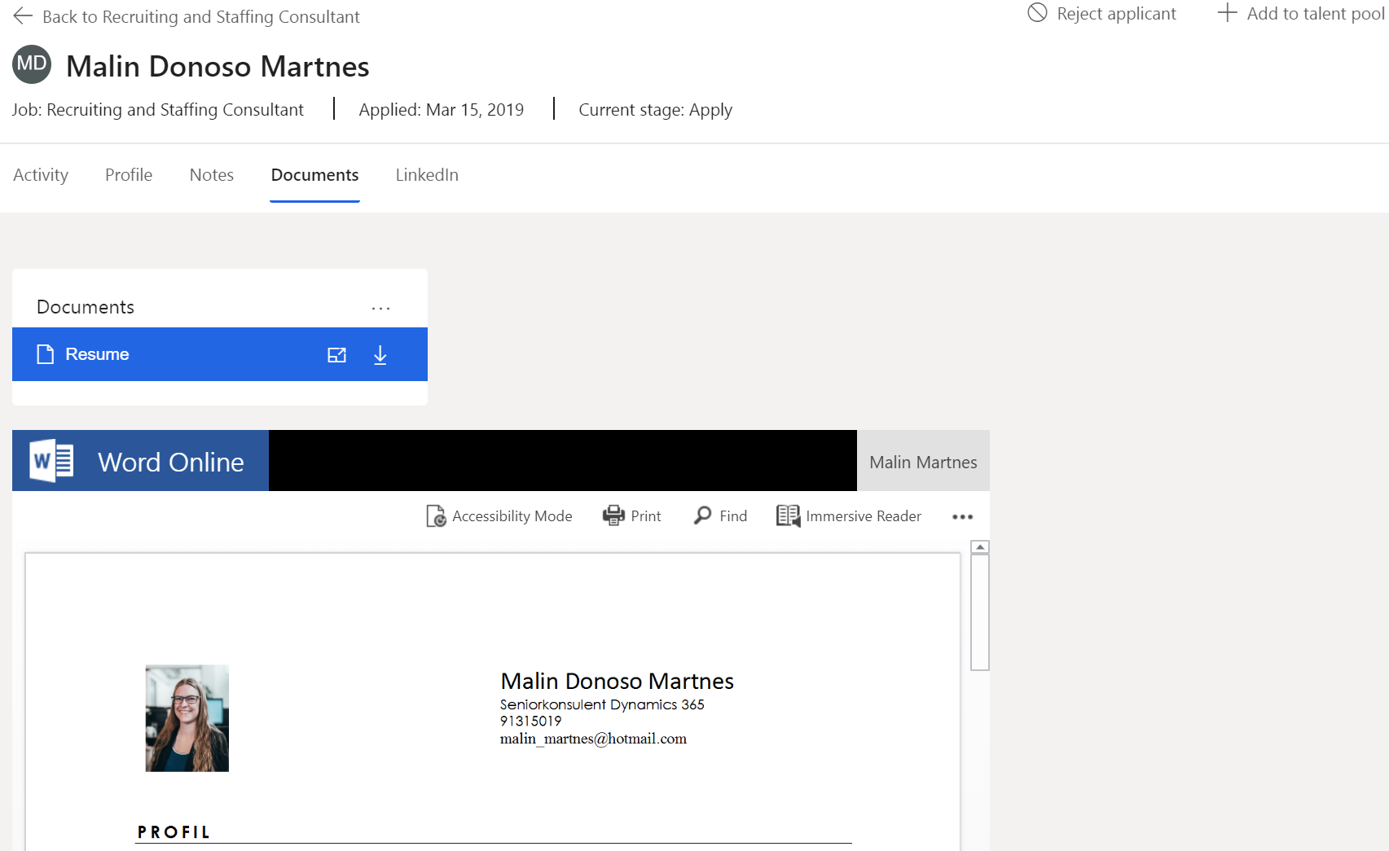
HR
Manager

Slide 24
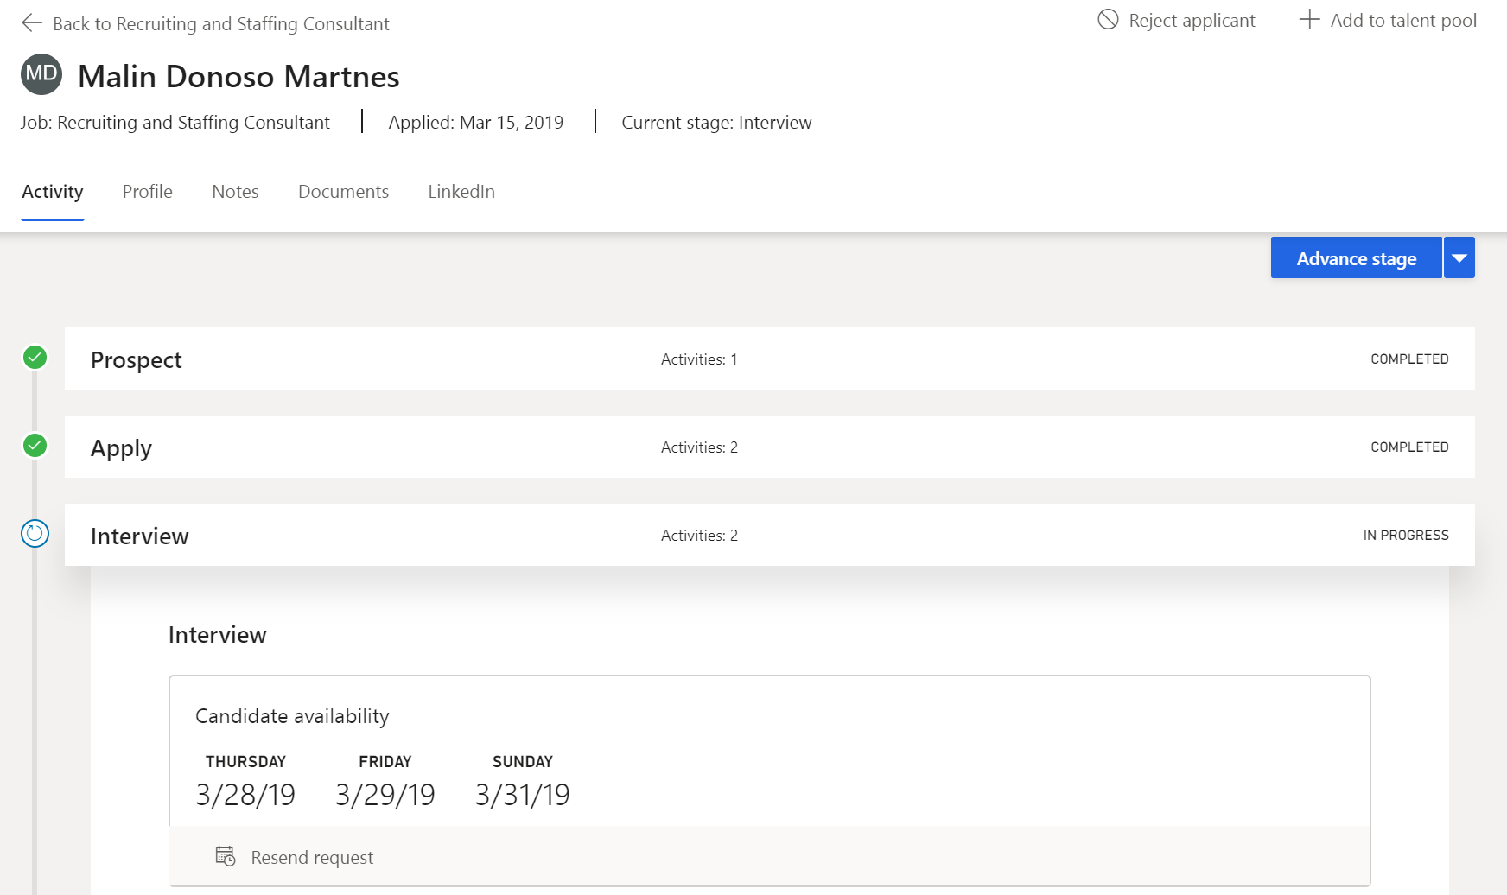
HR
Manager

Slide 25
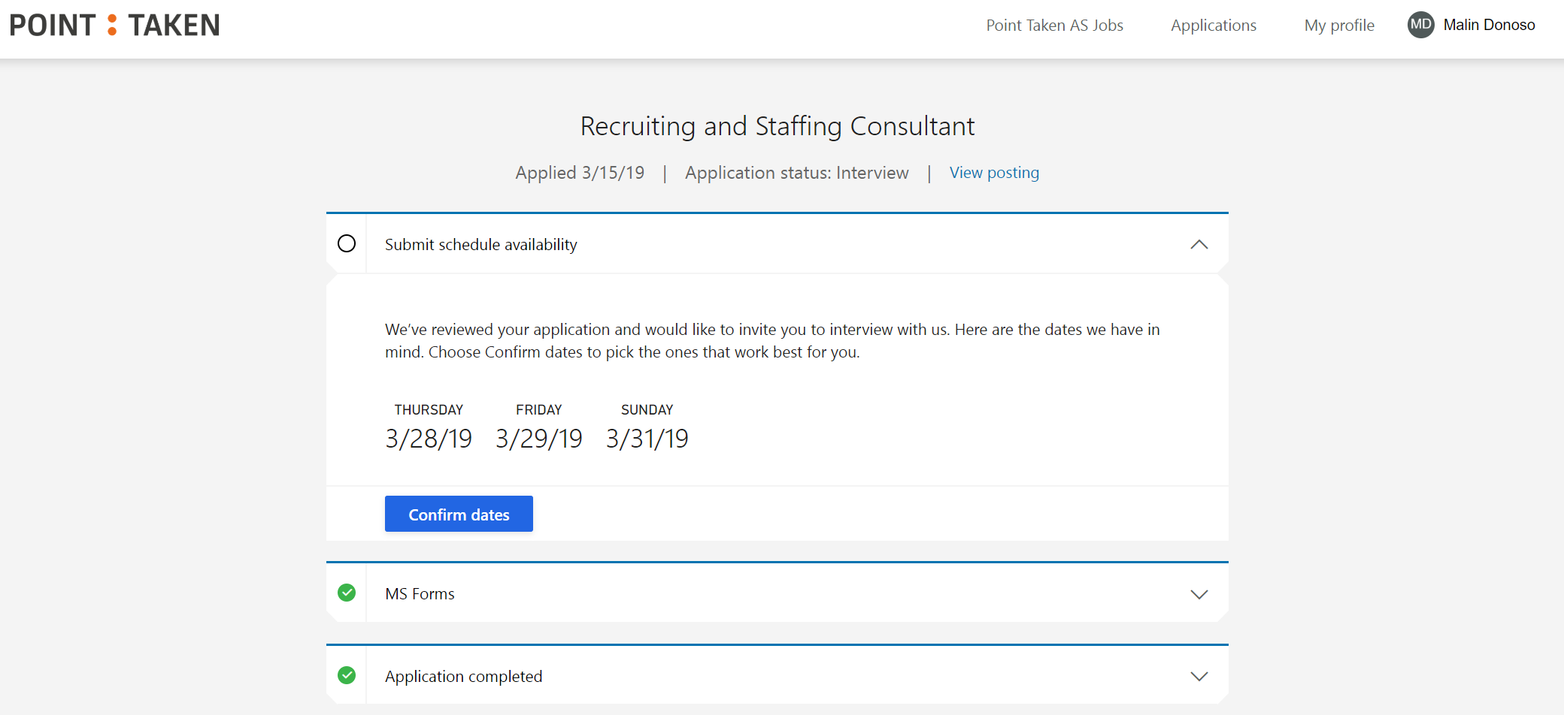
Candidate

Slide 26
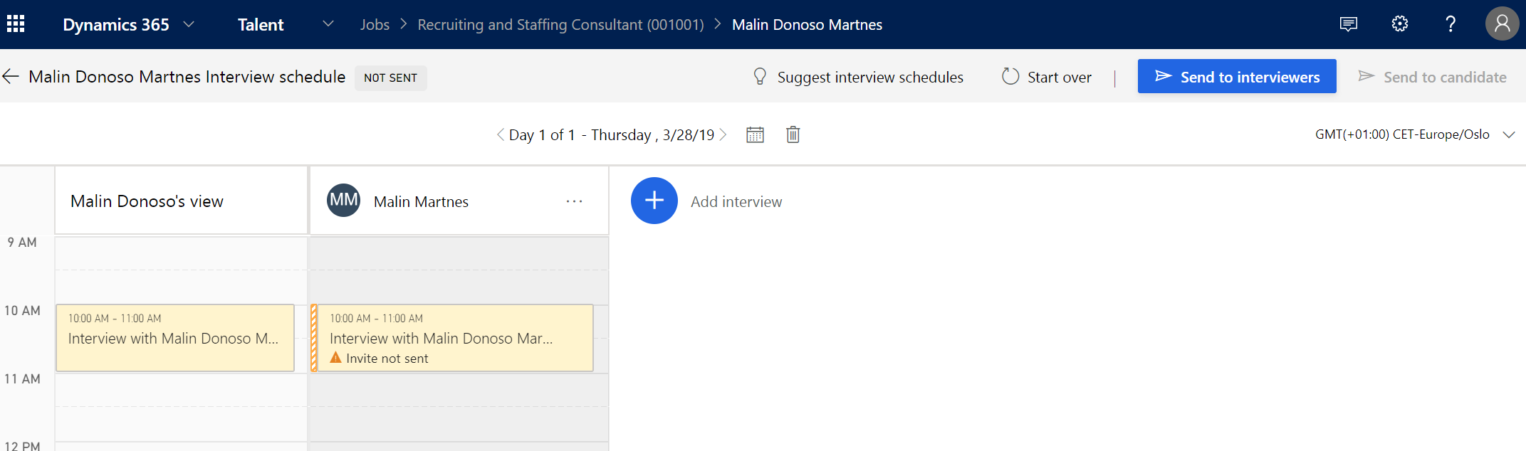
HR

Slide 27
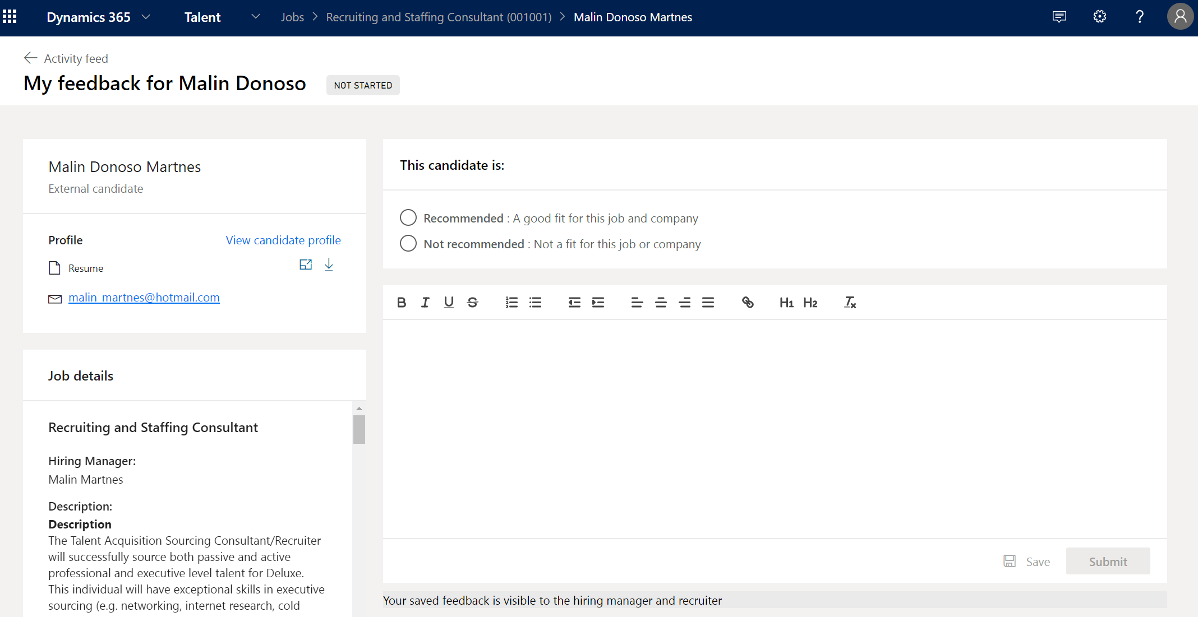
HR
Manager

Slide 28
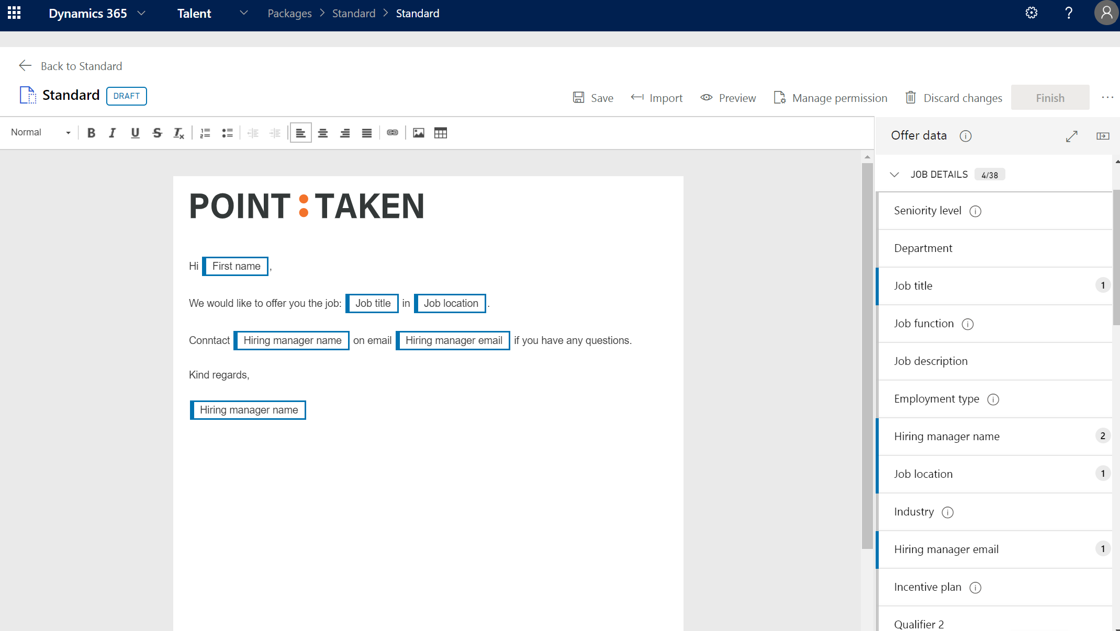
HR

Slide 29
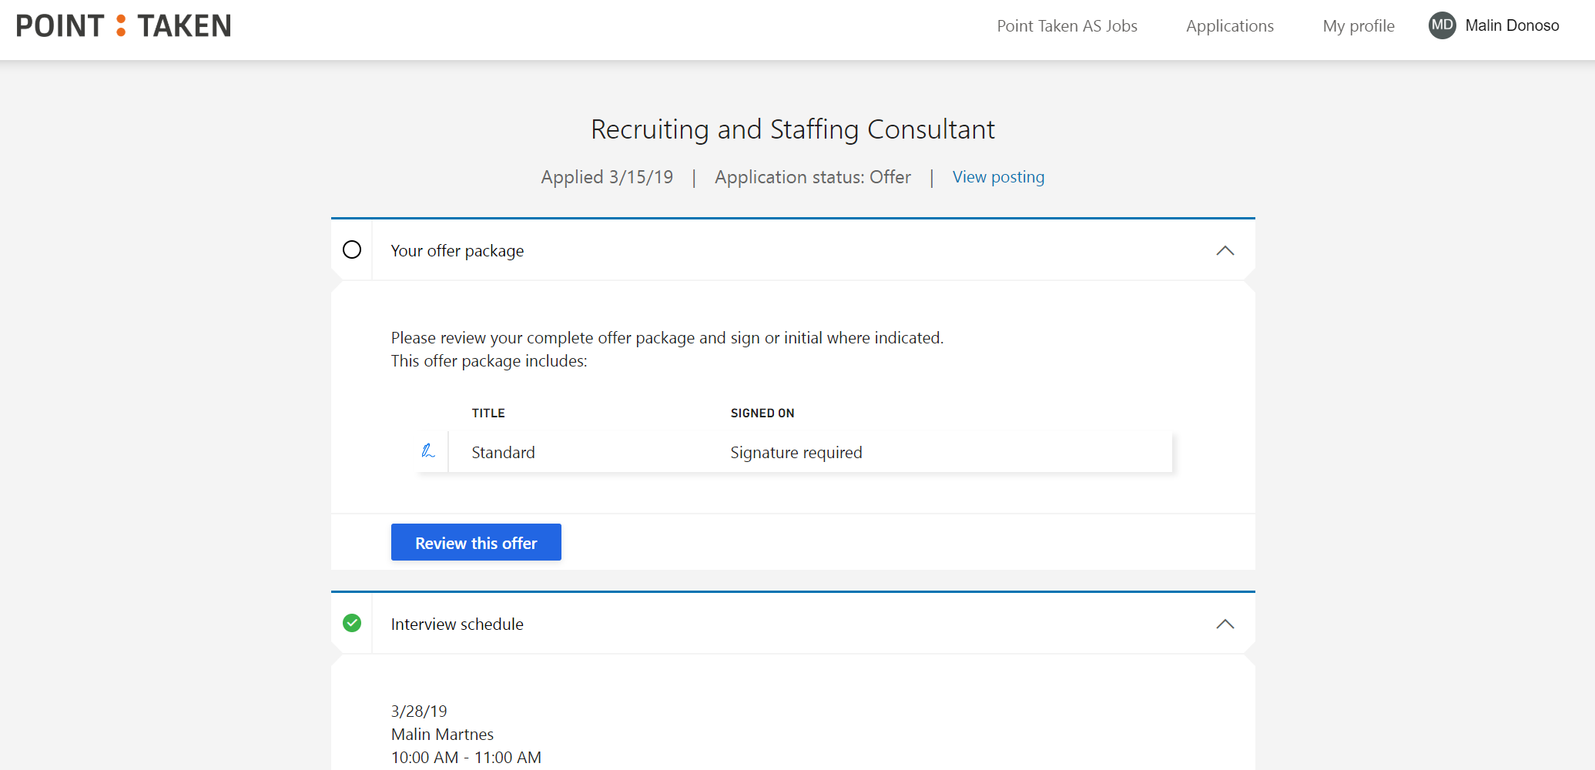
Candidate

Slide 30
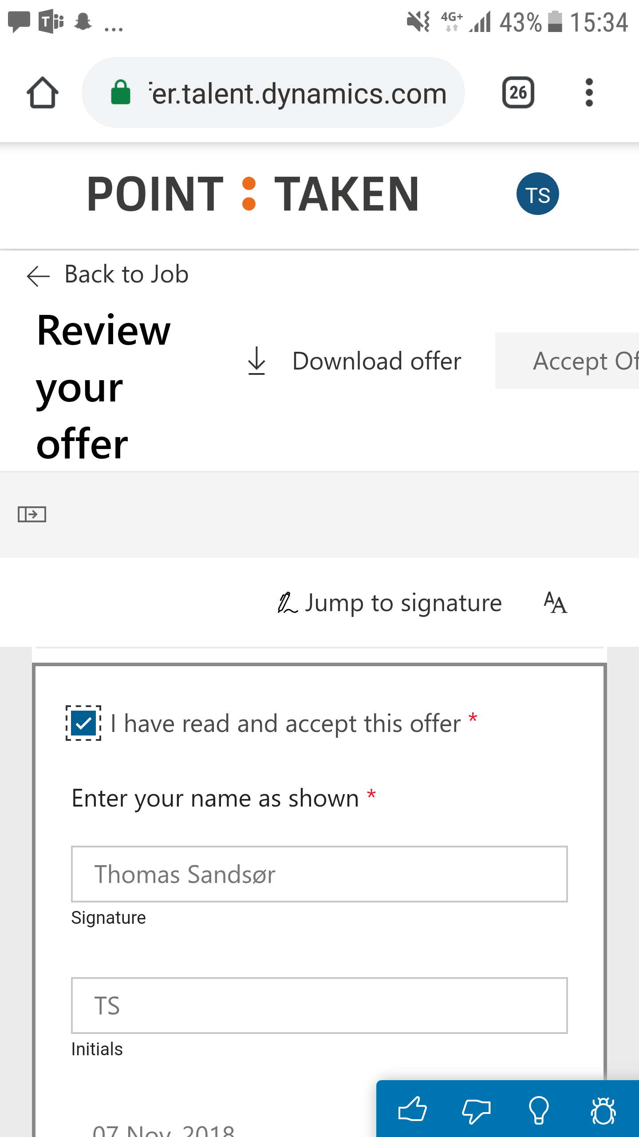
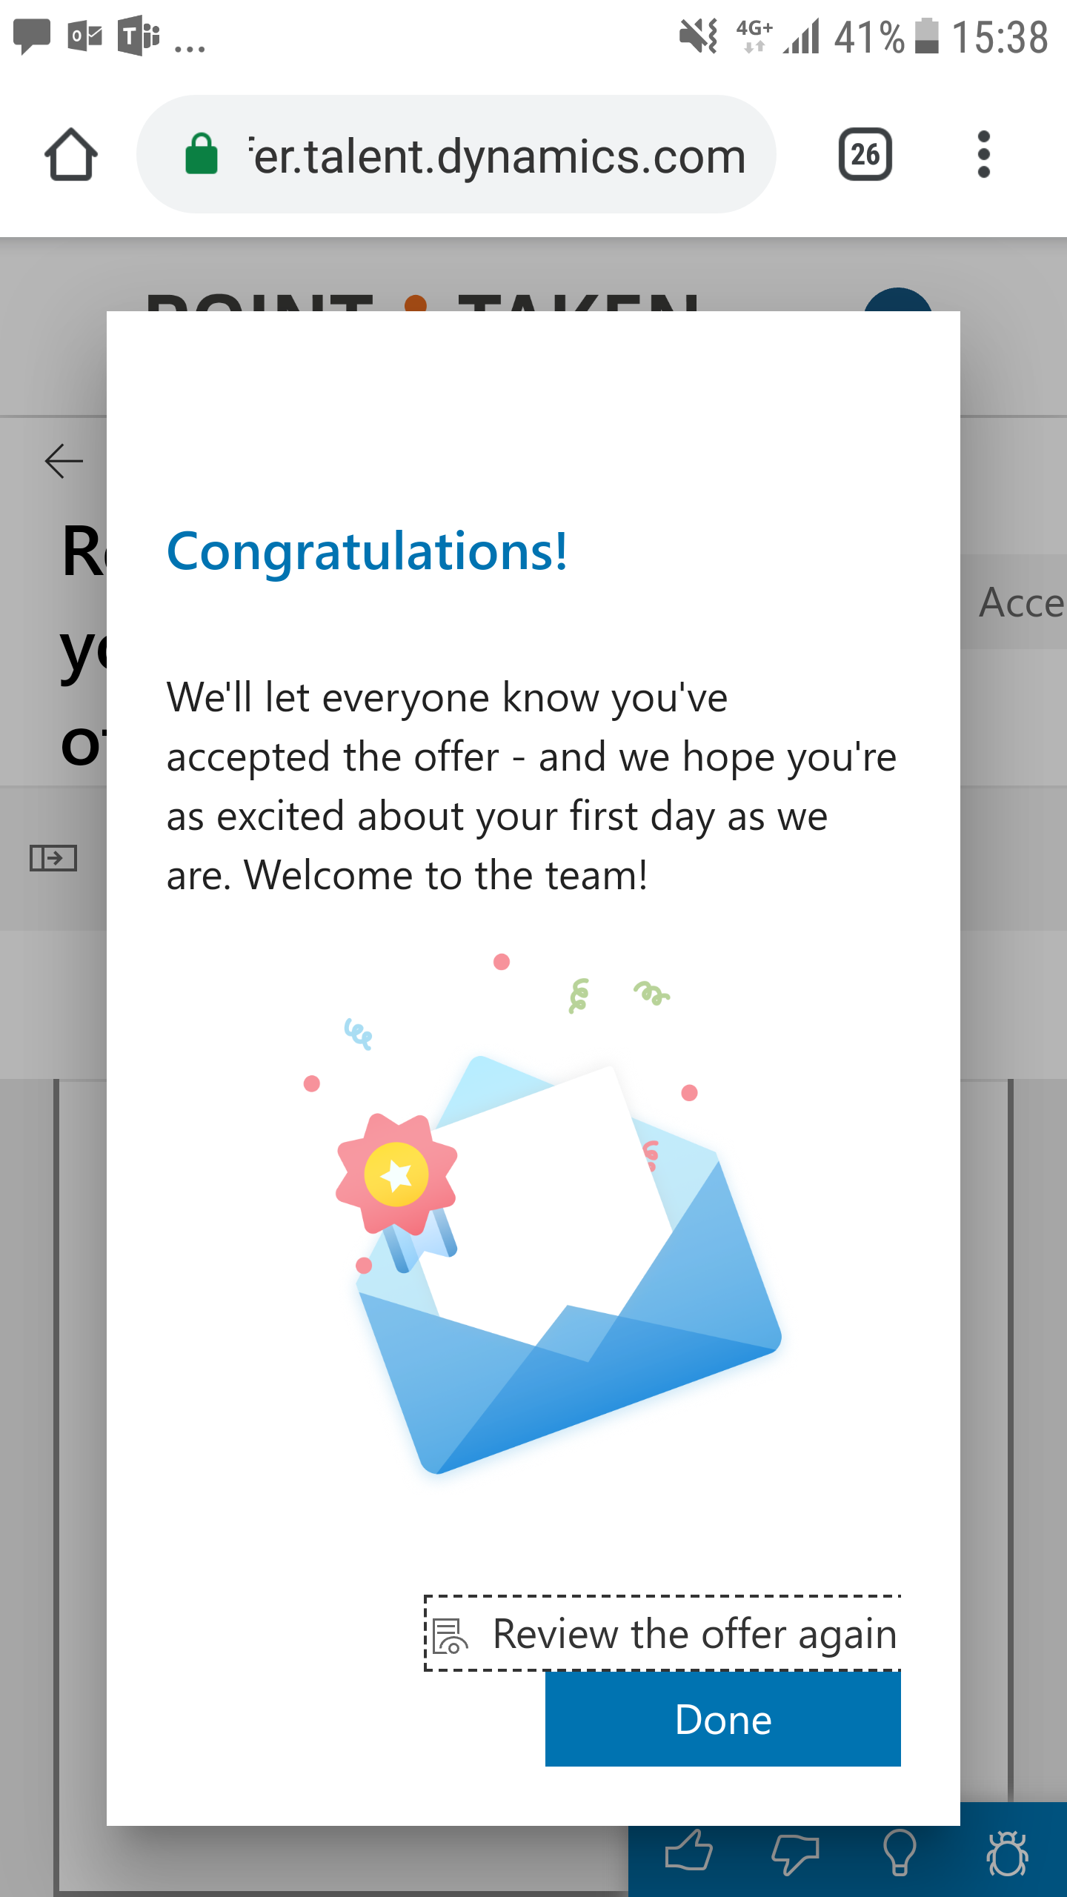
Candidate

Slide 31
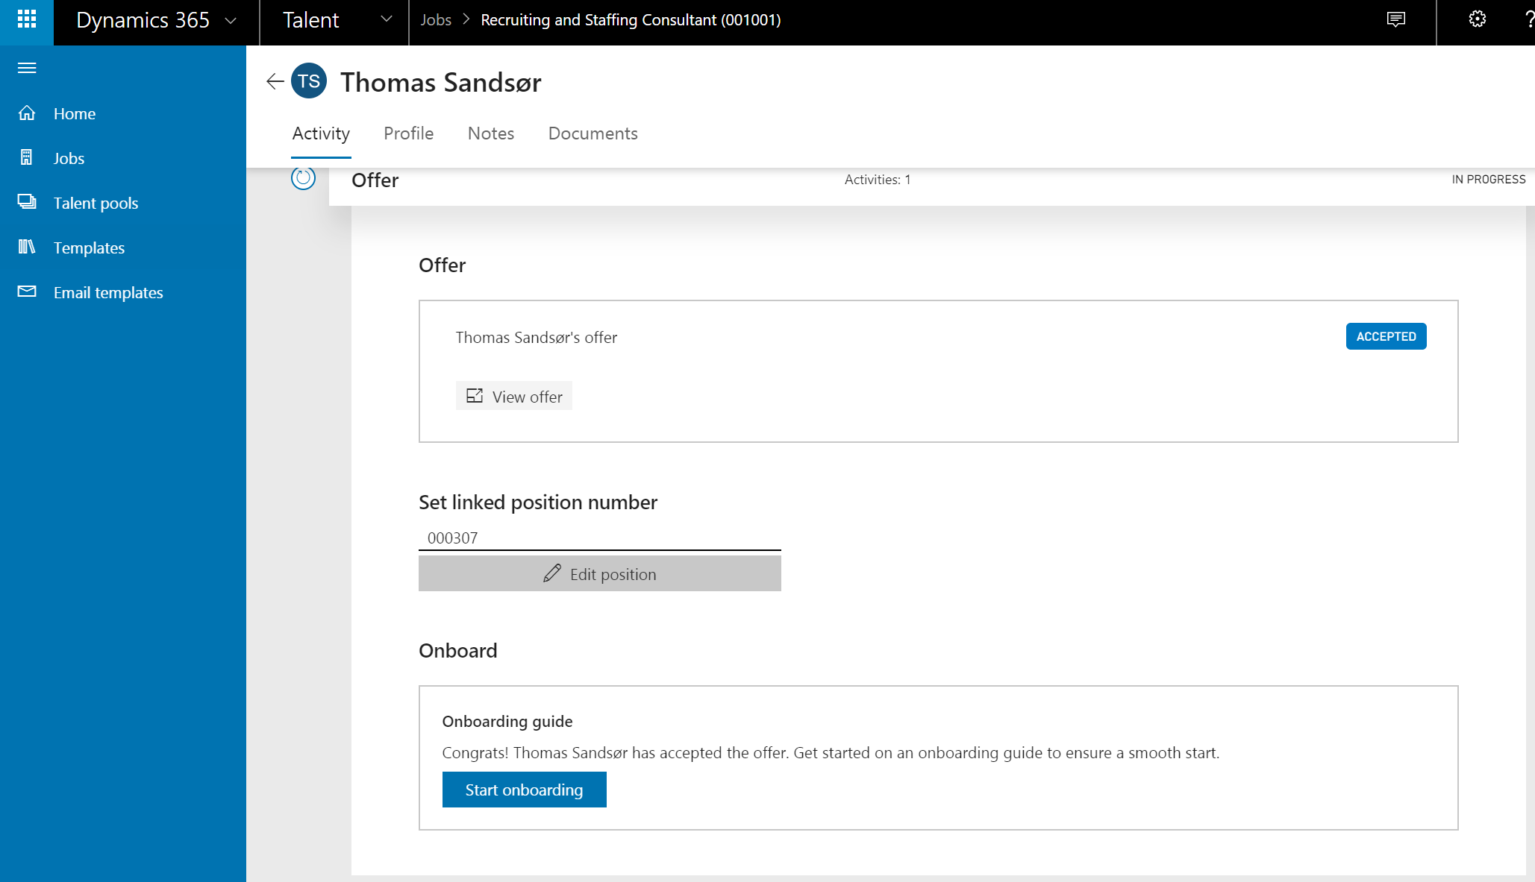
Manager

Slide 32
Onboard
Candidate
HR
Manager

Slide 33
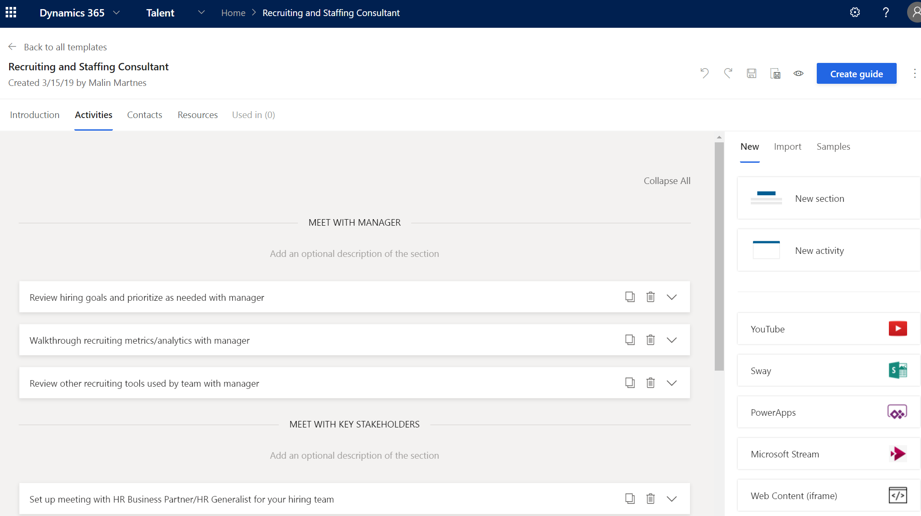
HR

Slide 34
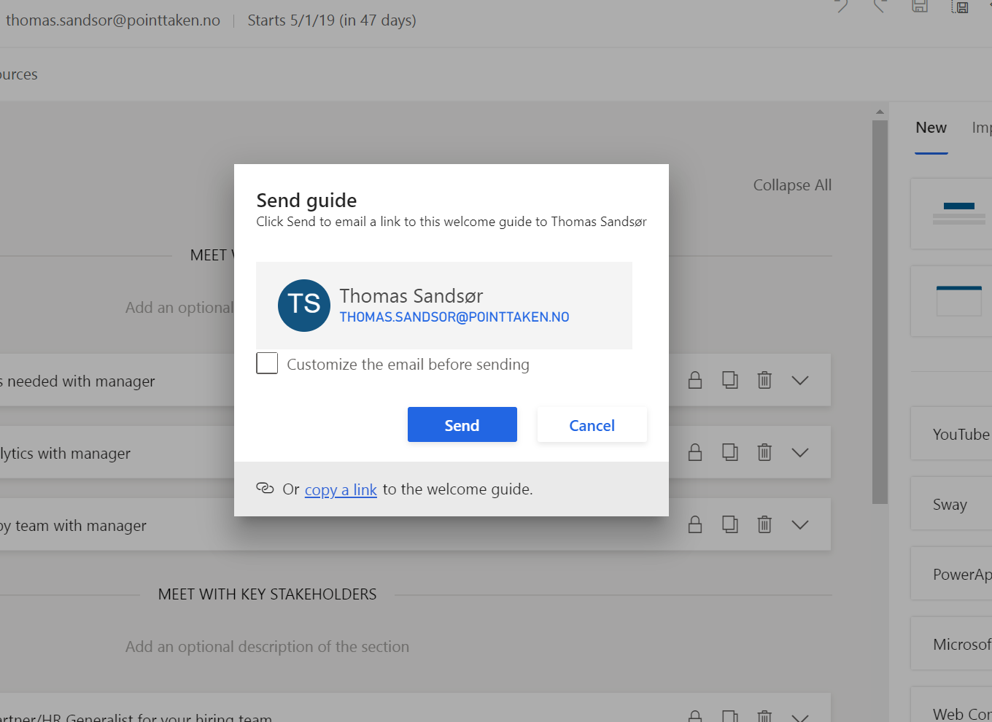
HR
Manager

Slide 35
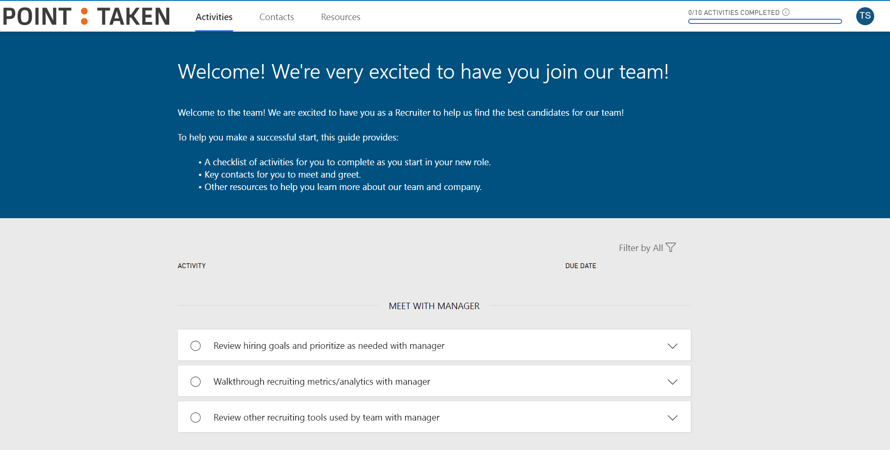
Candidate

Slide 36
Core HR
Employee
HR
Manager

Slide 37
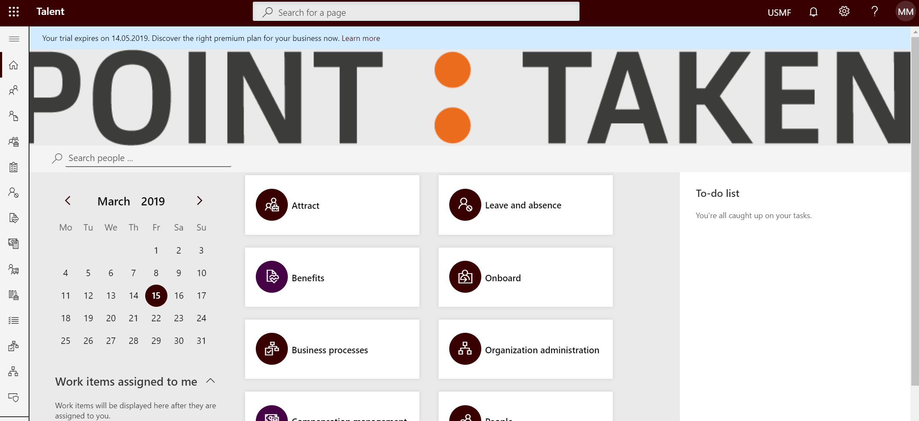
HR
Manager
Employee

Slide 38
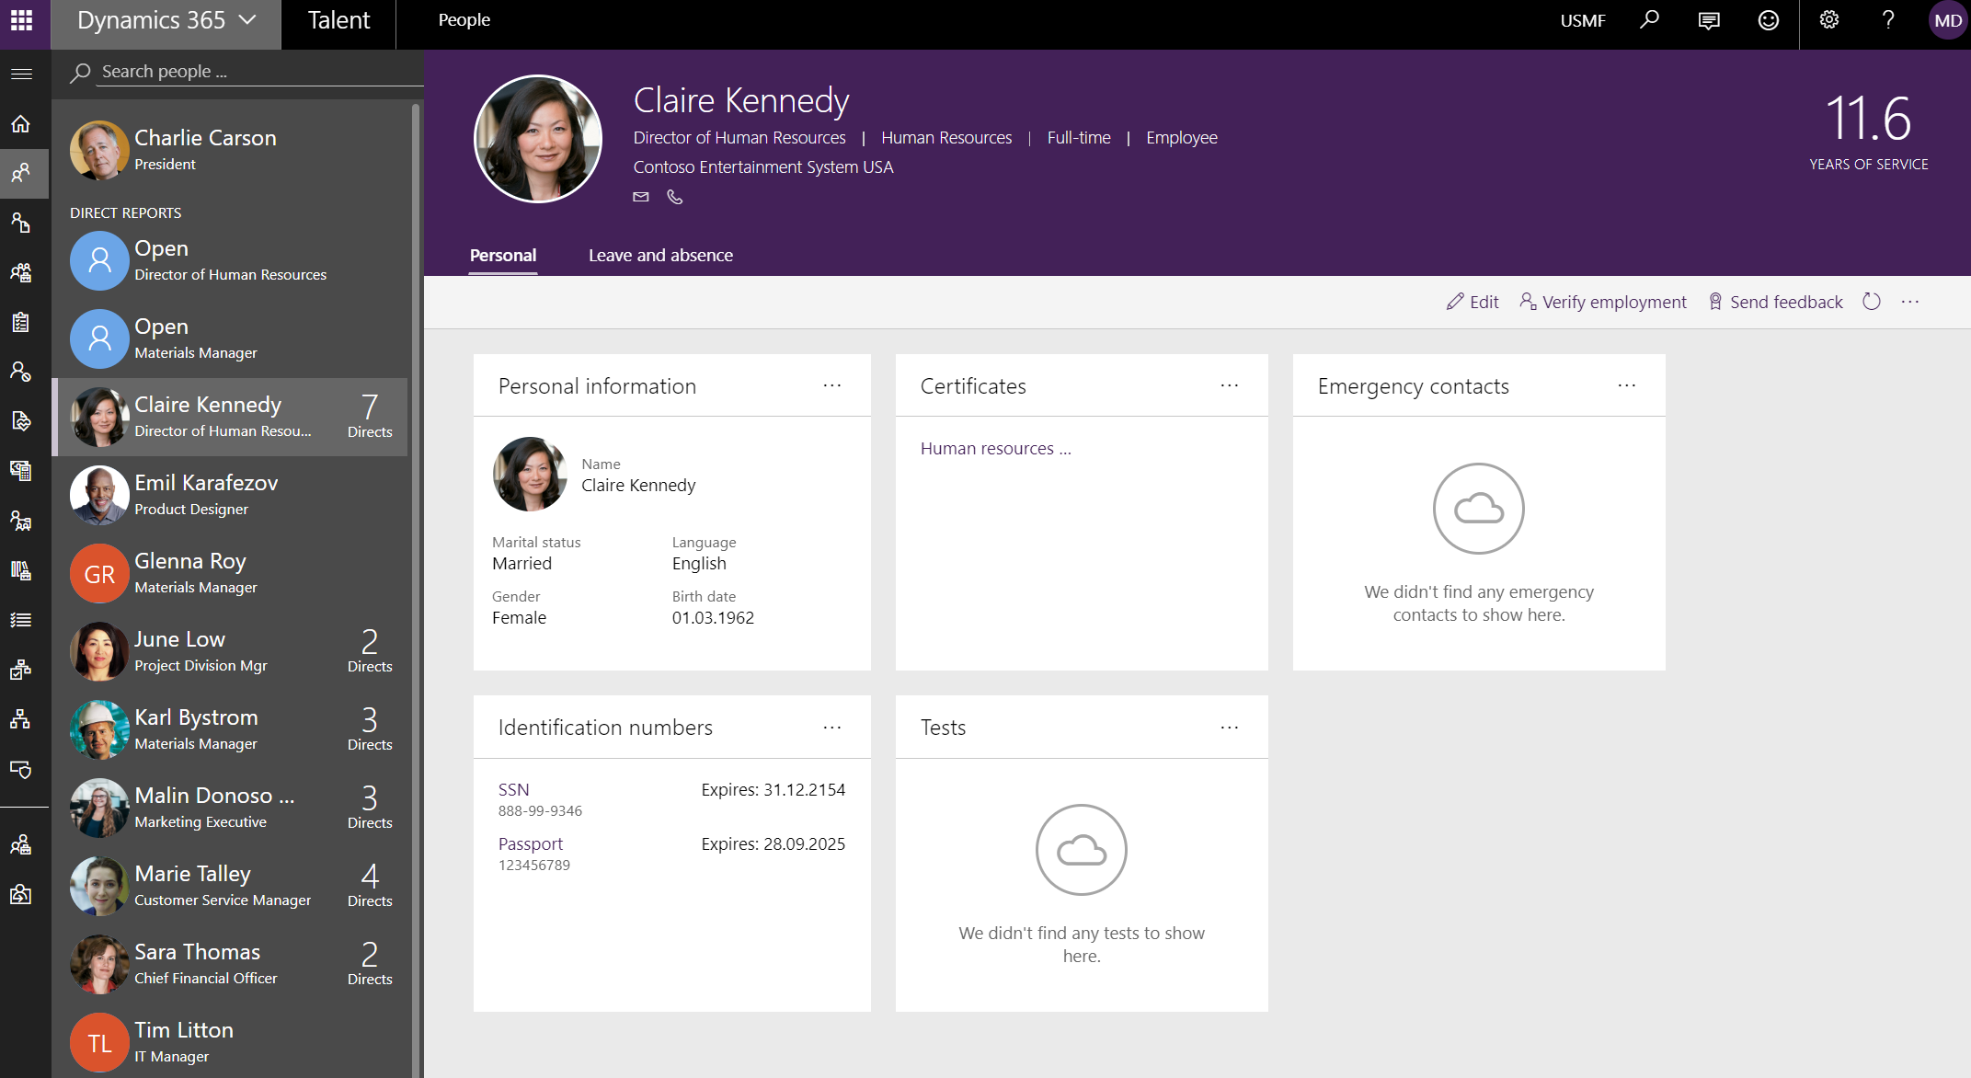
HR

Slide 39
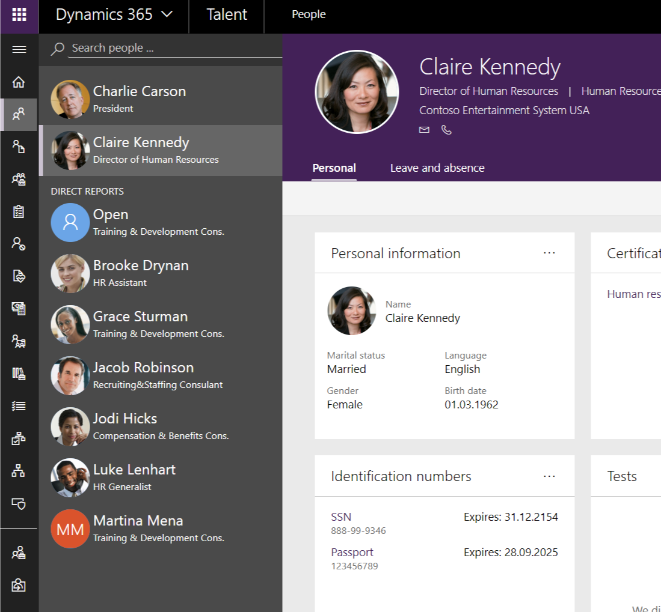
HR

Slide 40
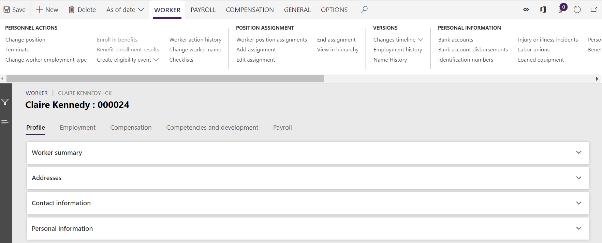
HR

Slide 41
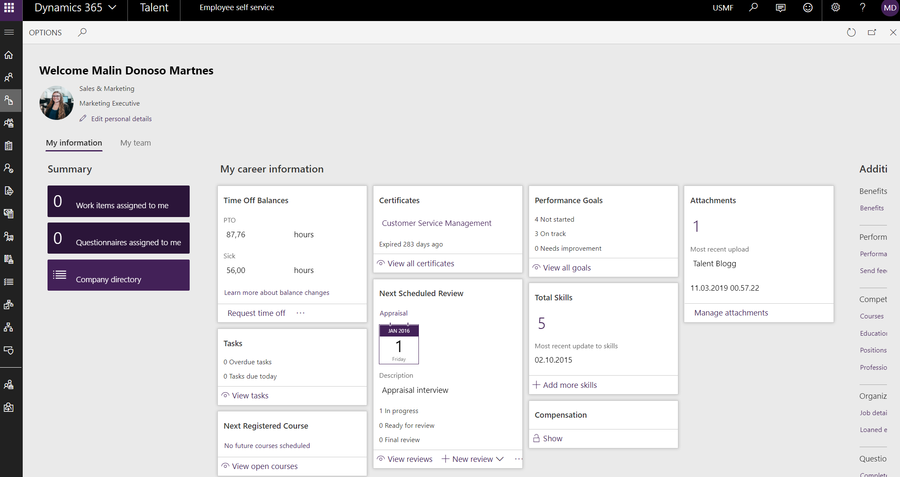
Self service portal
Employee

Slide 42
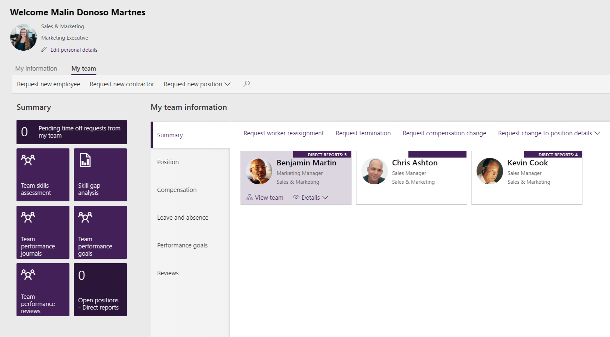
Manager

Slide 43
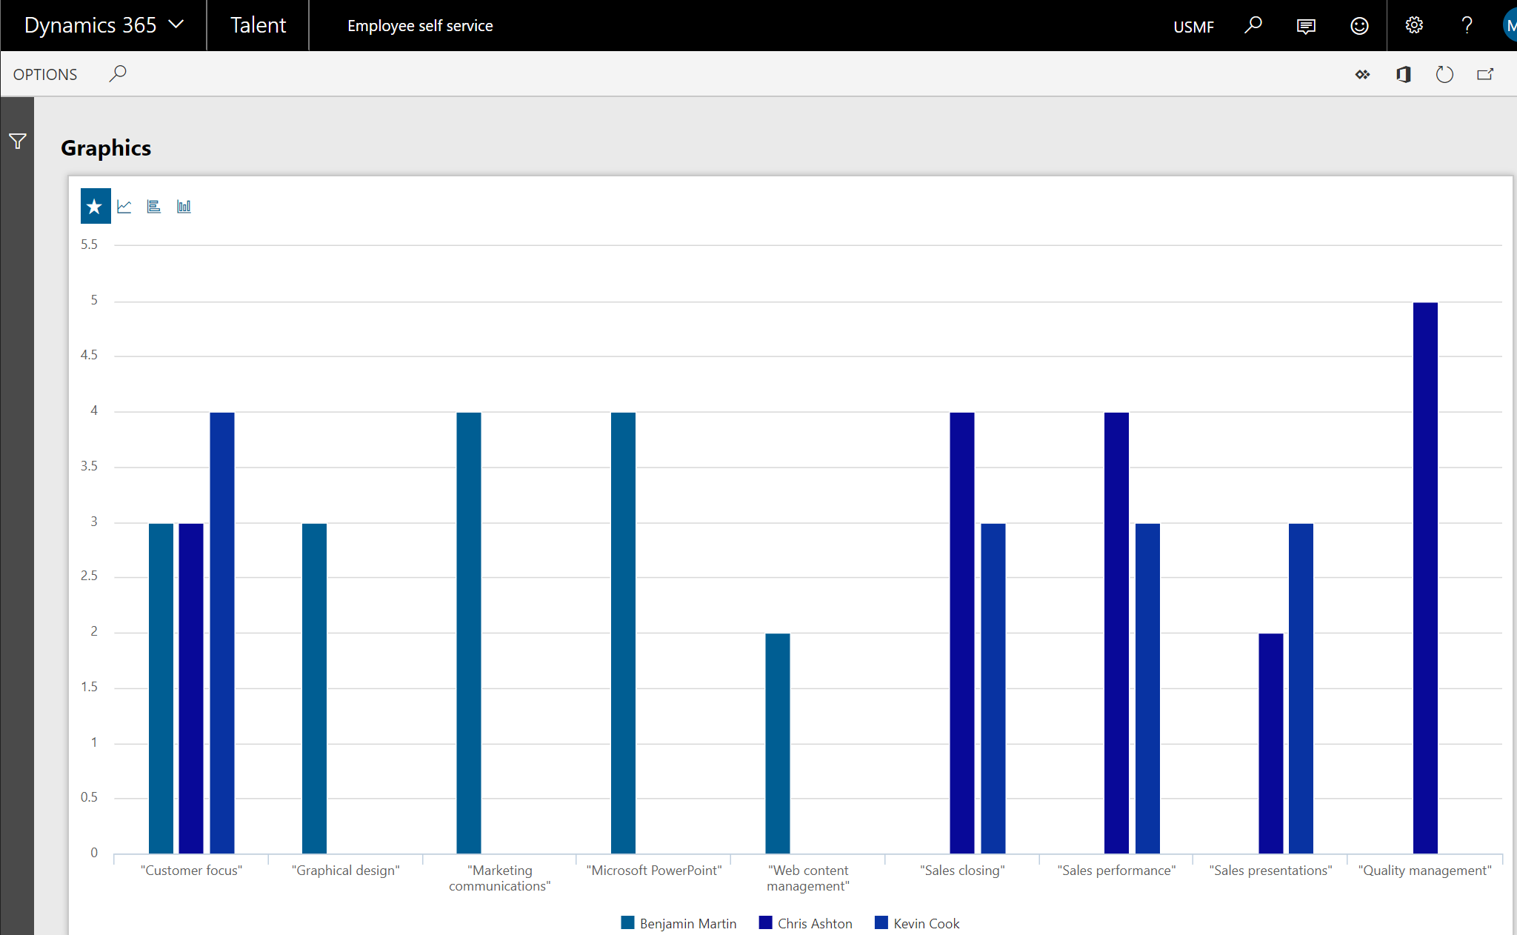
Manager

Slide 44
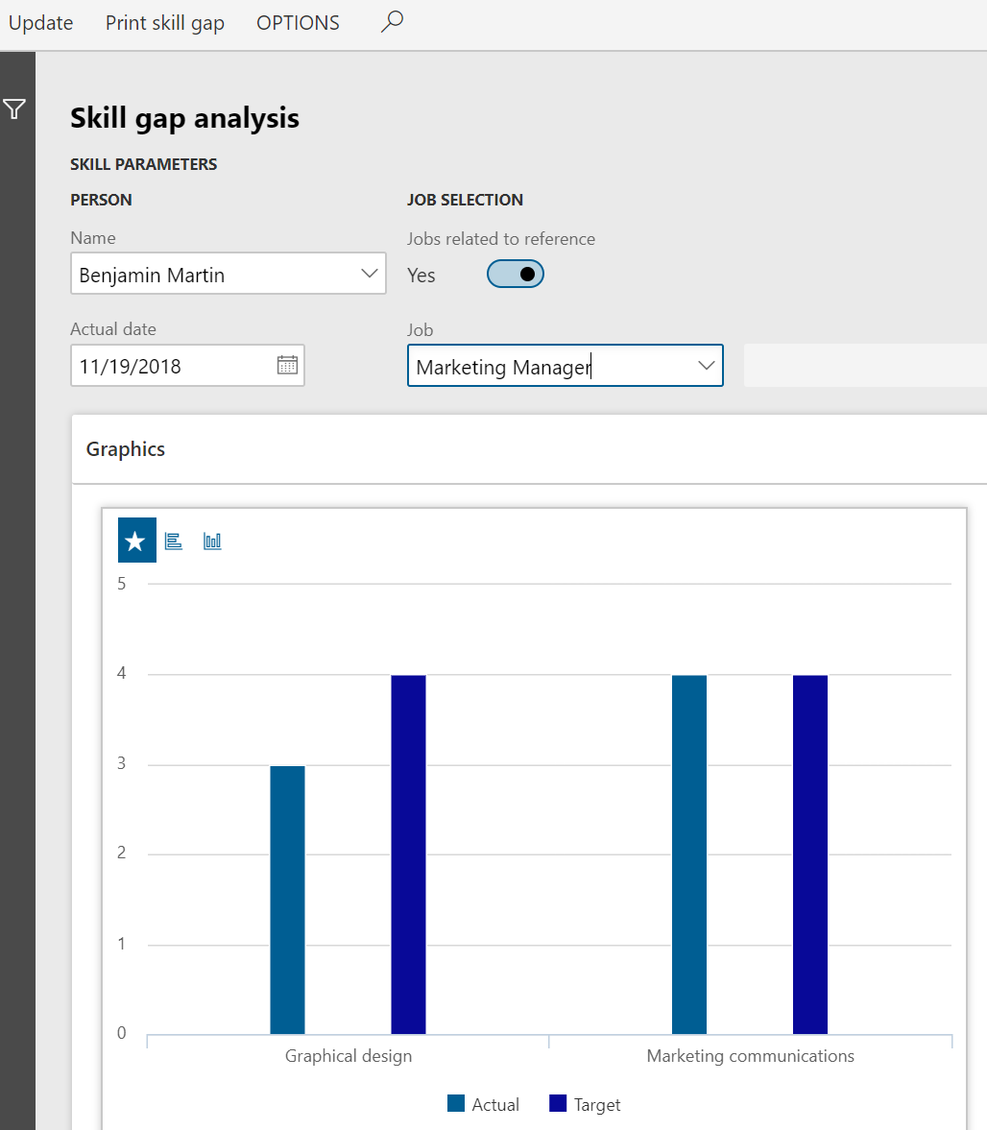
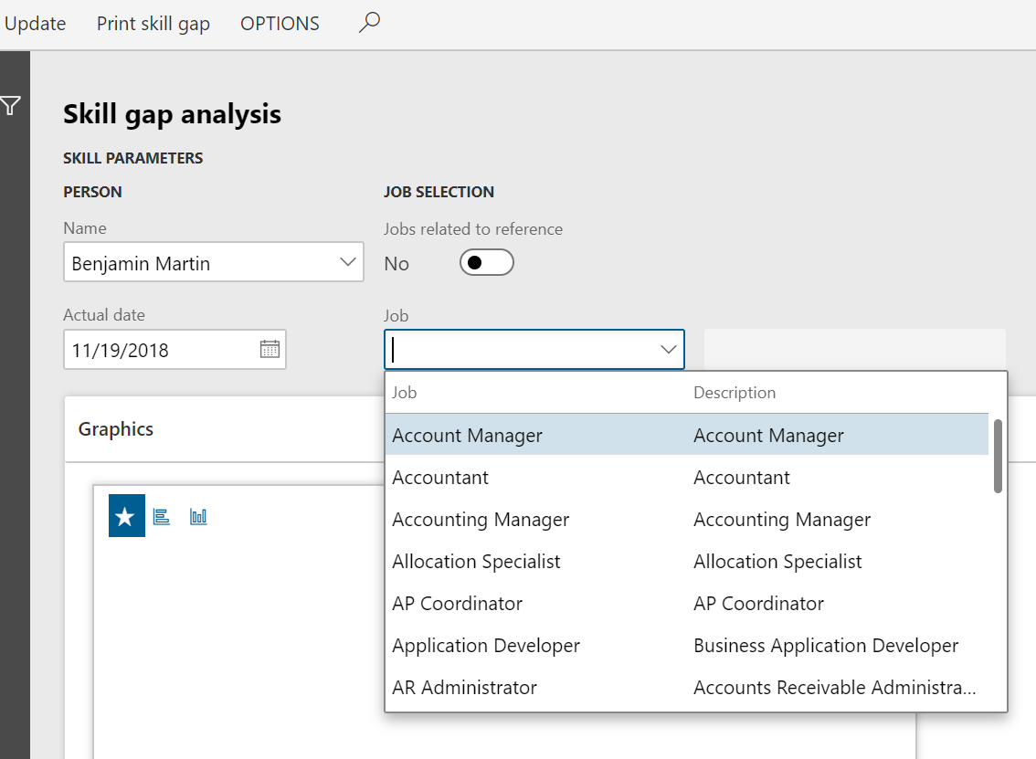
Manager

Slide 45
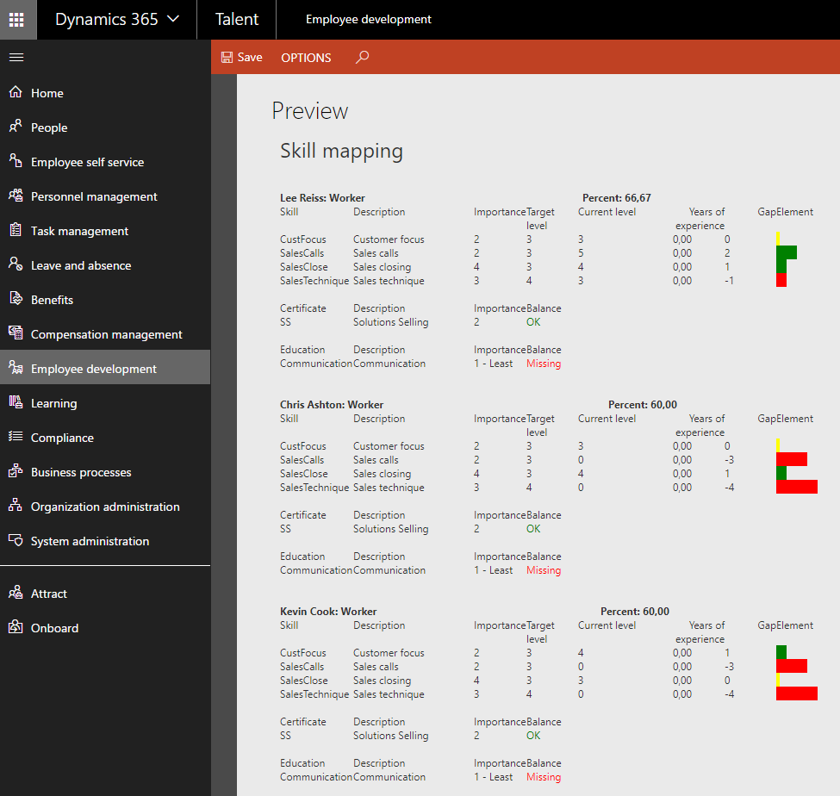
Manager

Slide 46
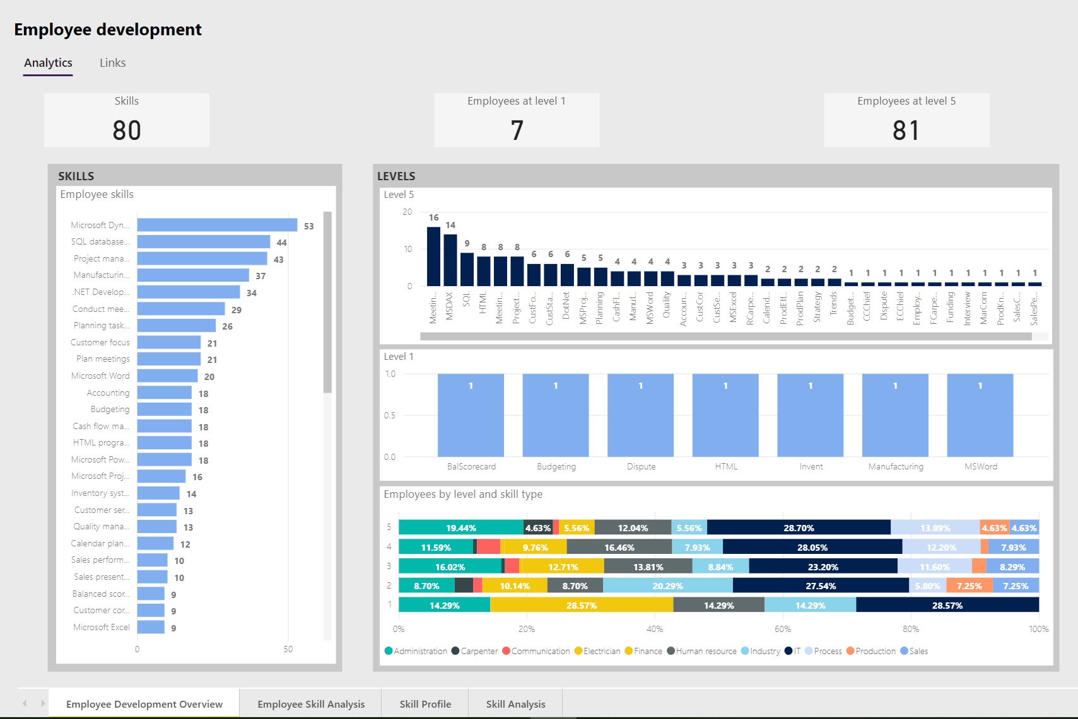
HR

Slide 47
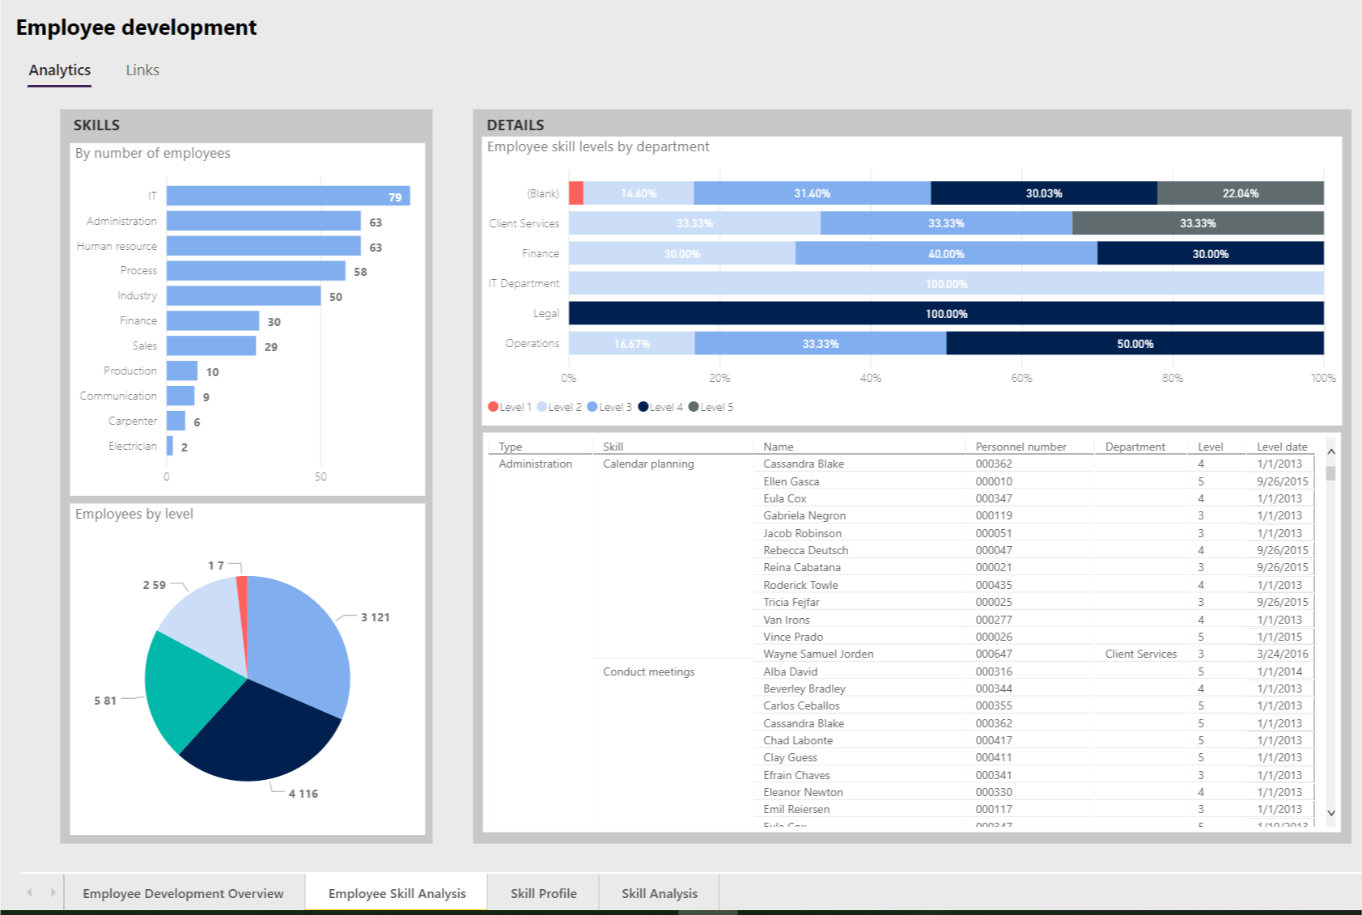
HR

Slide 48
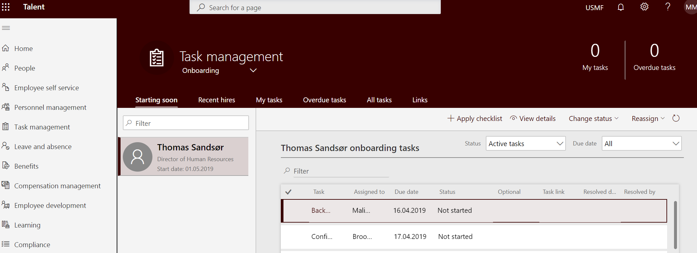
HR
Manager
Employee

Slide 49
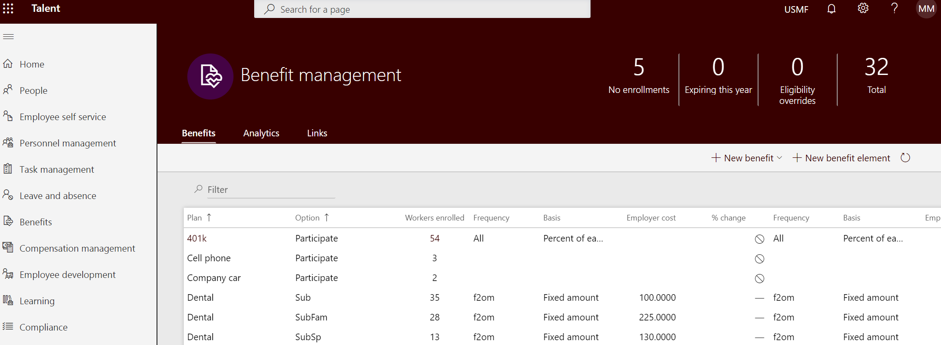
HR

Slide 50
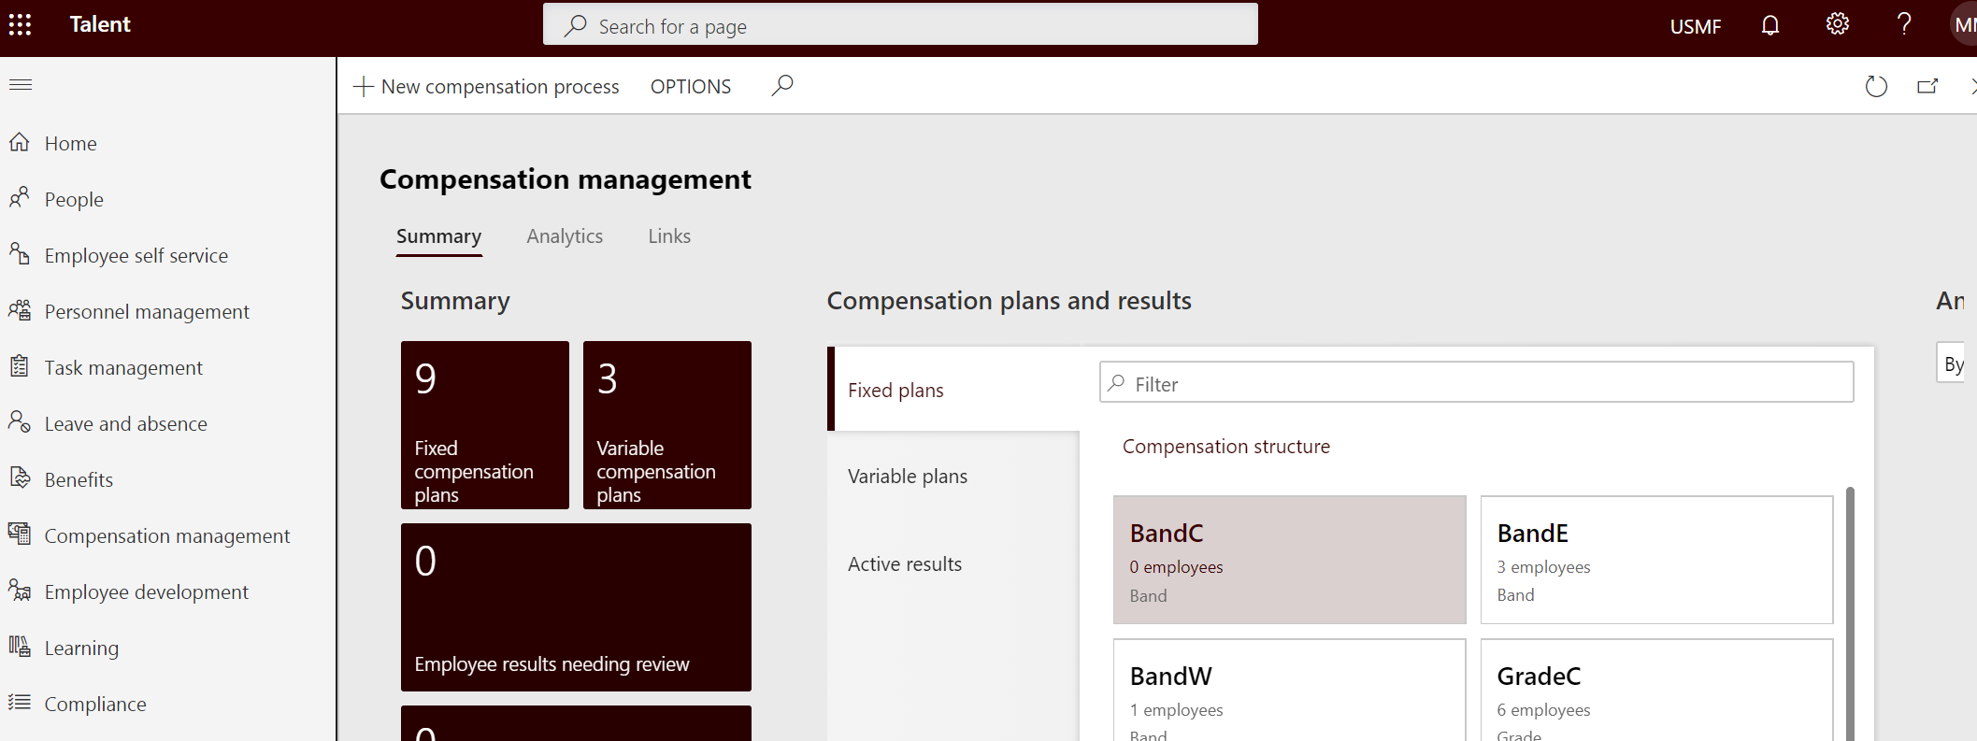
HR

Slide 51
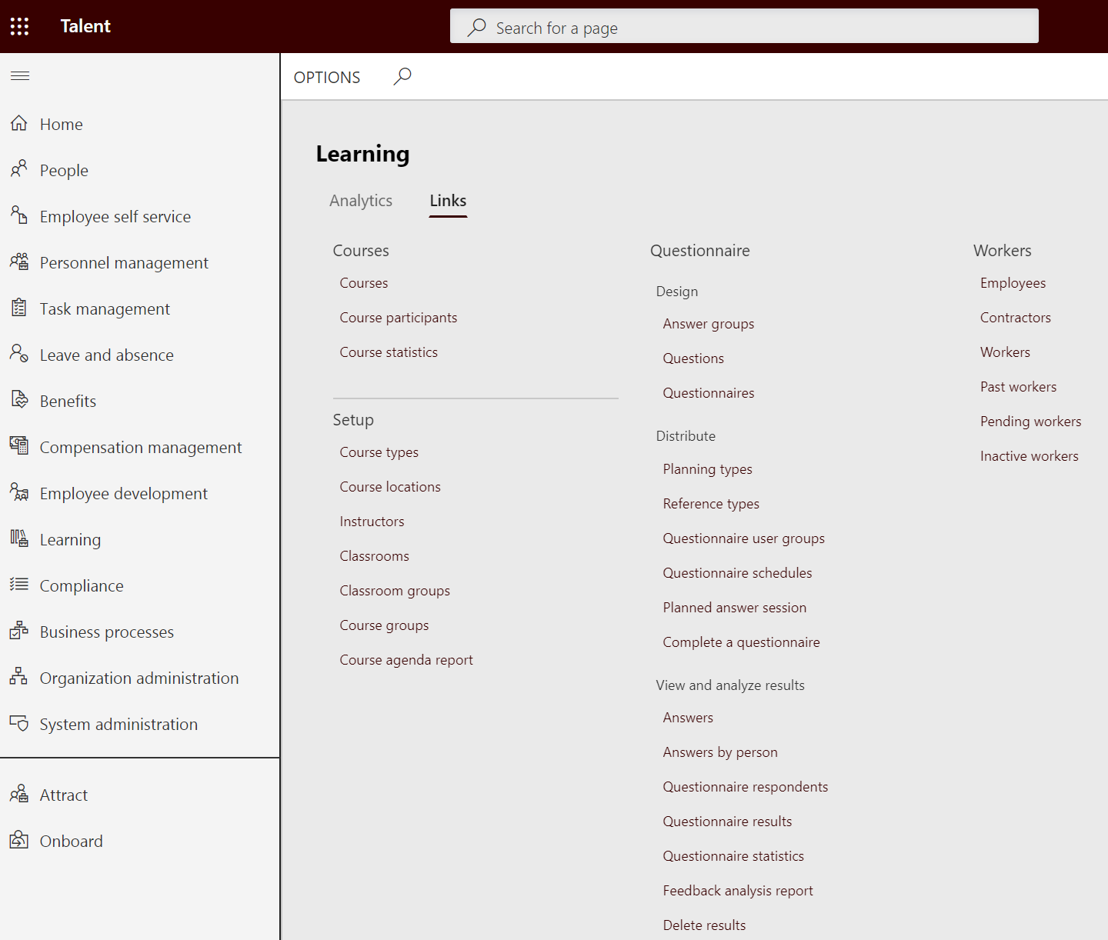
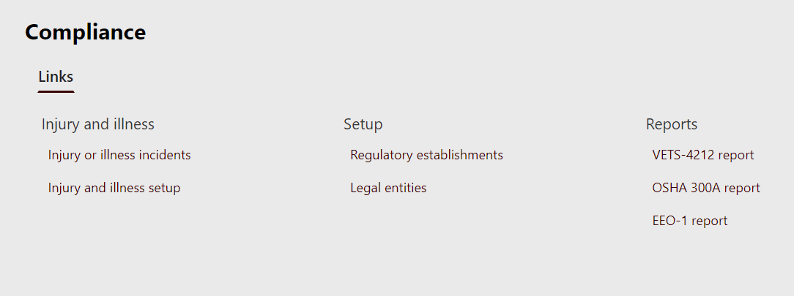
HR

Slide 52
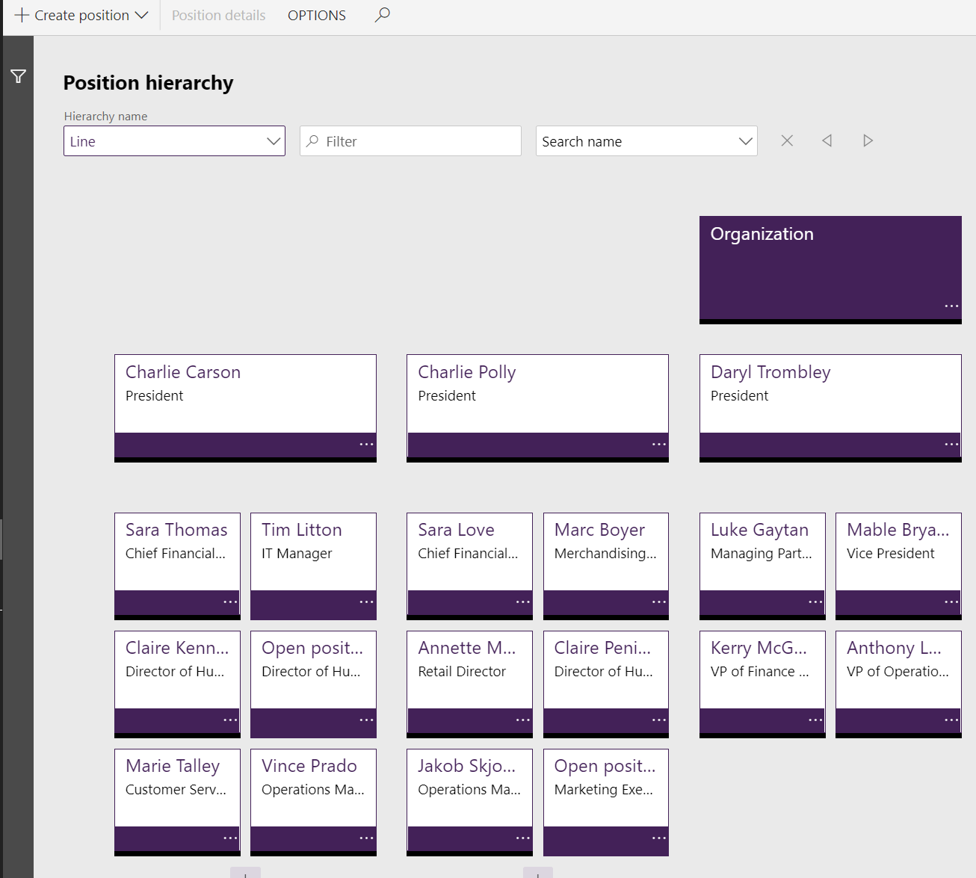
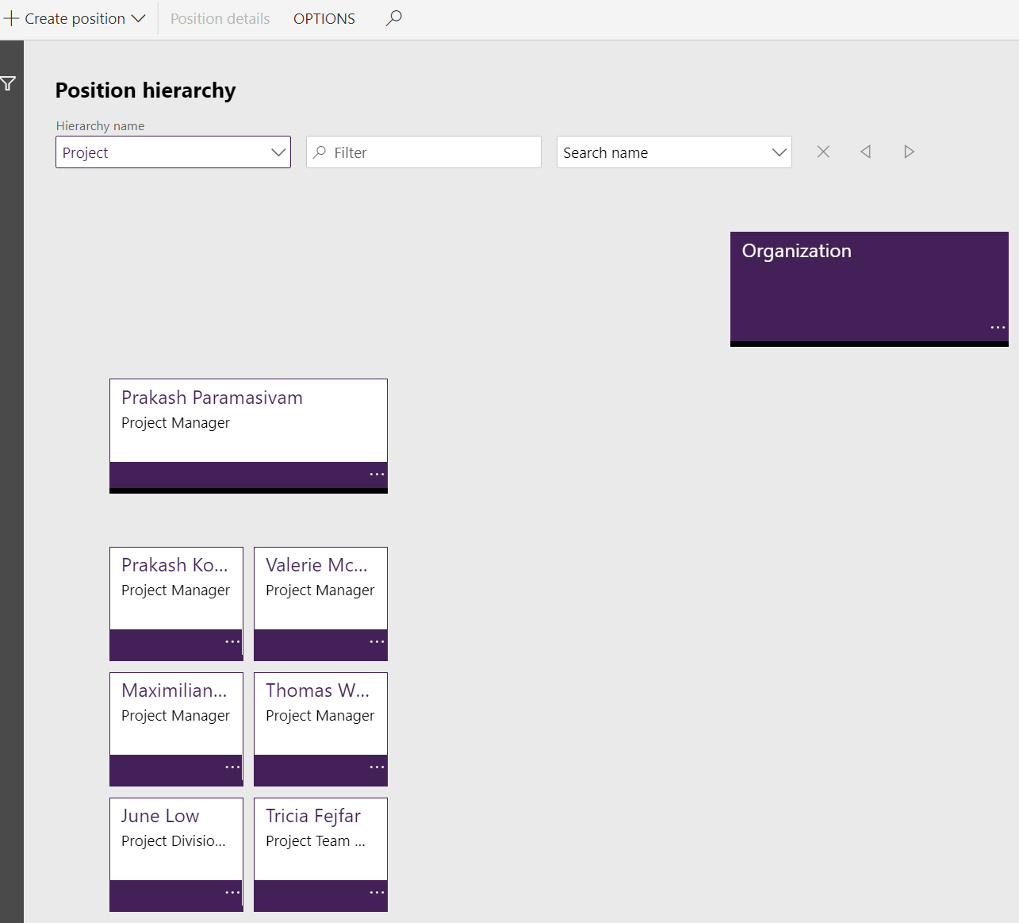
HR

Slide 53
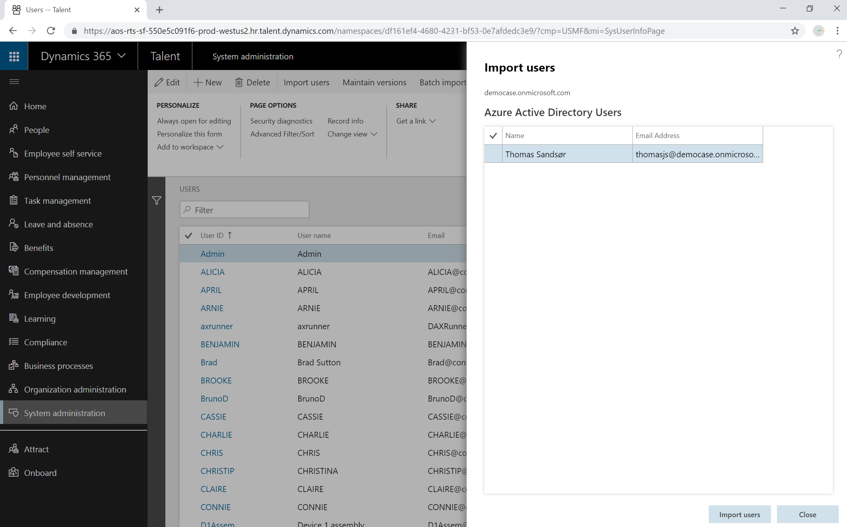

User administration

Slide 54


Slide 55

Data integrator template

Slide 56

Contact information
E-post: malin.donoso.martnes@pointtaken.no
LinkedIn: Malin Donoso Martnes
(https://www.linkedin.com/in/malin-donoso-martnes-0236a916/)
Twitter: @MalinMartnes
Blogg: https://malinsdynamics365fortalent.com/
Microsoft community: https://community.dynamics.com/365/talent / https://community.dynamics.com/members/malinm85

Slide 57
Thank you!

