Slide 2

Extending Talent with the Power Platform
Malin Donoso Martnes
@MalinMartnes

Slide 3



About me
Education in marketing
User in Dynamics CRM from 2009
Consultant in Dynamics CRM from 2014
Point Taken AS from February 2018
Talent from Mars 2018
#2 in the world to pass MB6-898 Talent
Run the Norwegian group Women in Dynamics
First and only MVP with a focus on Talent

Slide 4
This session
How can you extend Talent with;
Forms Pro
PowerApps
Flow

Slide 5
Go to Menti.com

Slide 6






Intelligence
Data
Marketing
Talent
Sales
MODERN
UNIFIED
Microsoft Dynamics 365
INTELLIGENT
ADAPTABLE
Operations
Commerce
Finance
Service
Power platform
Power BI
Flow
PowerApps
Notes:
To execute on our strategy, we created a unique data system
It removes the complexity of disparate systems
We tore down the traditional silos of ERP and CRM, bringing them together
This fundamental technology shift, set the foundation for Dynamics 365. An engine of intelligent applications that connect customers, products, people, and data. And help us break-down silos.
This includes marketing, services, sales, operations, finance and talent
These products are infused with data and intelligence, connecting the Dynamics 365 applications with Power BI, Flow and PowerApps
<click>
Together these products compose our modern, unified, intelligent and adaptable product line
By modern we mean mobile…
<click>

Slide 7
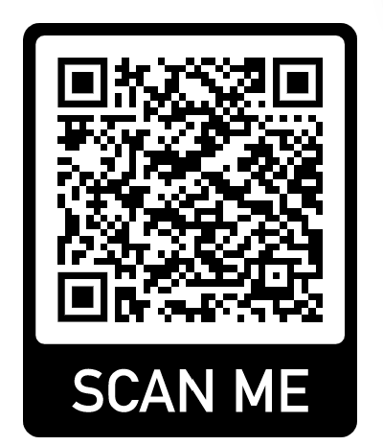
Common Data Service
https://docs.microsoft.com/en-us/dynamics365/unified-operations/talent/corehrentities
Not all Core HR entities on CDS (yet)

Slide 8
Why extend Talent?
Or any other system

Slide 9


No system is perfect!
Notes:
No system is perfect, there is always this one thing you really wish you had. With the Power Platform you can make it yourself!

Slide 10
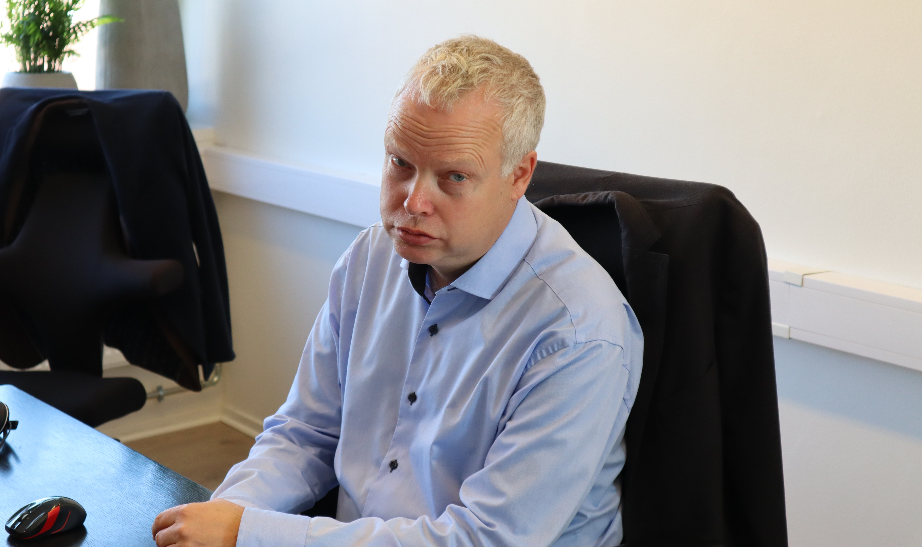
Runar Lund – Point Taken COO aka potato
Notes:
Meet Runar Lund, Point Takens do it all and know it all. He gets a lot of questions about everything from everyone. Talent can only solve so much, let’s look at some of the other features and applications that a none developer can create in the Power Platform to help so that Runar gets fewer questions

Slide 11
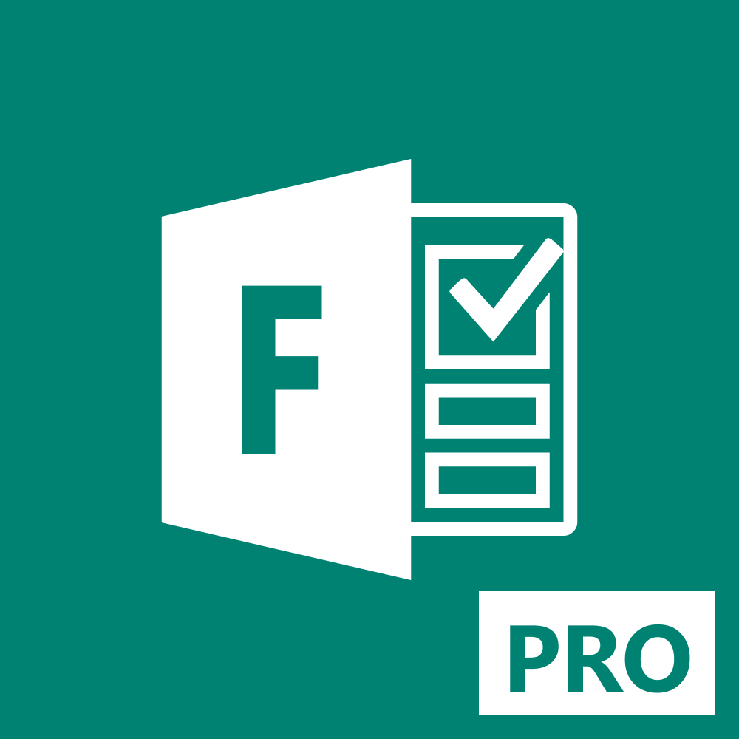

What is Forms Pro?
Forms Pro is a simple yet comprehensive survey solution that builds on the current survey-creation experience of Microsoft Forms in Office 365. It offers new capabilities that make capturing and analyzing customer and employee feedback simpler than ever
https://meganvwalker.com/

Slide 12
Forms Pro
Recruiting
Cultural fit assessment
Onboarding quiz
Employee of the year

Slide 13
Recruiting
You have simple recruiting needs
You don’t do much recruiting
Can be embedded or iframed on your website
Notes:
Simple solution if you don’t need Attract. Saved in CDS or in Excel, could be sent on e-mail. We are setting up our recruiting this way as we speak.

Slide 14
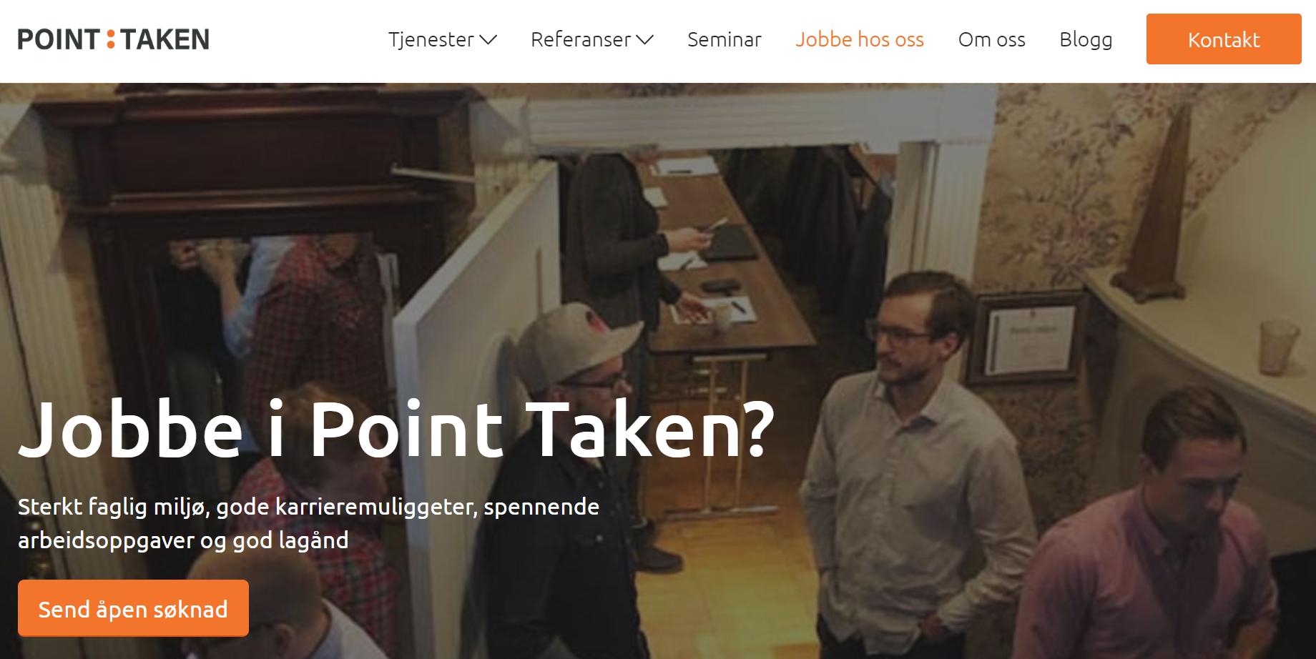
Notes:
Simple solution if you don’t need Attract. Saved in CDS or in Excel, could be sent on e-mail. We are setting up our recruiting this way as we speak.

Slide 15
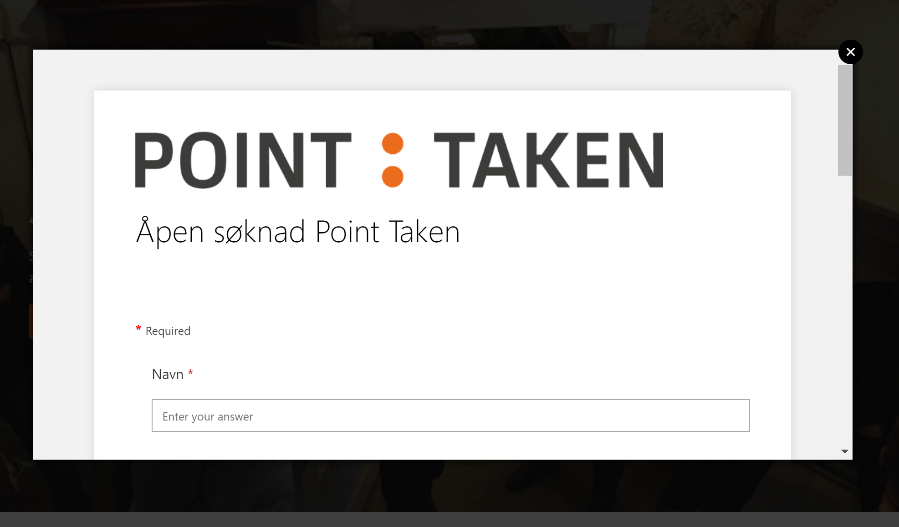
Notes:
Simple solution if you don’t need Attract. Saved in CDS or in Excel, could be sent on e-mail. We are setting up our recruiting this way as we speak.

Slide 16
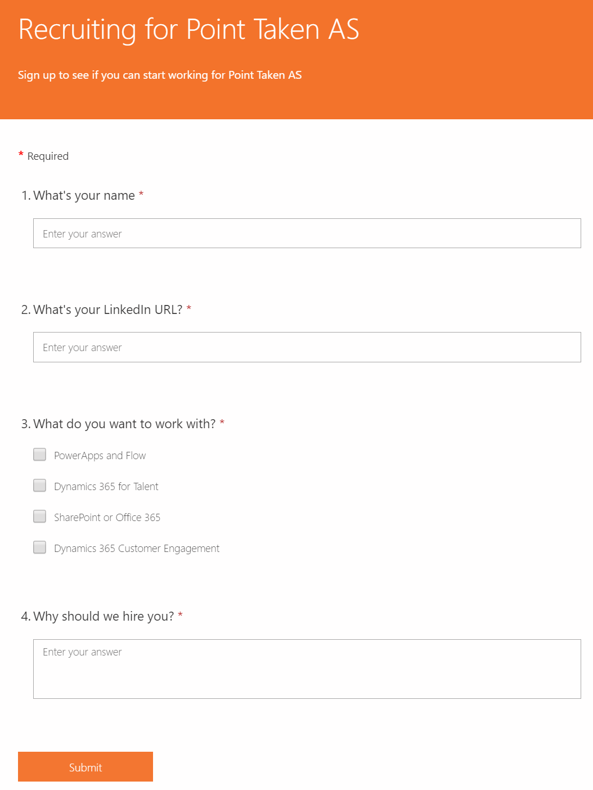
Notes:
Simple solution if you don’t need Attract. Saved in CDS or in Excel, could be sent on e-mail. We are setting up our recruiting this way as we speak.

Slide 17
Cultural fit assessment
Hire the right people for your organization
Pre-scan applicants
Notes:
Simple solution if you don’t need Attract. Saved in CDS or in Excel, could be sent on e-mail. We are setting up our recruiting this way as we speak.

Slide 18
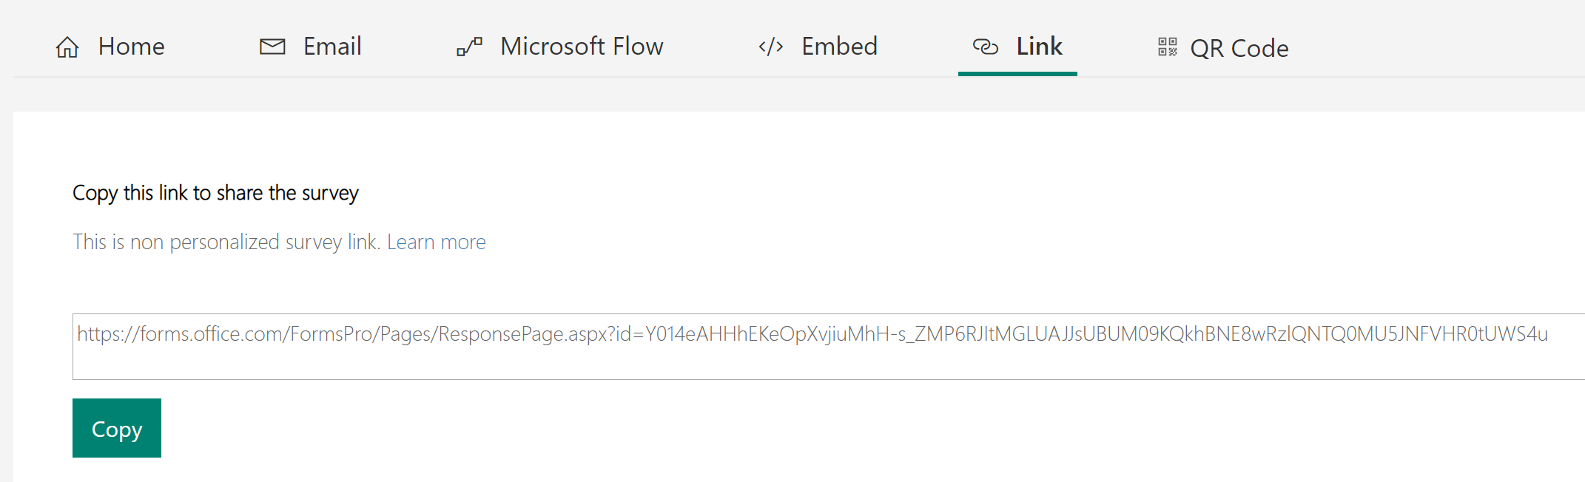

Slide 19
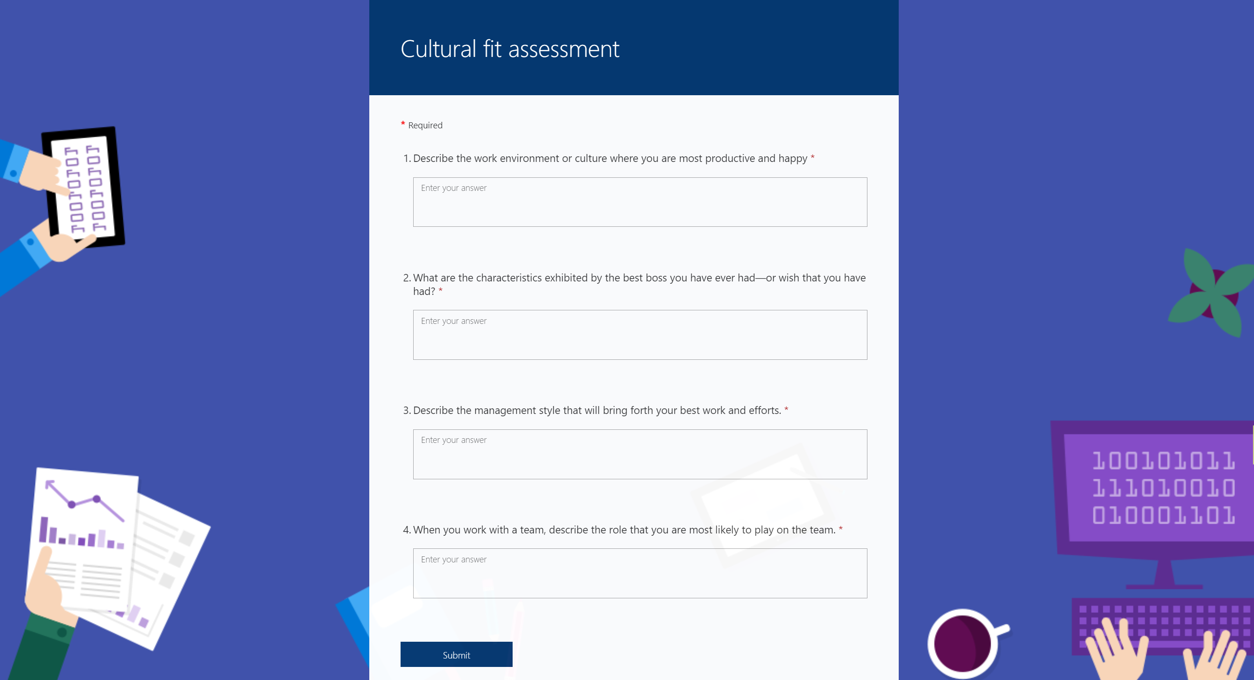

Slide 20
Onboarding Quiz
A way to see if they have learned something
Have they actually done their onboarding tasks?
Is your onboarding valuable?

Slide 21
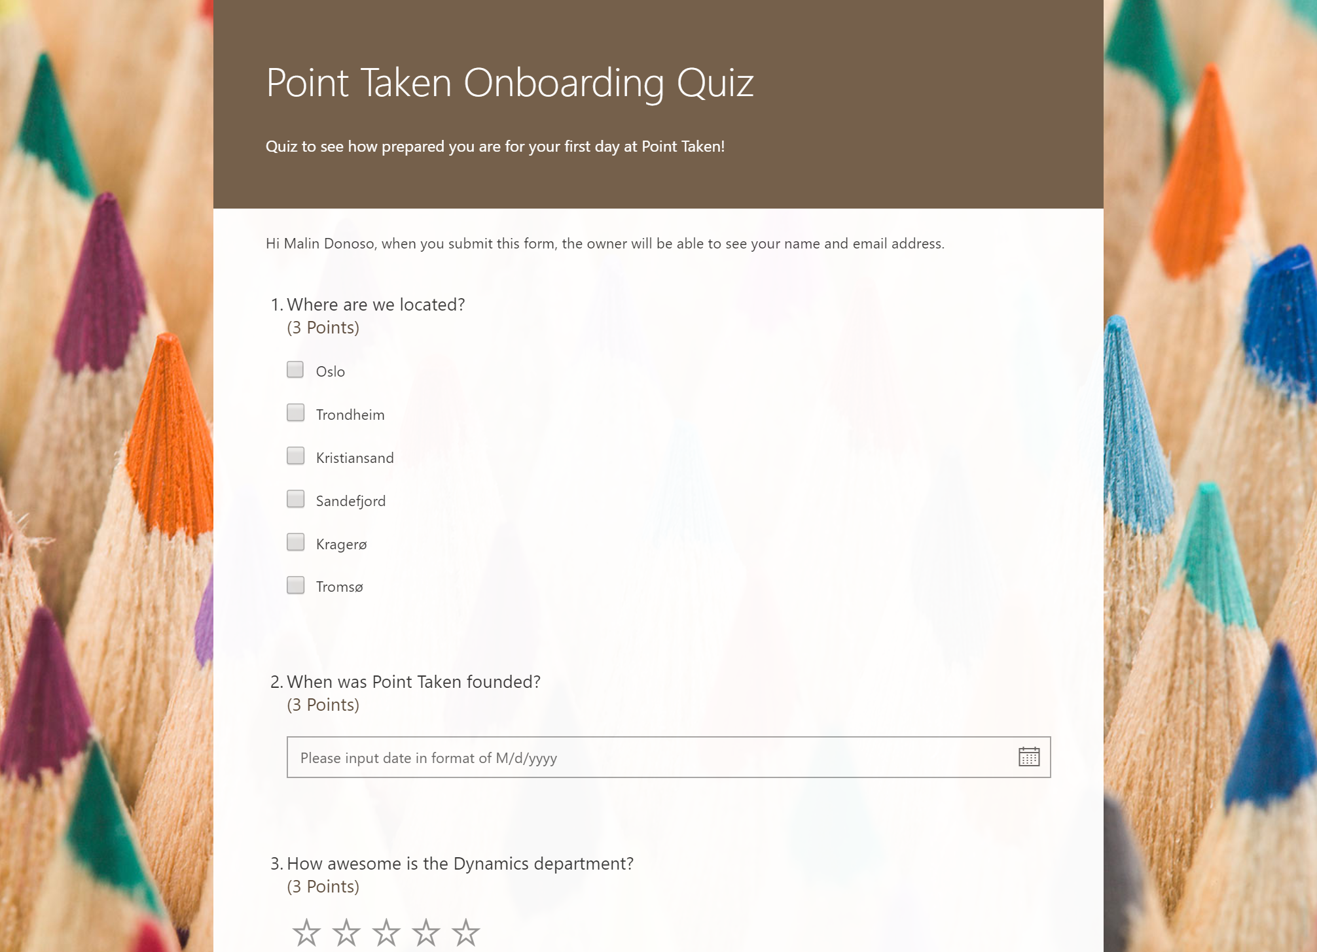
Notes:
After you are done with Onboarding, you could have them take a test to see if they have actually done the tasks

Slide 22
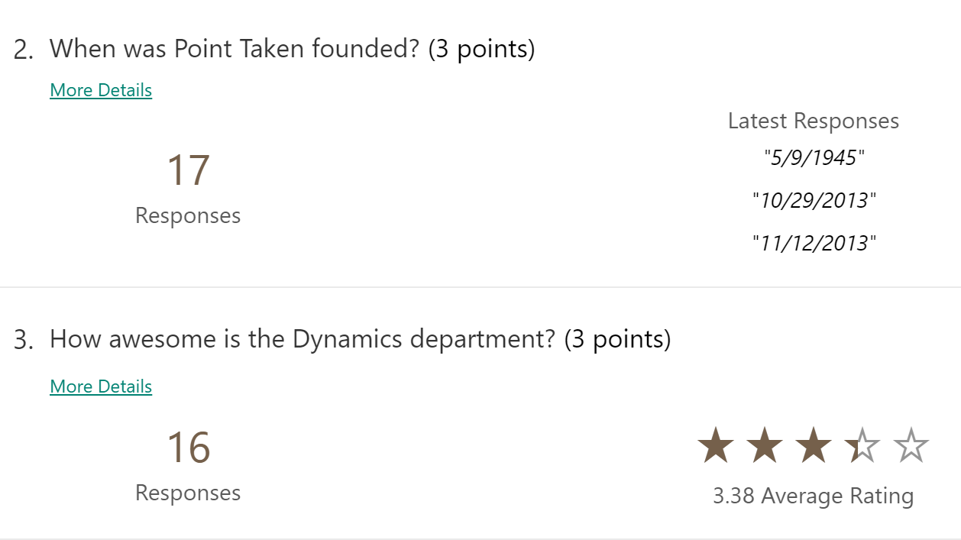
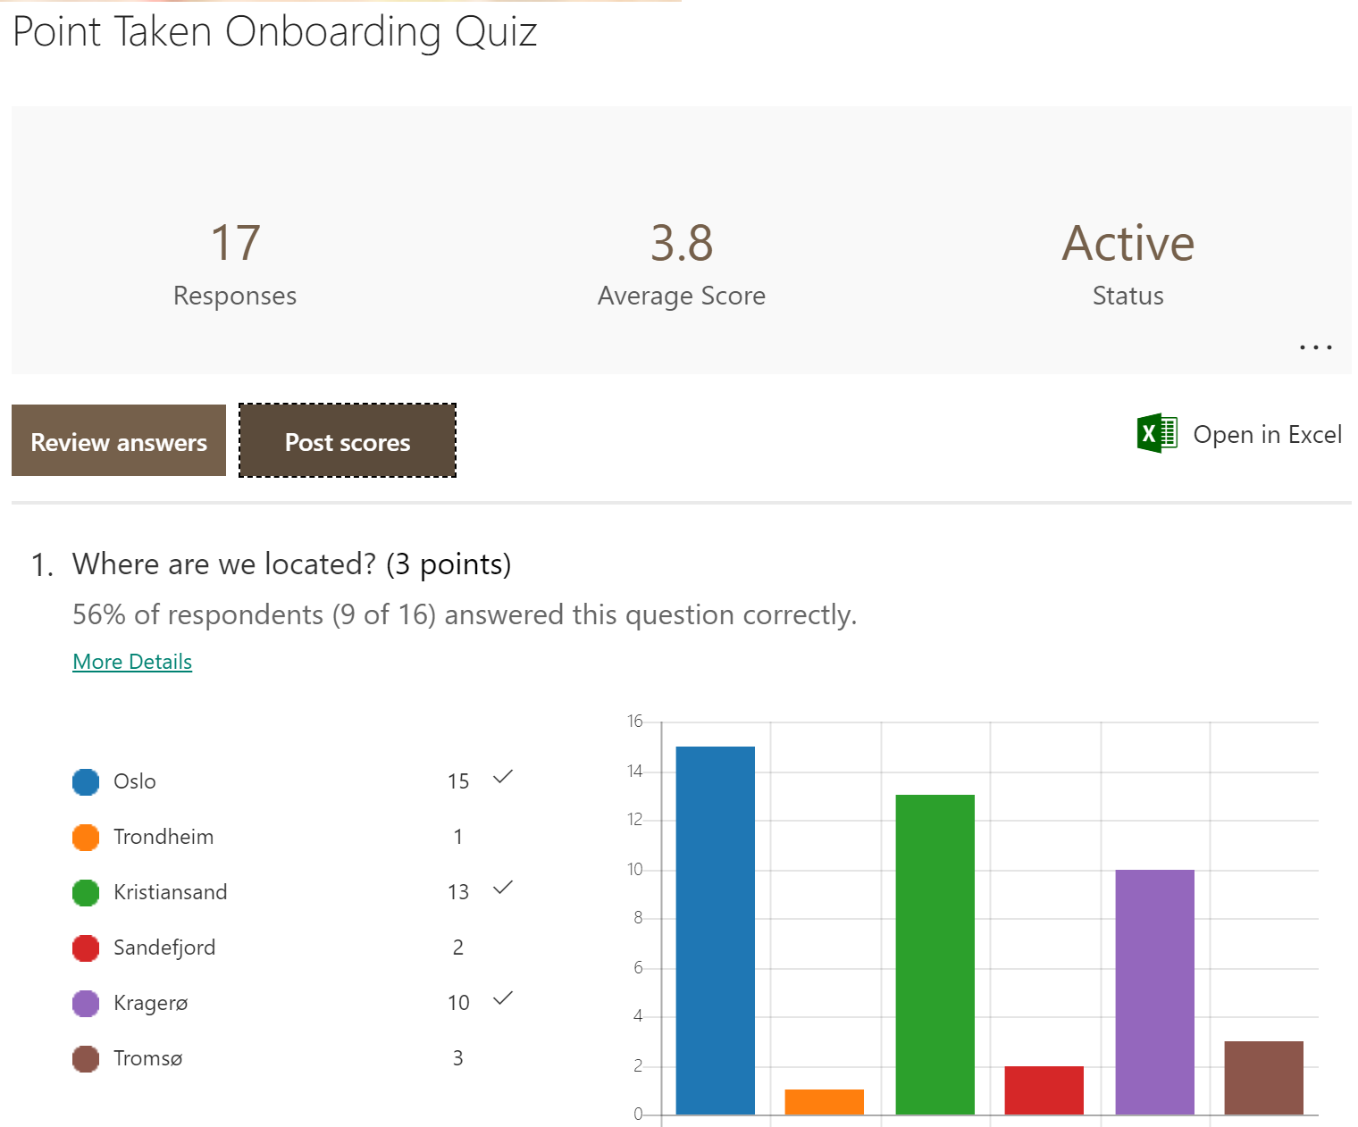

Slide 23

Employee of the year
Get input
Get answers

Slide 24
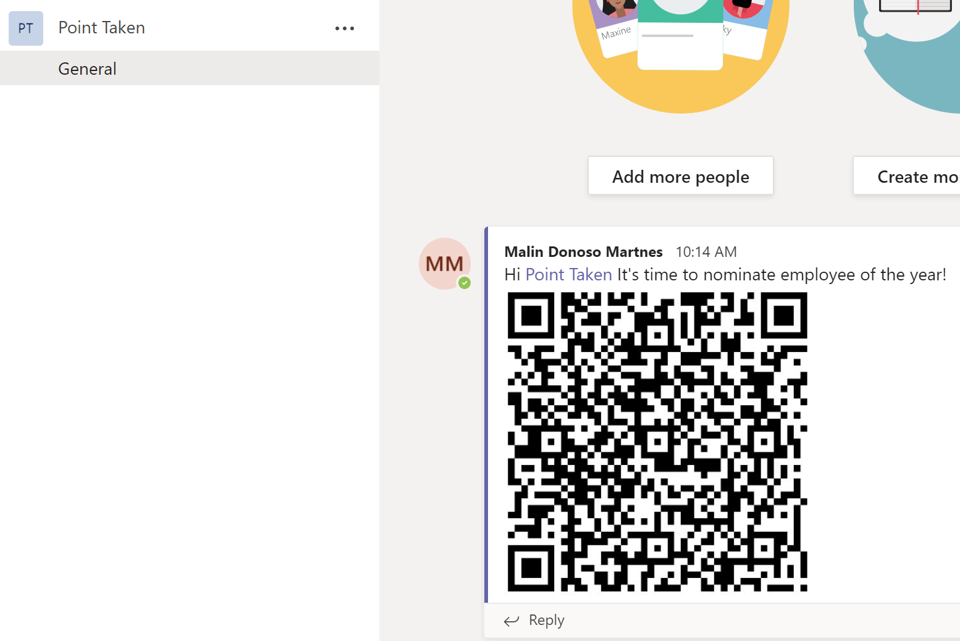
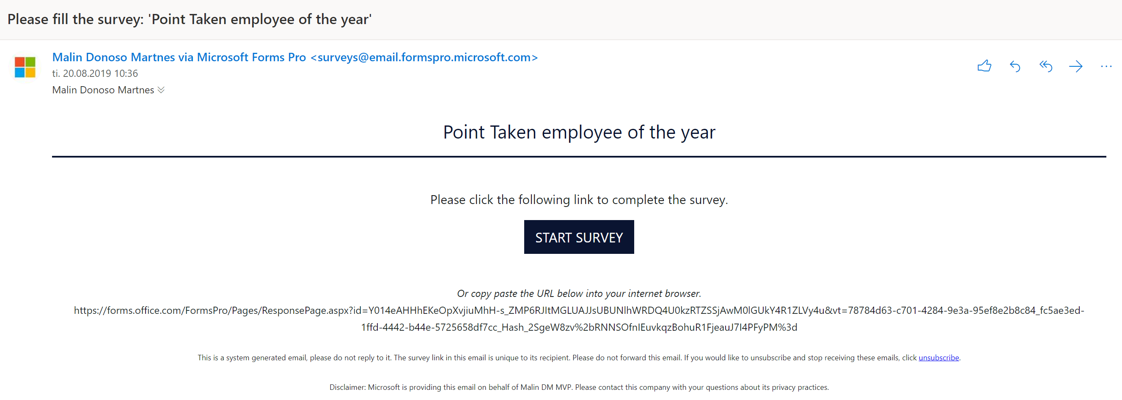
Notes:
Most companies have an award for the employee of the year, it’s easy to do this with Forms, you can send it out via email

Slide 25
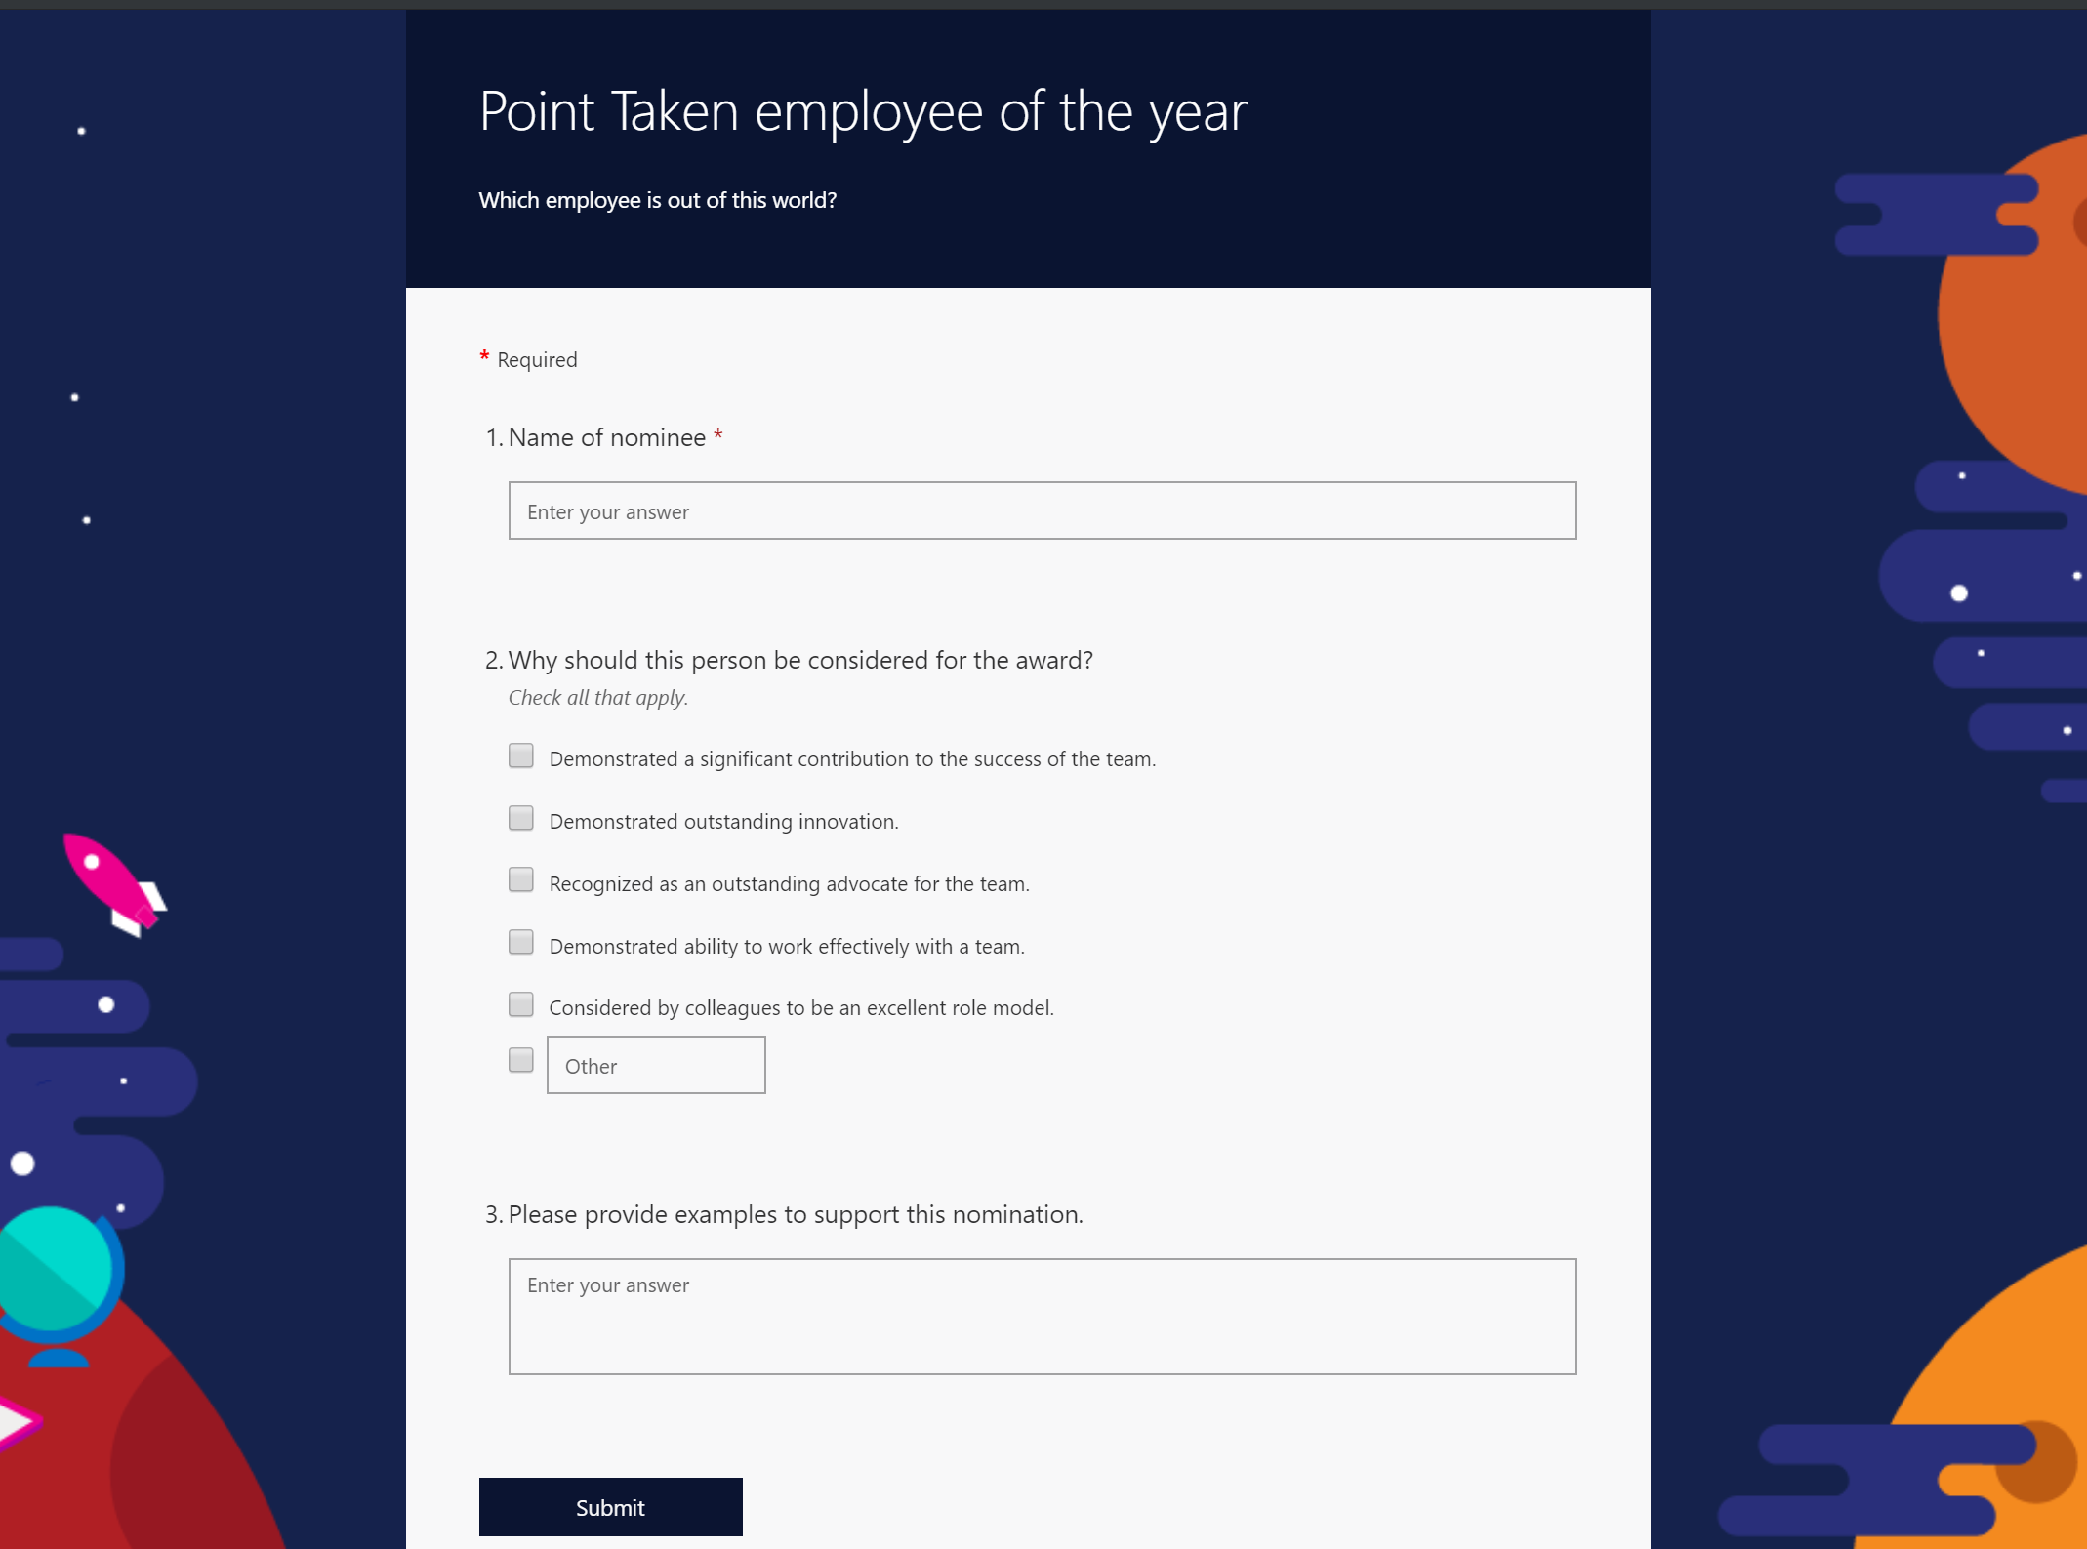
Notes:
Most companies have an award for the employee of the year, it’s easy to do this with Forms, you can send it out via email

Slide 26
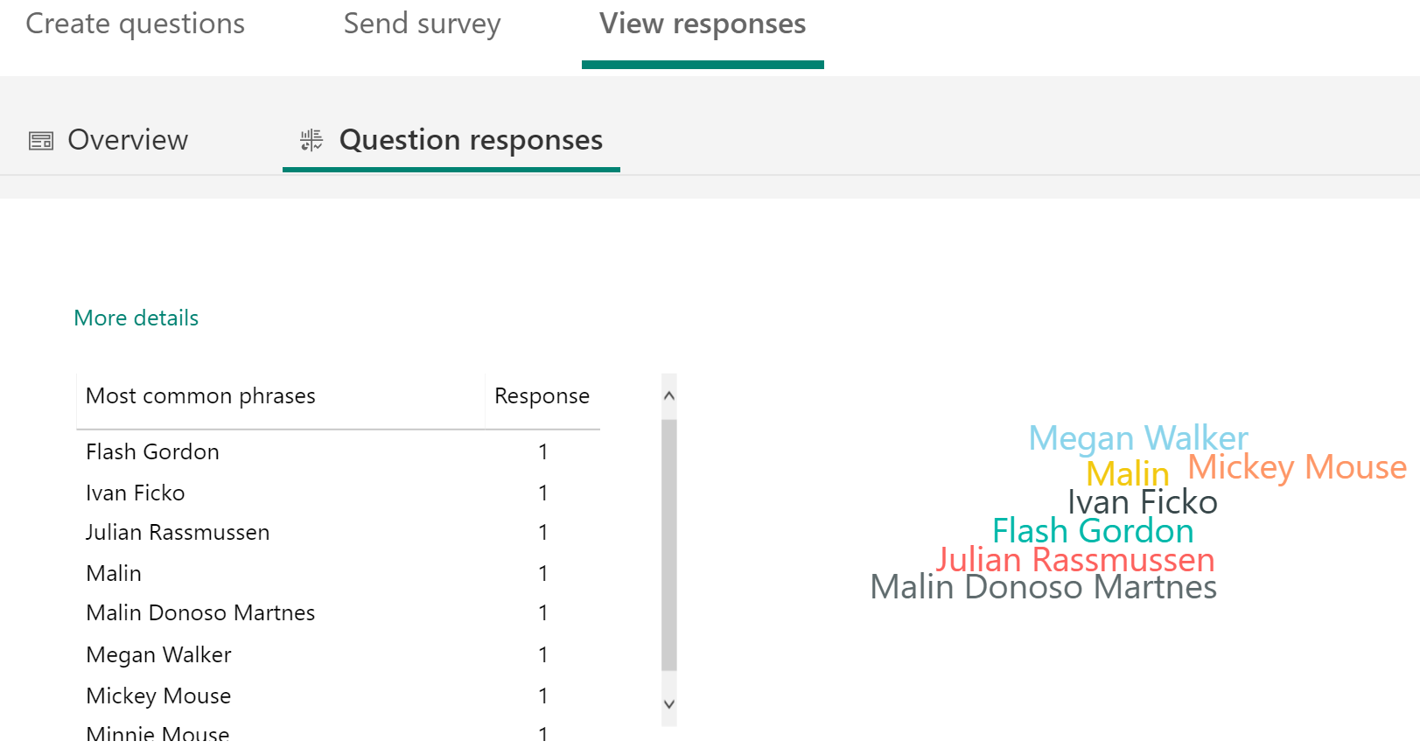
Notes:
Most companies have an award for the employee of the year, it’s easy to do this with Forms, you can send it out via email

Slide 27
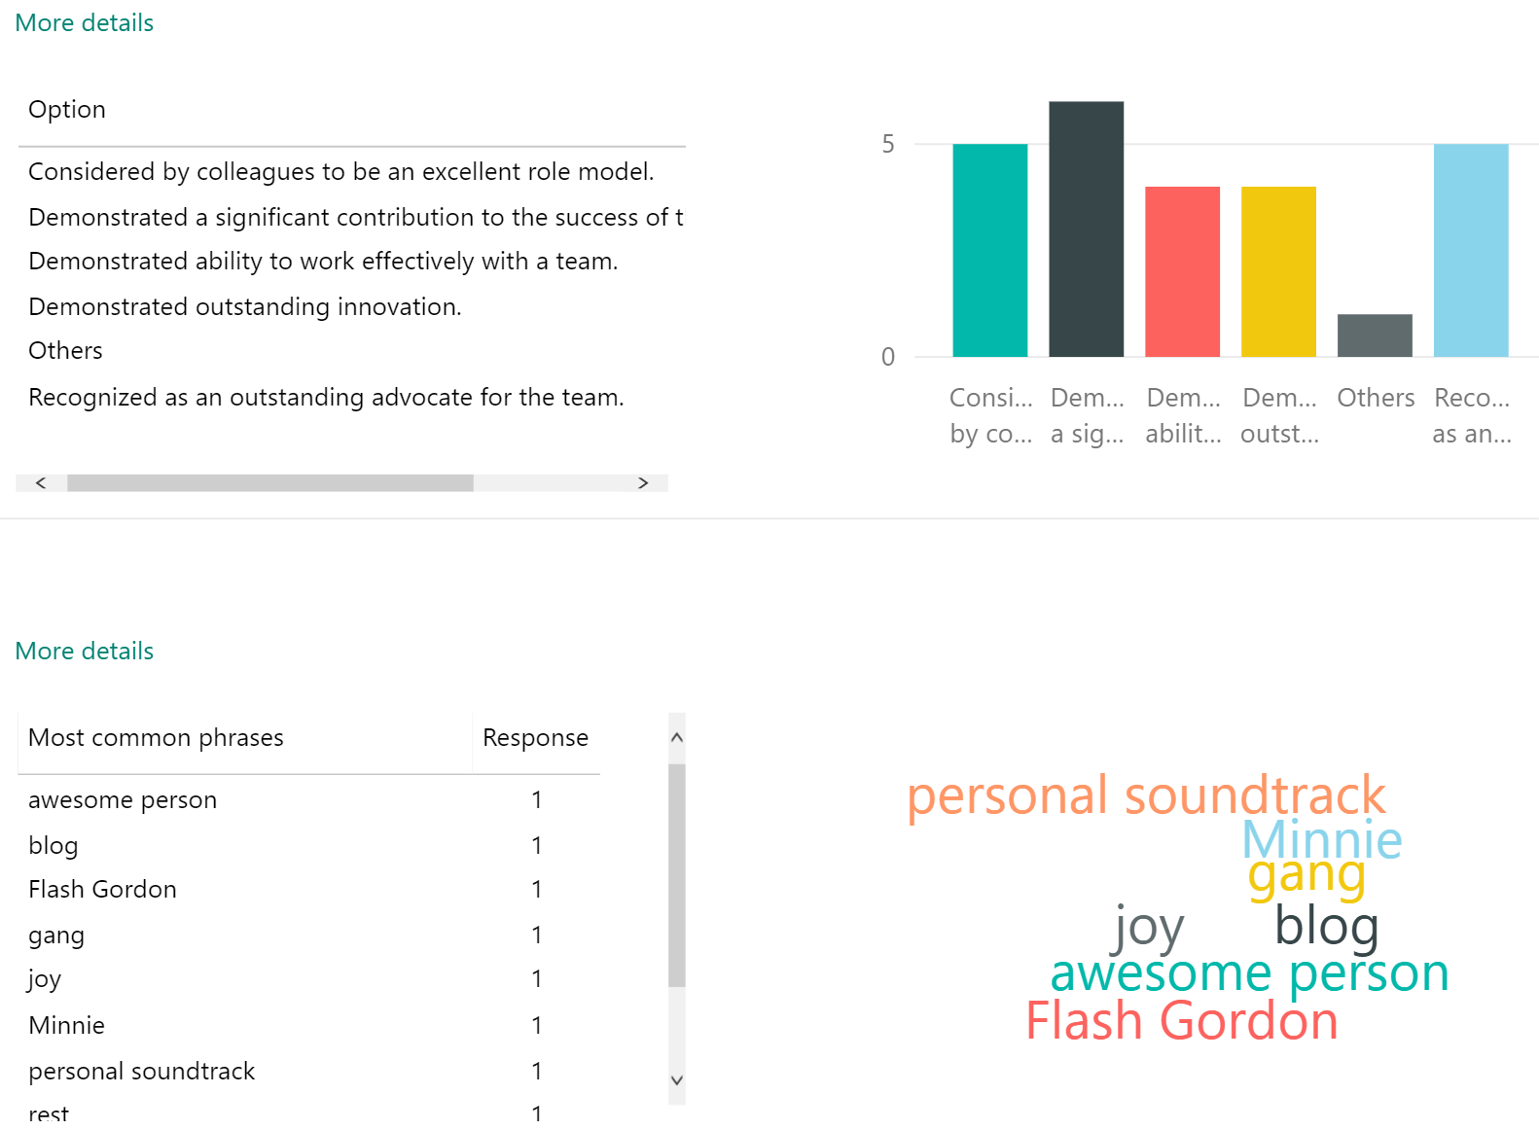
Notes:
Most companies have an award for the employee of the year, it’s easy to do this with Forms, you can send it out via email

Slide 28
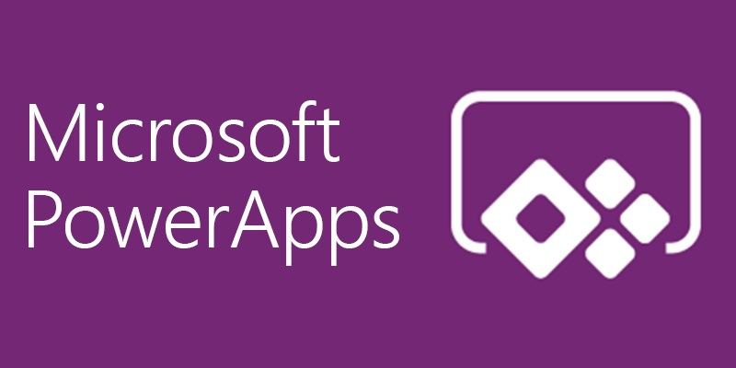
What is PowerApps?
PowerApps is an initiative by Microsoft that allows developers and nontechnical users to build mobile applications from selectable templates. The objective of PowerApps is to enable business users to build new capabilities via apps, without requiring that they have code expertise.

Slide 29
PowerApps
Referral App
Interview tool
Onboarding App
Employee engagement survey
Where do I find stuff?

Slide 30
Referral app
Hiring is expensive
Getting referrals are useful

Slide 31
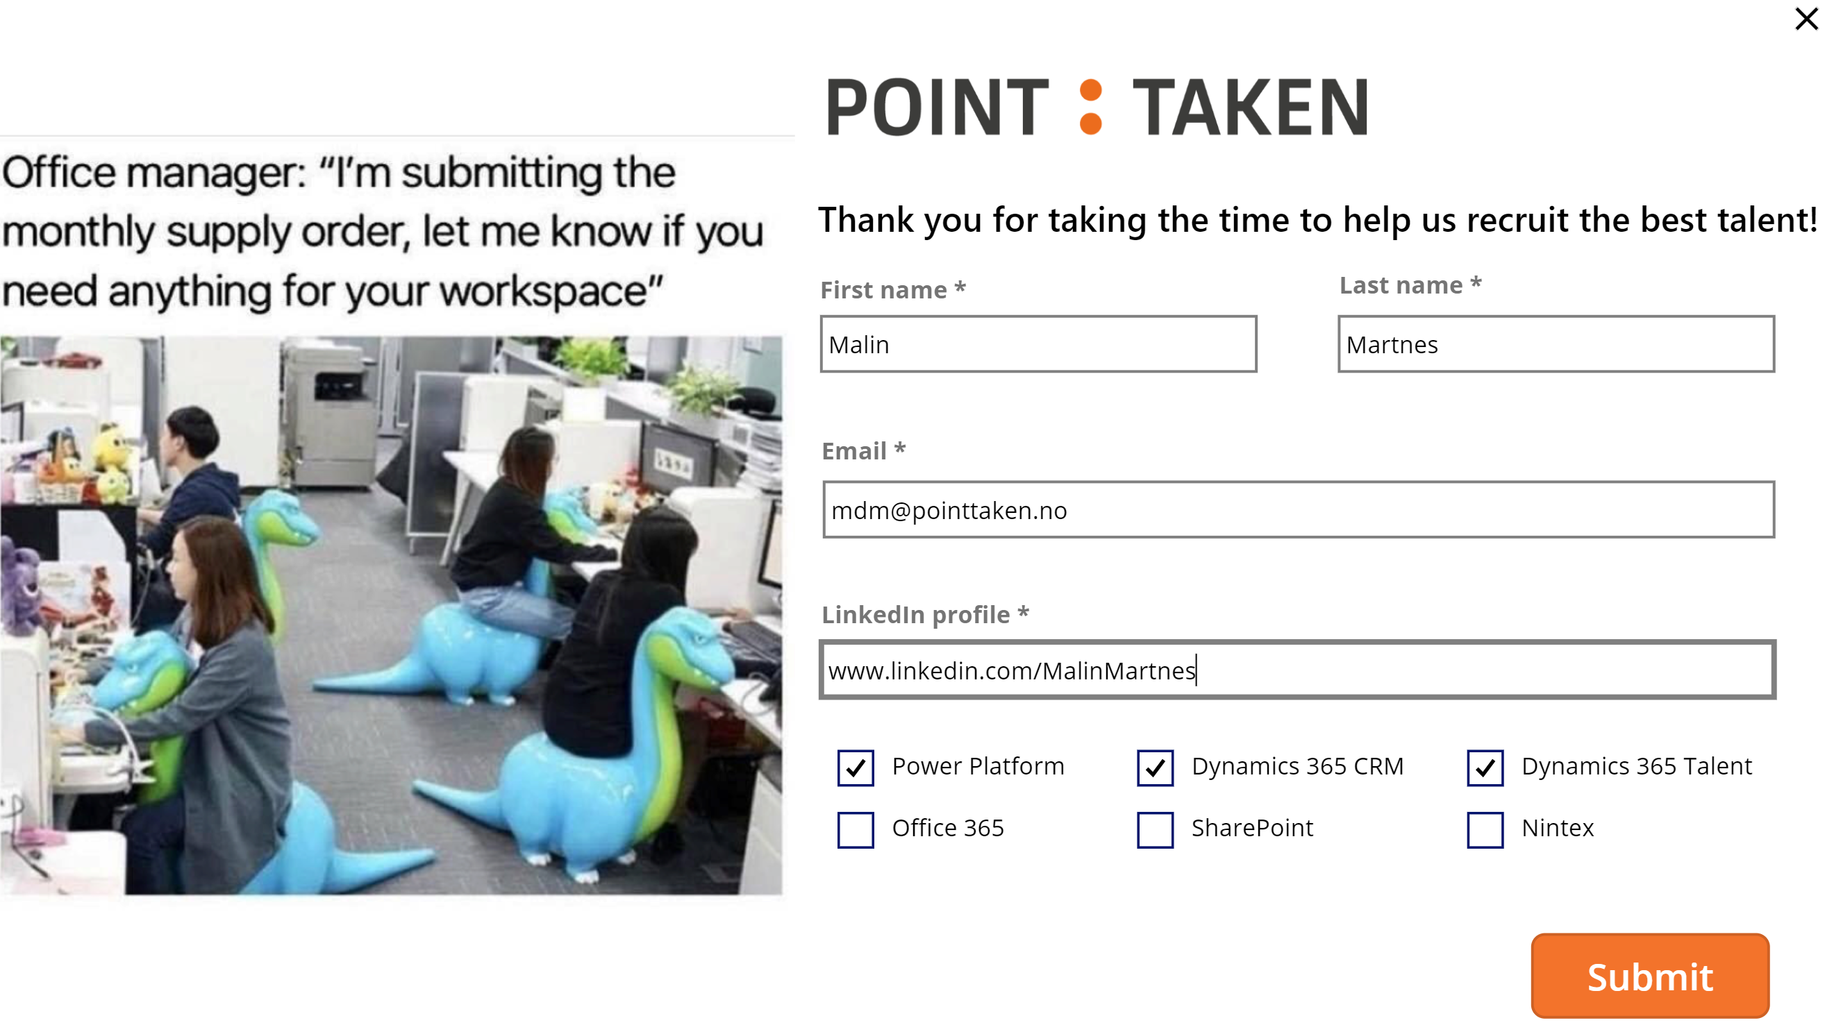
Notes:
Getting new employees is hard, with an open position you would like to get other employees to refer people they know. With this app it makes it that much easier.

Slide 32
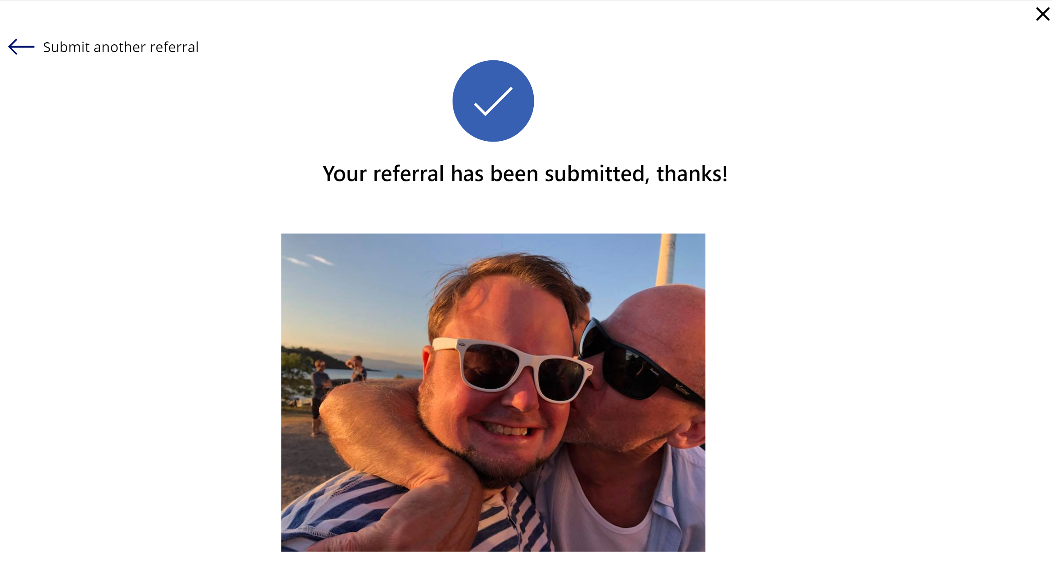
Notes:
Getting new employees is hard, with an open position you would like to get other employees to refer people they know. With this app it makes it that much easier.

Slide 33
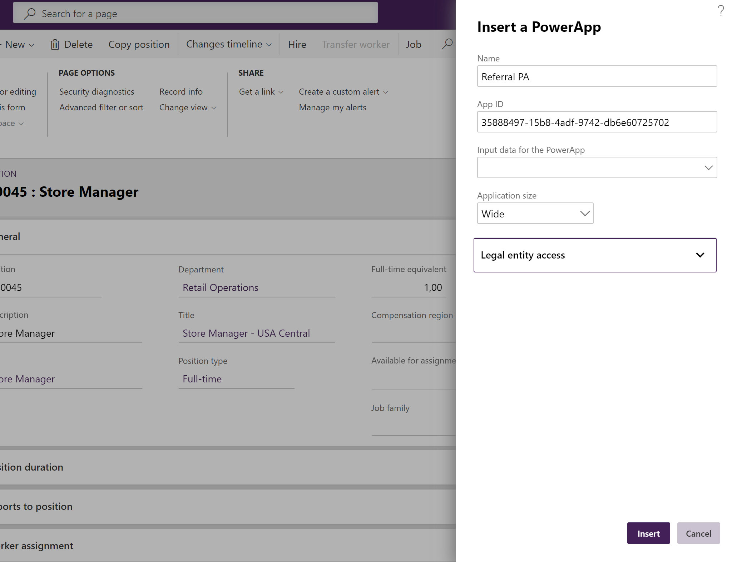
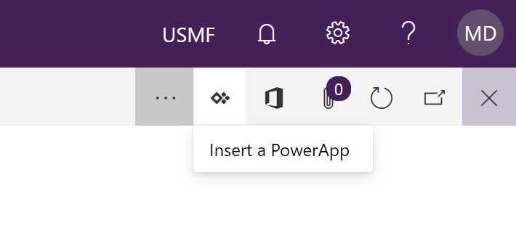
Core HR
Notes:
Getting new employees is hard, with an open position you would like to get other employees to refer people they know. With this app it makes it that much easier.

Slide 34
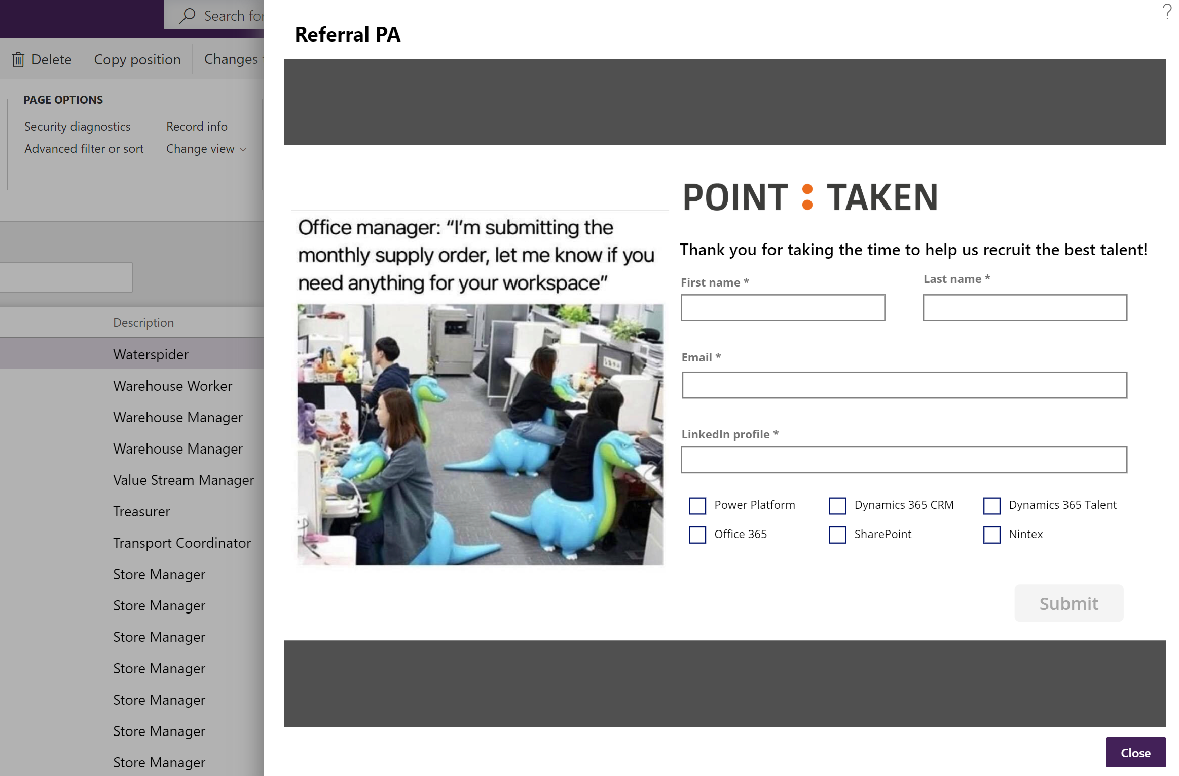
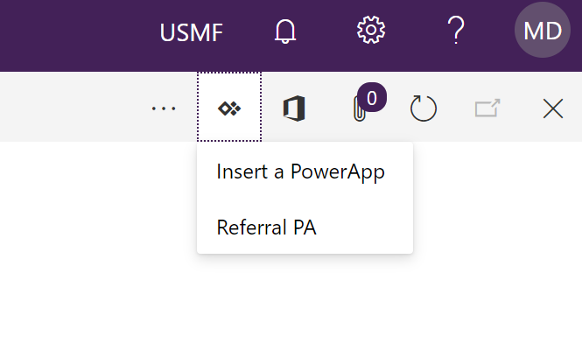
Notes:
Getting new employees is hard, with an open position you would like to get other employees to refer people they know. With this app it makes it that much easier.

Slide 35
Interview tool
Get feedback from interviewers

Slide 36
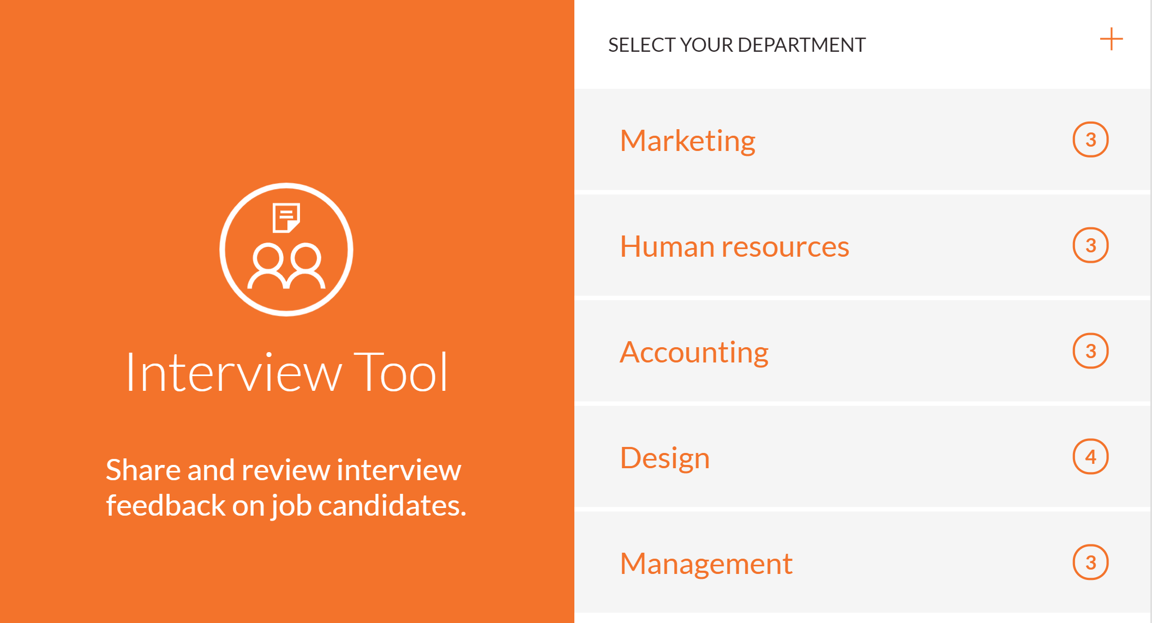

Slide 37
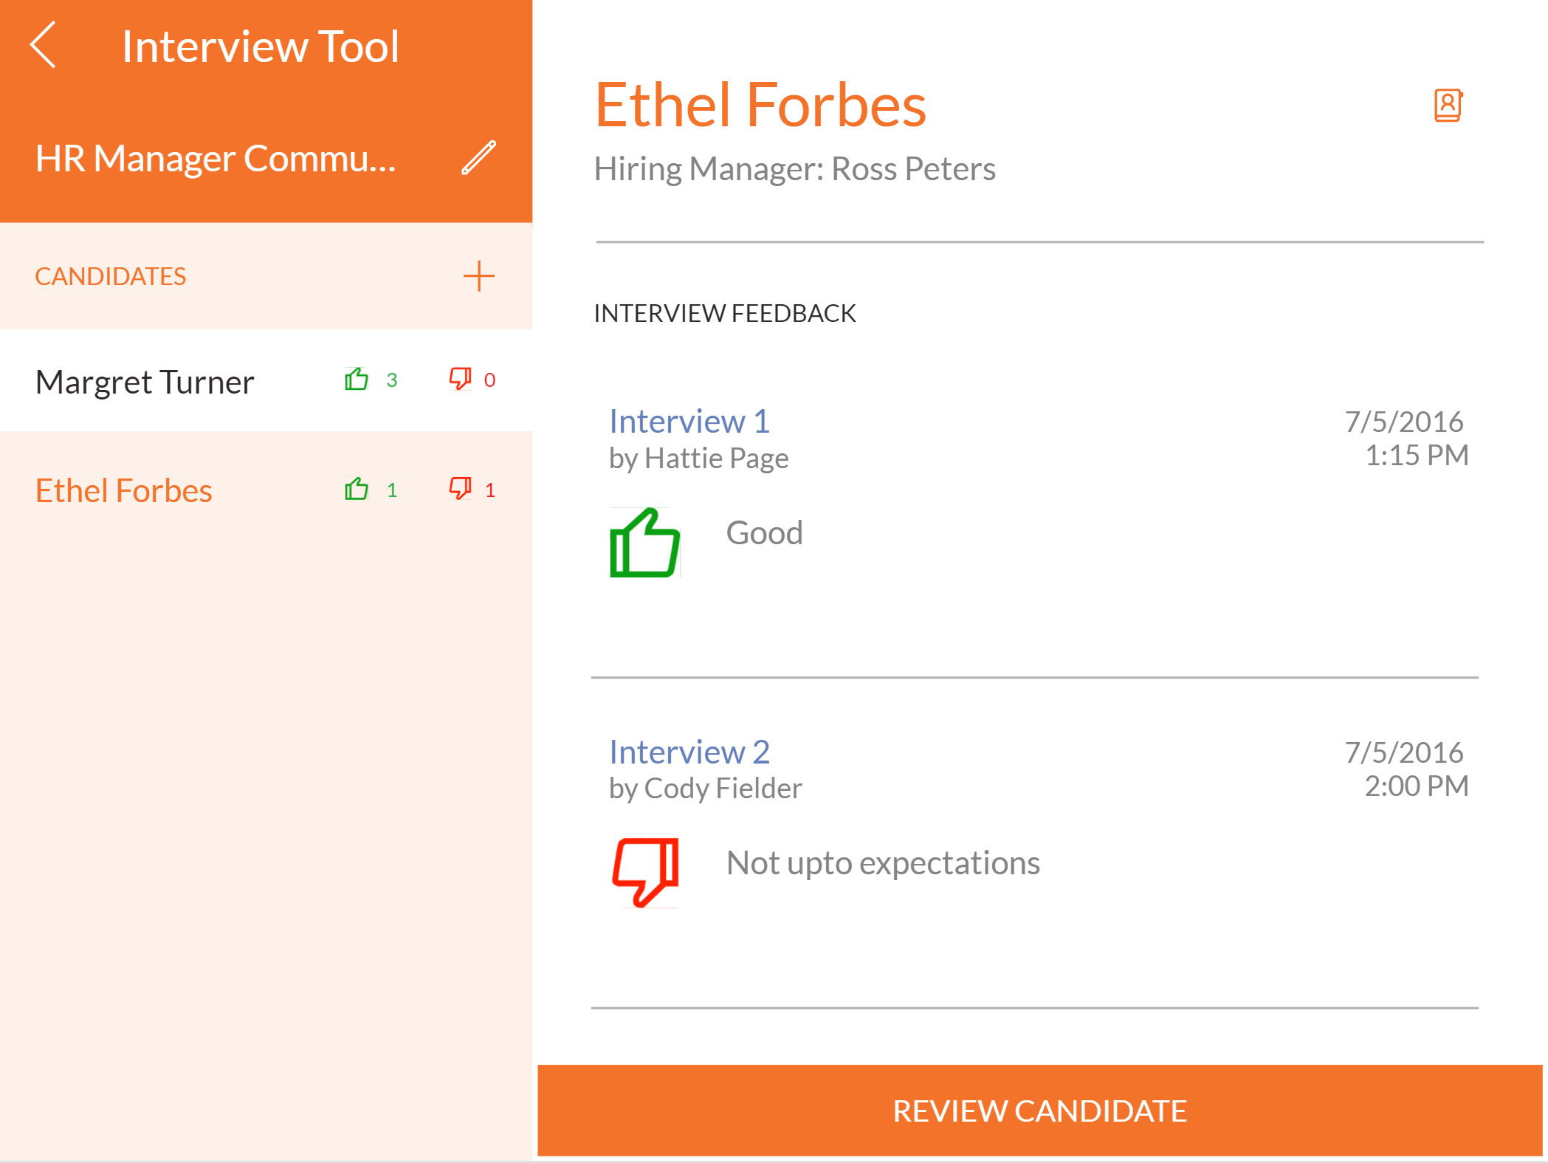

Slide 38
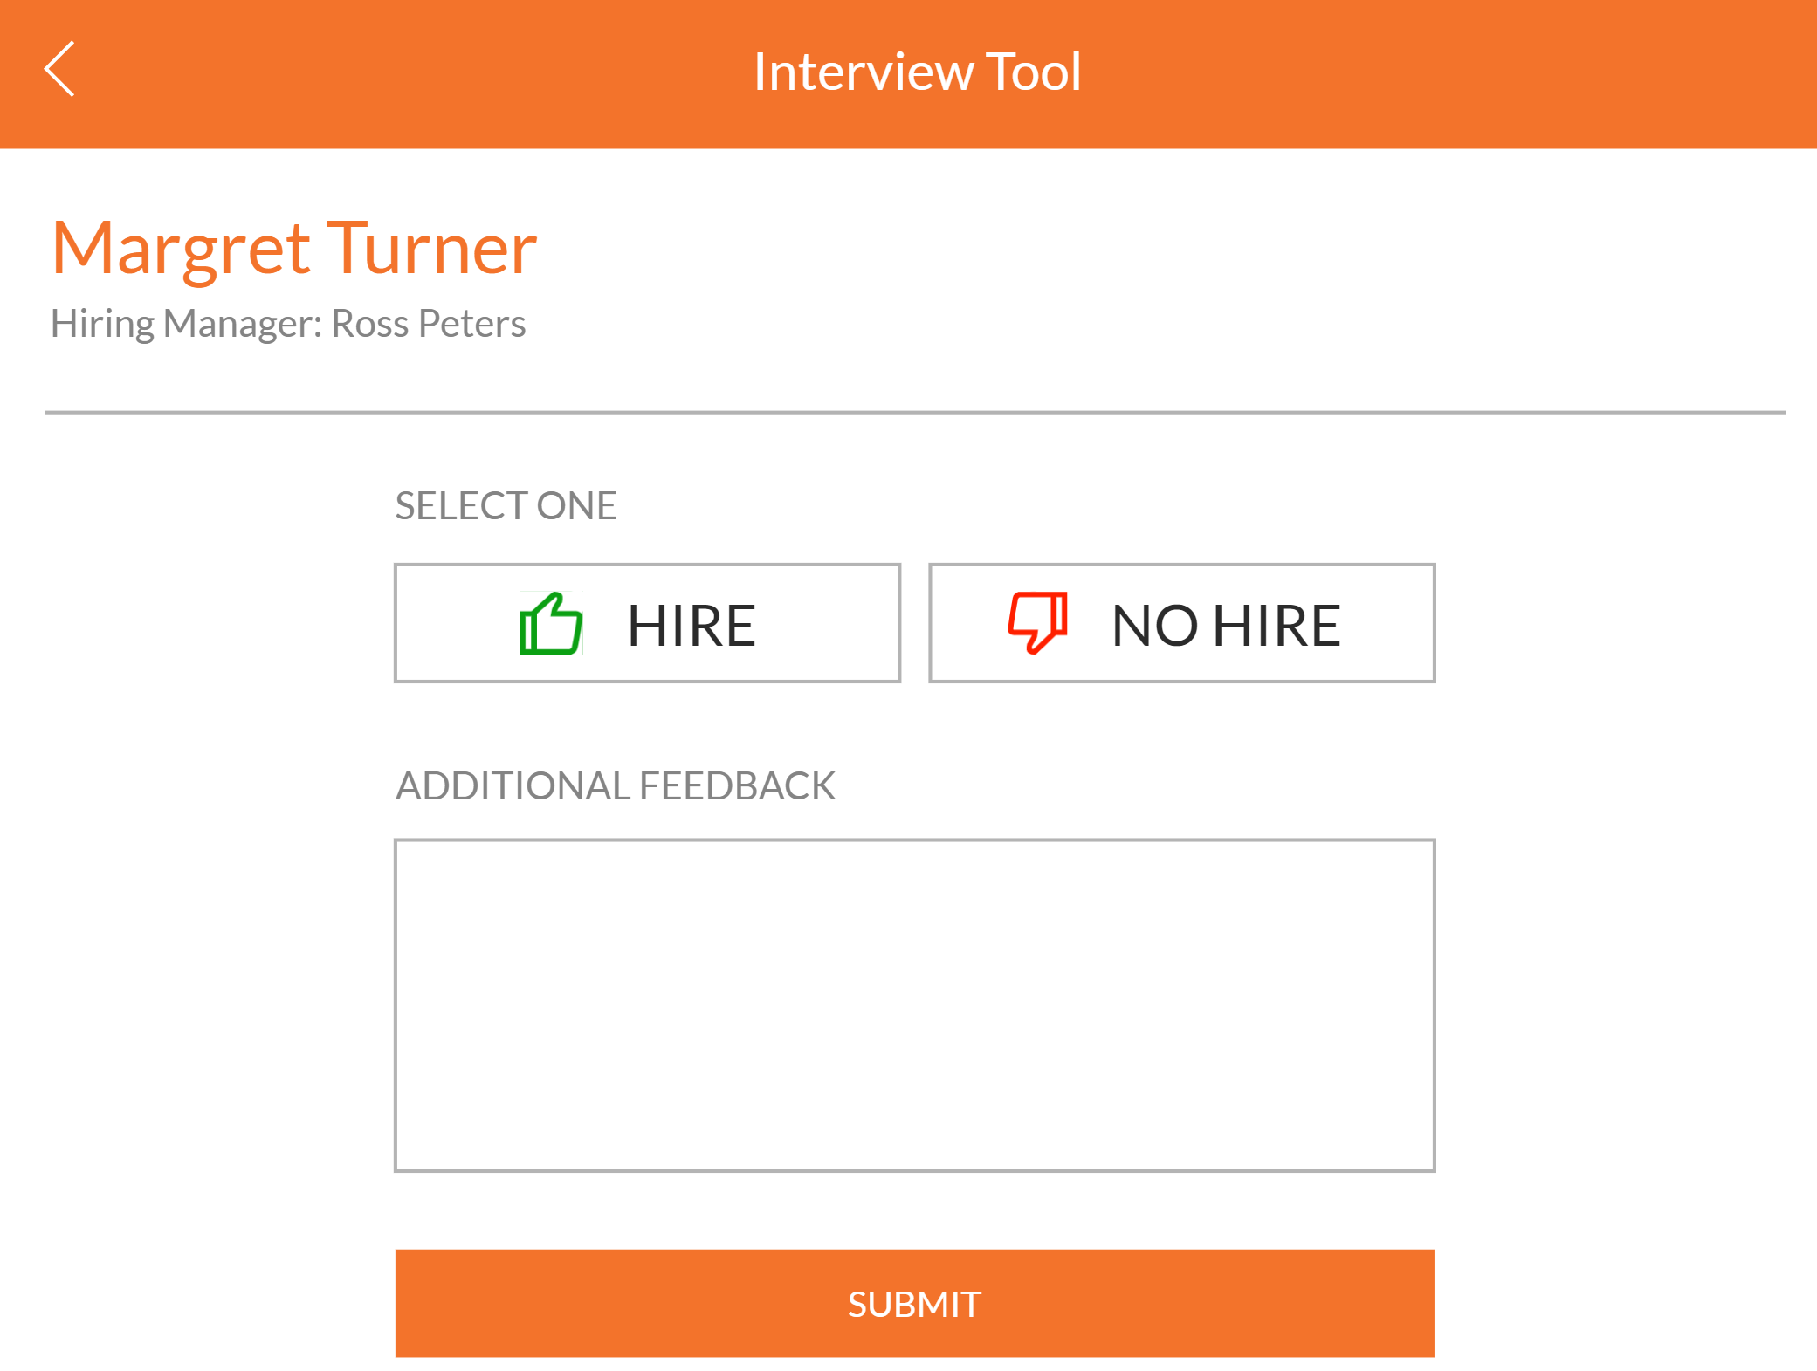

Slide 39
Employee engagement survey
Feelings about your company
How is life?
Do you need to change anything?
Are people happy?

Slide 40
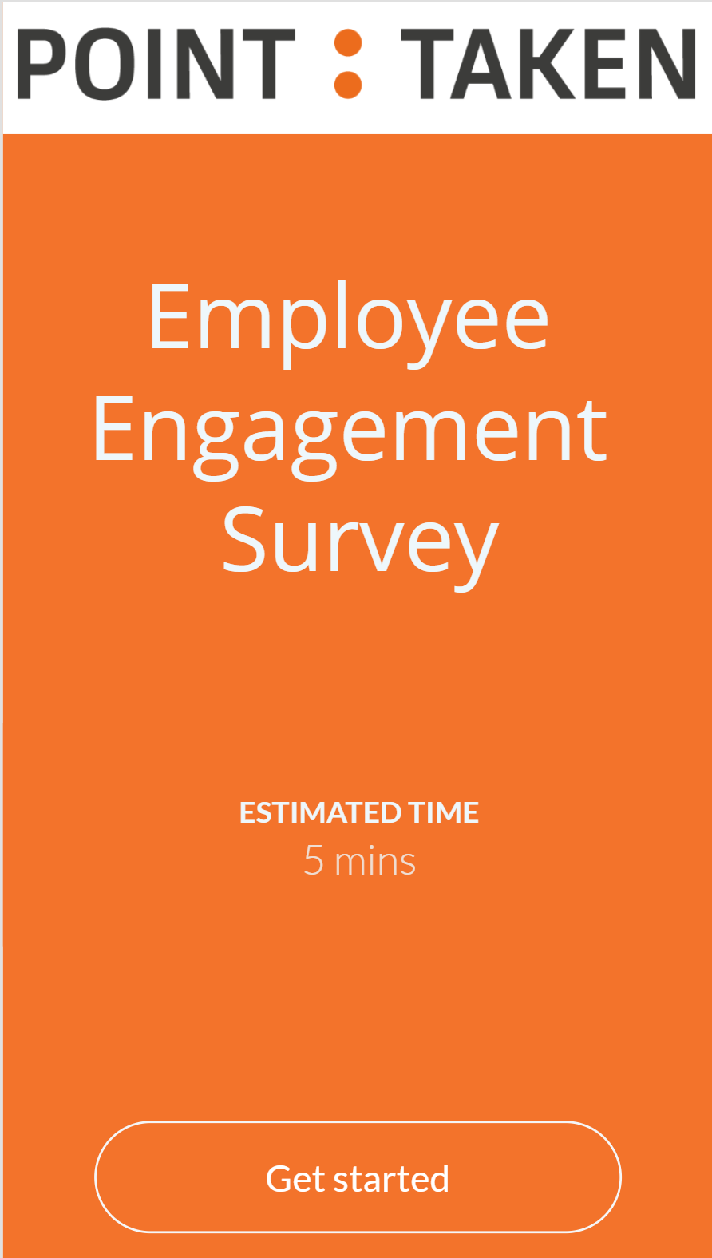
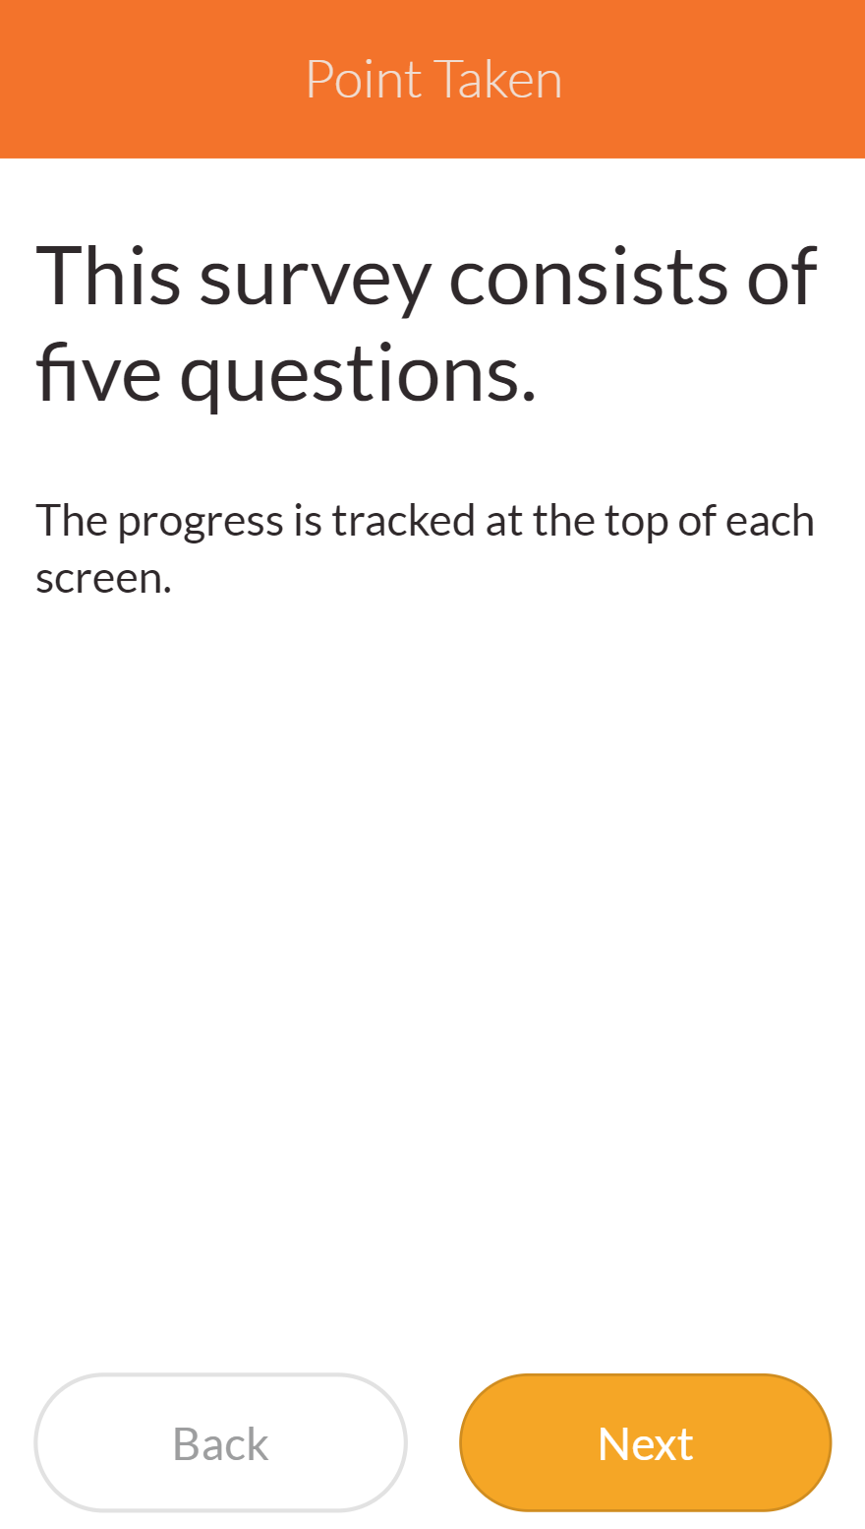

Slide 41
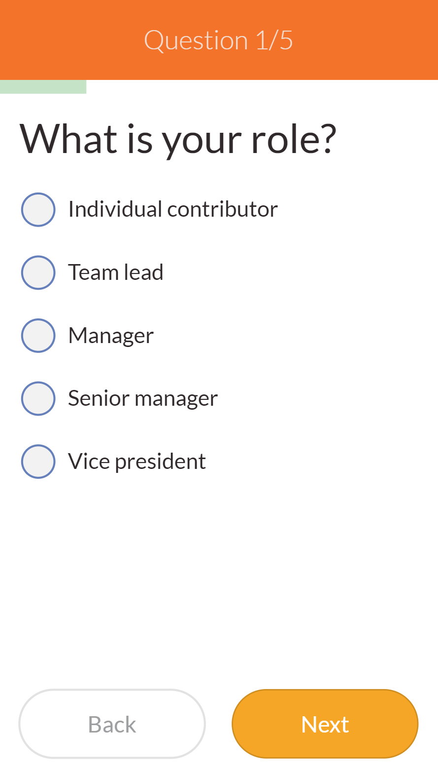
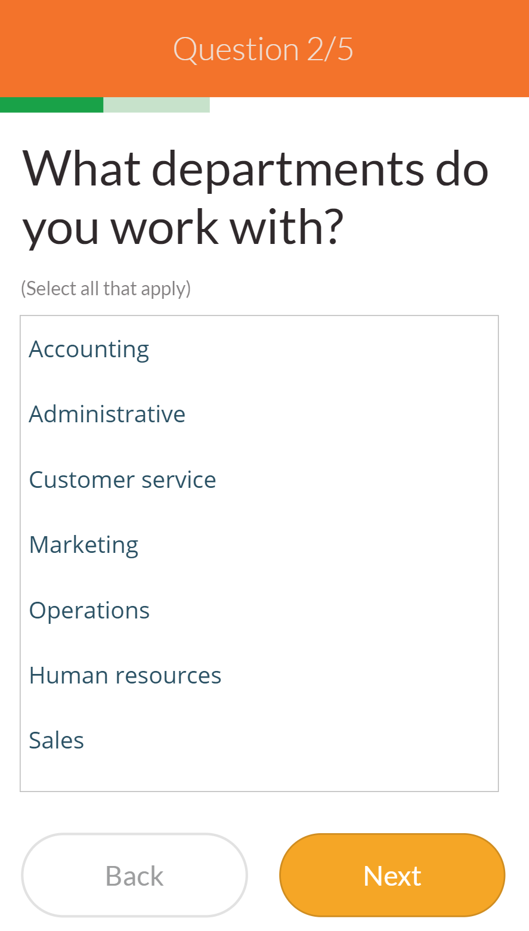
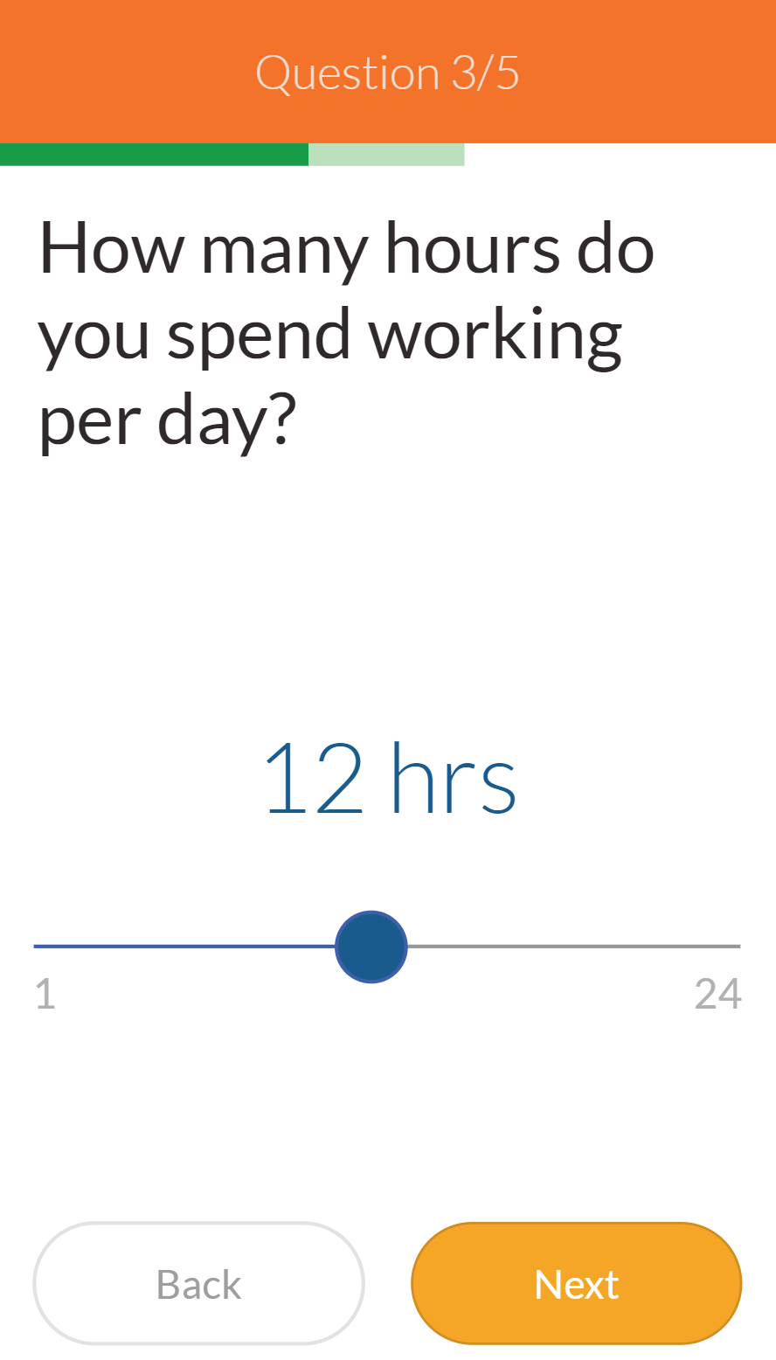

Slide 42
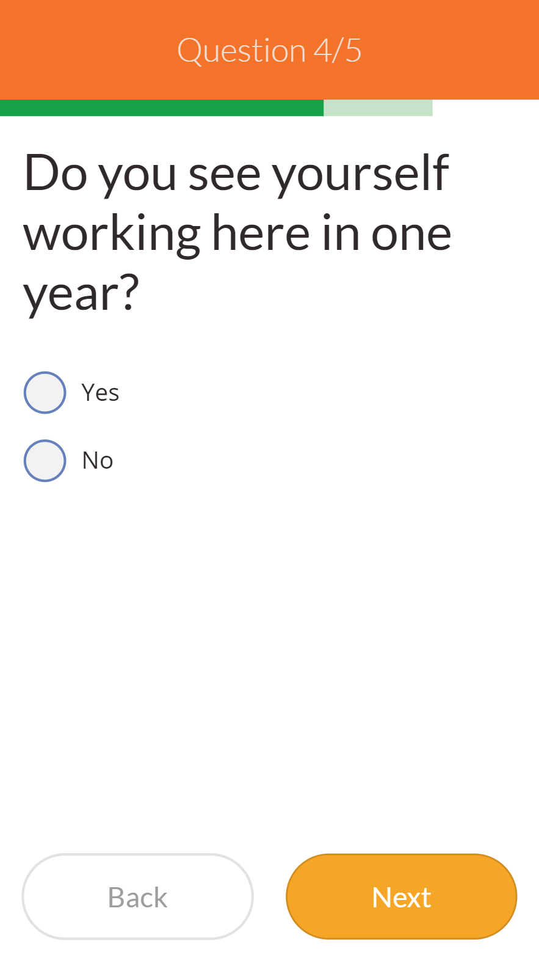
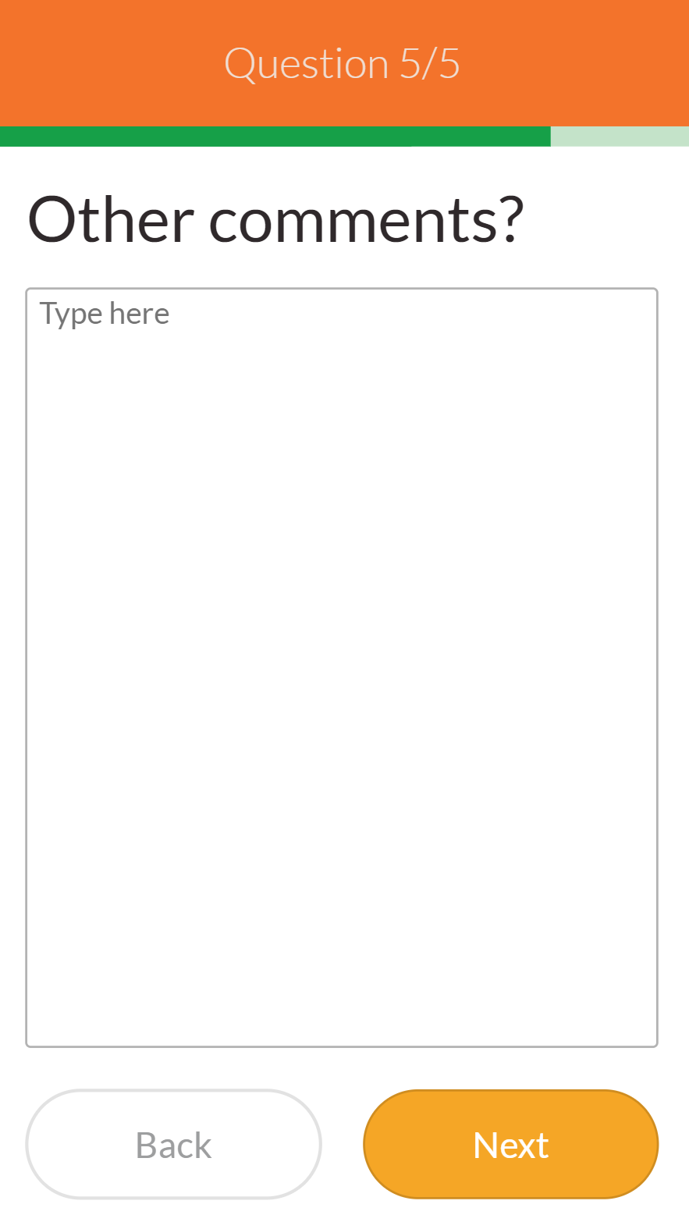
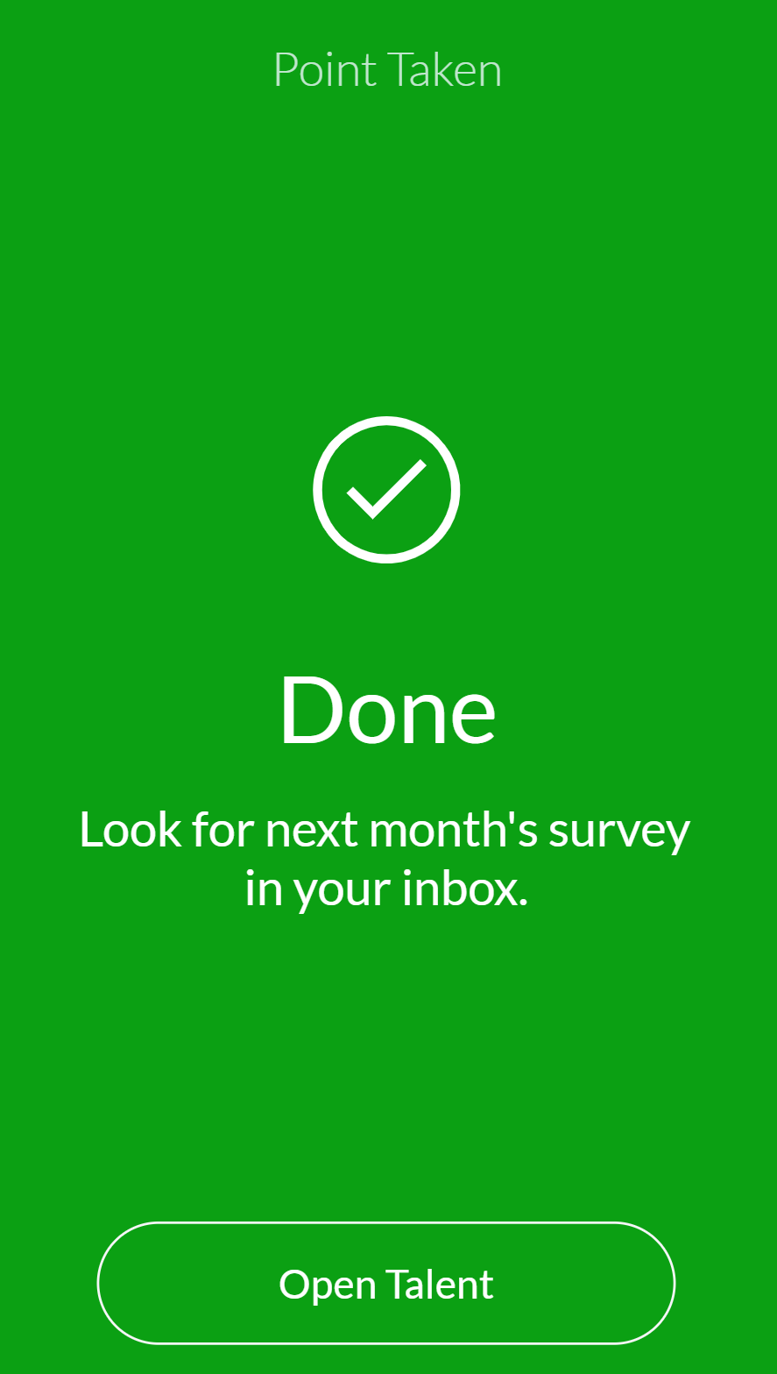

Slide 43
Onboarding
Could lower turnover
Increase engagement
Increase productivity
https://www.strayboots.com/blog/why-is-onboarding-so-important/
Notes:
The only App I made from scratch

Slide 44
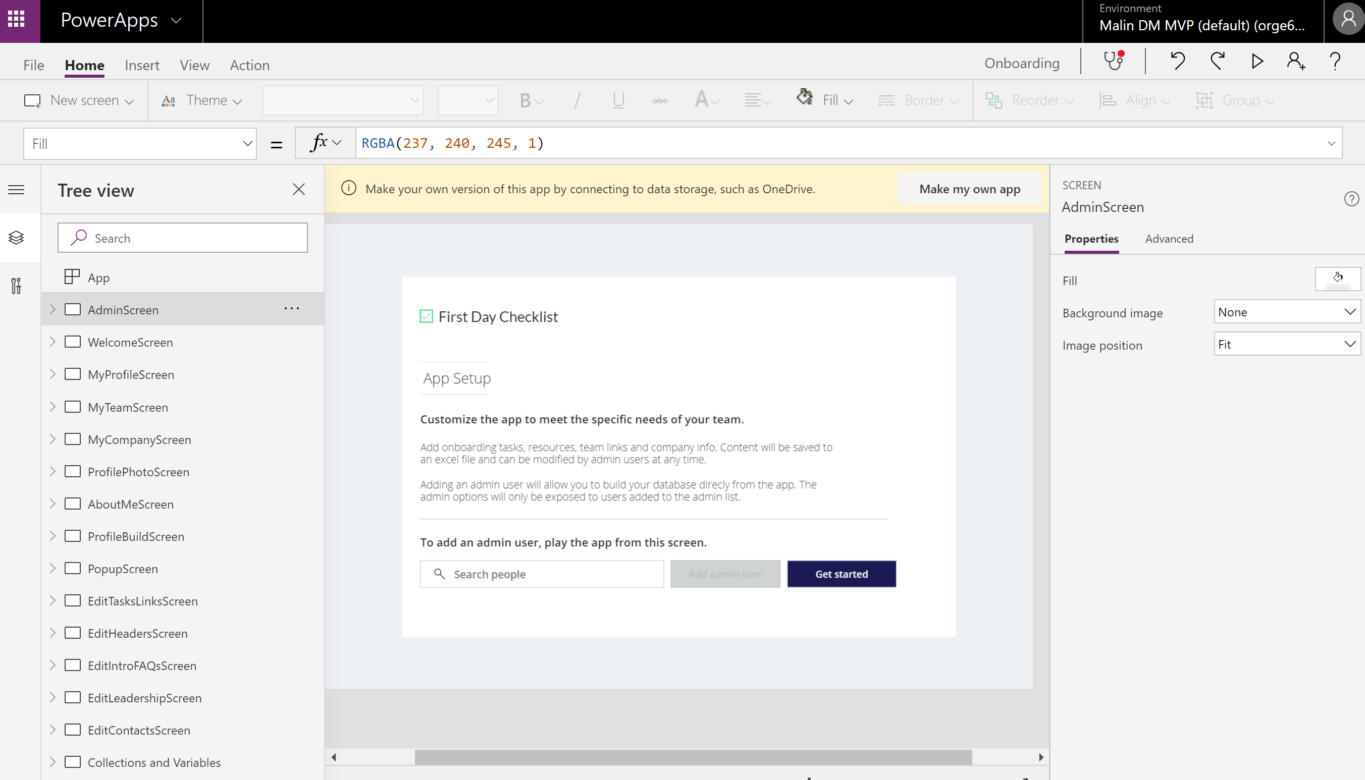

Slide 45
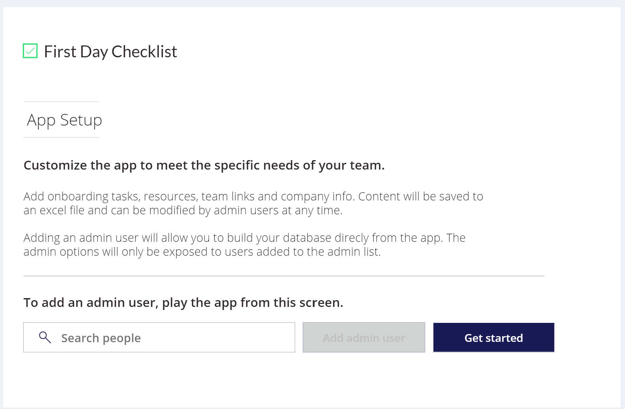

Slide 46
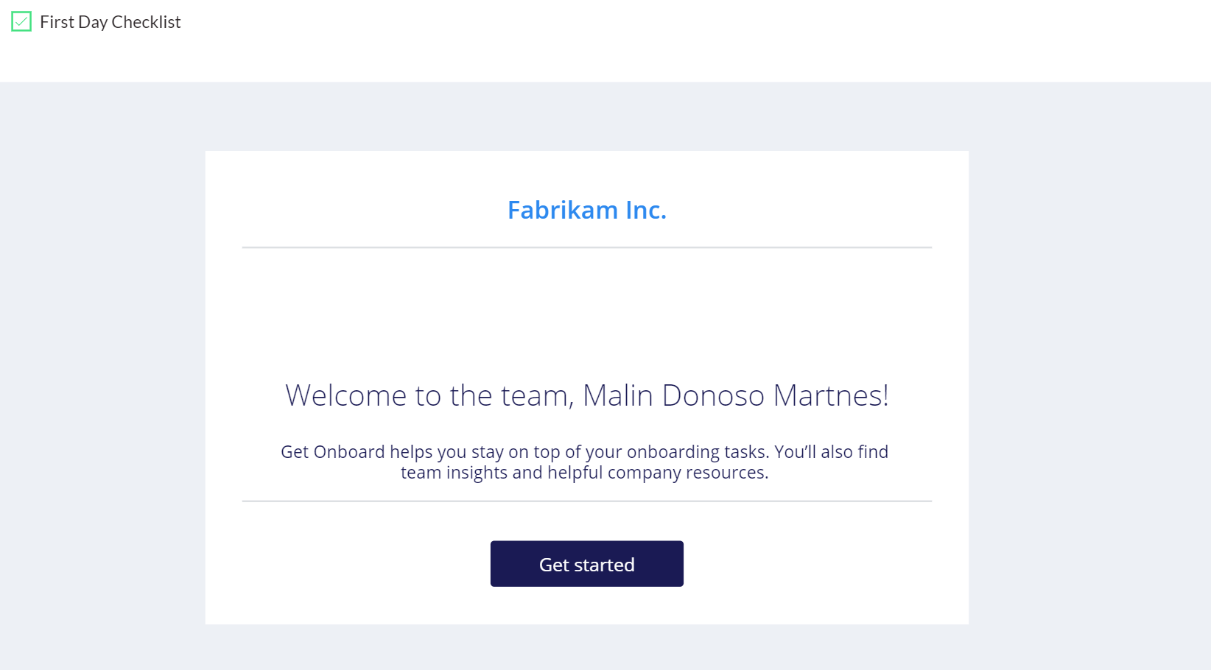

Slide 47
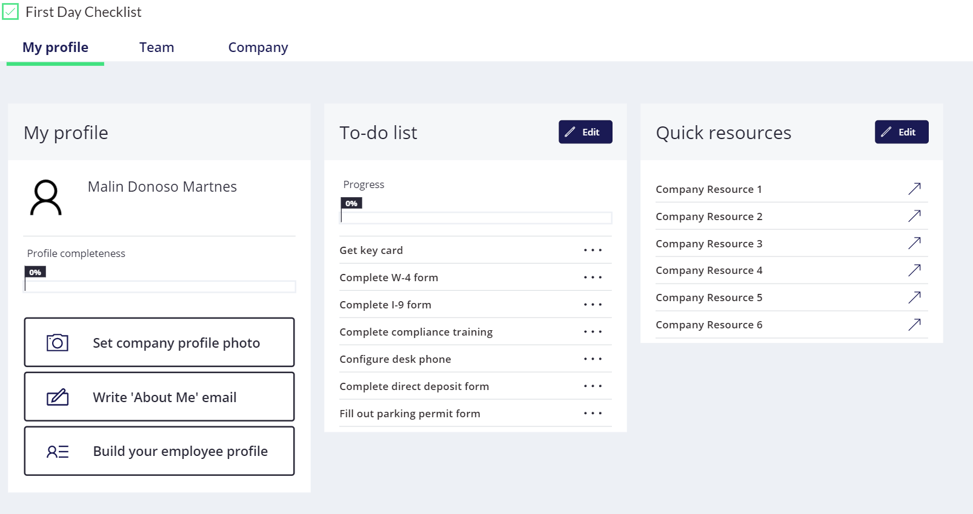

Slide 48
Where do I find stuff?
All the links you need but never remember
Notes:
The only App I made from scratch

Slide 49
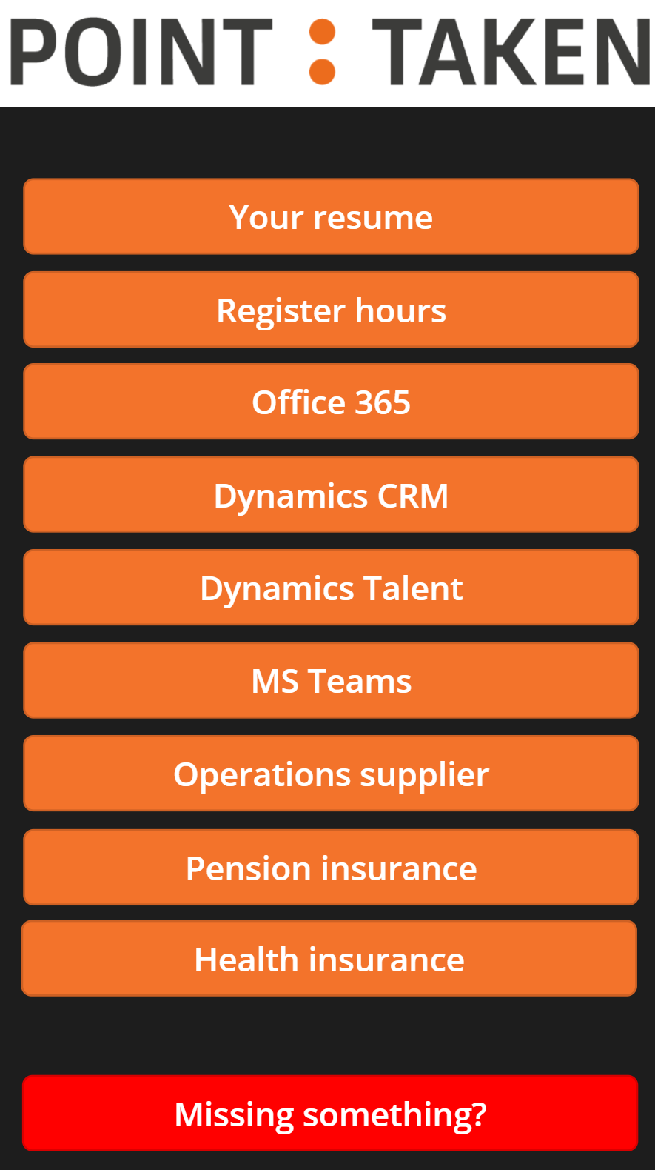

Slide 50
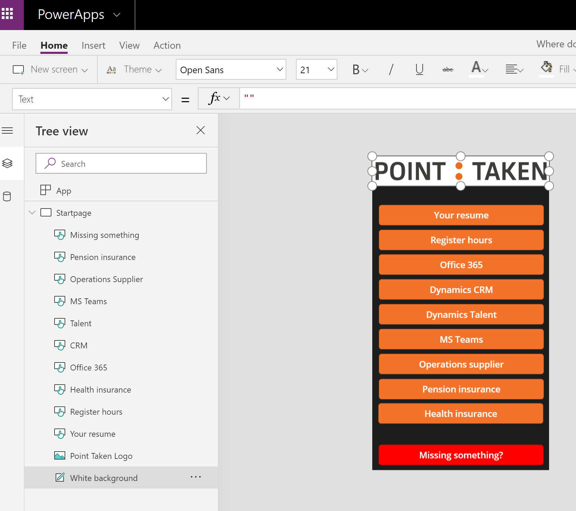

Slide 51
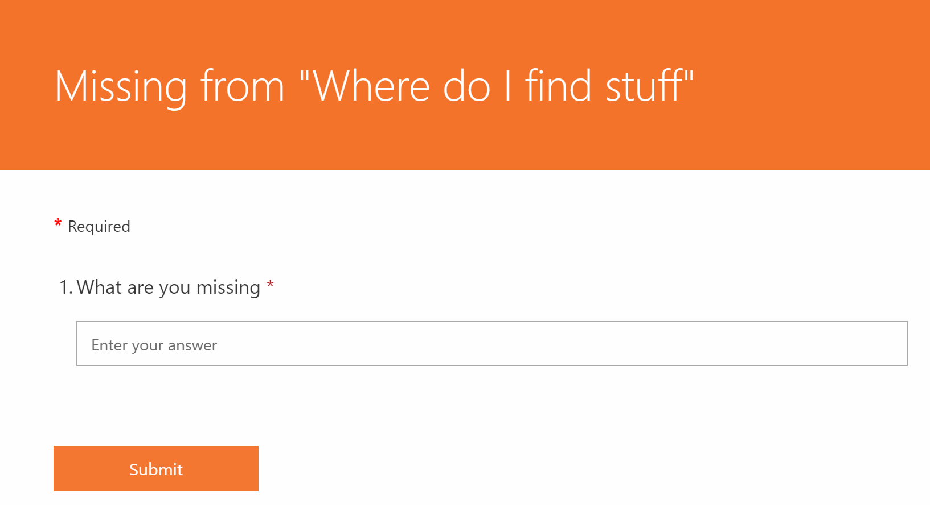

Slide 52

What is Flow?
Microsoft Flow is cloud-based software that allows employees to create and automate workflows and tasks across multiple applications and services without help from developers. Automated workflows are called flows. Once a flow is built, it can be managed on the desktop or through an app on a mobile device.

Slide 53
Flow
New applicant
Out Sick
Panic Button
Weather app
Recruiting

Slide 54
Out sick
Make it easy to report
Have an updated calendar

Slide 55
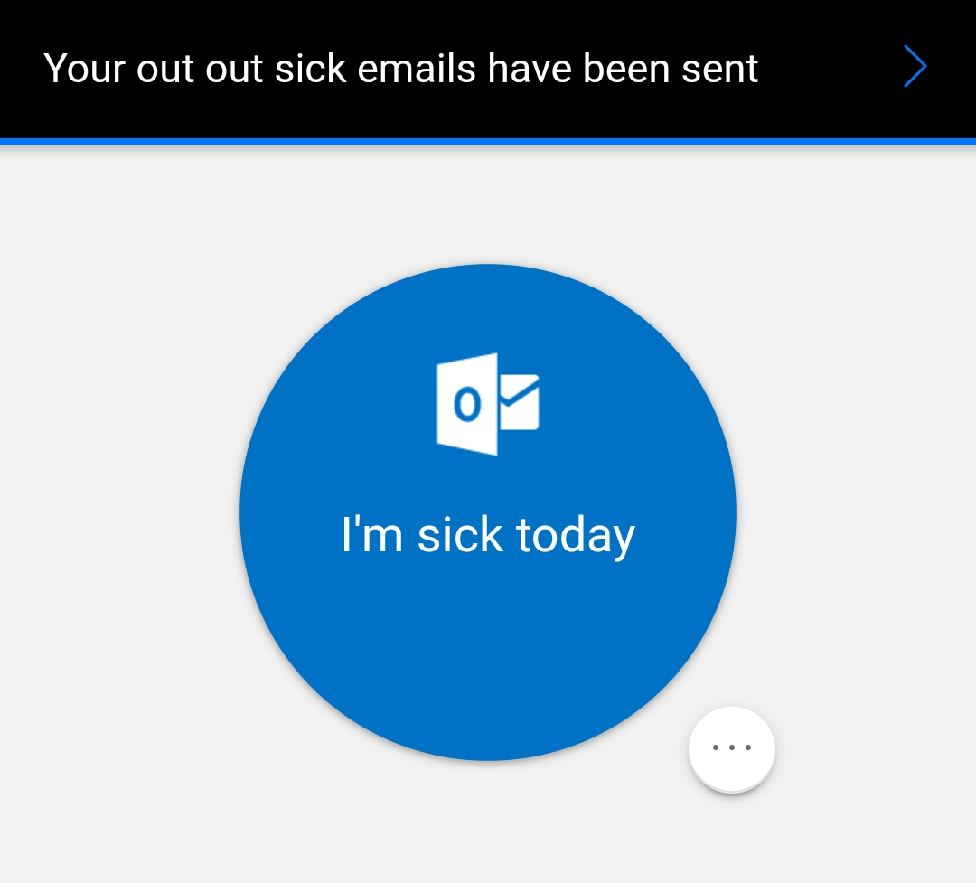

Slide 56
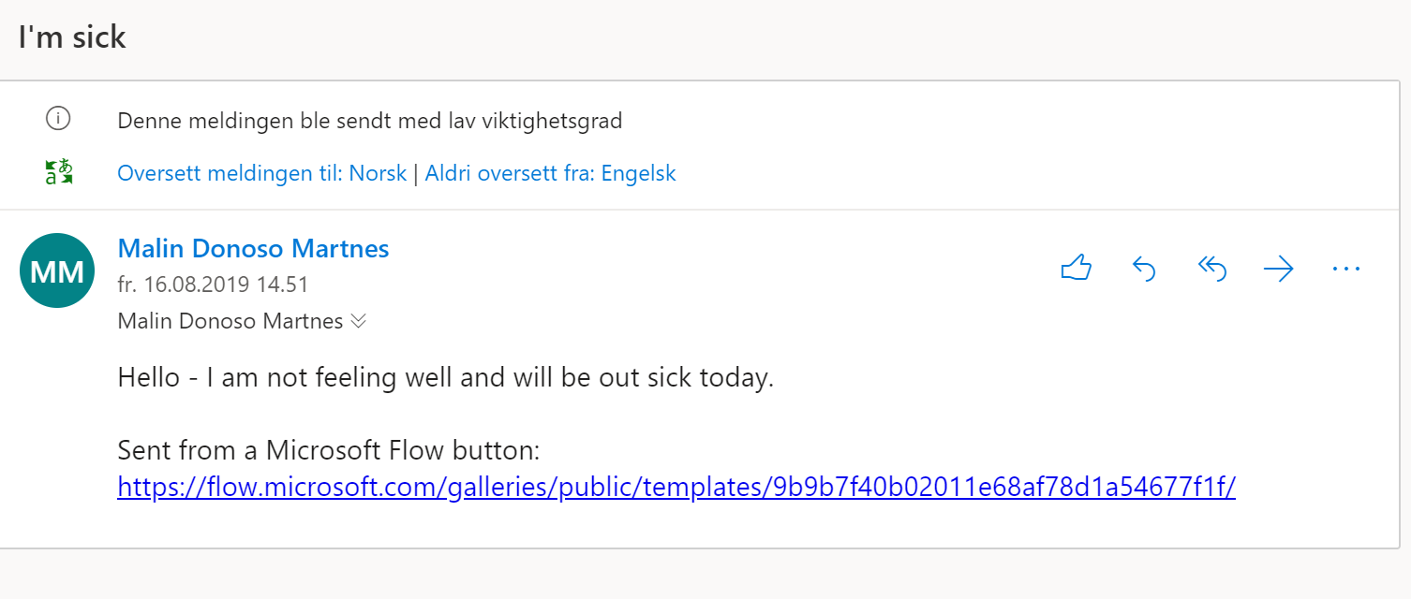

Slide 57
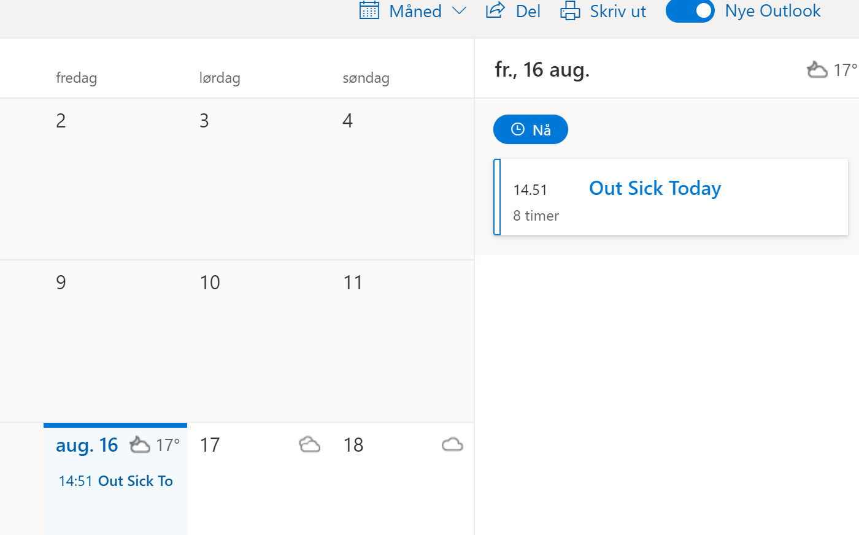

Slide 58
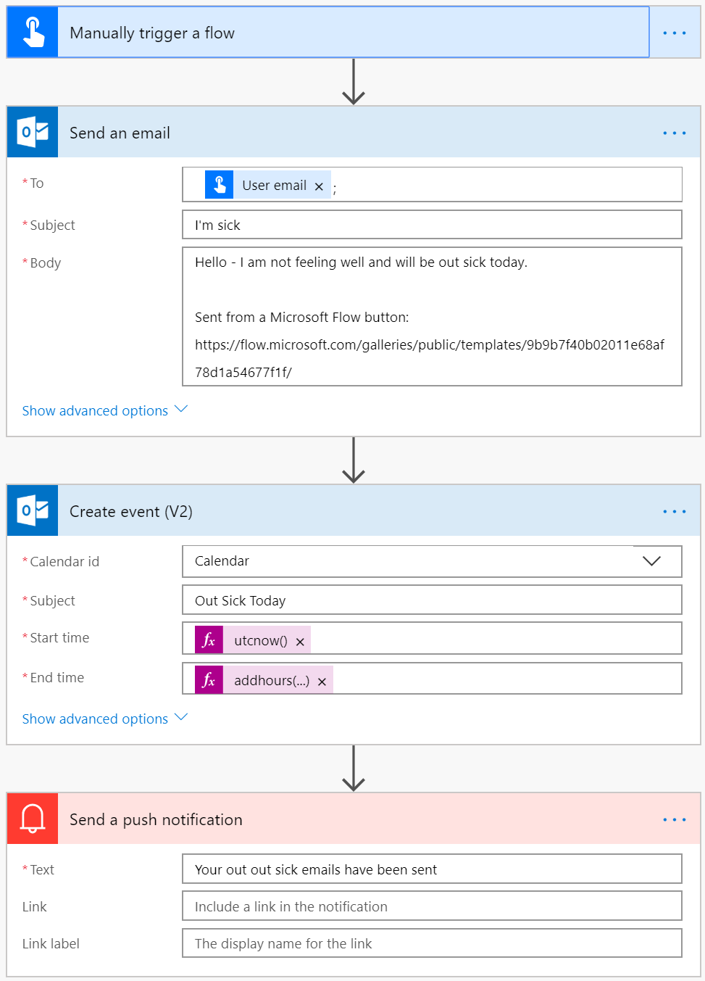

Slide 59
Panic button
For unsafe situations
Matter of life and death

Slide 60
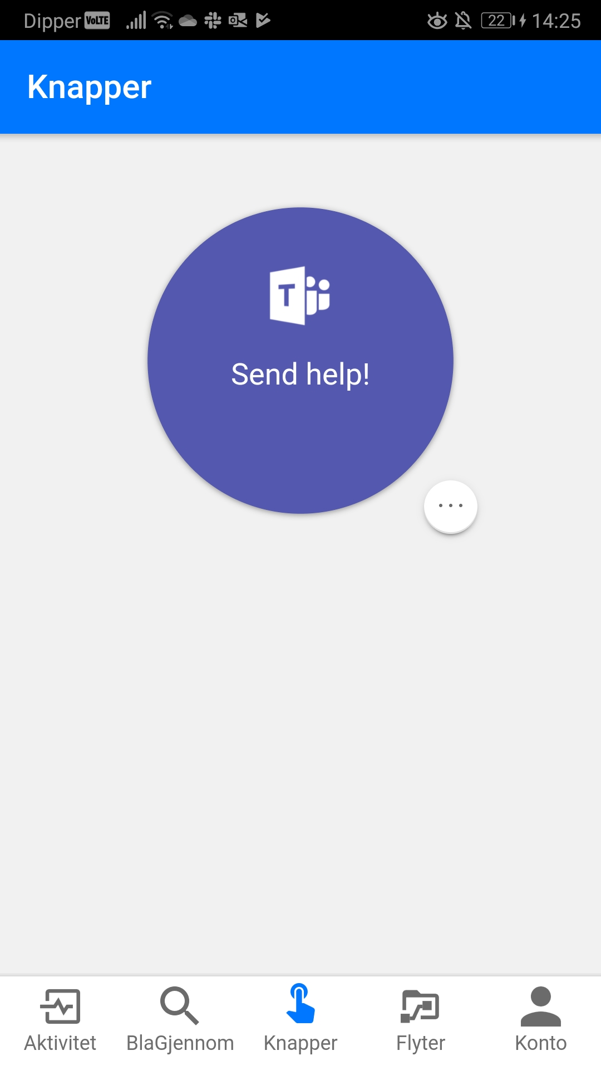
Notes:
Security for your employees

Slide 61
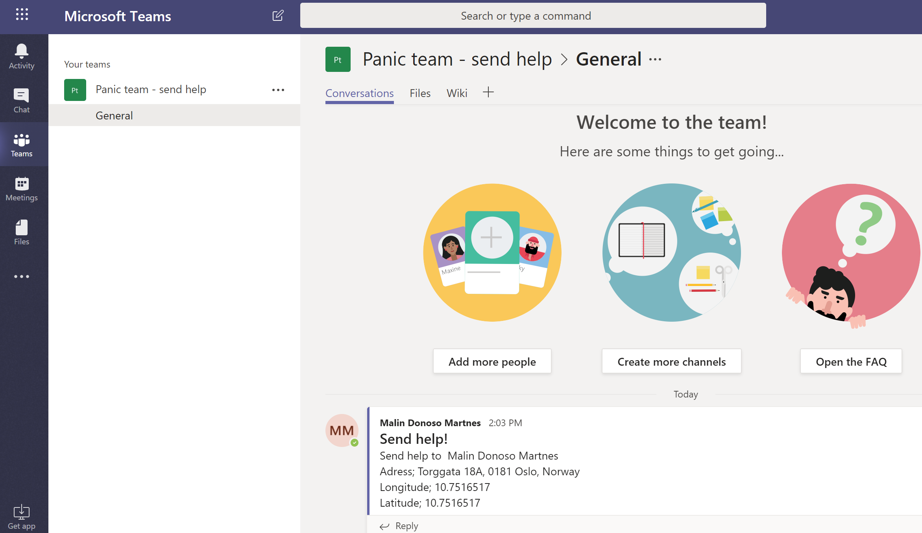
Notes:
Security for your employees

Slide 62
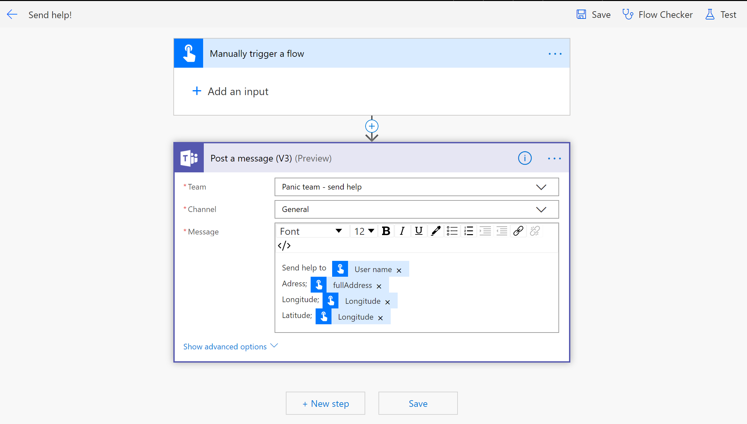
Notes:
Security for your employees

Slide 63
Weather app
What’s the weather like?

Slide 64
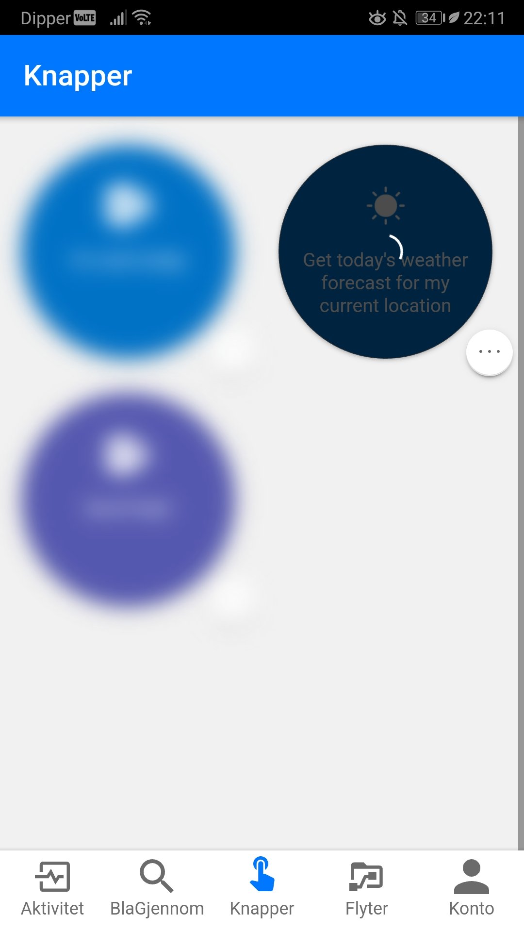
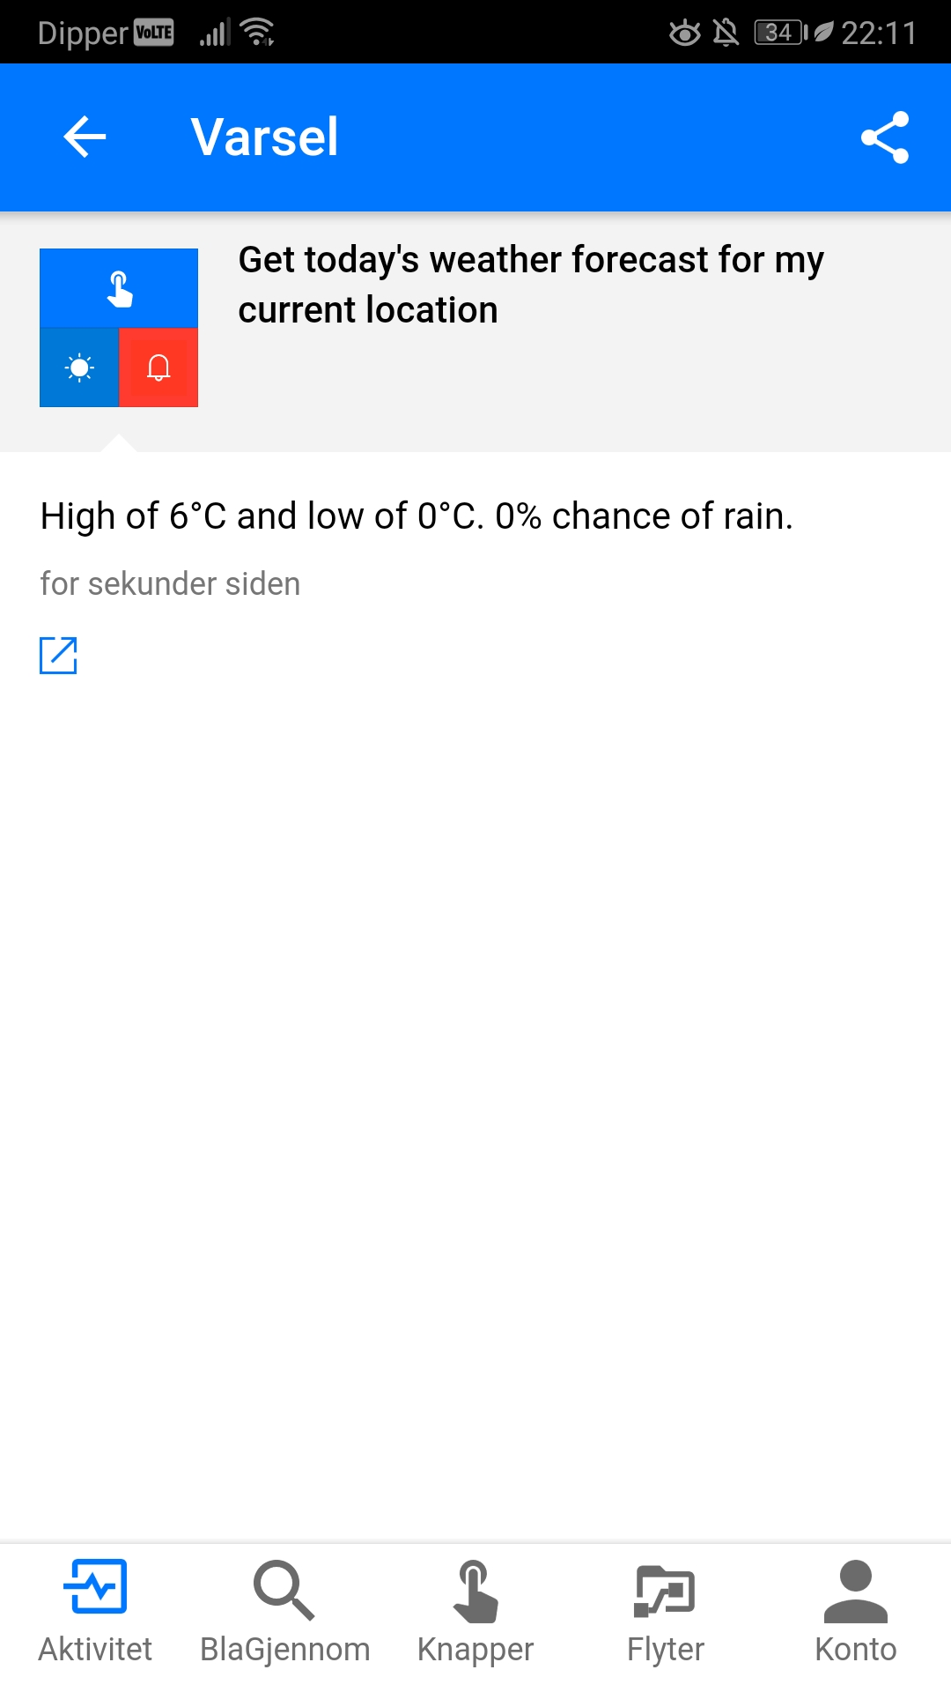
Notes:
Security for your employees

Slide 65


Notes:
Security for your employees

Slide 66
Recruiting
Magic when MS Form submitted

Slide 67
Notes:
Simple solution if you don’t need Attract. Saved in CDS or in Excel, could be sent on e-mail. We are setting up our recruiting this way as we speak.

Slide 68


Notes:
Security for your employees

Slide 69

Notes:
Security for your employees

Slide 70

This is Runar now!

Slide 71







Contact information
https://malinsdynamics365fortalent.com/
https://www.linkedin.com/in/malinmartnes/
https://twitter.com/MalinMartnes - @MalinMartnes
Malin_martnes@hotmail.com / mdm@pointtaken.no
https://www.meetup.com/Women-in-Dynamics/
http://tiny.cc/MalinMVP

Slide 72
Answer the survey please

Slide 73



@D365UG #D365Focus
Thank You!
FOLLOW
LIKE
SHARE
@MalinMartnes #LetstalktTalent

Slide 74


