Slide 2
The ABC of a Talent project
Malin Donoso Martnes
@MalinMartnes

Slide 3

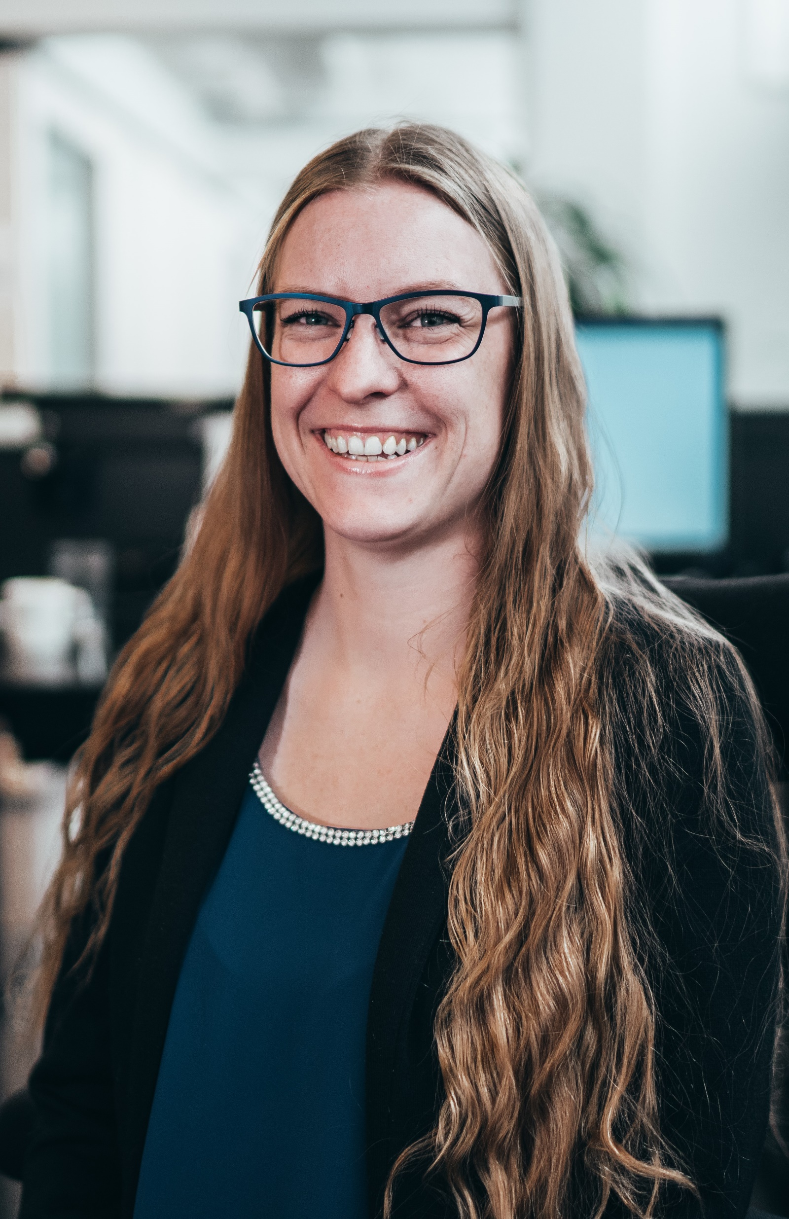

About me
Education in marketing
User in Dynamics CRM from 2009
Consultant in Dynamics CRM from 2014
Point Taken AS from February 2018
Talent from Mars 2018
#2 in the world to pass MB6-898 Talent
Run the Norwegian group Women in Dynamics
First and only MVP with a focus on Talent

Slide 4
Menti.com
Who are you?

Slide 5
What will you learn?
Start your own talent project with confidence
How entities are connected
Start setting up a new environment

Slide 6
My first Talent project!
Sold late spring 2018 – estimated 21 days
Project start June 2018
System completed October 2018
Project failed June 2019
Notes:
Lets go back to the summer of 2018

Slide 7
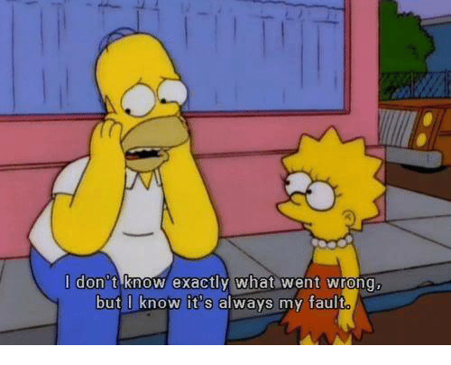
What went wrong?
Notes:
And it was my fault

Slide 8
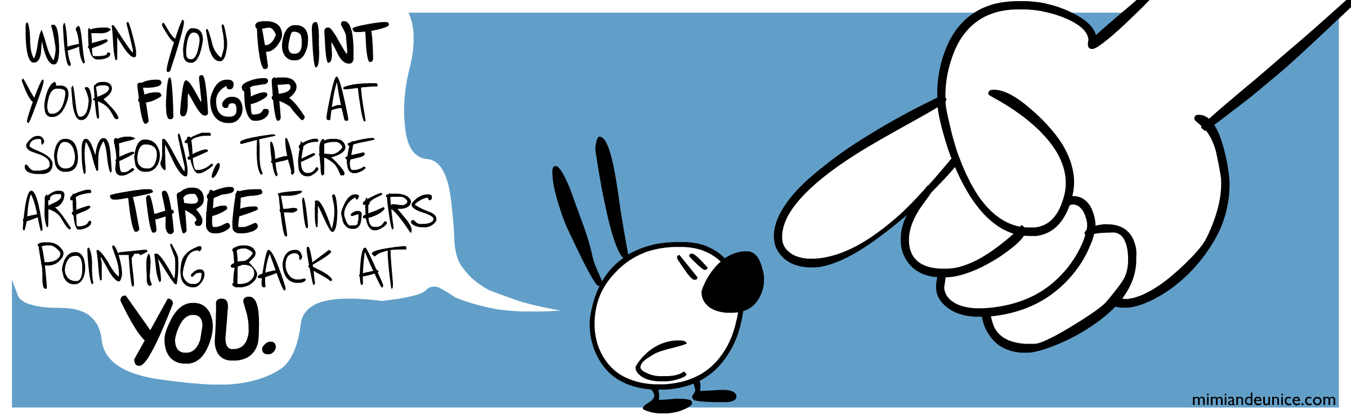
Who is to blame?

Slide 9

People
Notes:
Some fear technology. Unfortunately in my first project we had the first kind, and we should have almost doubled the estimate to hold their hand.

Slide 10
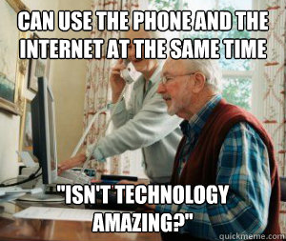
People
Notes:
some have want to know more but are still a bit behind others love technology

Slide 11

People
Notes:
Some fear technology, some have want to know more but are still a bit behind others love technology
Unfortunately in my first project we had the first kind, and we should have almost doubled the estimate to hold their hand.

Slide 12

People
Notes:
People are different, some more different then others. We didn’t think about that in the estimates.

Slide 13
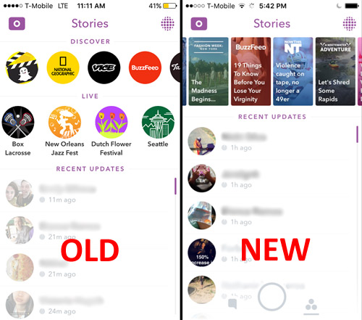

Old vs new
Snapchat - 190 million daily active users
Notes:
You can have ppl that love the system
You are dealing with people that are used to another system and change never comes easy, how can you work around that?
New Snapchat 2018

Slide 14
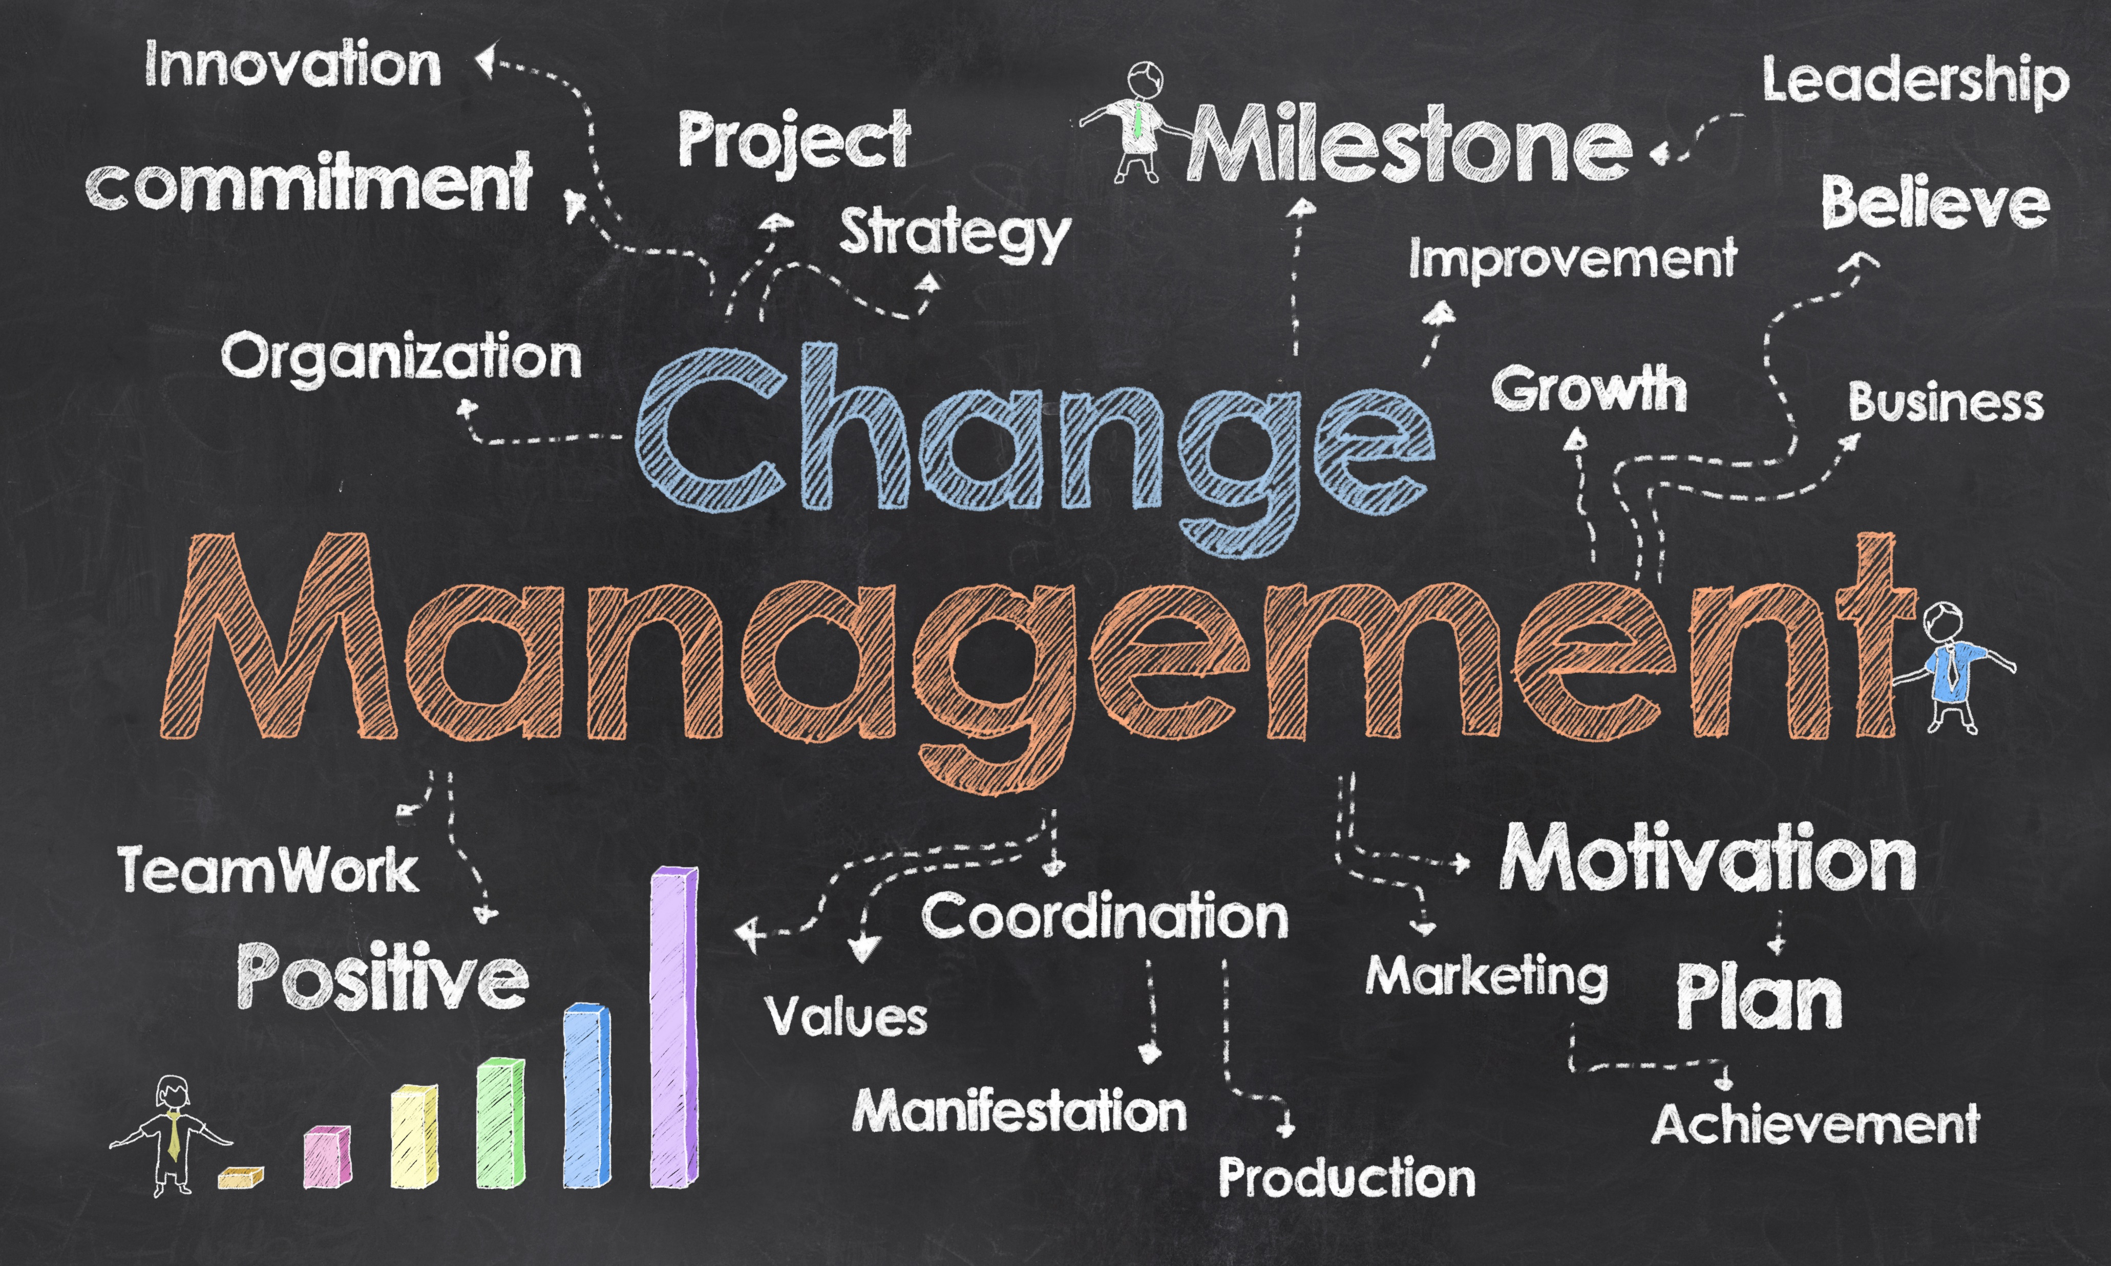
Old vs new
Notes:
You can have ppl that love the system
You are dealing with people that are used to another system and change never comes easy, how can you work around that?
New Snapchat 2018

Slide 15
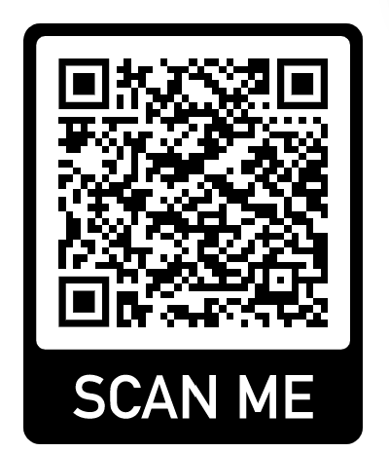
Underestimated the complexity of Talent
https://docs.microsoft.com/en-us/dynamics365/unified-operations/talent/corehrentities
Not all entities on CDS (yet)

Slide 16
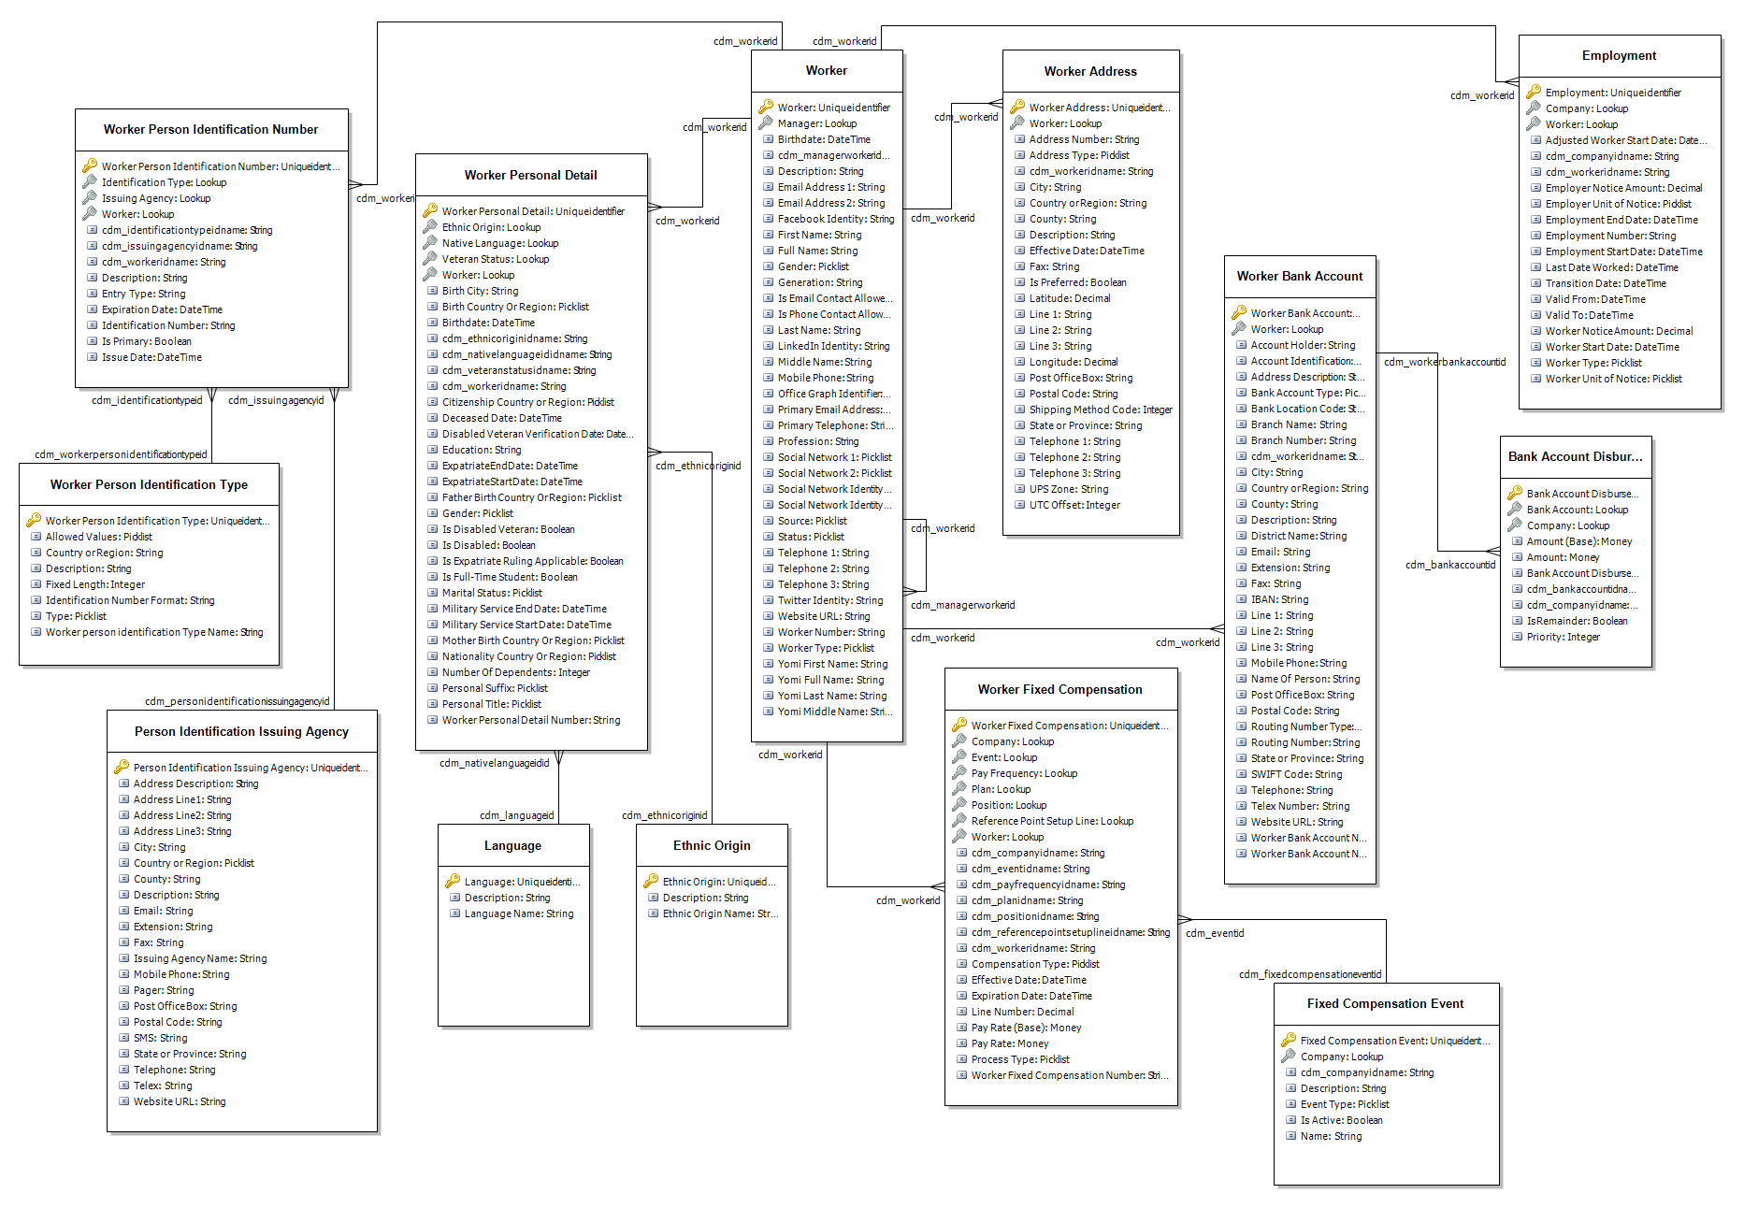
Notes:
Worker

Slide 17
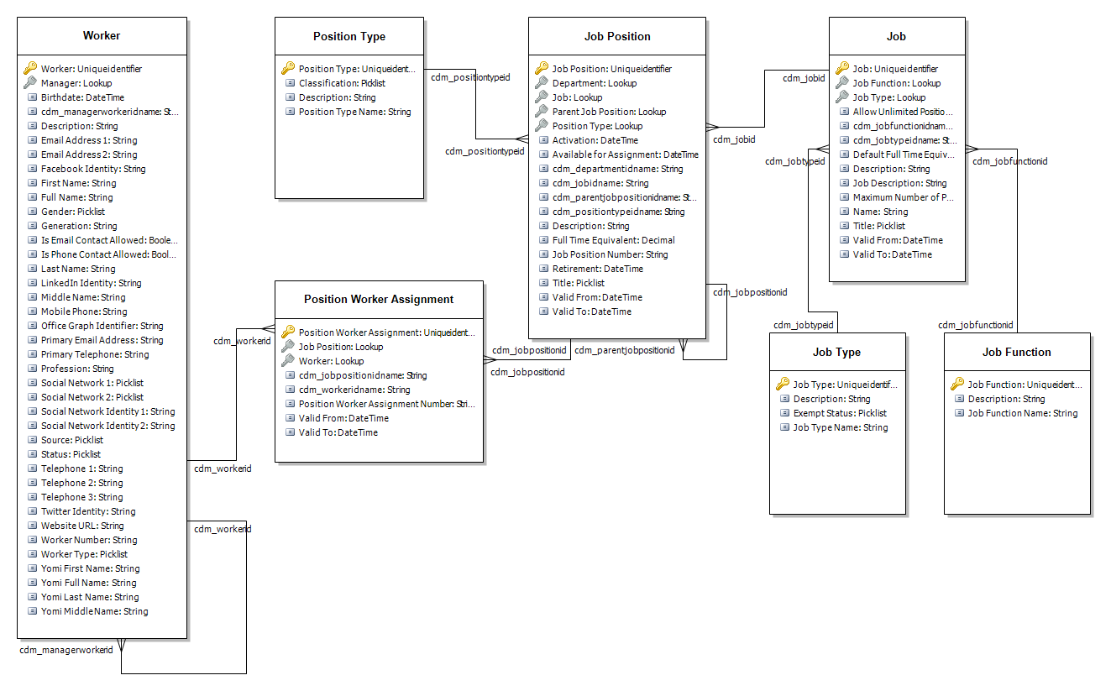
Notes:
Job and job position

Slide 18
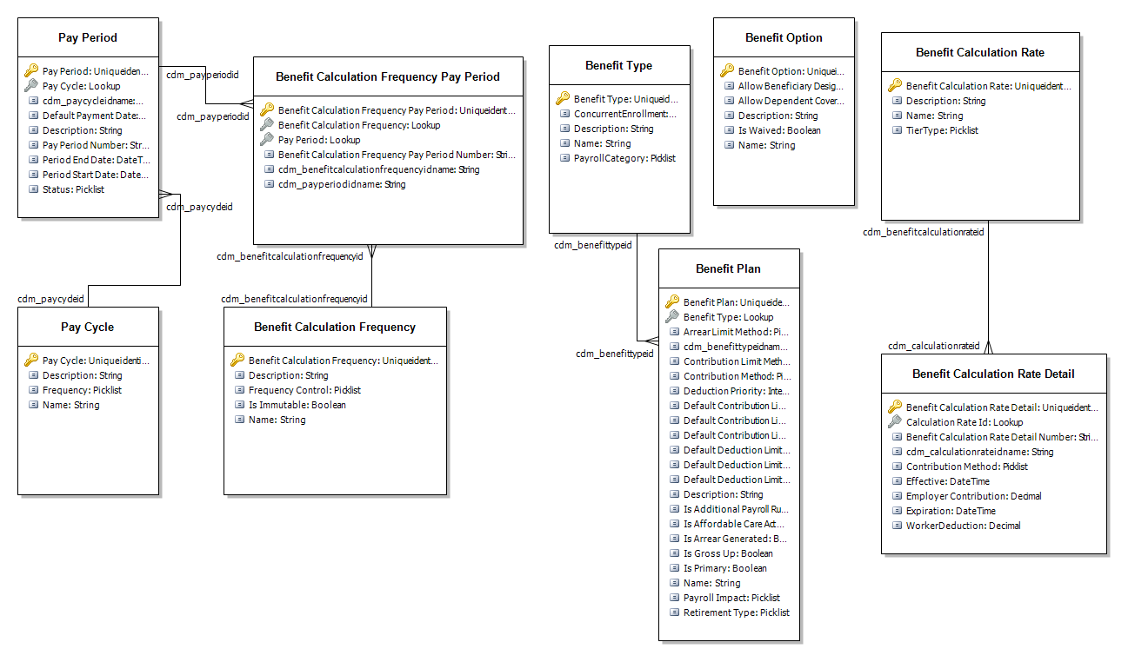
Notes:
Benefits

Slide 19

Underestimated the system as the HR-foundation

Slide 20

What should you do?

Slide 21
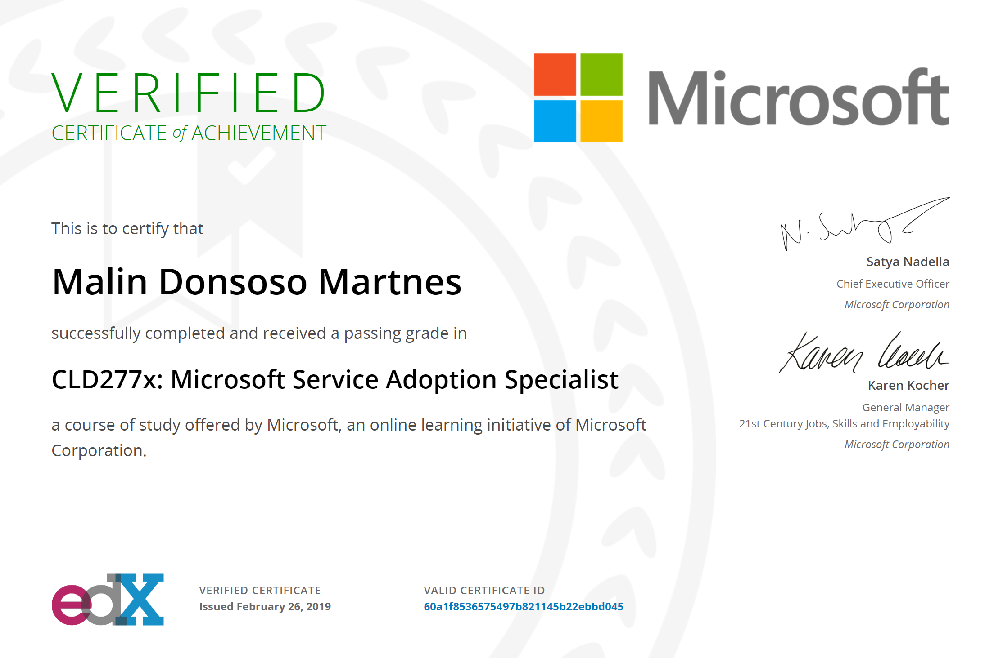
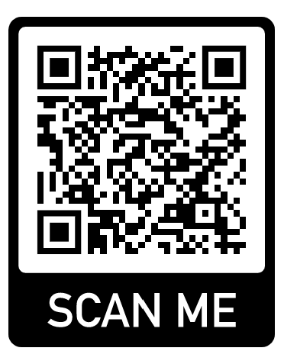
Microsoft Service Adoption Specialist
https://www.edx.org/course/microsoft-service-adoption-specialist-5

Slide 22
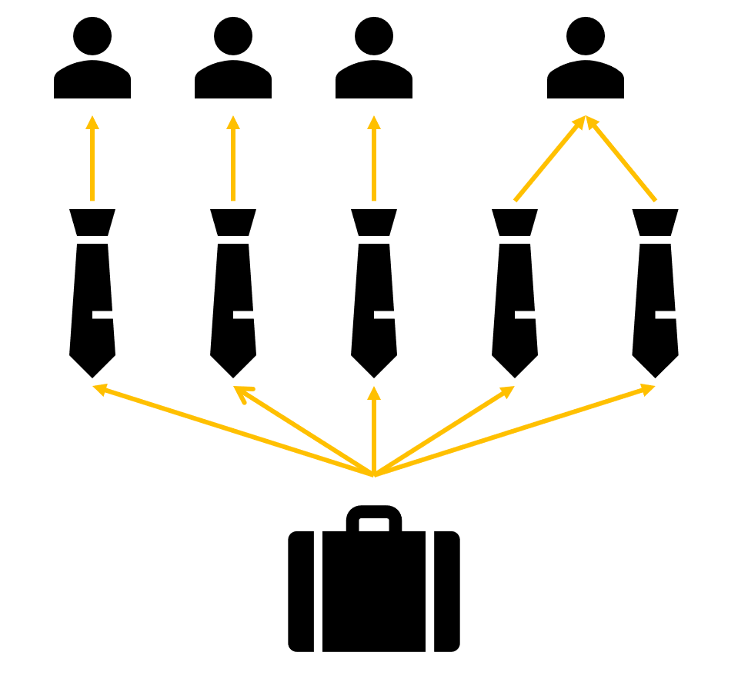
How entities are connected
Worker
Position
Job
Notes:
Right click – view details – go directly to the page you need to fill inn information

Slide 23
Connected entities - job
Certificates
Education
Work tasks
ADA requirements
Screening
Tests
Title
Compensation
Skills
Job type
Job family
Function
Area of responsibility
Notes:
Skills also requires Skill rating and Skill type

Slide 24
Connected entities - job
Certificates
Education
Work tasks
ADA requirements
Screening
Tests
Compensation
Job type
Job family
Function
Area of responsibility
Title
Skills
Notes:
Skills also requires Skill rating and Skill type

Slide 25
Connected entities - position
Company
Department
Title
Position type
Compensation region
Job family
Labor union
Legal entities
Distribution template
Cost center
Payroll
Notes:
Payroll Pay cycle and Paid by (company)

Slide 26
Connected entities - position
Company
Department
Payroll
Position type
Labor union
Cost center
Job family
Legal entities
Distribution template
Compensation region
Title
Notes:
Payroll Pay cycle and Paid by (company)

Slide 27
Connected entities - Worker
Company
Title
Personal title
Personal suffix
Address books
Marital status
Language
Ethnic origin
Veteran status
Native language
Notice unit
Calendar
Regulatory establishment
Affordable care act
CostCenter
Notes:
Personal title (Miss, DR., MR., Mrs., Ms.)

Slide 28
Connected entities - Worker
Company
Title
Address books
Language
Native language
Calendar
Regulatory establishment
Affordable care act
Marital status
Personal title
Personal suffix
CostCenter
Notice unit
Ethnic origin
Veteran status
Notes:
Personal title (Miss, DR., MR., Mrs., Ms.)

Slide 29
New environment

Slide 30
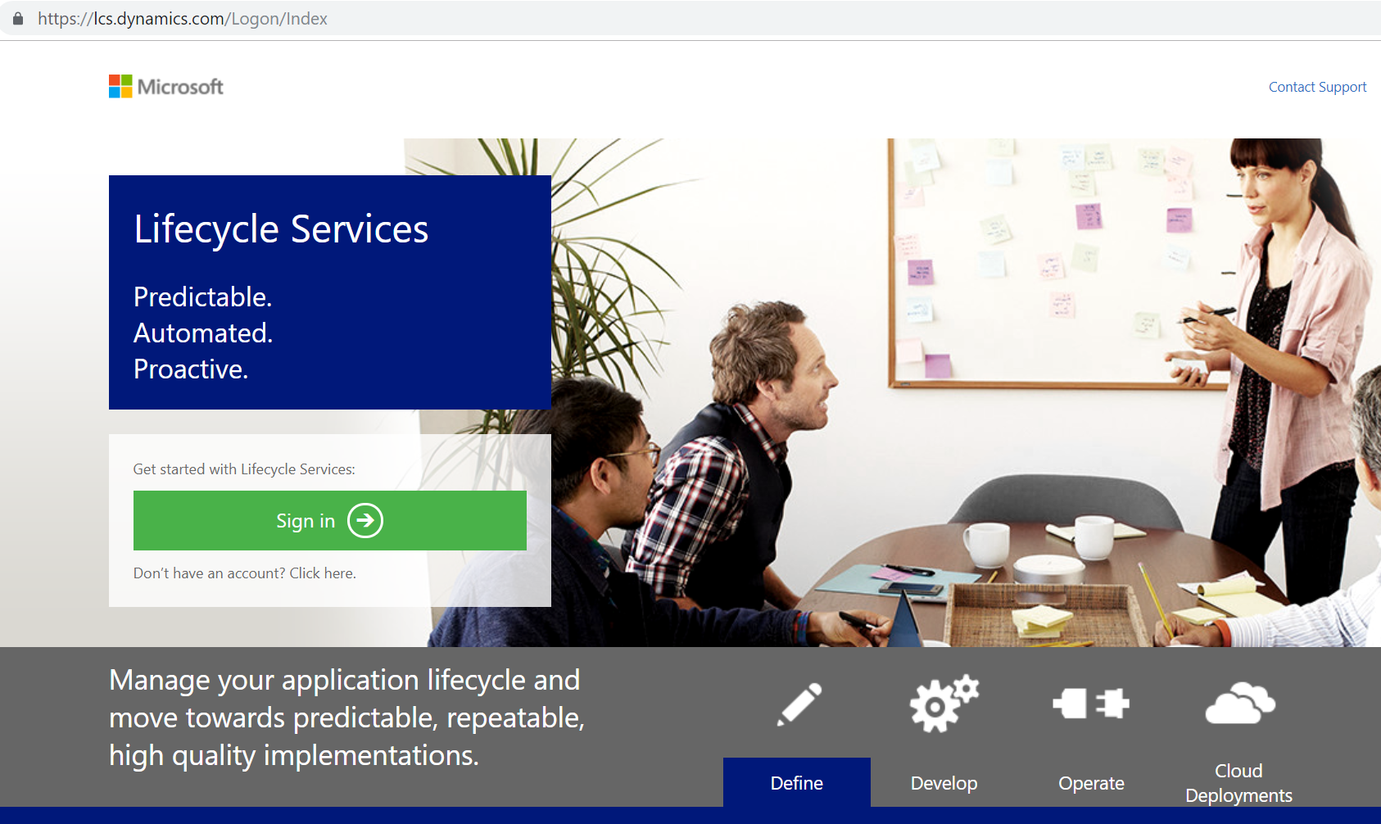

Slide 31
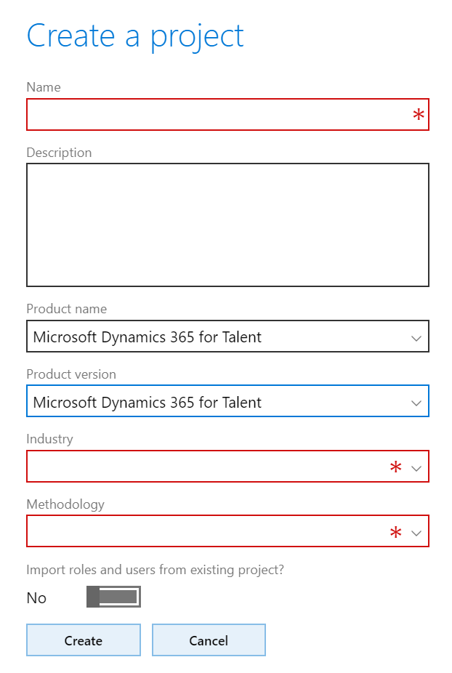
Issues?
https://malinsdynamics365fortalent.com/2018/10/24/how-to-start-and-access-your-new-talent-environment/
Buy minimum 5 full licenses and assign one to this user
Have a global admin role
Don’t use the default CDS environment
Notes:
You need to have

Slide 32
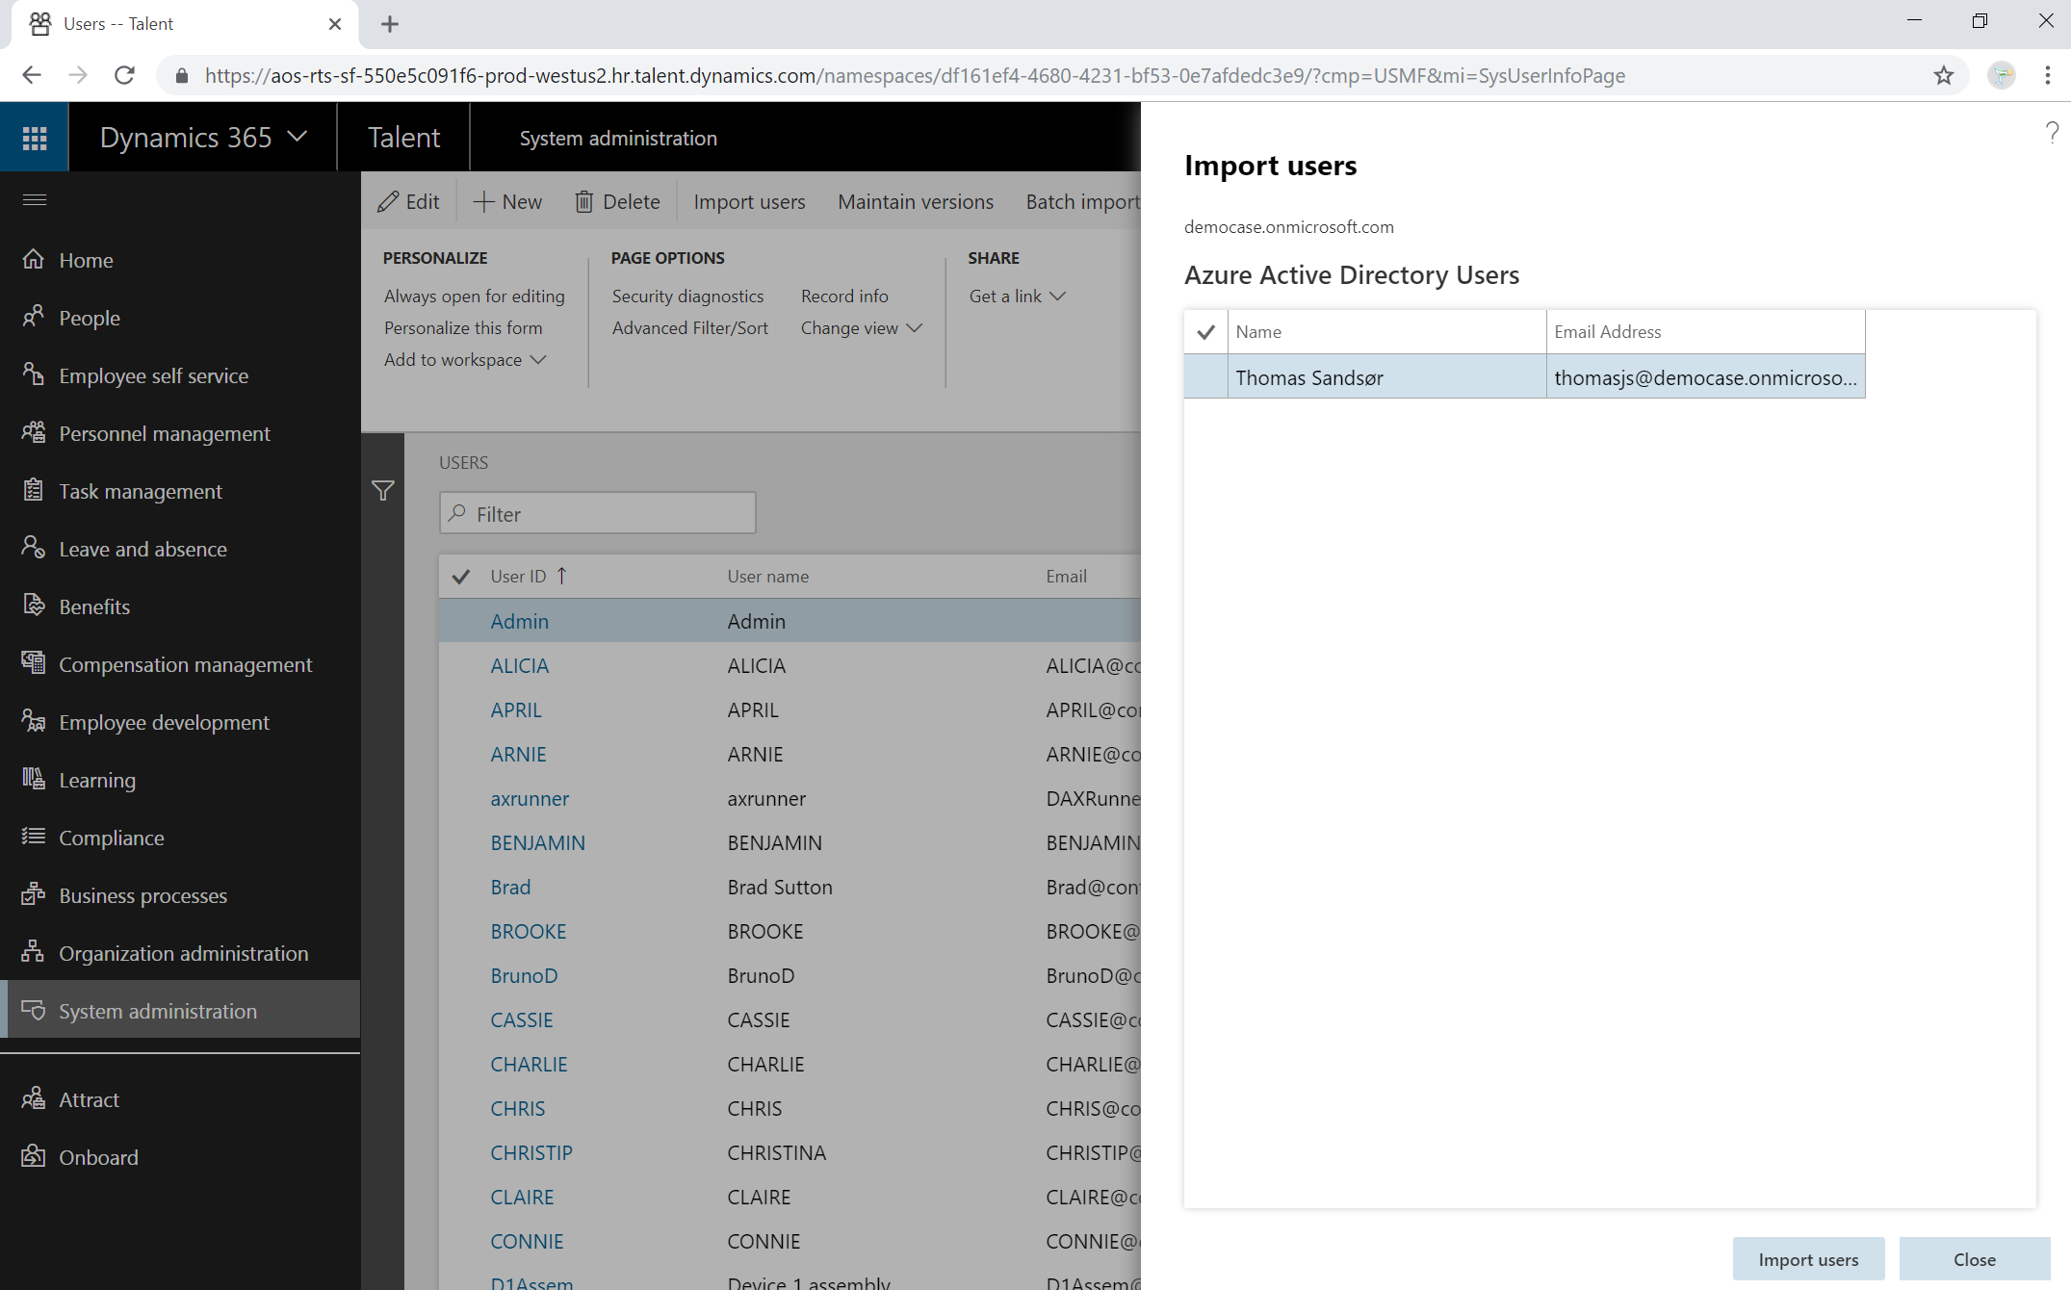

Slide 33
Done?
No

Slide 34
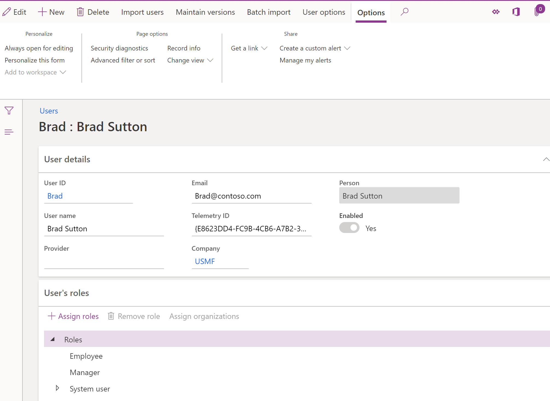

Slide 35

Notes:
How can you get the data
How is the data structured
What are you using in the system

Slide 36




Learn the system
Trials

Slide 37
Trials
Slide content.

Slide 38
Learn the system
Trials
Try the system

Slide 39
Try the system
Slide content.

Slide 40
Learn the system
Trials
Take the certification
Try the system

Slide 41
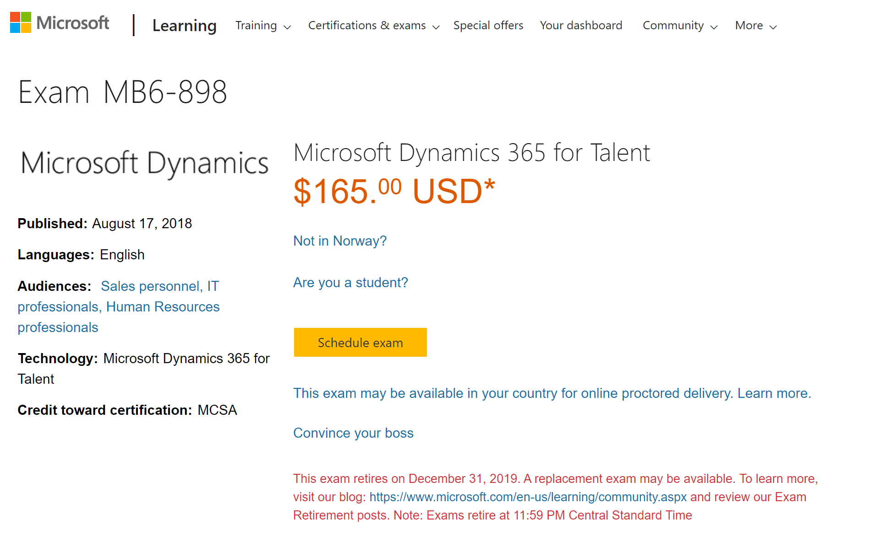
Take the certification

Slide 42
Learn the system
Trials
Take the certification
https://malinsdynamics365fortalent.com/
Try the system

Slide 43
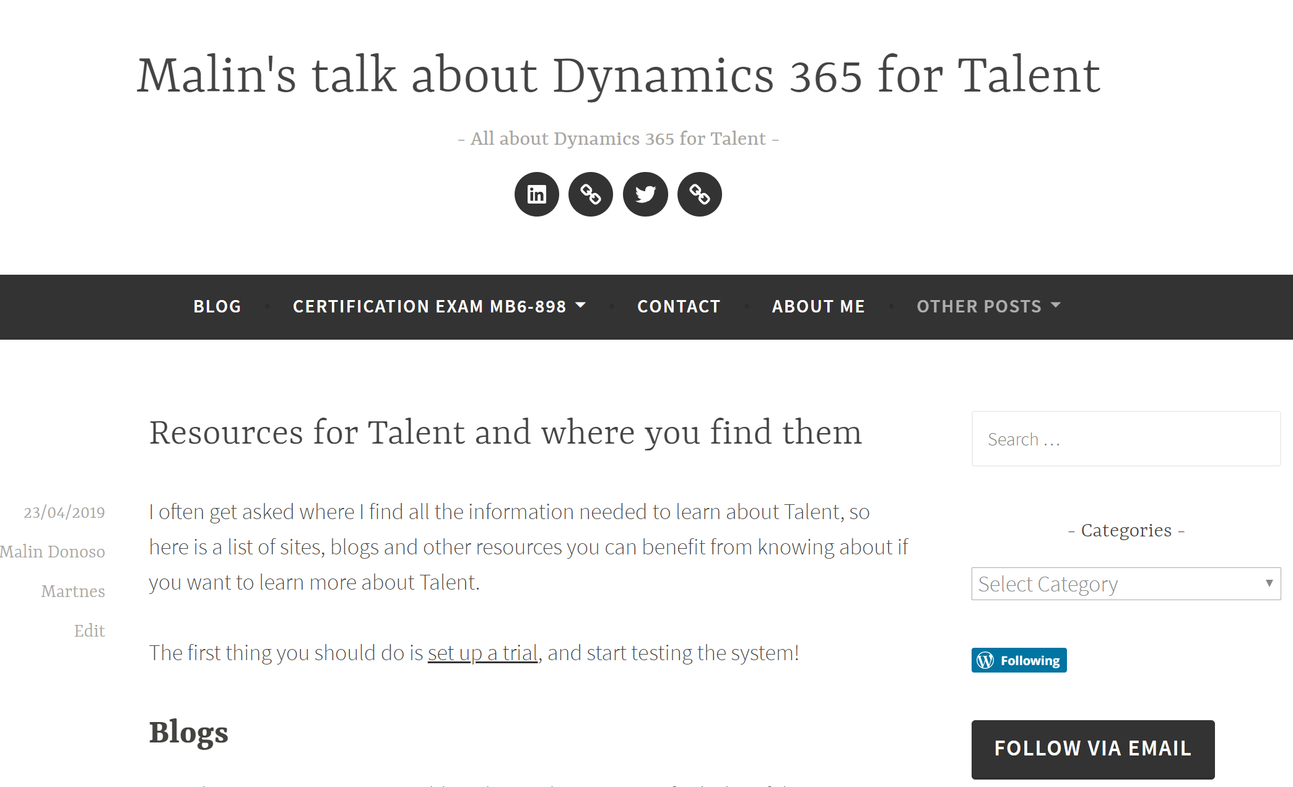
My own blog (#Shamelesspromotion)

Slide 44
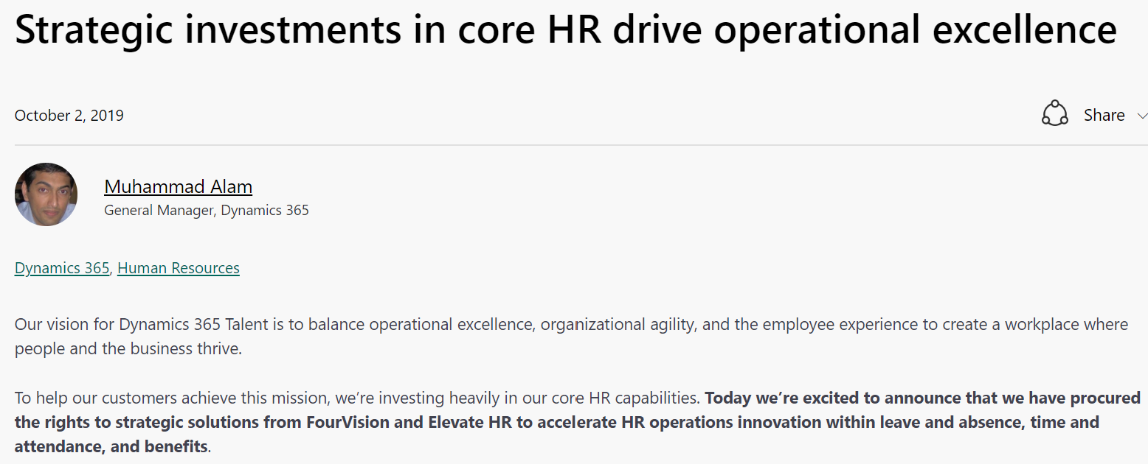
https://tinyurl.com/talentnews2october

Slide 45
Menti.com
Questions?

Slide 46







Contact information
https://malinsdynamics365fortalent.com/
https://www.linkedin.com/in/malinmartnes/
https://twitter.com/MalinMartnes - @MalinMartnes
Malin_martnes@hotmail.com / mdm@pointtaken.no
https://www.meetup.com/Women-in-Dynamics/
http://tiny.cc/MalinMVP

Slide 47
Answer the survey please

Slide 48


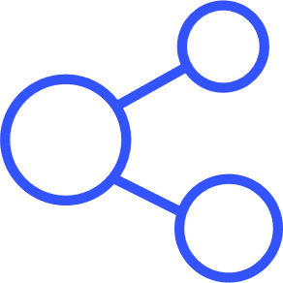
@D365UG #D365Focus
Thank You!
FOLLOW
LIKE
SHARE
@MalinMartnes #LetstalktTalent

Slide 49


