Slide 1

The ABC of a
Talent project
Malin Donoso Martnes
@MalinMartnes

Slide 2
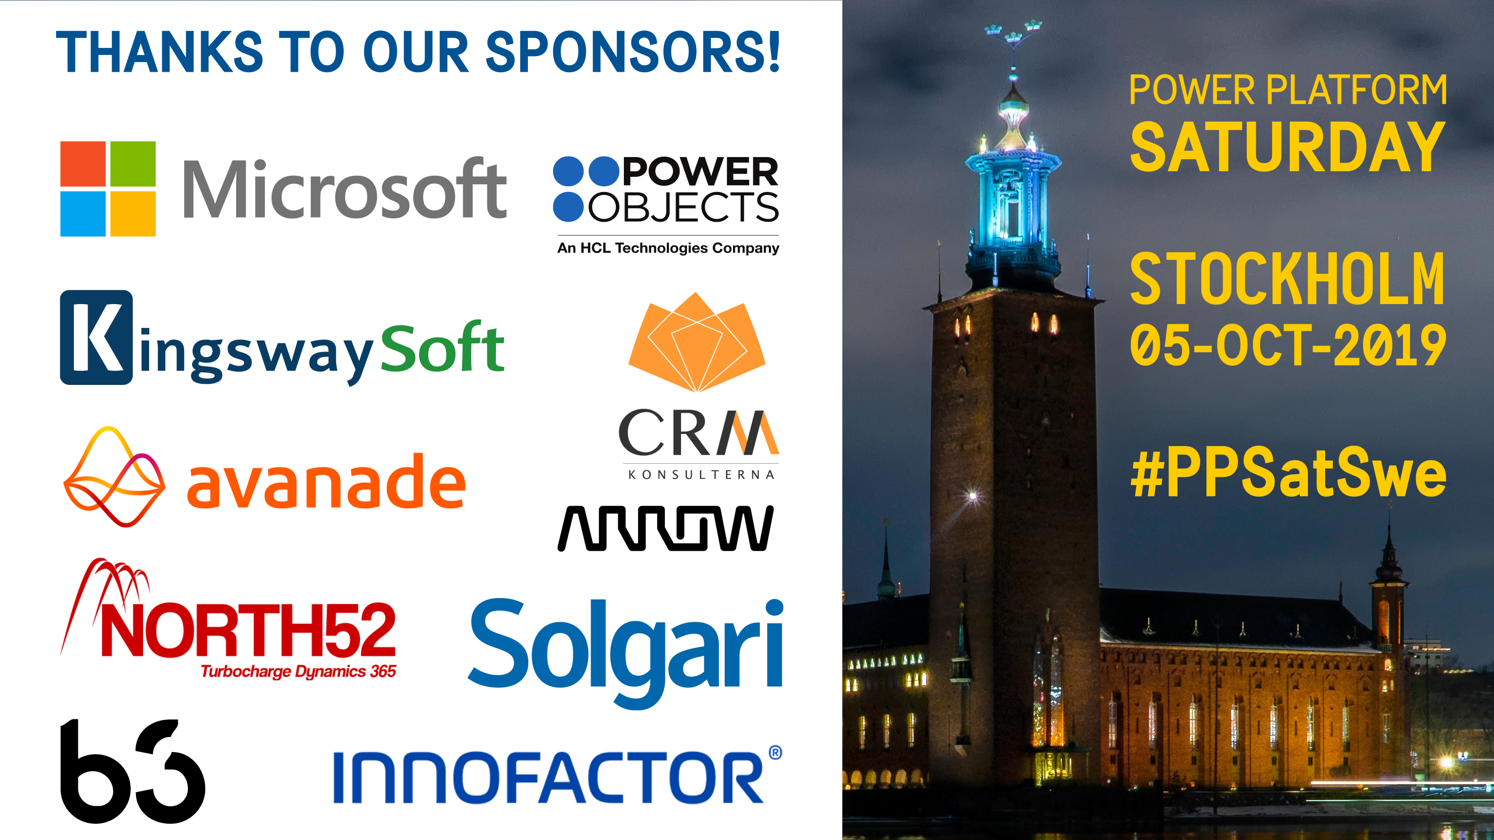

Slide 3

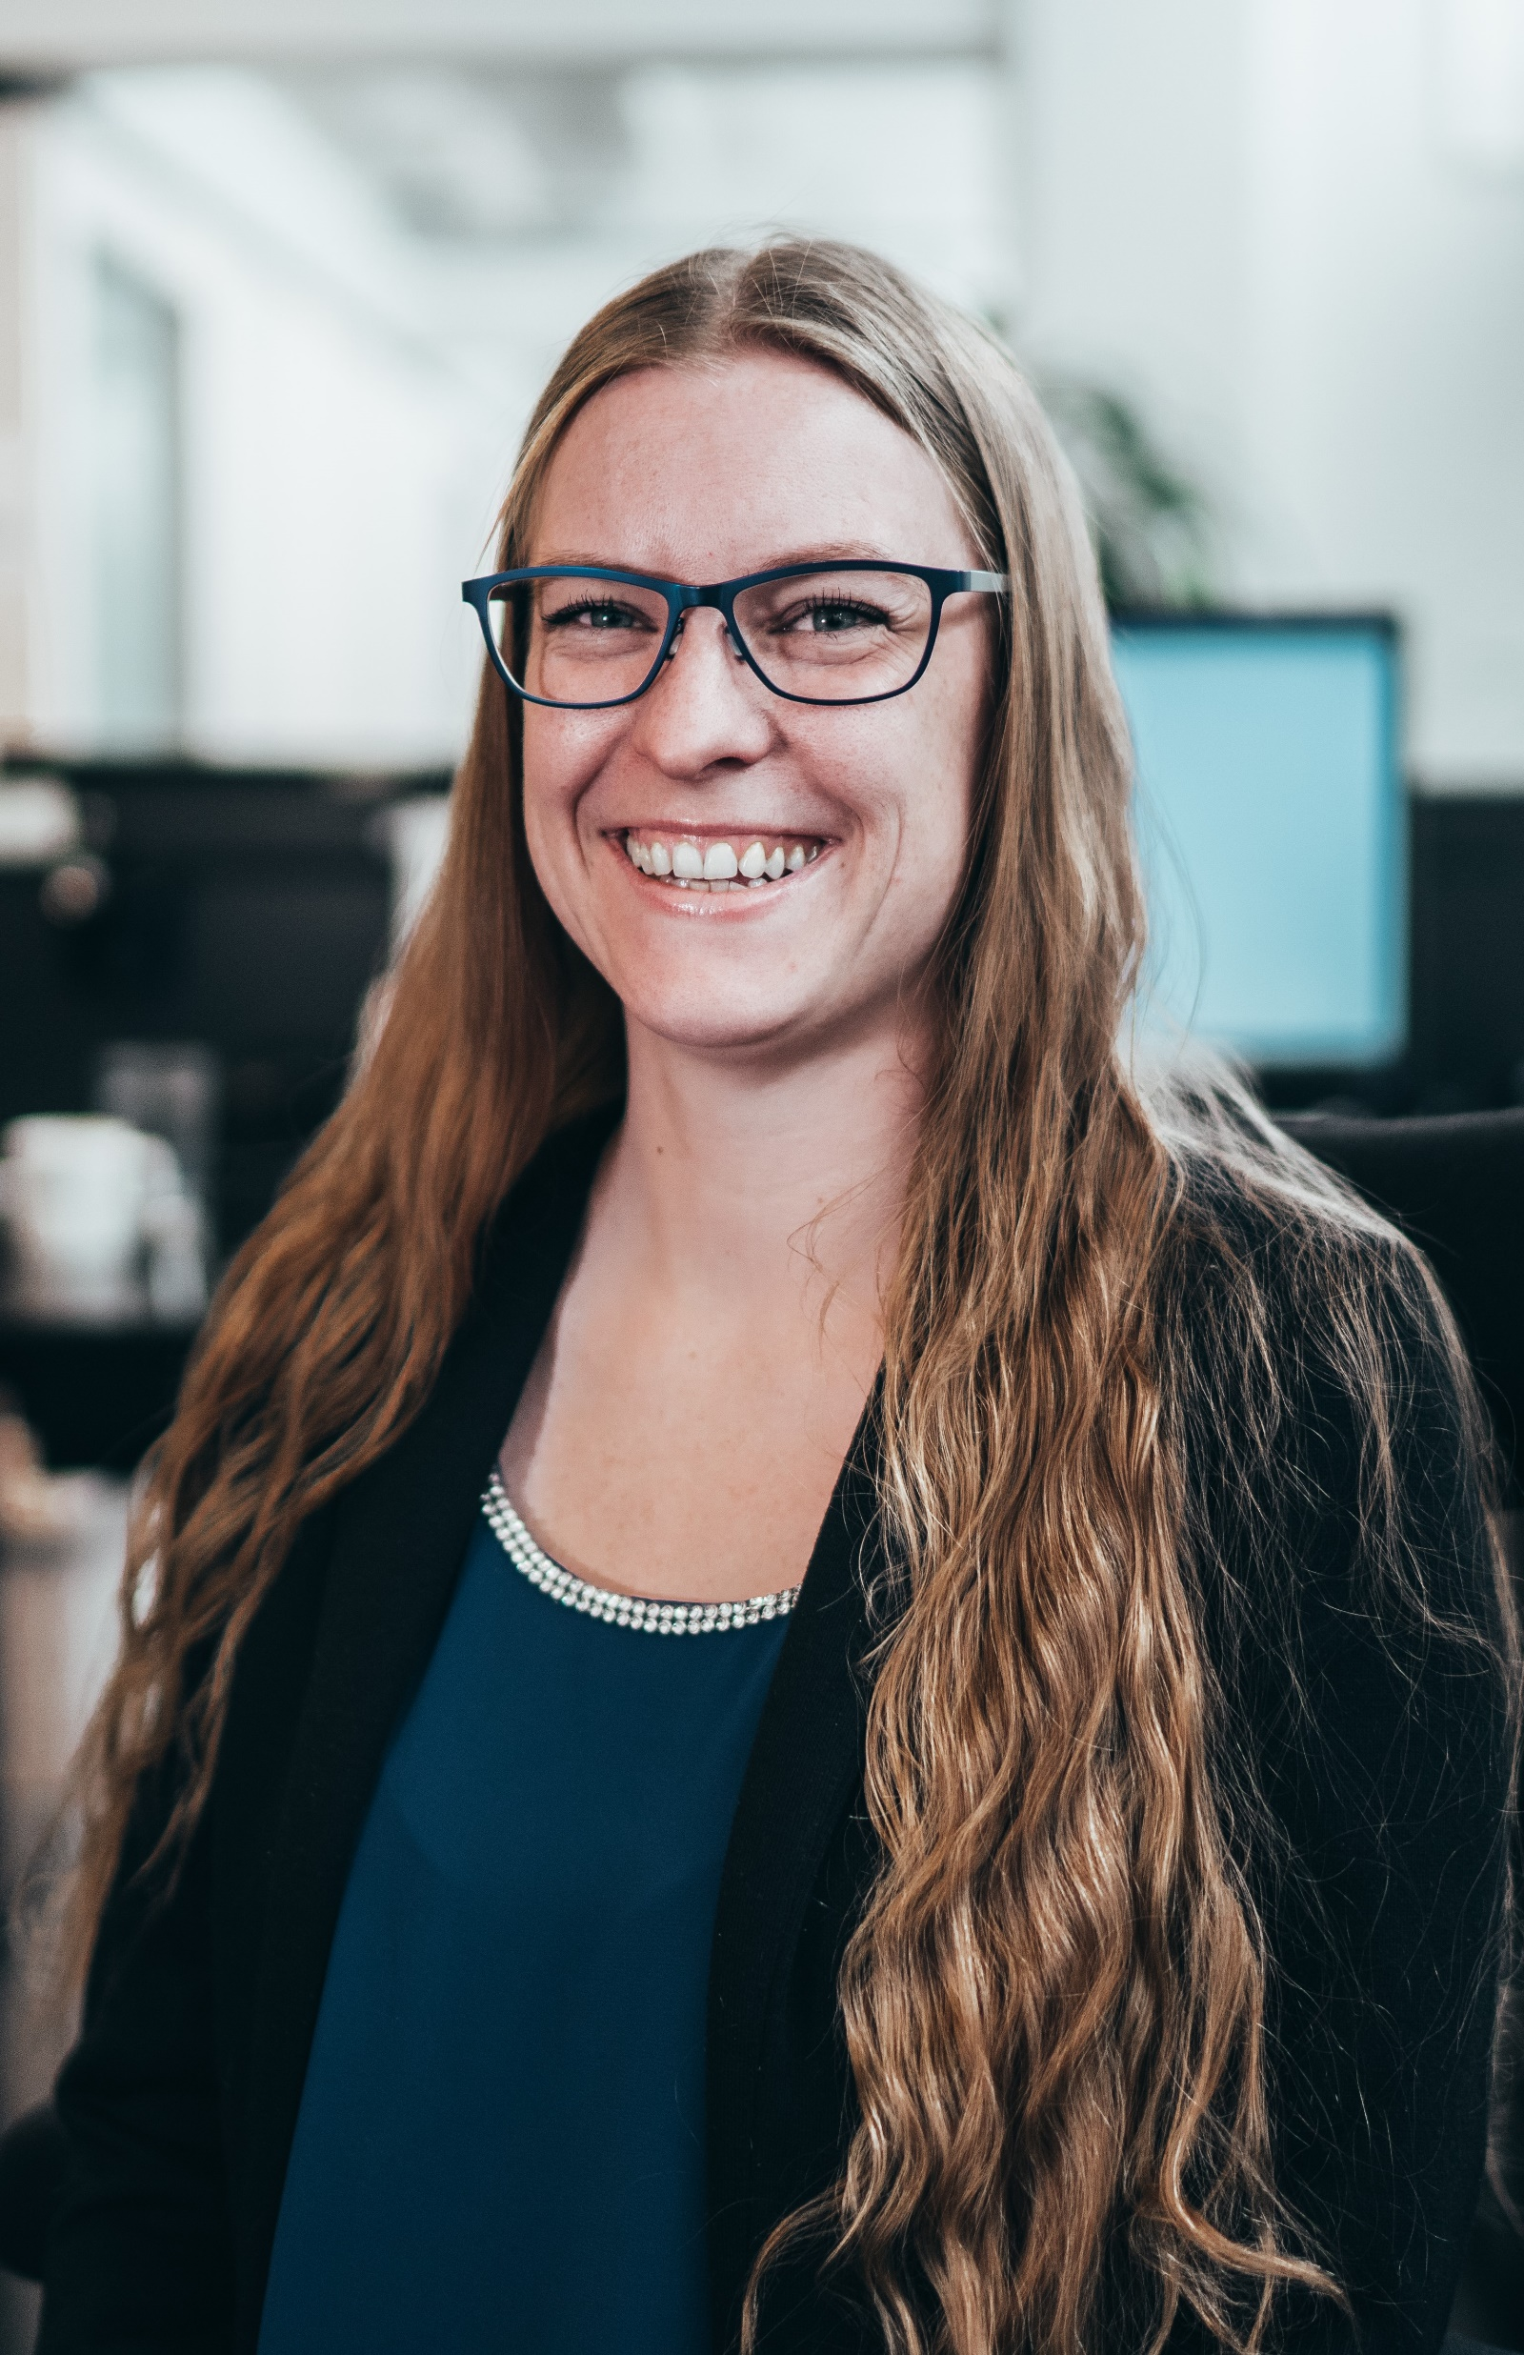

About me
Education in marketing
User in Dynamics CRM from 2009
Consultant in Dynamics CRM from 2014
Point Taken AS from February 2018
Talent from Mars 2018
#2 in the world to pass MB6-898 Talent 31.August 2018
Run the Norwegian group Women in Dynamics
First and only MVP with a focus on Talent
C
od
e

Slide 4
The first Talent project!
Sold late spring 2018 – estimated 21 days
Project start June 2018
System completed October 2018
Project failed June 2019
Notes:
Lets go back to the summer of 2018

Slide 5
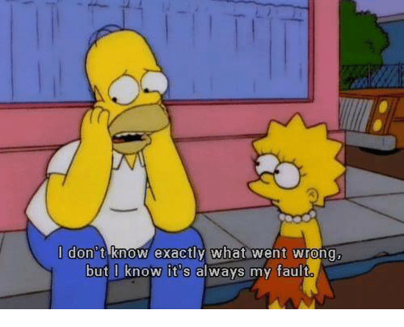
What went wrong?
Notes:
And it was my fault

Slide 6
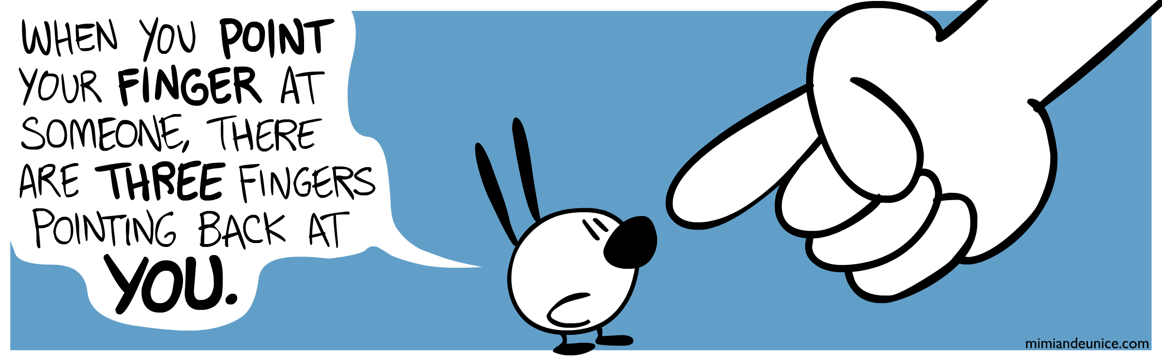
Who is to blame?

Slide 7

People
Notes:
People are different, some more different then others. We didn’t think about that in the estimates.

Slide 8

People
Notes:
Some fear technology. Unfortunately in my first project we had the first kind, and we should have almost doubled the estimate to hold their hand.

Slide 9
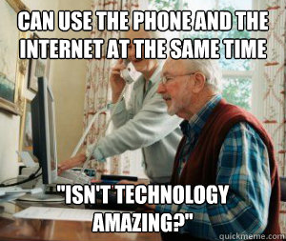
People
Notes:
some have want to know more but are still a bit behind others love technology

Slide 10

People
Notes:
Some fear technology, some have want to know more but are still a bit behind others love technology
Unfortunately in my first project we had the first kind, and we should have almost doubled the estimate to hold their hand.

Slide 11
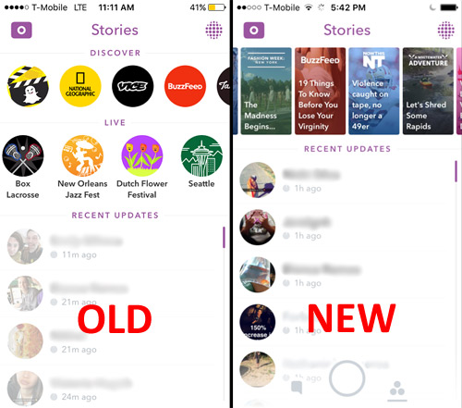

Old vs new
Snapchat - 190 million daily active users
Notes:
You can have ppl that love the system
You are dealing with people that are used to another system and change never comes easy, how can you work around that?
New Snapchat 2018

Slide 12
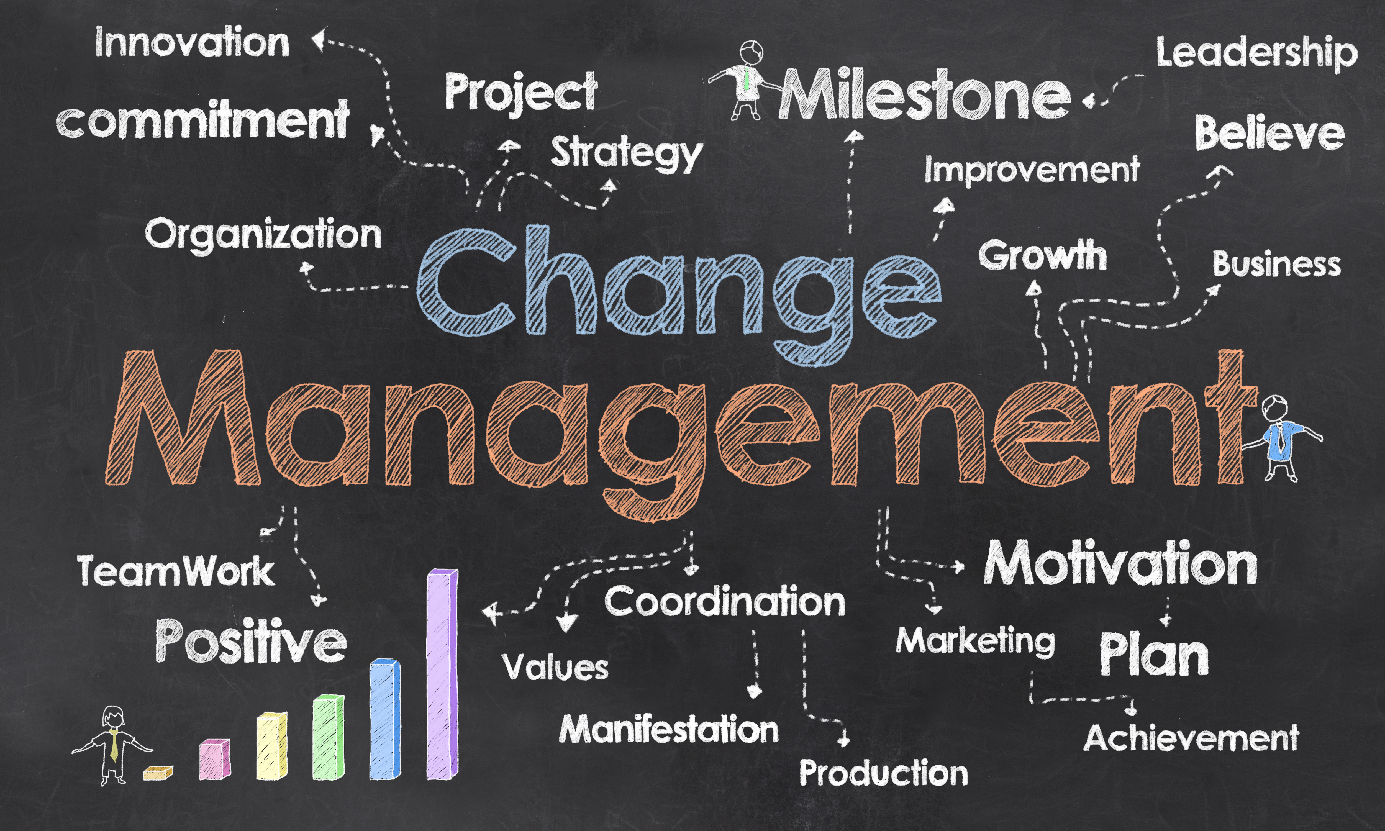
Old vs new
Notes:
You can have ppl that love the system
You are dealing with people that are used to another system and change never comes easy, how can you work around that?
New Snapchat 2018

Slide 13
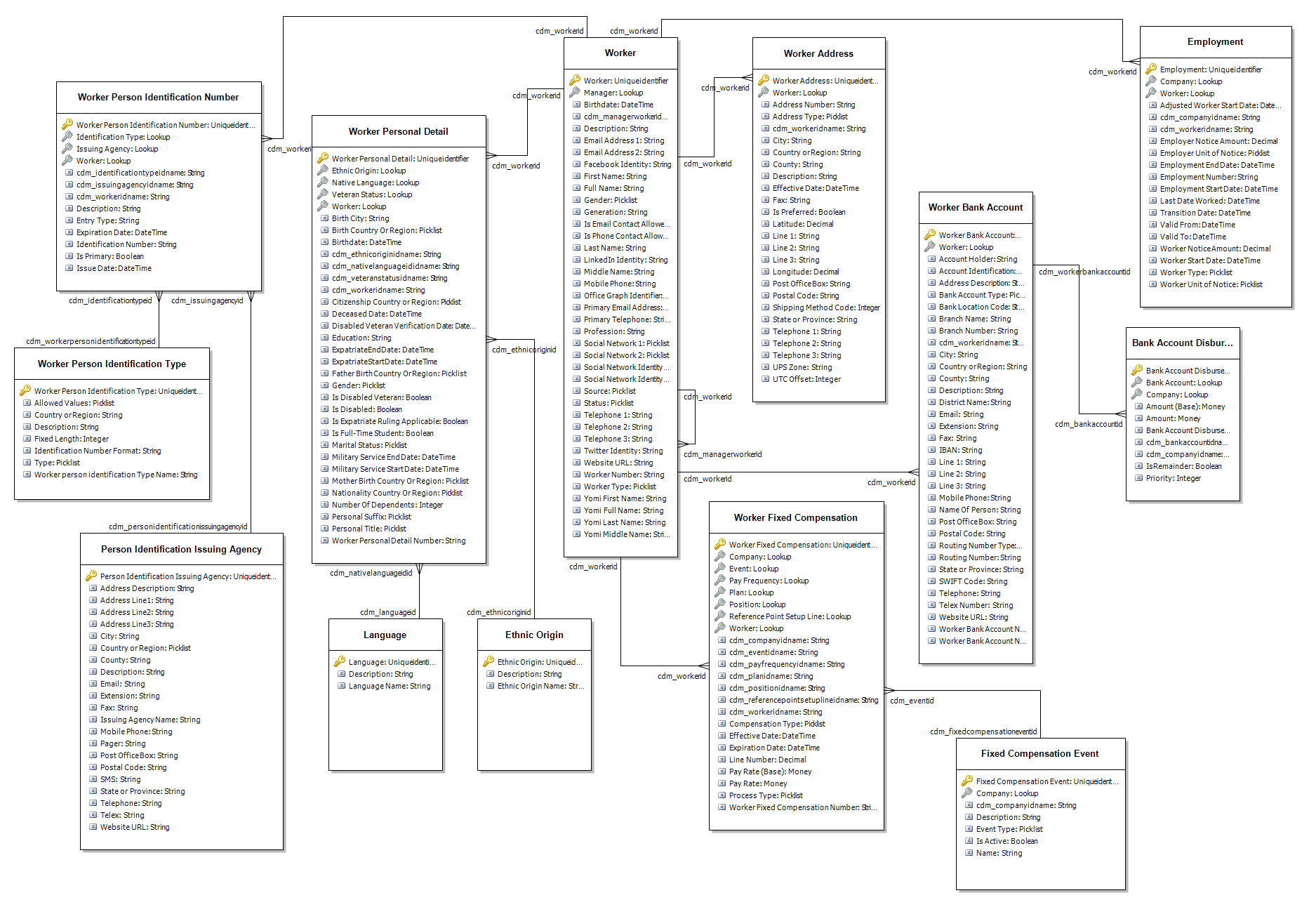
Underestimated the complexity of Talent
https://docs.microsoft.com/en-us/dynamics365/unified-operations/talent/corehrentities

Slide 14
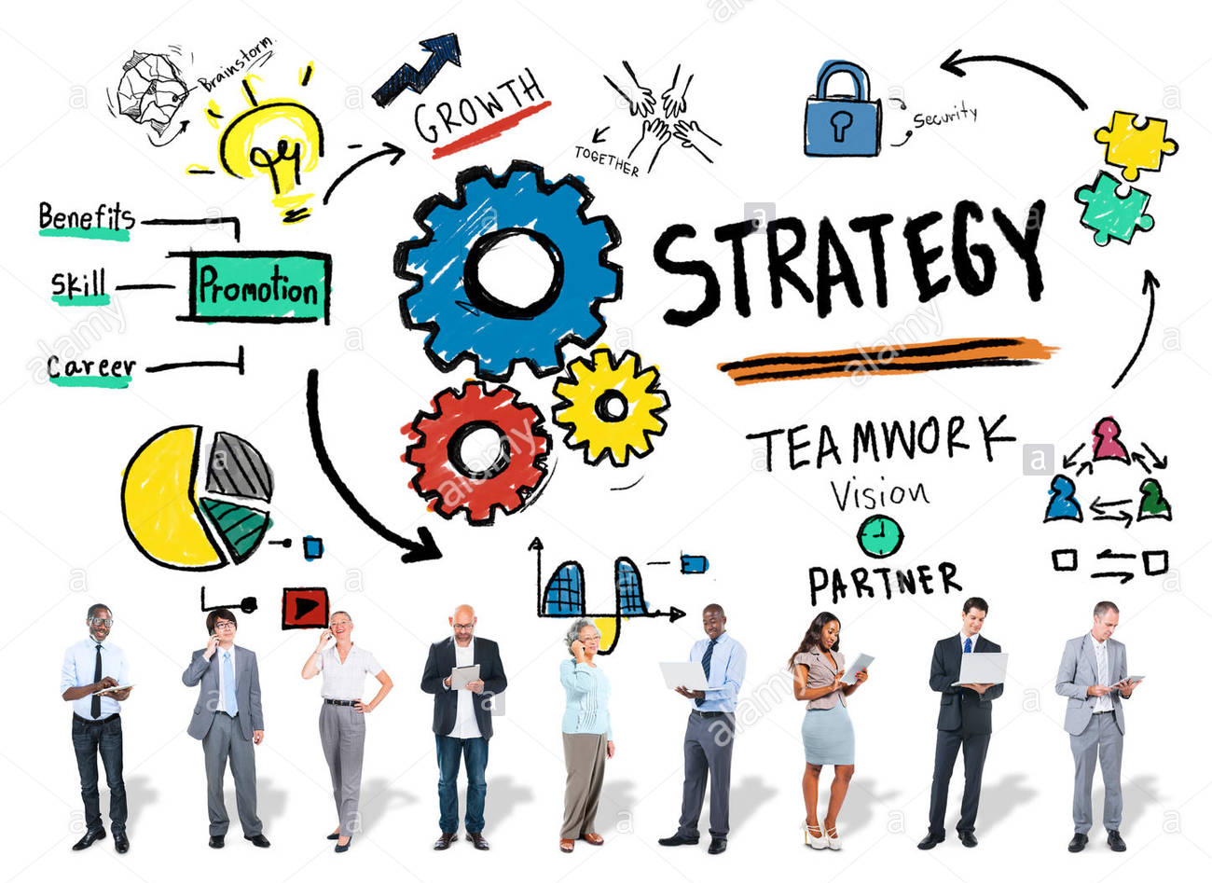
Underestimated the system as the HR foundation

Slide 15

What should you do?

Slide 16

Notes:
How can you get the data
How is the data structured
What are you using in the system

Slide 17
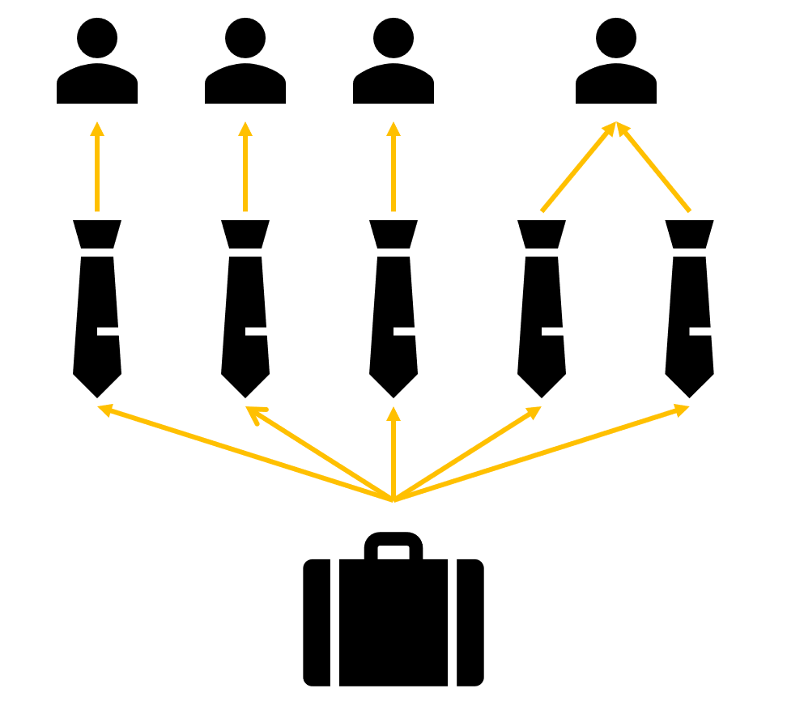
How entities are connected to each other
Worker
Position
Job
Notes:
Right click – view details – go directly to the page you need to fill inn information

Slide 18
Connected entities - job
Certificates
Education
Work tasks
ADA requirements
Screening
Tests
Title
Compensation
Skills
Job type
Job family
Function
Area of responsibility
Notes:
Skills also requires Skill rating and Skill type

Slide 19
Connected entities - job
Certificates
Education
Work tasks
ADA requirements
Screening
Tests
Compensation
Job type
Job family
Function
Area of responsibility
Title
Skills
Notes:
Skills also requires Skill rating and Skill type

Slide 20
Connected entities - position
Company
Department
Title
Position type
Compensation region
Job family
Labor union
Legal entities
Distribution template
Cost center
Payroll
Notes:
Payroll Pay cycle and Paid by (company)

Slide 21
Connected entities - position
Company
Department
Payroll
Position type
Labor union
Cost center
Job family
Legal entities
Distribution template
Compensation region
Title
Notes:
Payroll Pay cycle and Paid by (company)

Slide 22
Connected entities - Worker
Company
Title
Personal title
Personal suffix
Address books
Marital status
Language
Ethnic origin
Veteran status
Native language
Notice unit
Calendar
Regulatory establishment
Affordable care act
CostCenter
Notes:
Personal title (Miss, DR., MR., Mrs., Ms.)

Slide 23
Connected entities - Worker
Company
Title
Address books
Language
Native language
Calendar
Regulatory establishment
Affordable care act
Marital status
Personal title
Personal suffix
CostCenter
Notice unit
Ethnic origin
Veteran status
Notes:
Personal title (Miss, DR., MR., Mrs., Ms.)

Slide 24
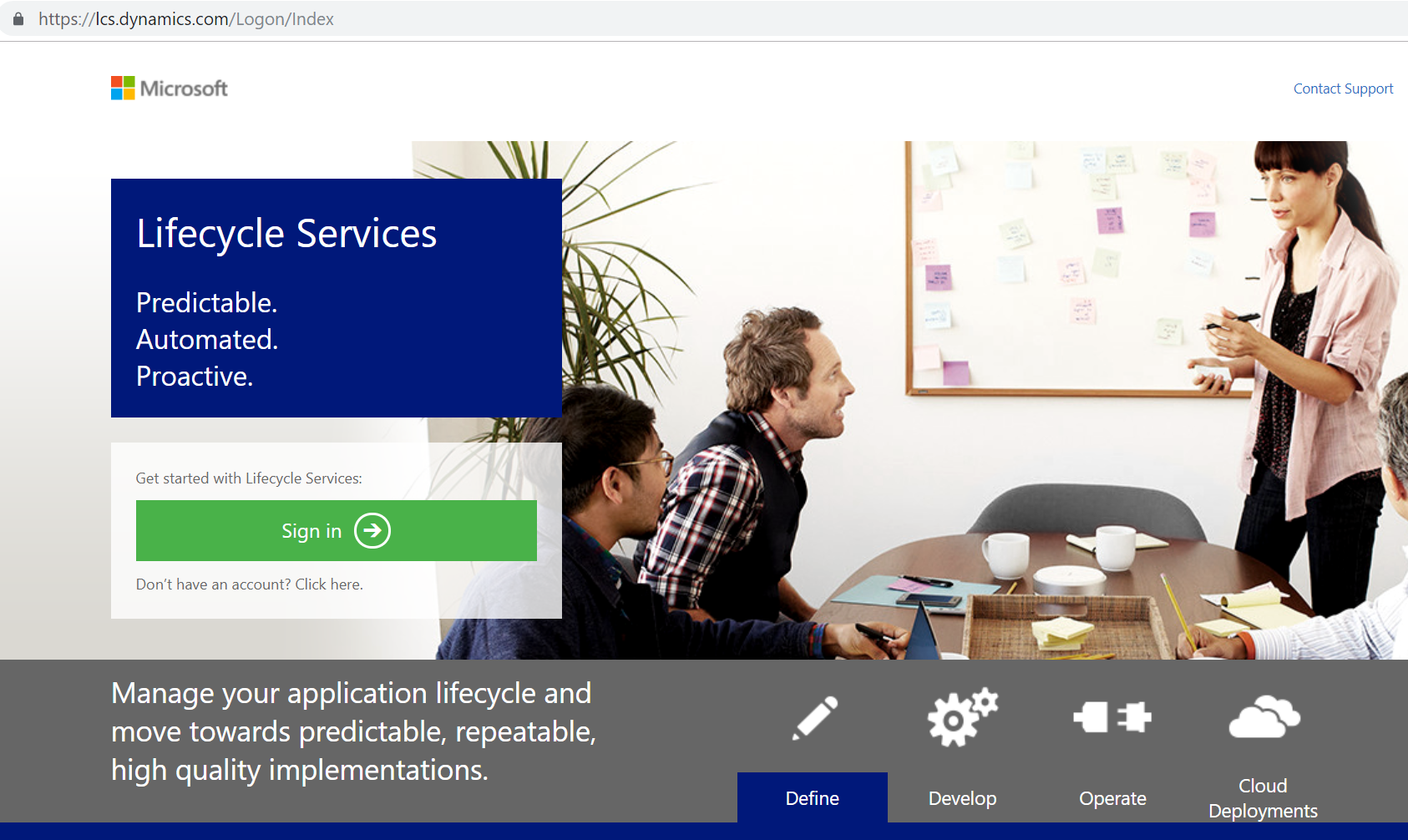
New environment – Where?

Slide 25
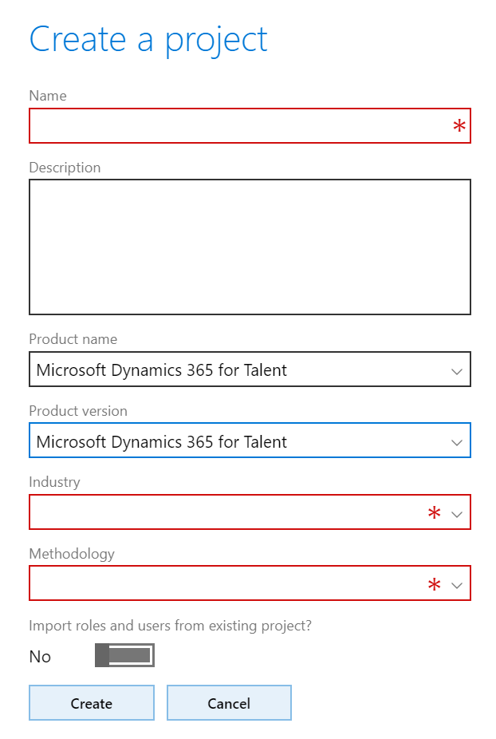
New environment – Problem?
https://malinsdynamics365fortalent.com/2018/10/24/how-to-start-and-access-your-new-talent-environment/
Buy minimum 5 full licenses and assign one to this user
Have a global admin role
Don’t use the default CDS environment
Make sure the same user login to Attract and Onboarding
Notes:
You need to have

Slide 26
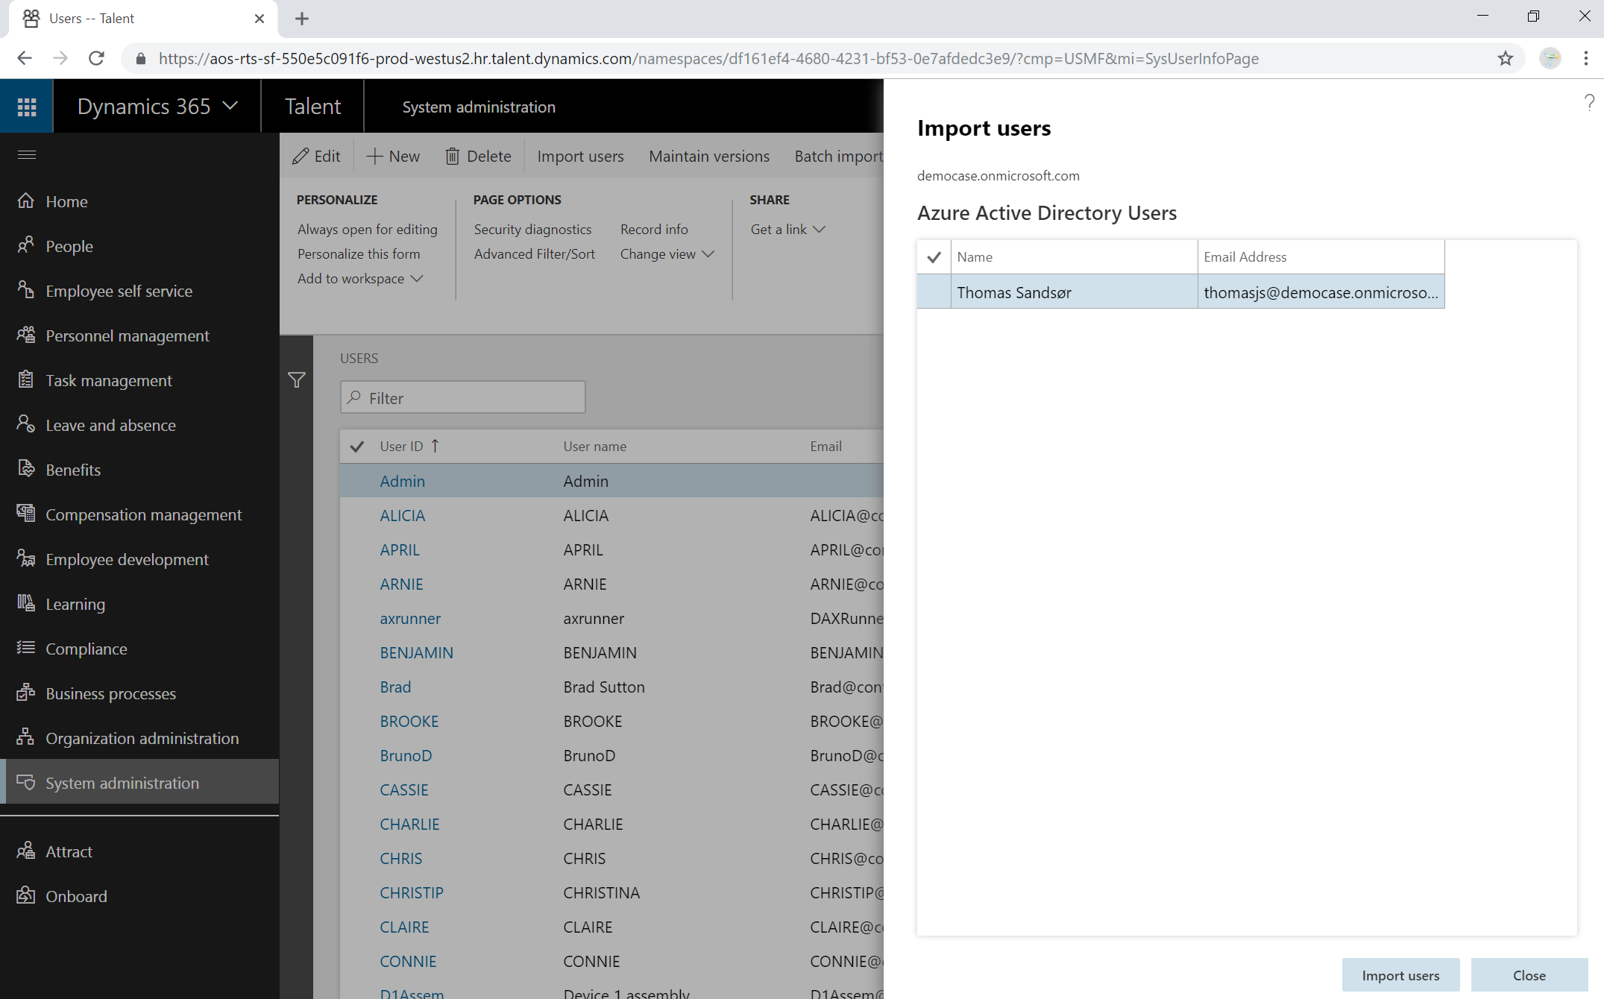
New environment – Done?

Slide 27
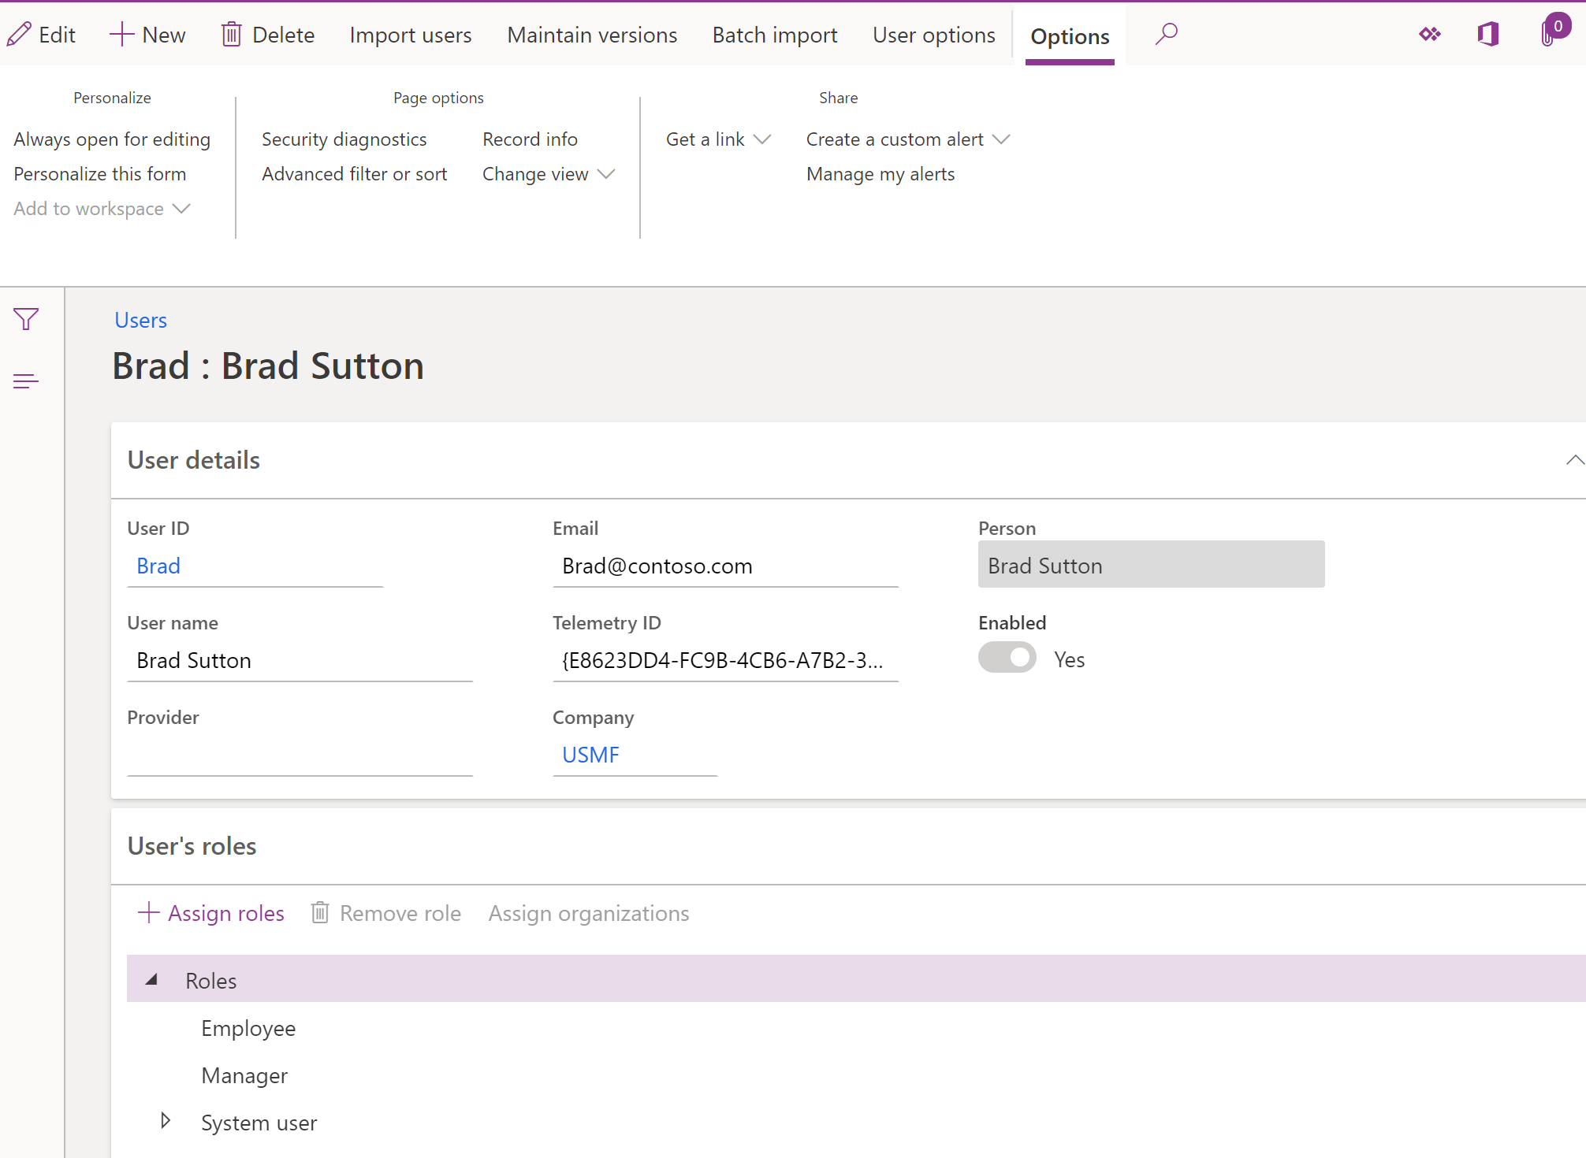
New environment – Done!

Slide 28




Become better by
Trials
Take the certification
https://malinsdynamics365fortalent.com/
Try the system

Slide 29
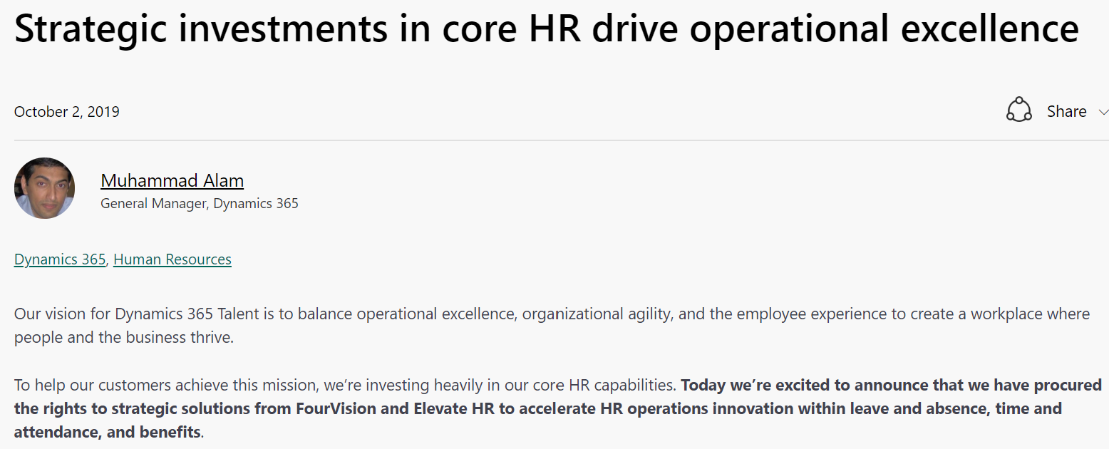
https://tinyurl.com/talentnews2october

Slide 30







Contact information
https://malinsdynamics365fortalent.com/
https://www.linkedin.com/in/malinmartnes/
https://twitter.com/MalinMartnes - @MalinMartnes
Malin_martnes@hotmail.com / mdm@pointtaken.no
https://www.meetup.com/Women-in-Dynamics/
http://tiny.cc/MalinMVP

Slide 32
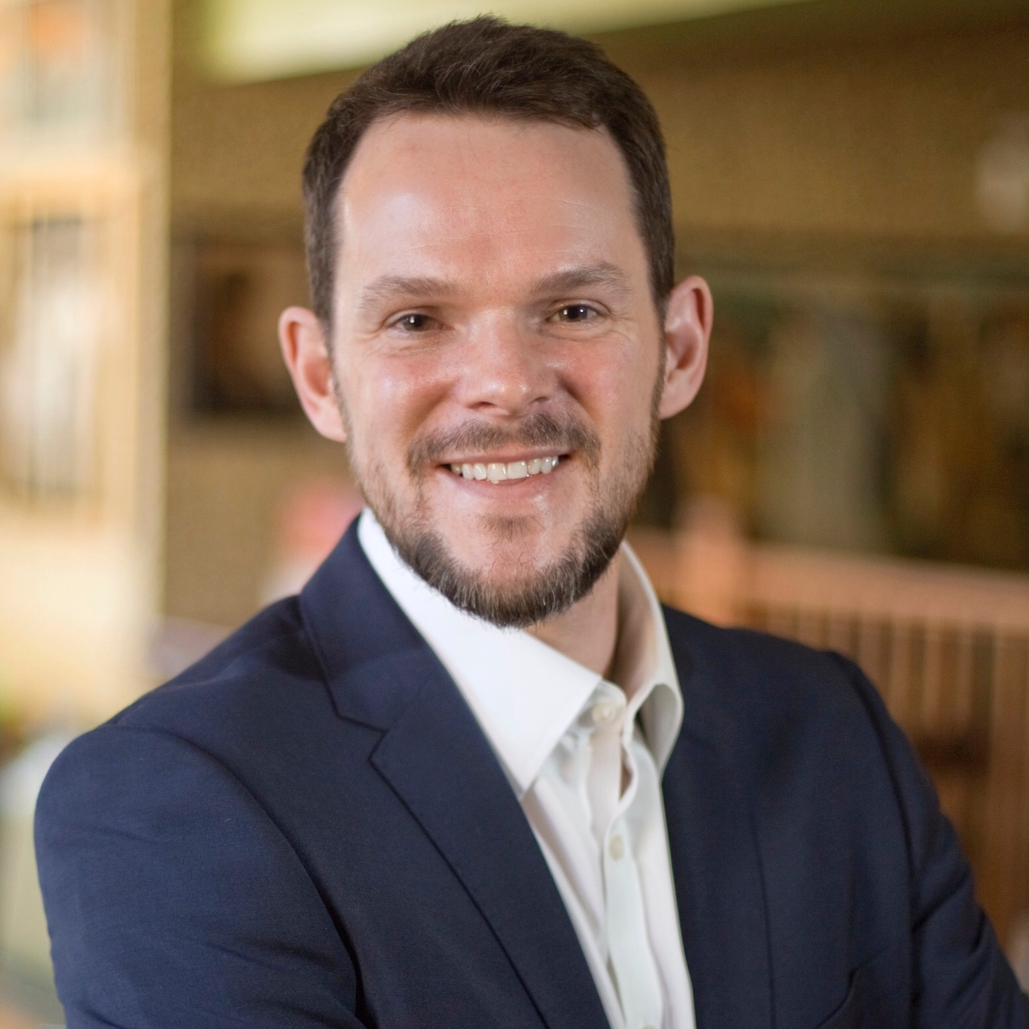
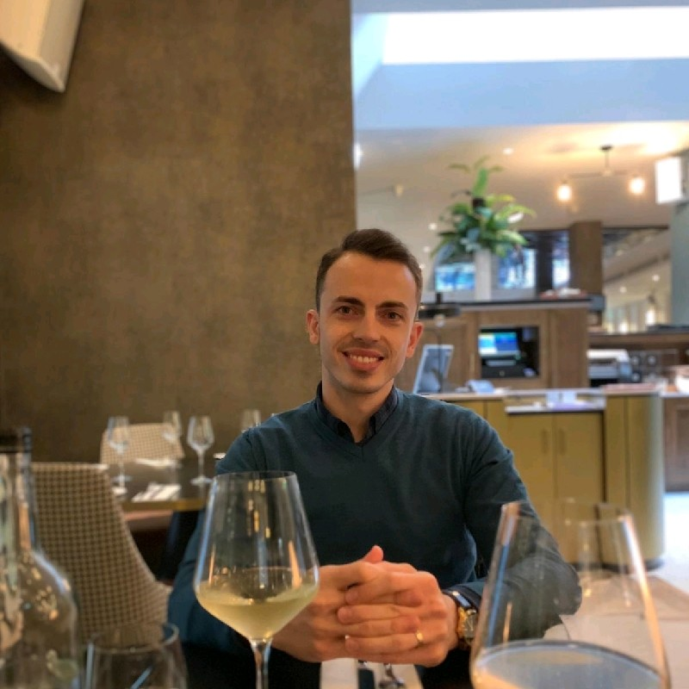
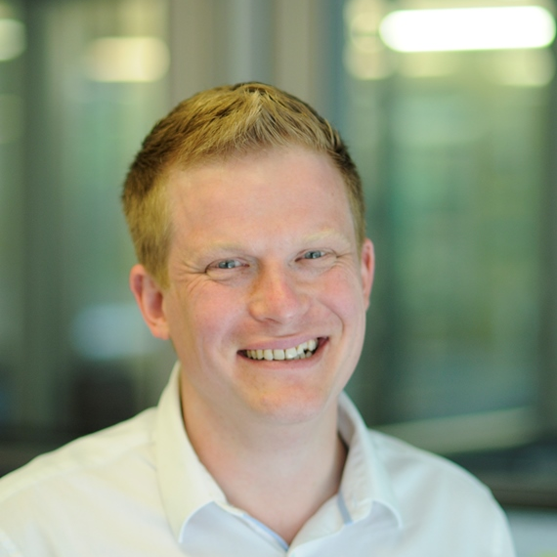
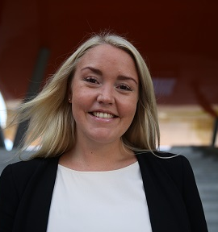
Next Up…
11:30-12:20
What's new and cool in 2019 release wave 2 for Dynamics 365 and Power Platform?
Solgari - Powering customer engagement with all channel communications inside D365
A bullshitters guide to PowerApps
Power BI Storytelling 101
Andrew Bibby
Dan Bozesan
Keith Whatling
Ida Bergum
In a packed session, we'll be looking at the best new features in the second release wave of 2019 for Dynamics 365 and the Power Platform. There will be demos! Good luck everyone!
Powering customer engagement through all-channel communications inside D365. Come join us for this session and we’ll show you how it empowers all-channel communications inside Dynamics 365. We’ll take you through the seamless customer & agent journeys, and talk a bit about how Solgari’s all-channel, all-functionality solution is bringing CIF to life.
How am I supposed to learn this? Were do I get these "citizen developers" , what do I say to my terrified clients of letting users build apps, and how do I sell it? Get these answers and learn to have enough vocab to get you by in the world of the power platform.
As humans, we face an increasing amount of data and information every day. To derive meaning and make sense of this complex world, we constantly scan the world around us and select what we believe is important and what is not. In this session I will go trough the end to end framework about turning data into business actions.

