Slide 1
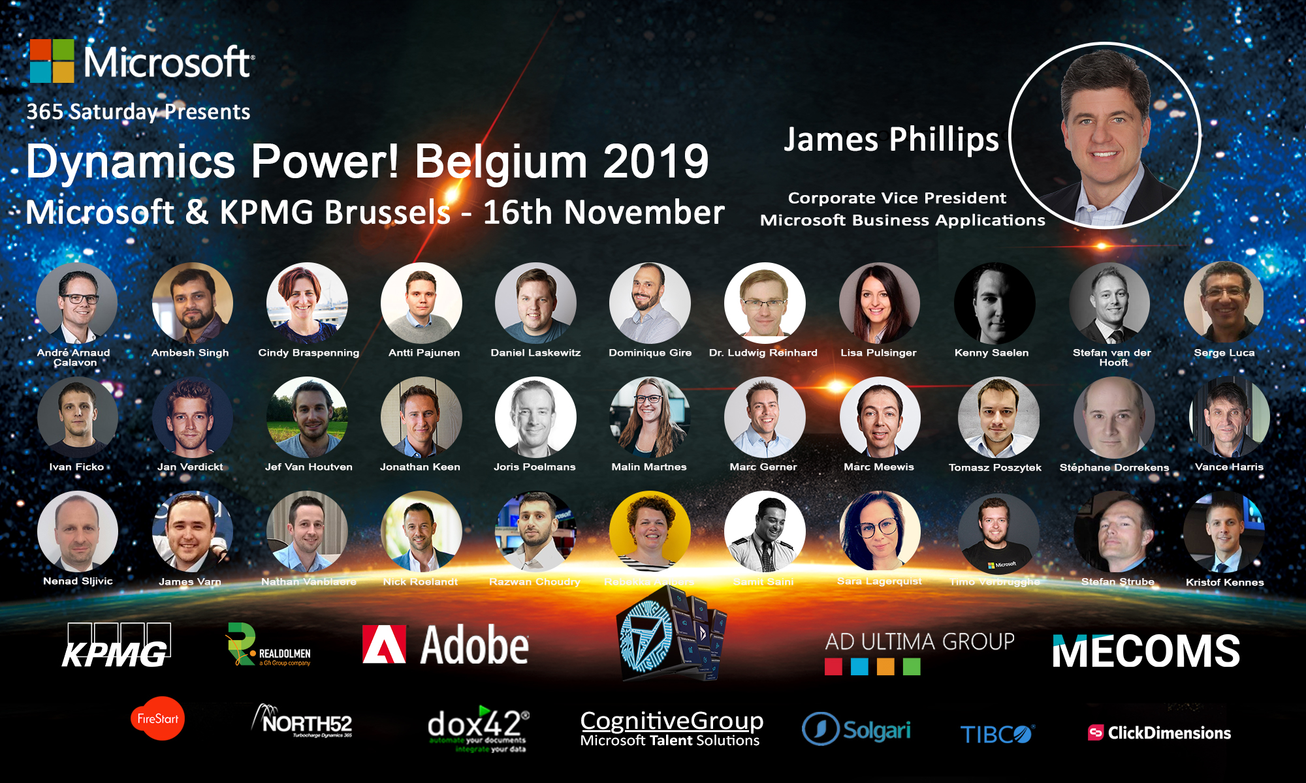

Slide 2

How Talent can digitize a forgotten HR department
Malin Donoso Martnes

Slide 3






Special thanks to our local sponsors

Slide 4
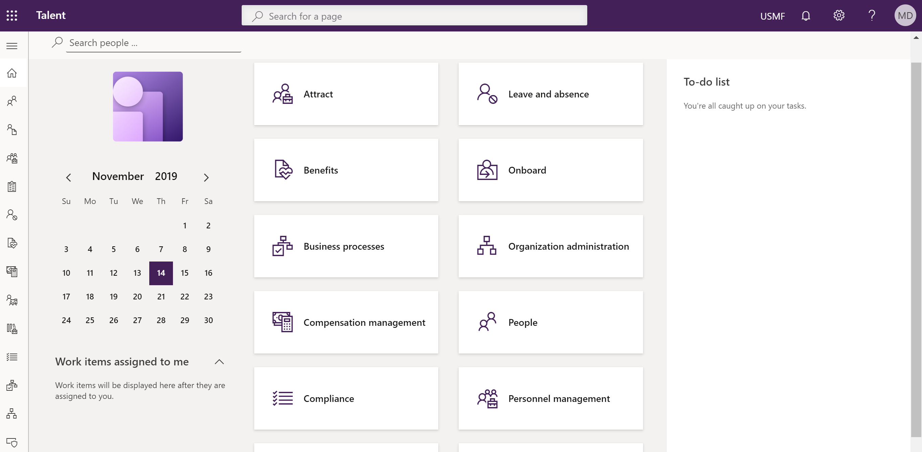
How Talent can digitize a forgotten HR department
Malin Donoso Martnes

Slide 5
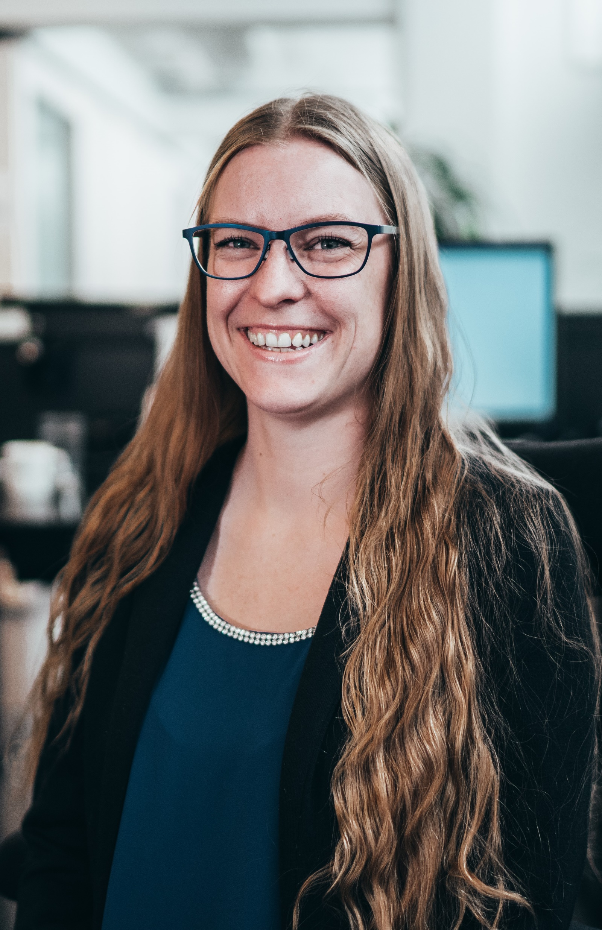

About me
Education in marketing
User in Dynamics CRM from 2009
Consultant in Dynamics CRM from 2014
Talent from Mars 2018
#2 in the world to pass MB6-898 Talent
Run the Norwegian group Women in Dynamics
First and only MVP with a focus on Talent

Slide 6
Go to Menti.com
About you

Slide 7
Ecosystem Dynamics 365

Slide 8
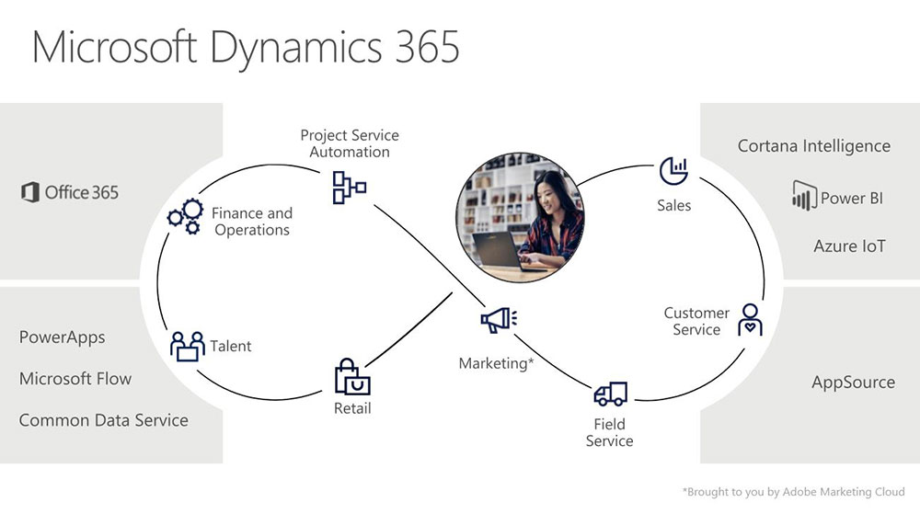

Slide 9
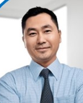

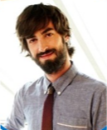
Core HR
Employee
HR
Manager

Slide 10
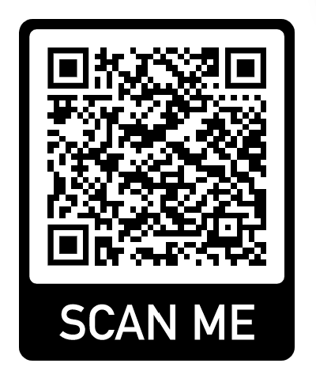
Common Data Service
https://docs.microsoft.com/en-us/dynamics365/unified-operations/talent/corehrentities
Not all Core HR entities on CDS (yet)

Slide 12
Person, position and hierarchy

Slide 13
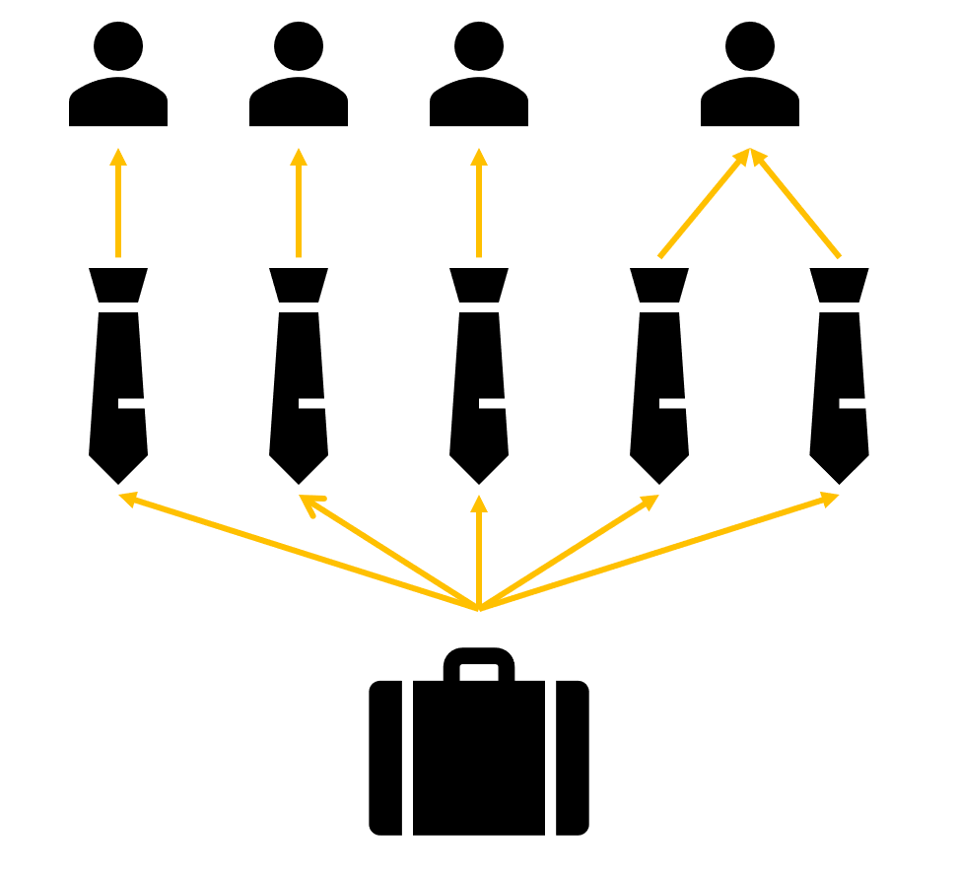
Employee
Position
Job
Notes:
Right click – view details – go directly to the page you need to fill inn information

Slide 14
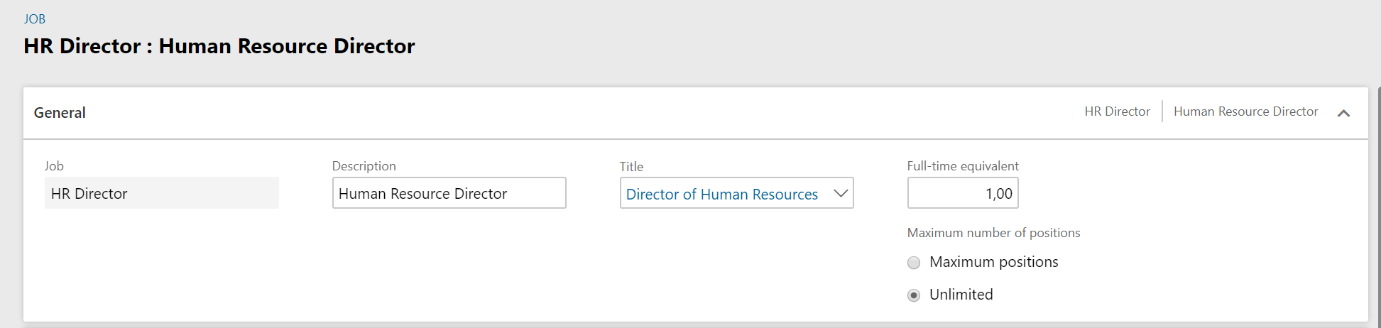
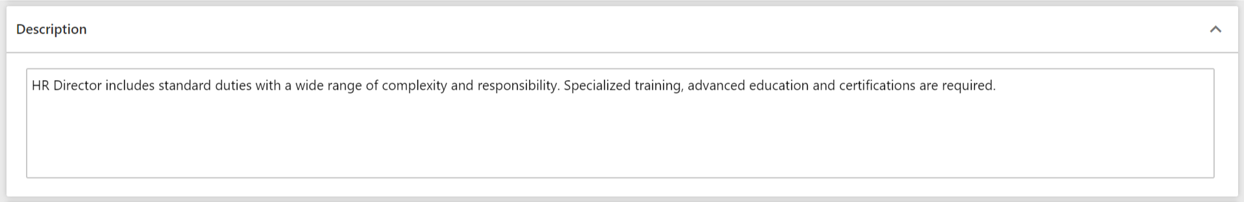
HR
Notes:
Right click – view details – go directly to the page you need to fill inn information

Slide 15
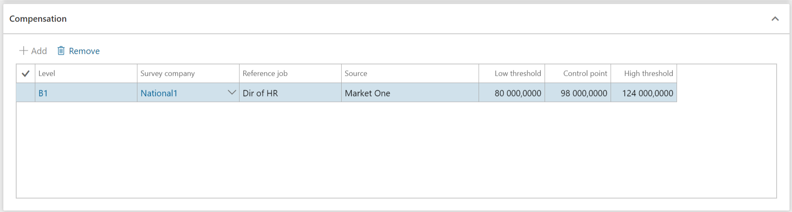
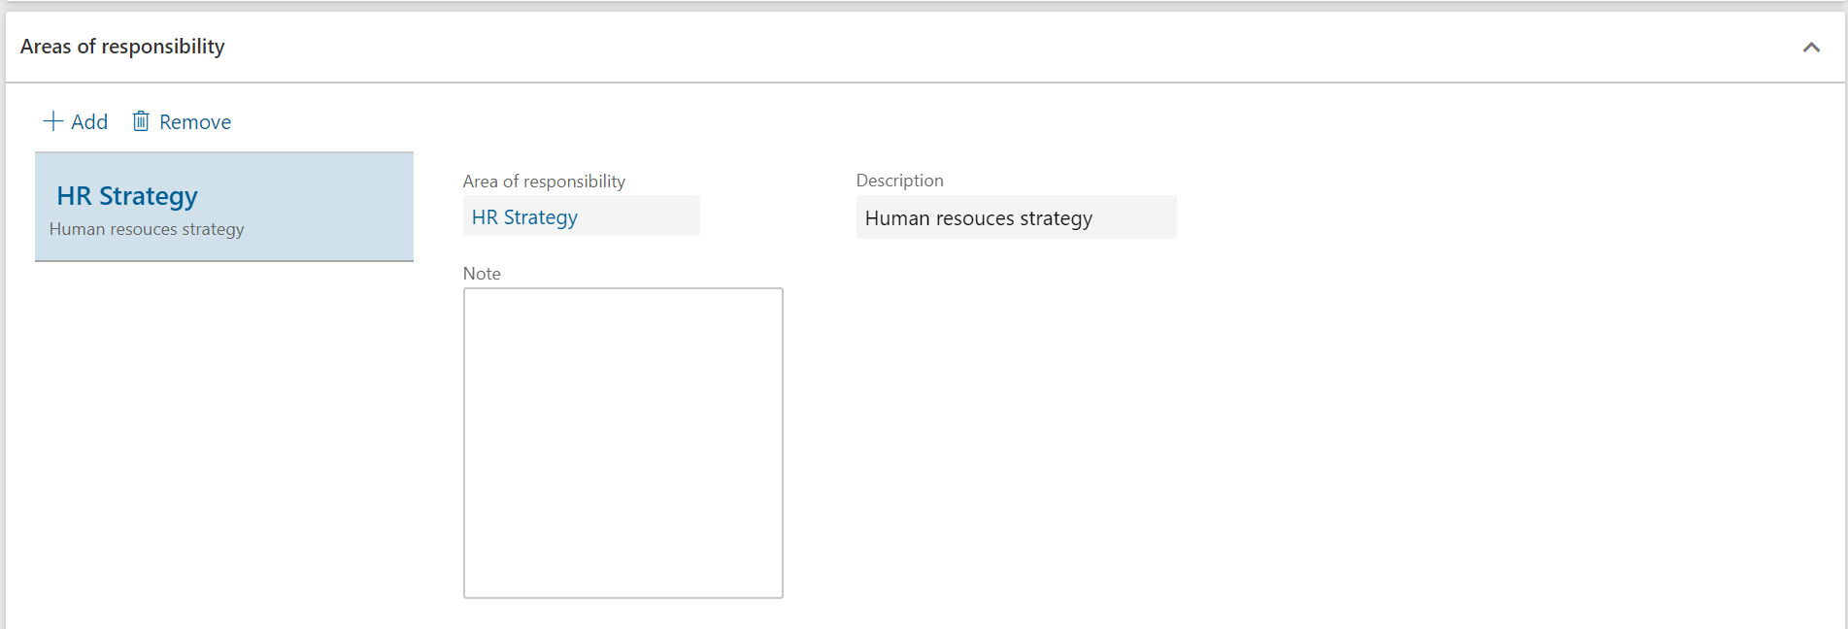
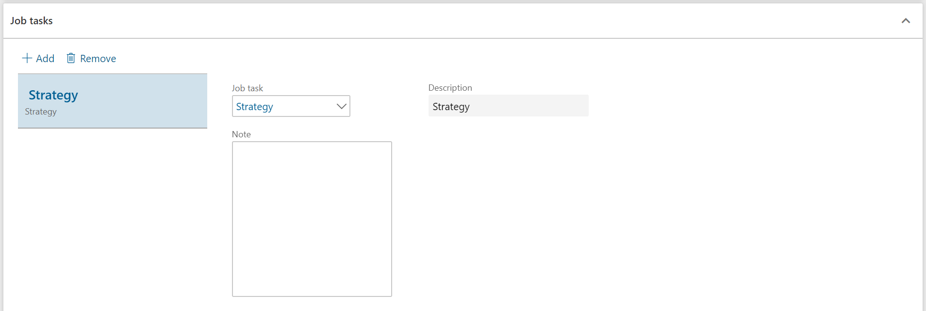
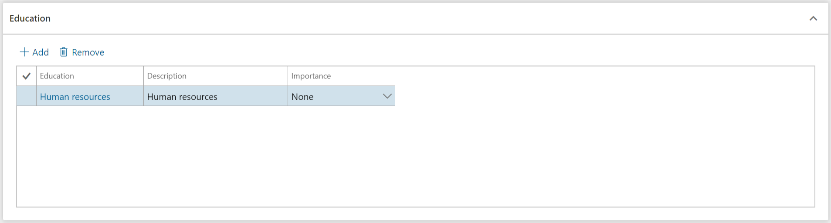
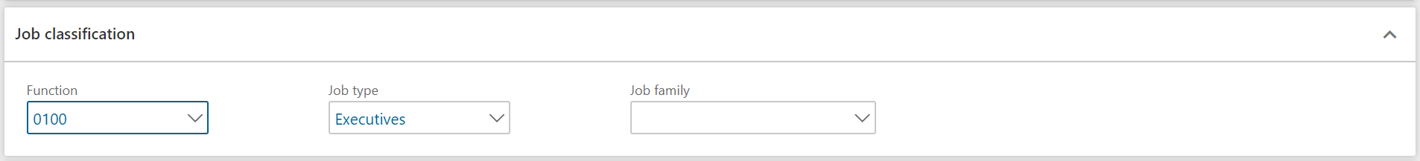
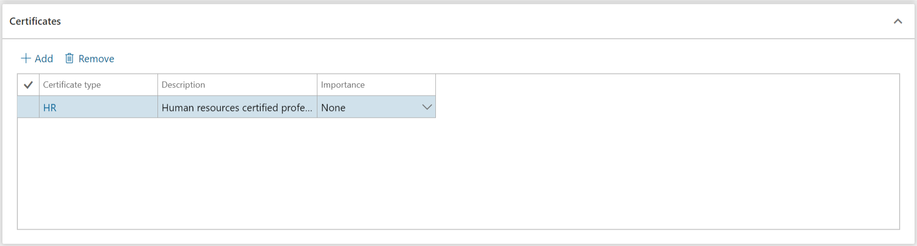
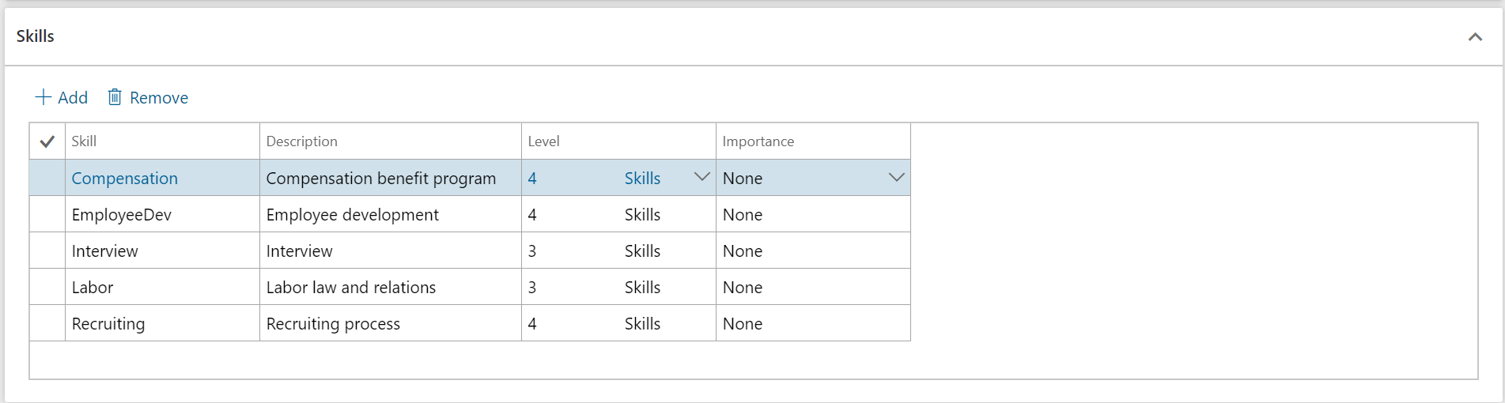
HR
Notes:
Right click – view details – go directly to the page you need to fill inn information

Slide 16
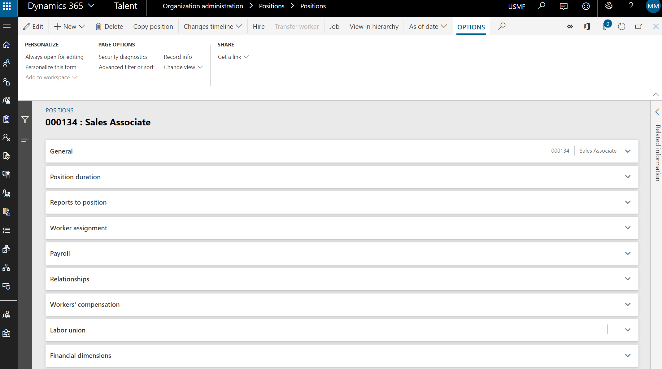
HR

Slide 17
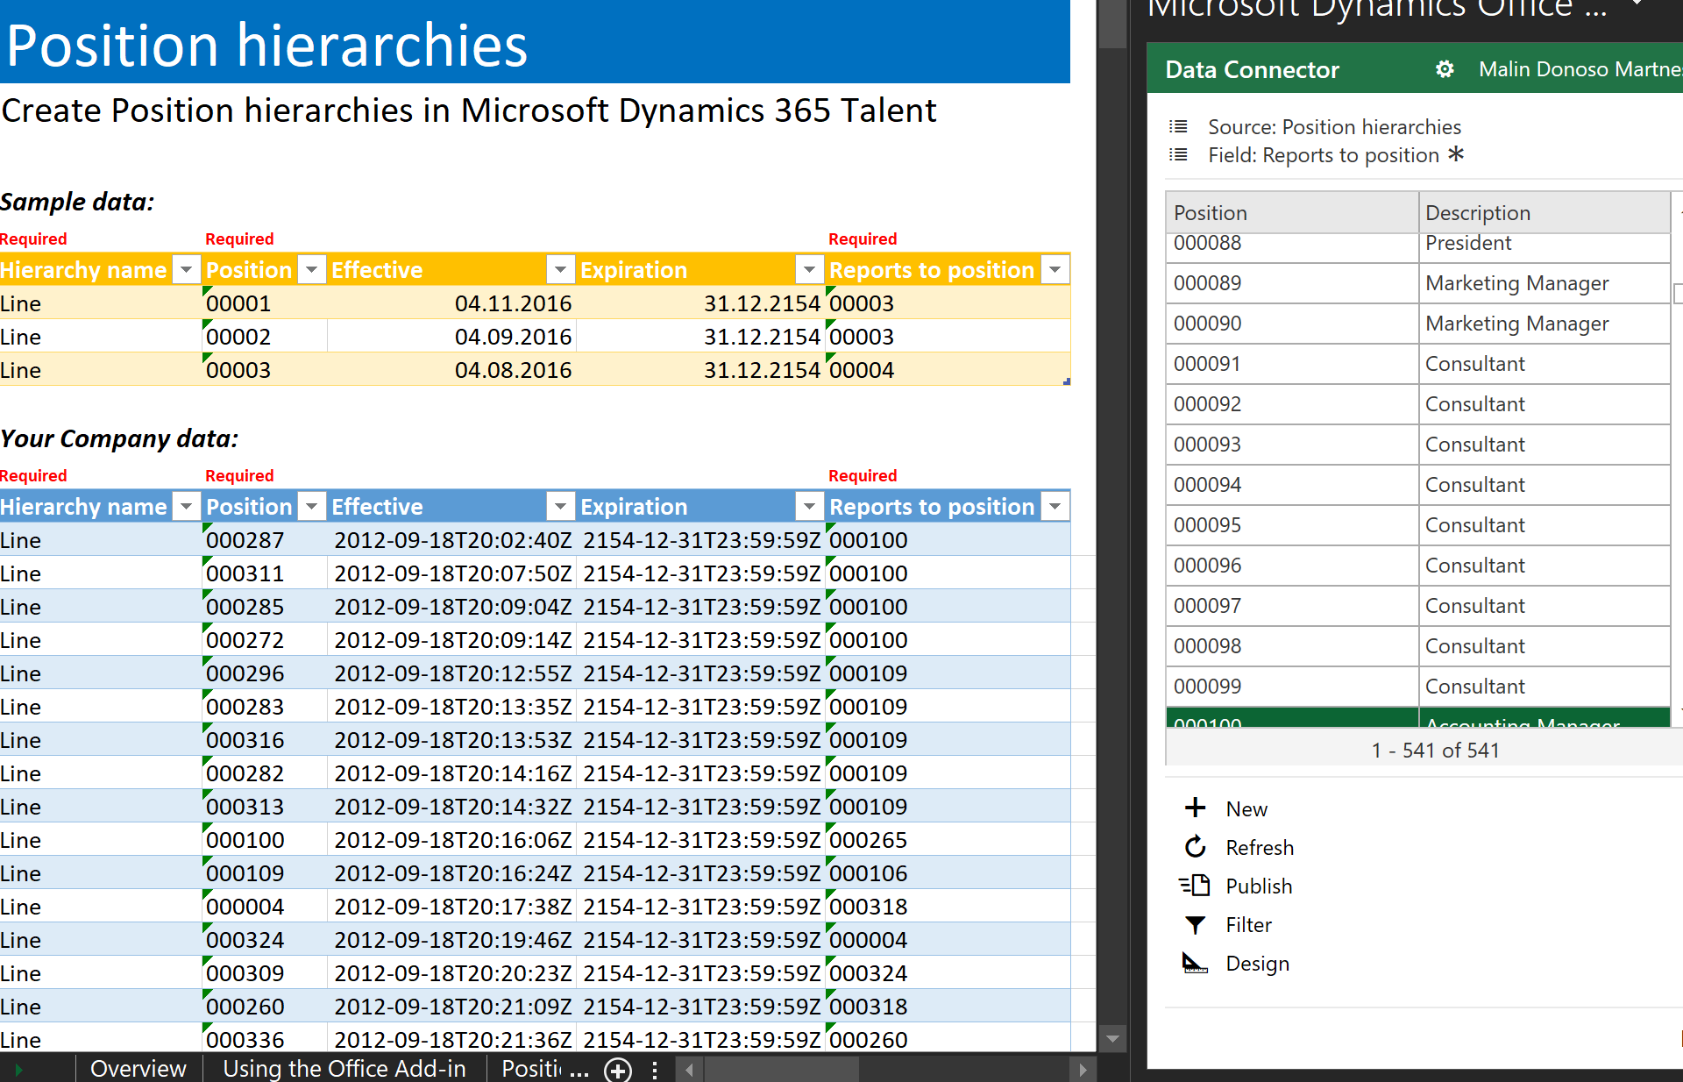
HR

Slide 18
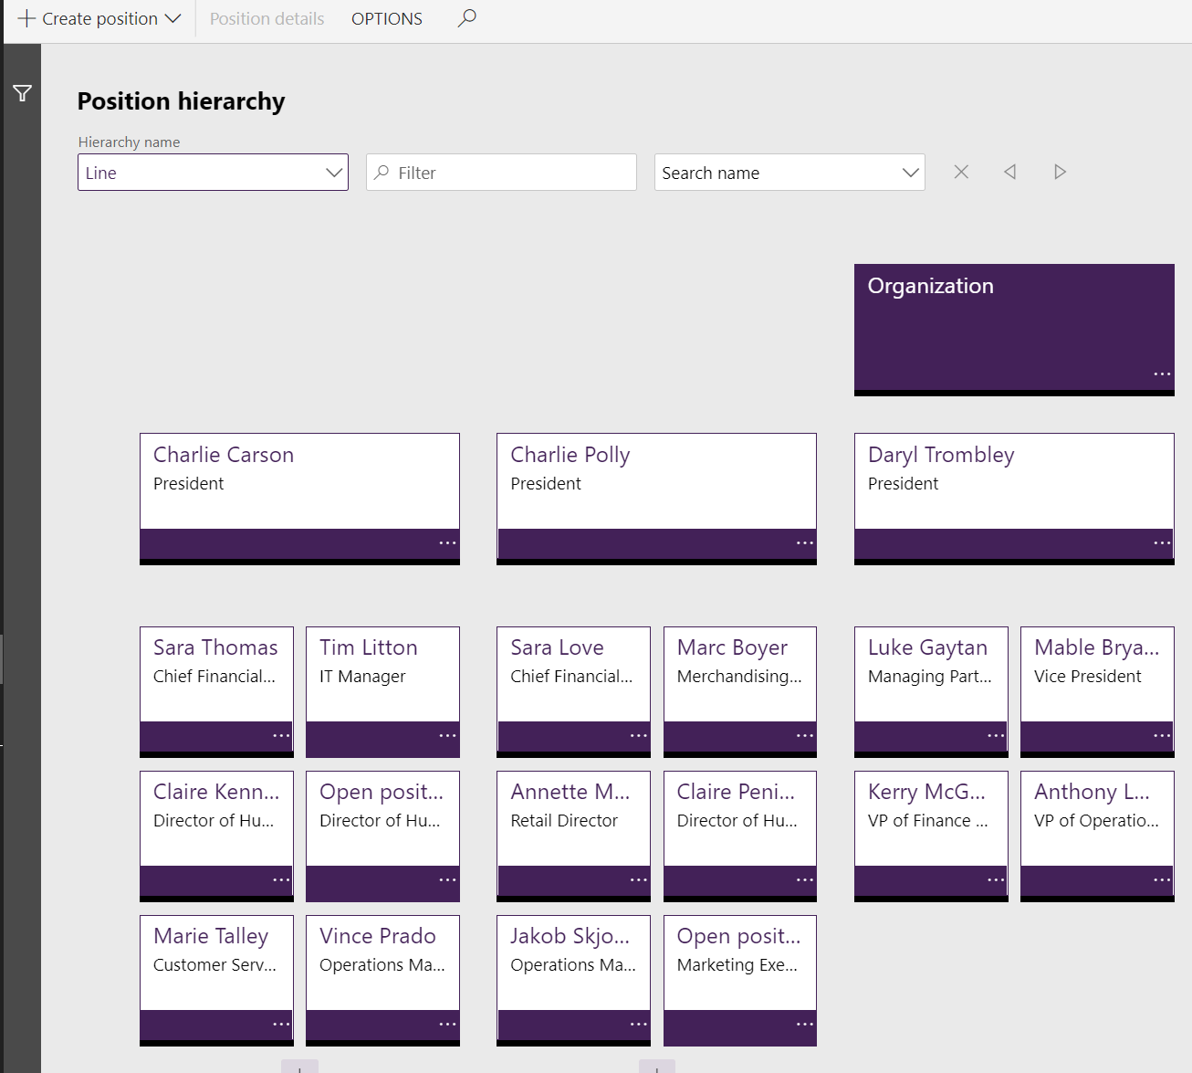
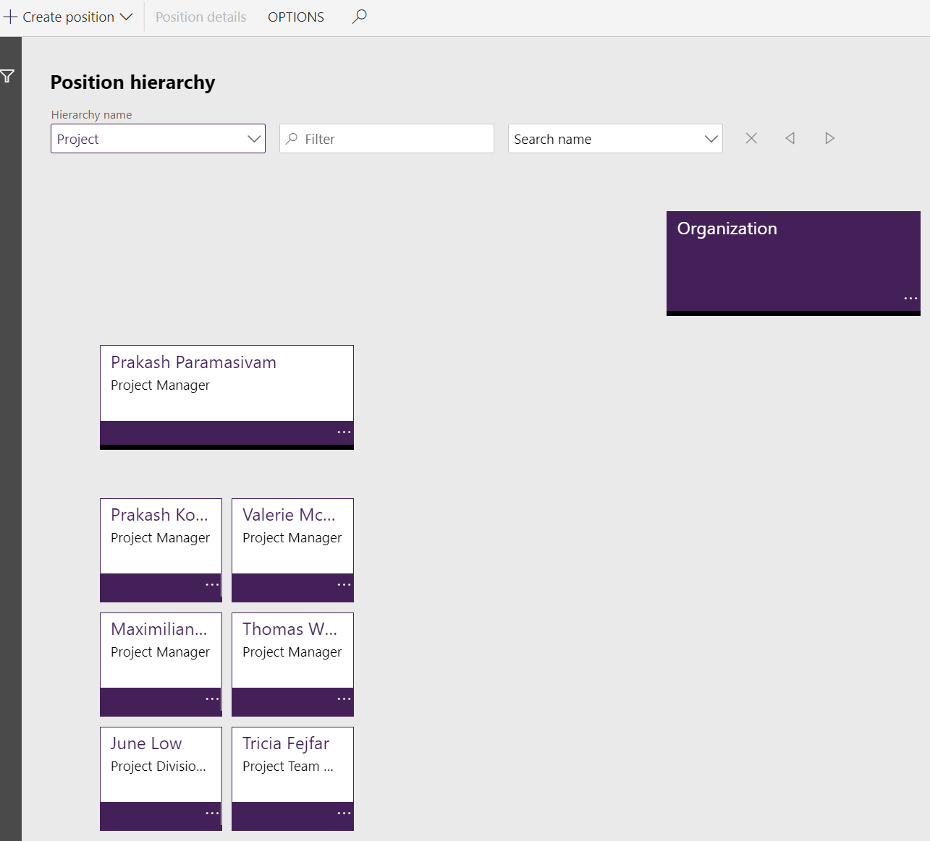
HR

Slide 19
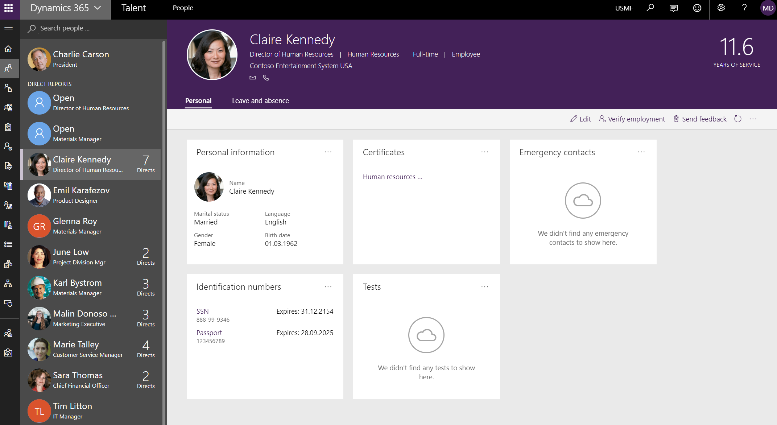
HR

Slide 20
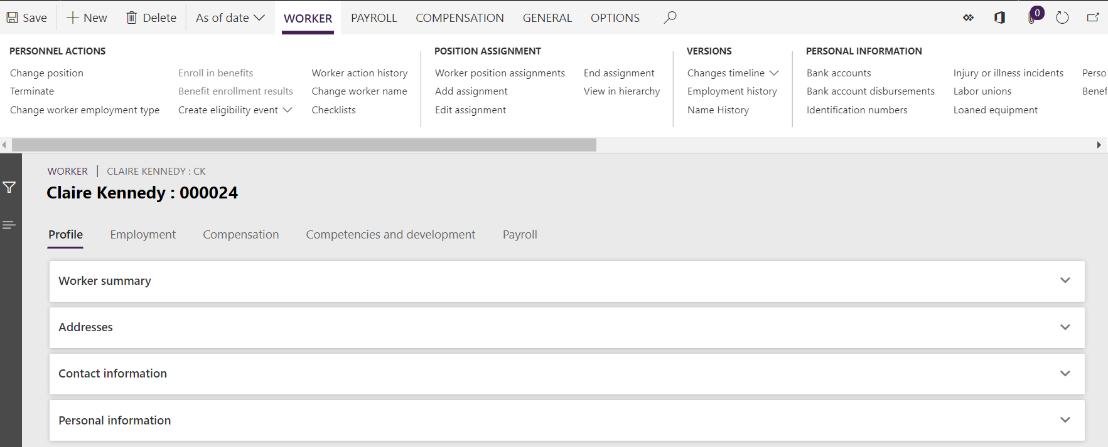
HR

Slide 21
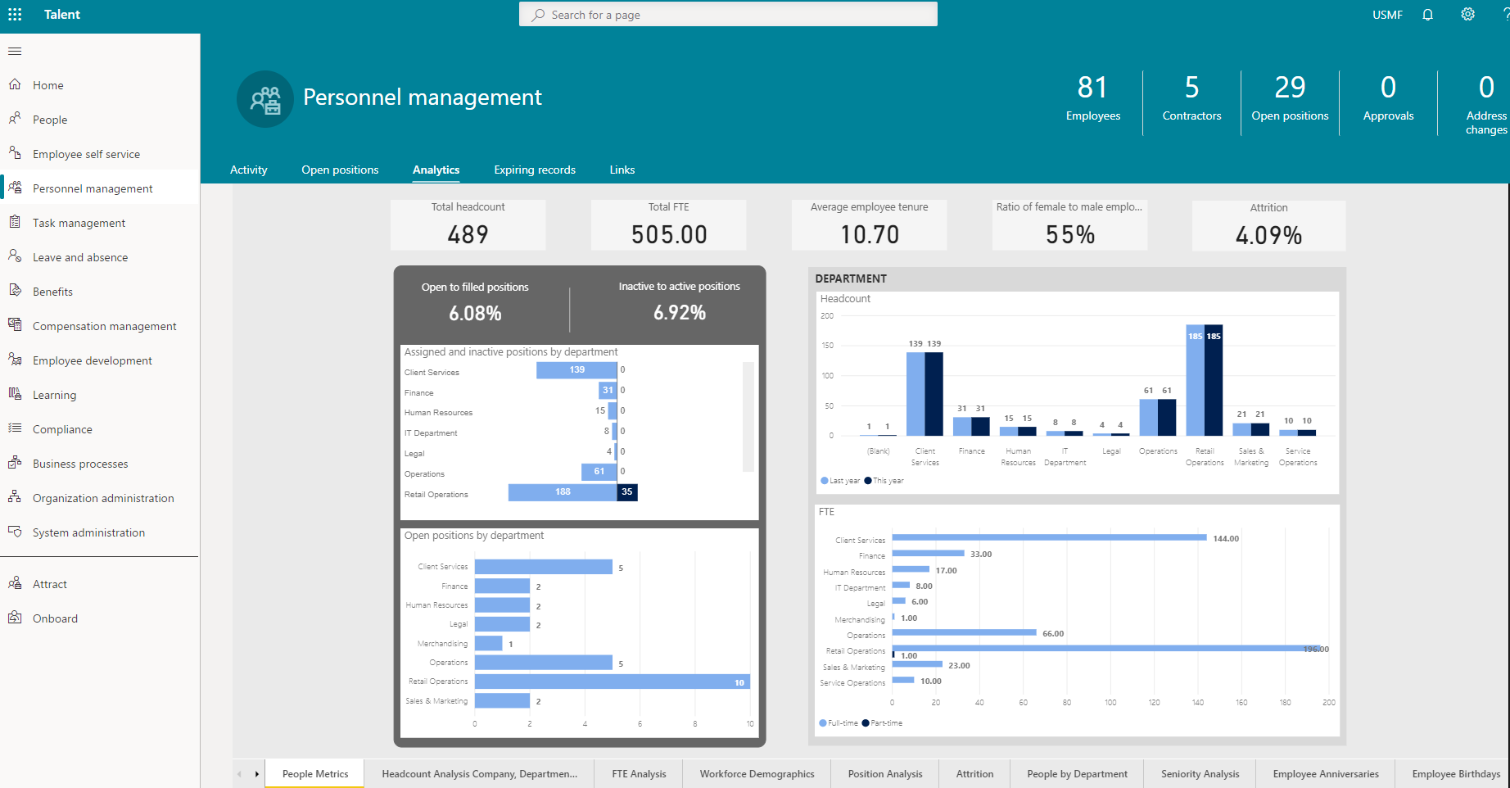
HR

Slide 22
Onboarding, transition and Offboarding

Slide 23
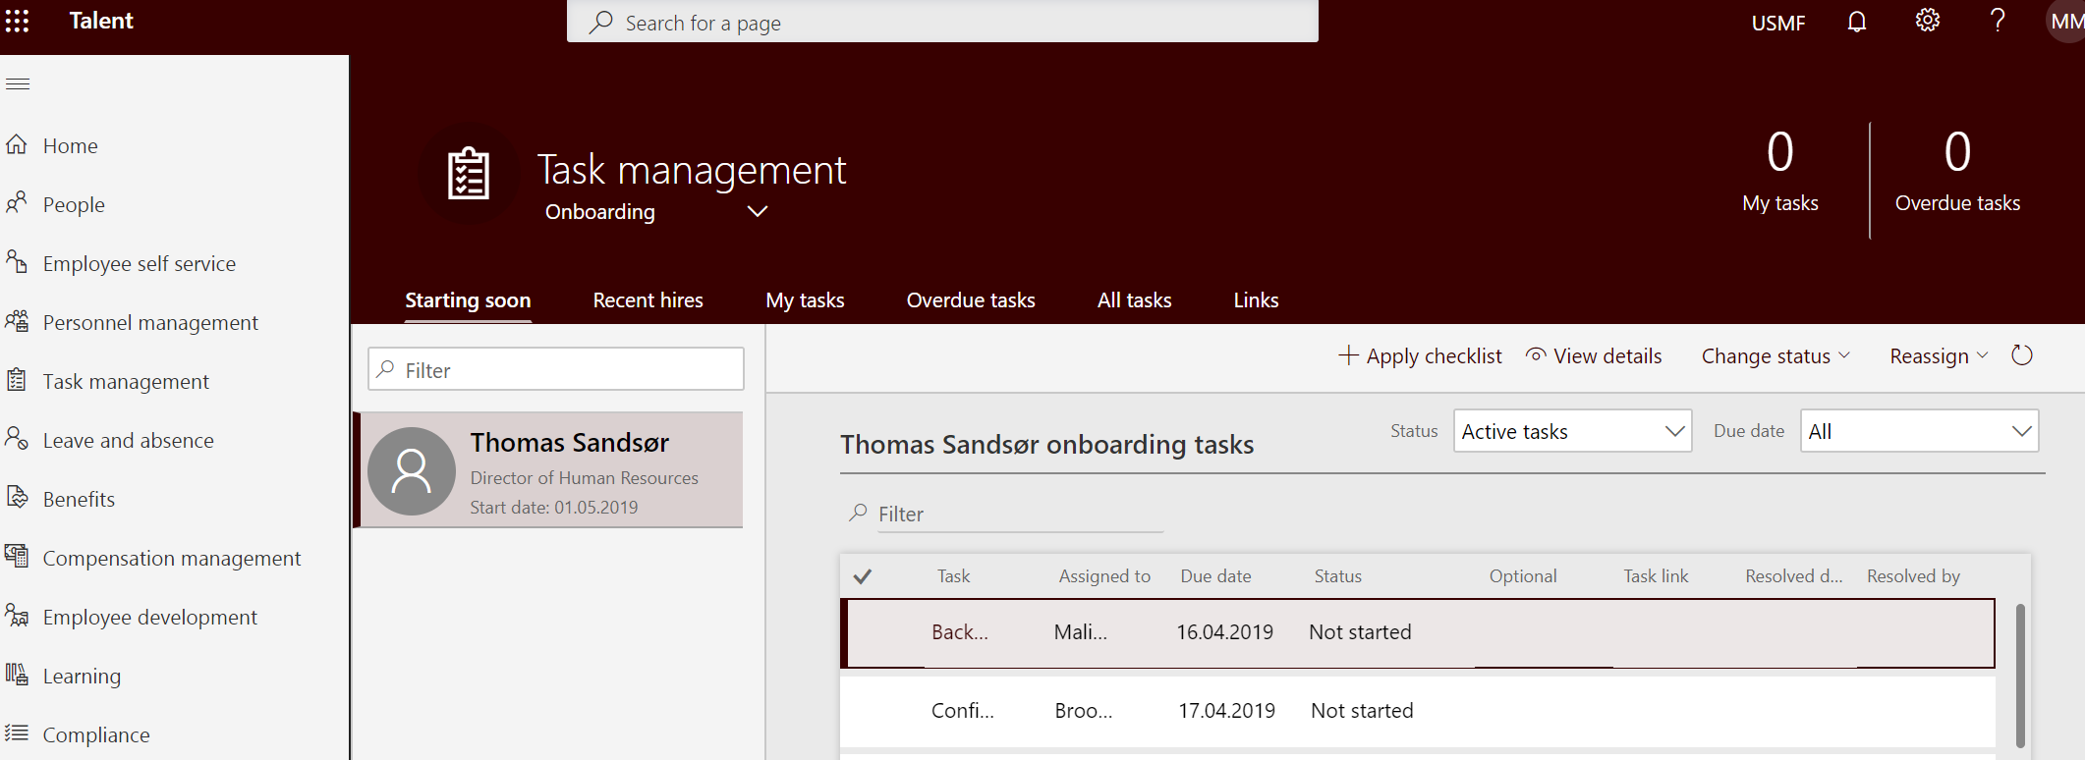
HR
Manager
Employee

Slide 24
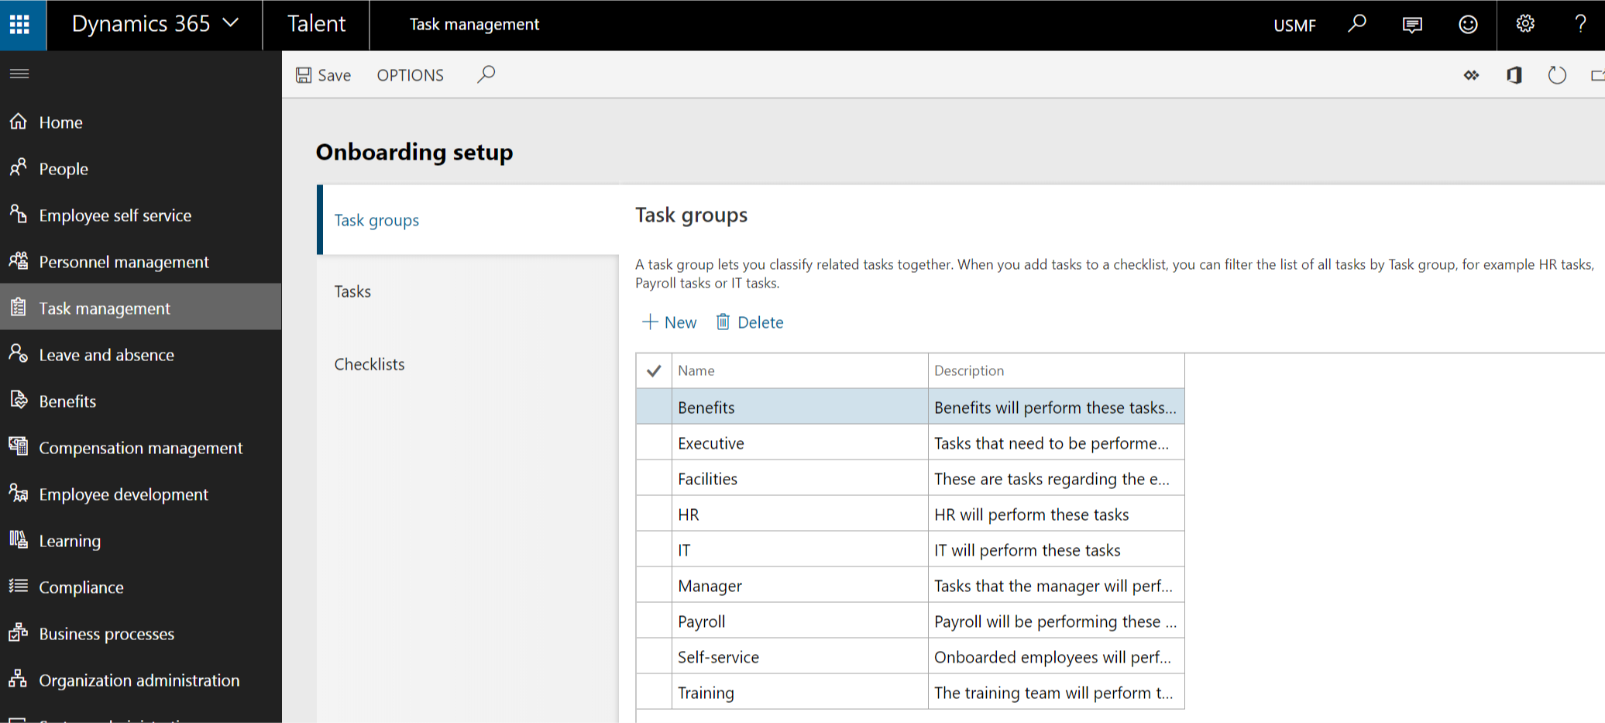
HR

Slide 25
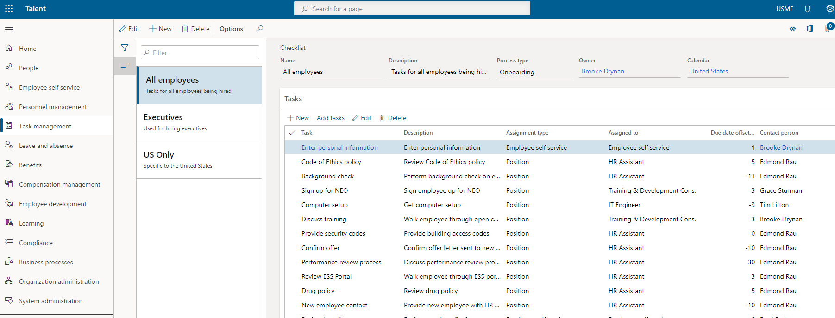
HR

Slide 26
Self service
Manager
Employee

Slide 27
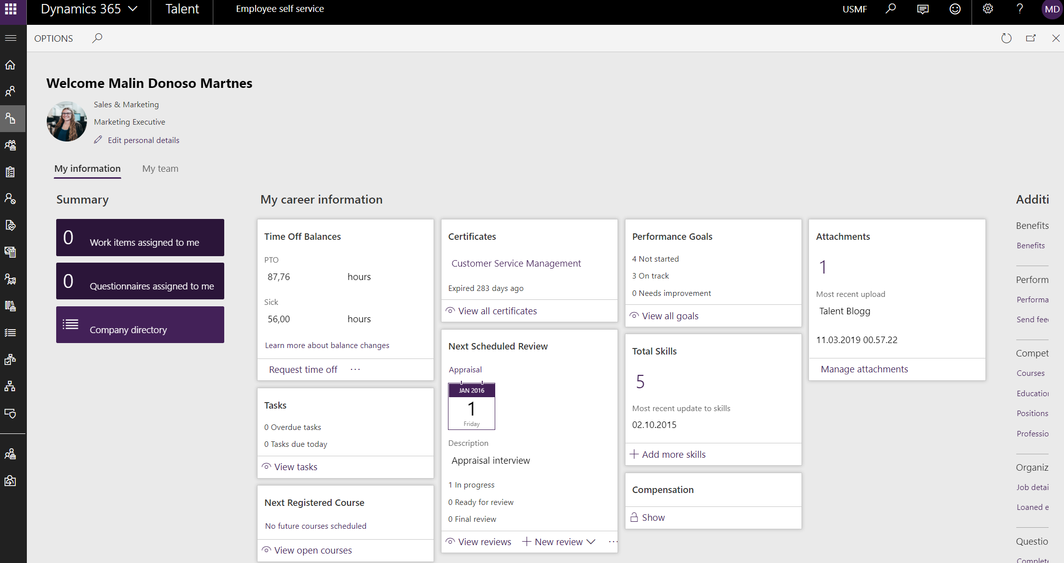
Employee

Slide 28
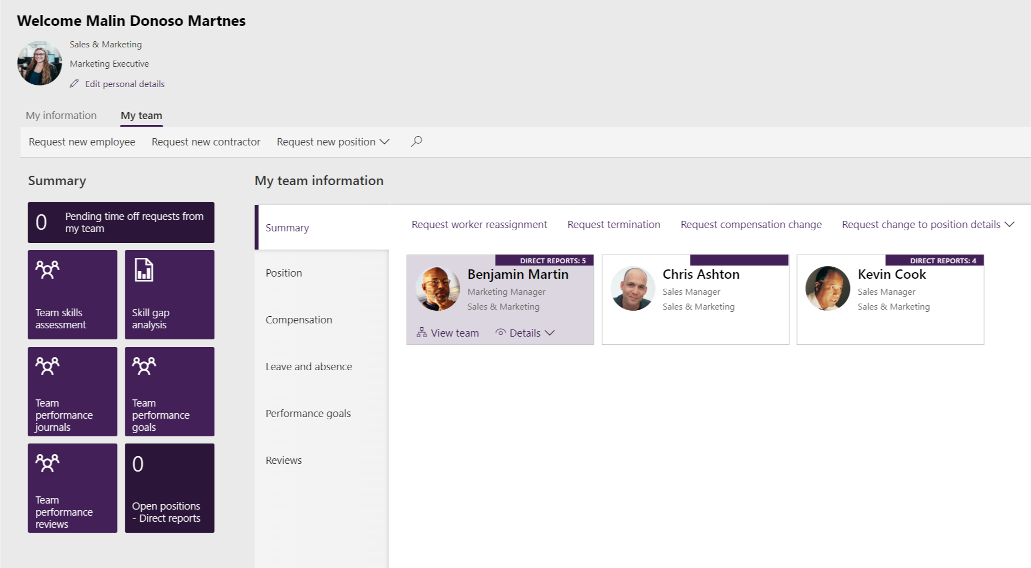
Manager

Slide 29
Personal development and Compensation management

Slide 30
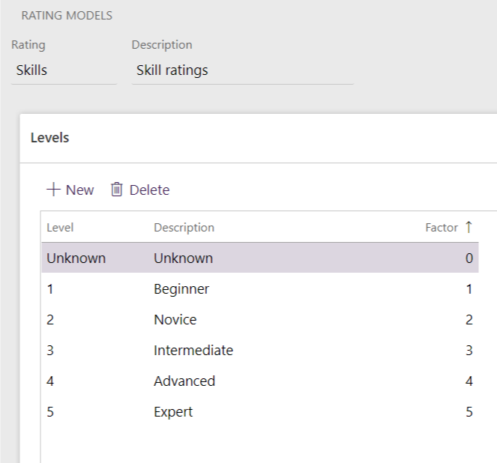
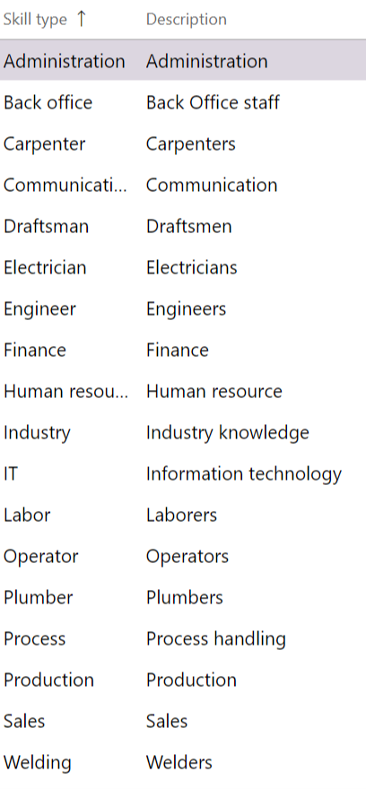
HR

Slide 31
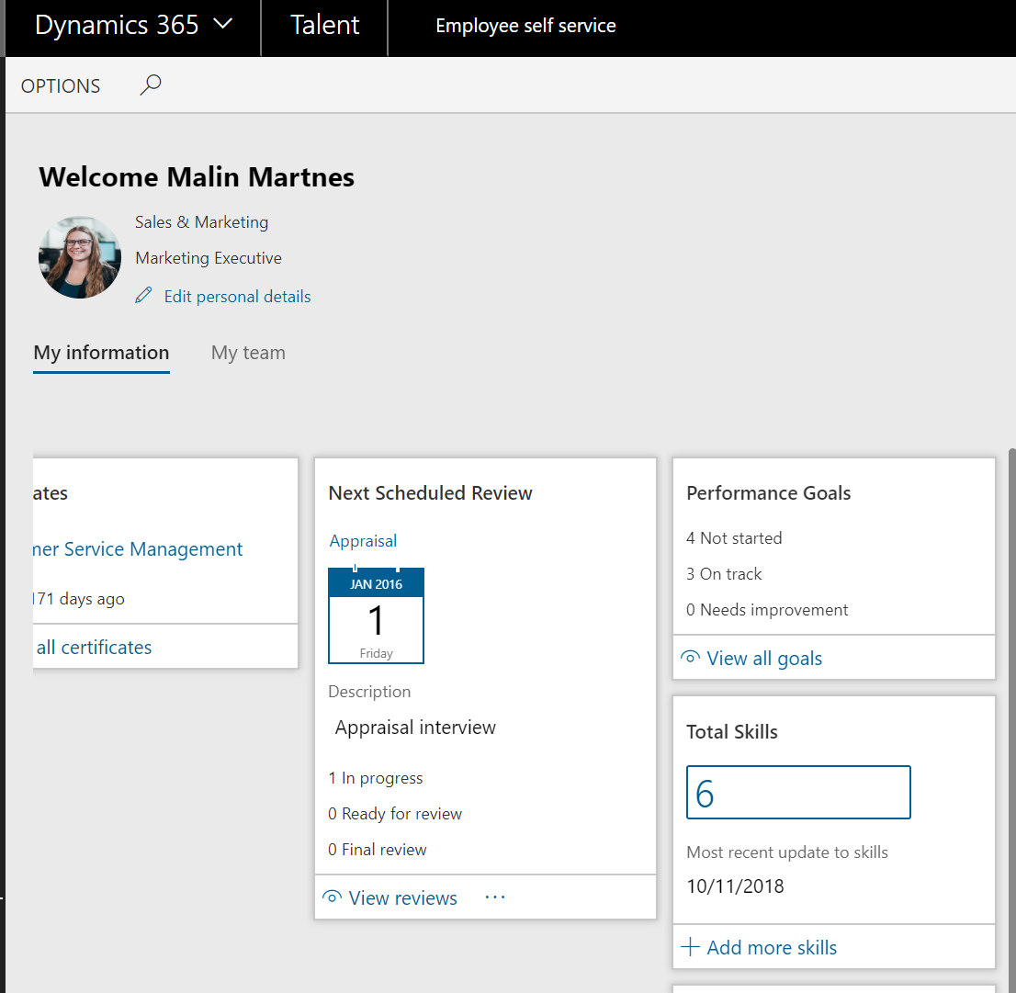
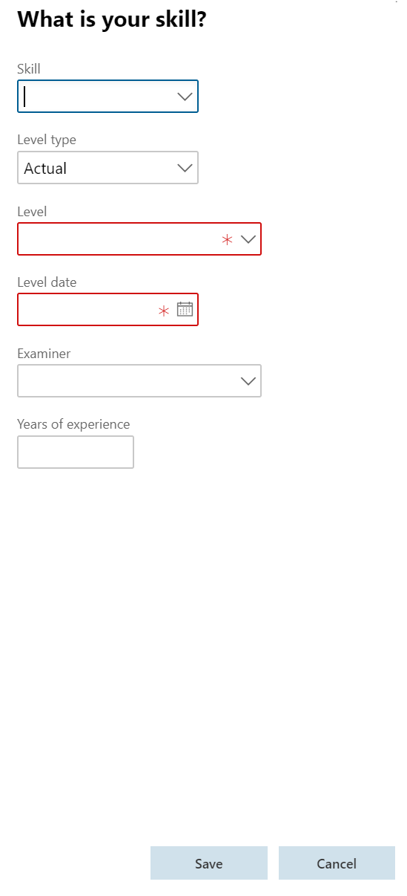
Employee

Slide 32
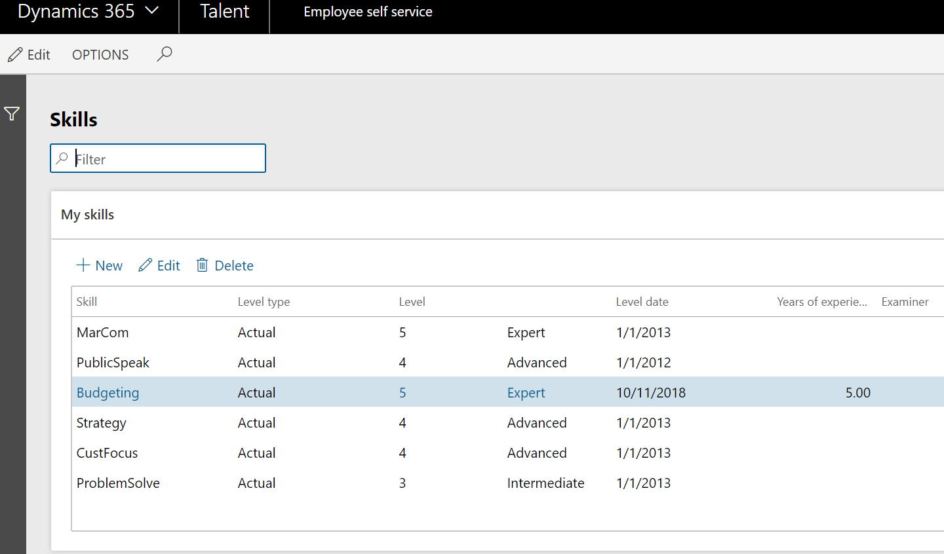
Employee

Slide 33
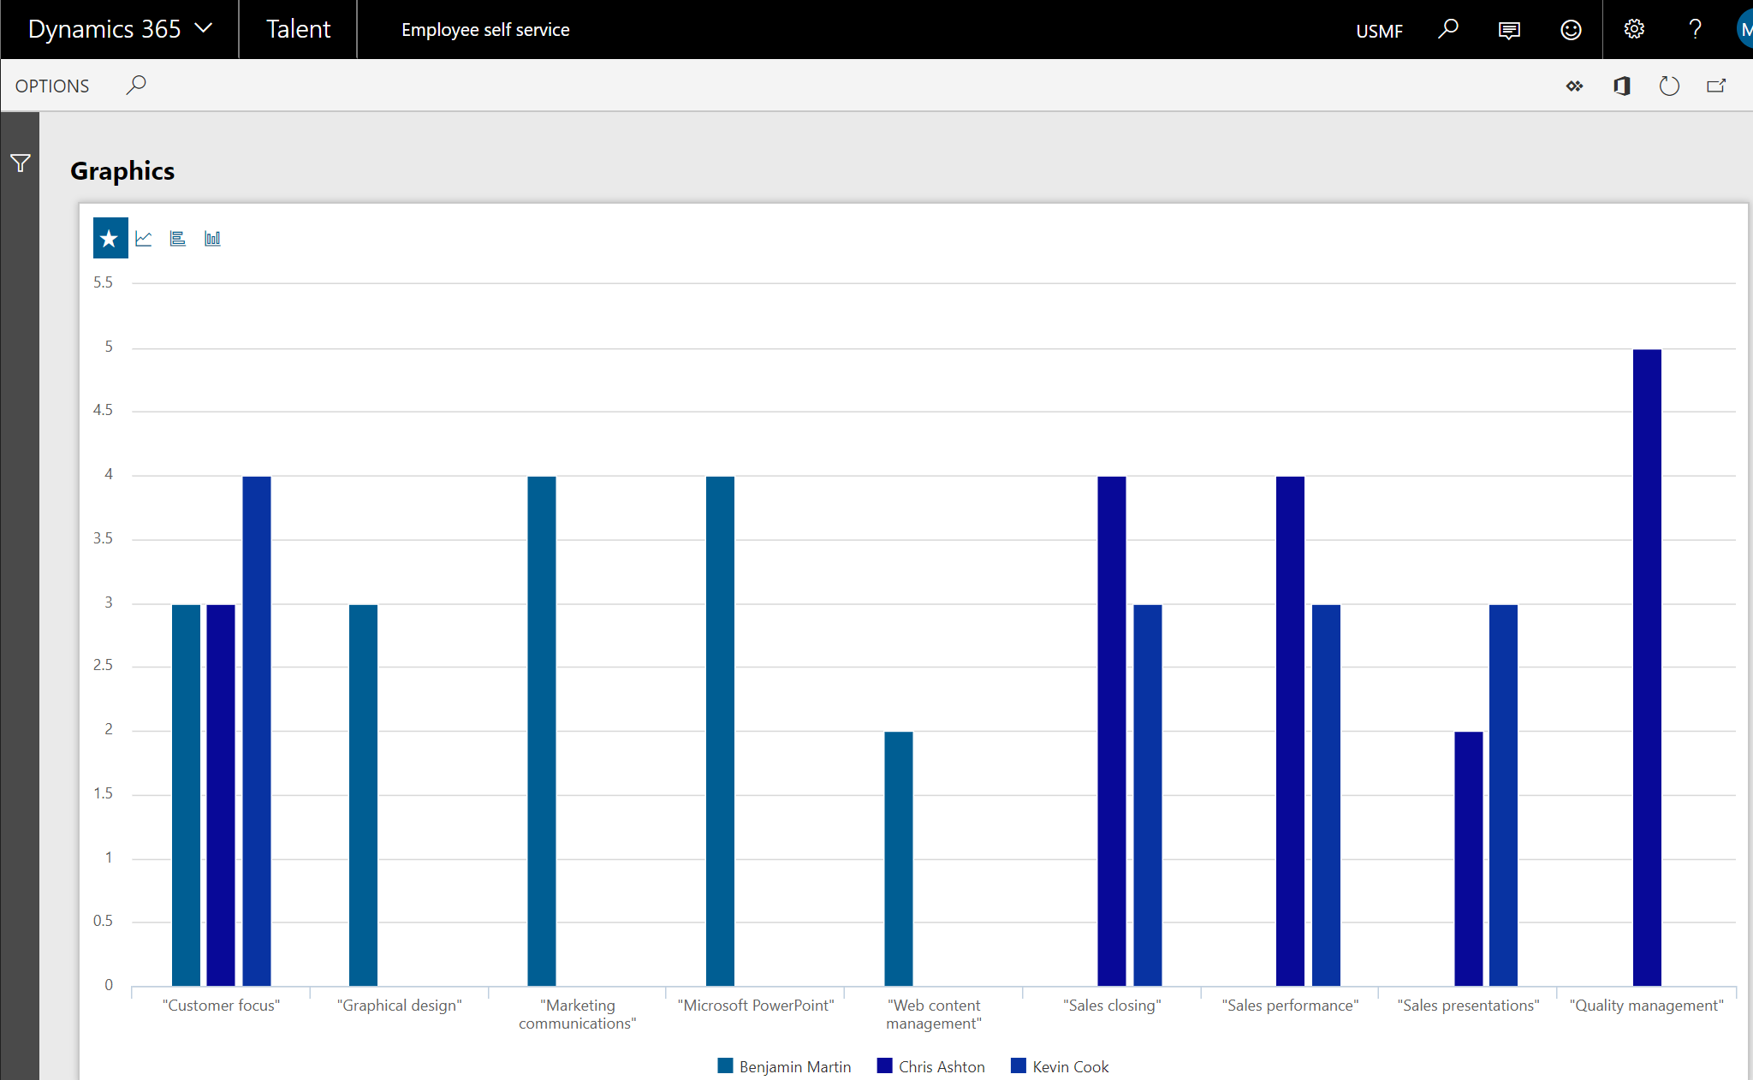
Manager

Slide 34
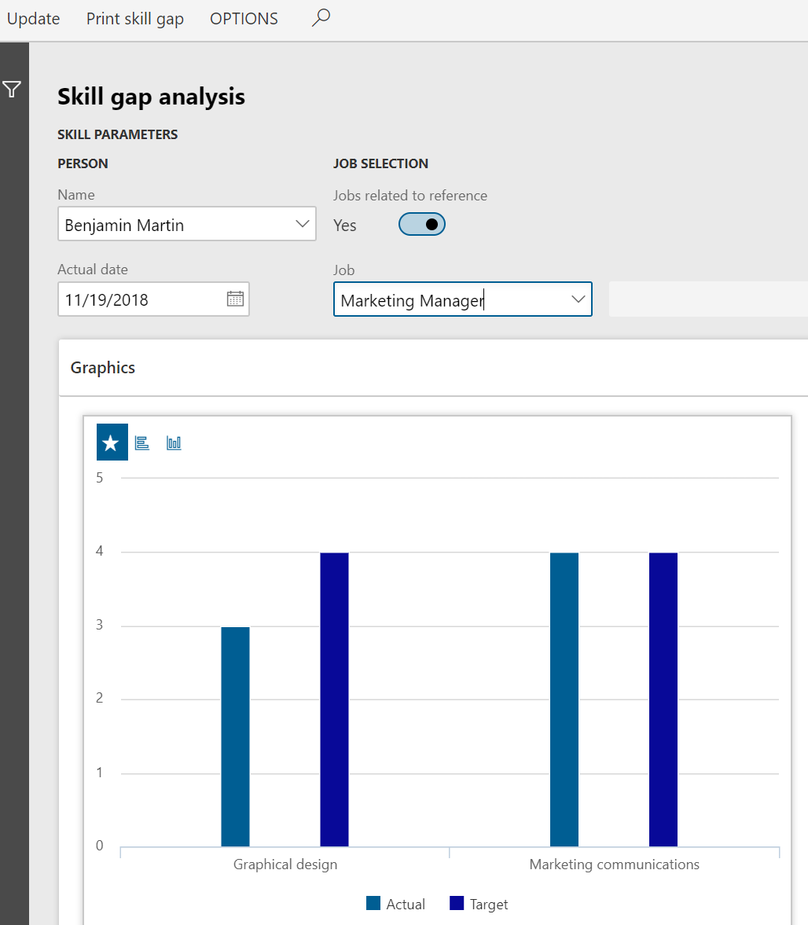
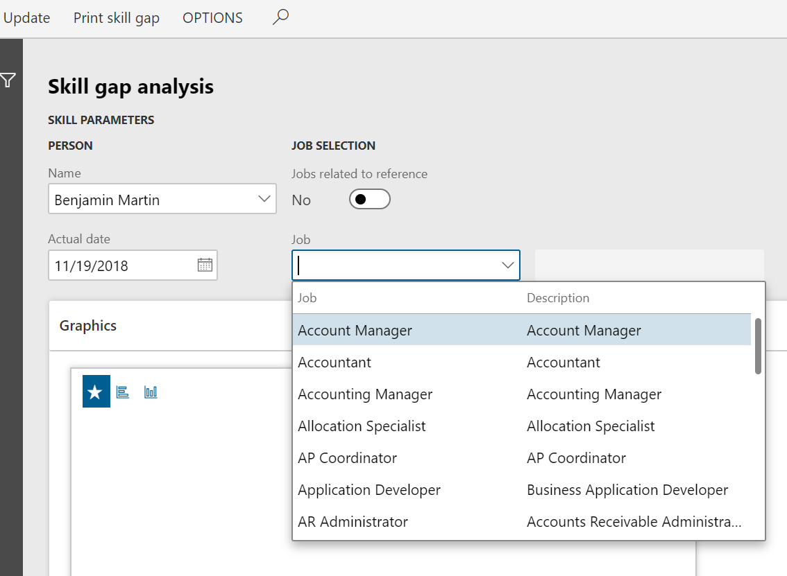
Manager

Slide 35
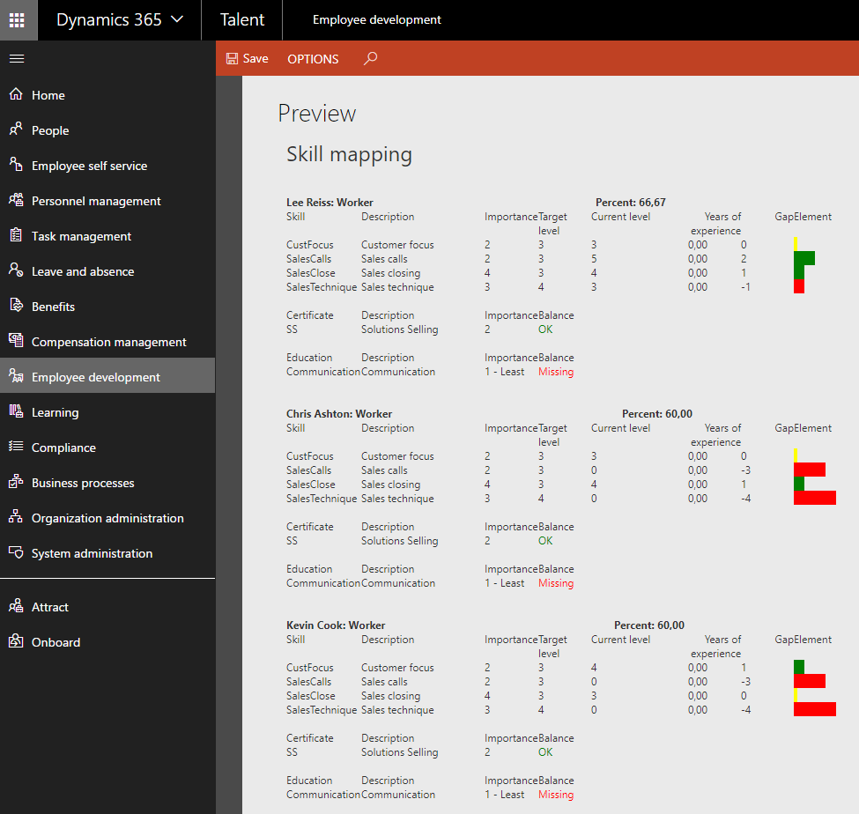
HR
Manager

Slide 36
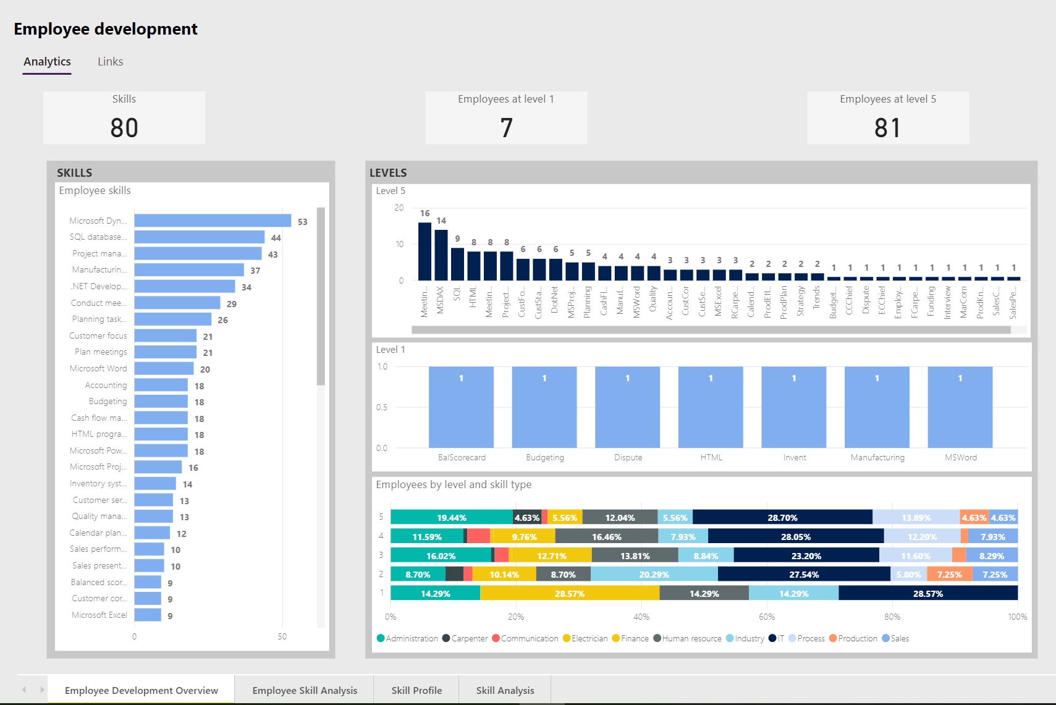
HR

Slide 37
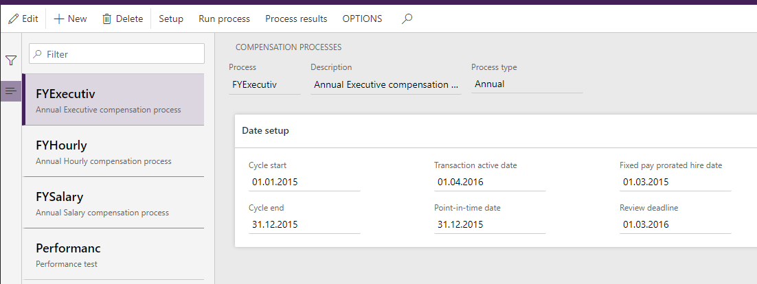
HR
Manager

Slide 38
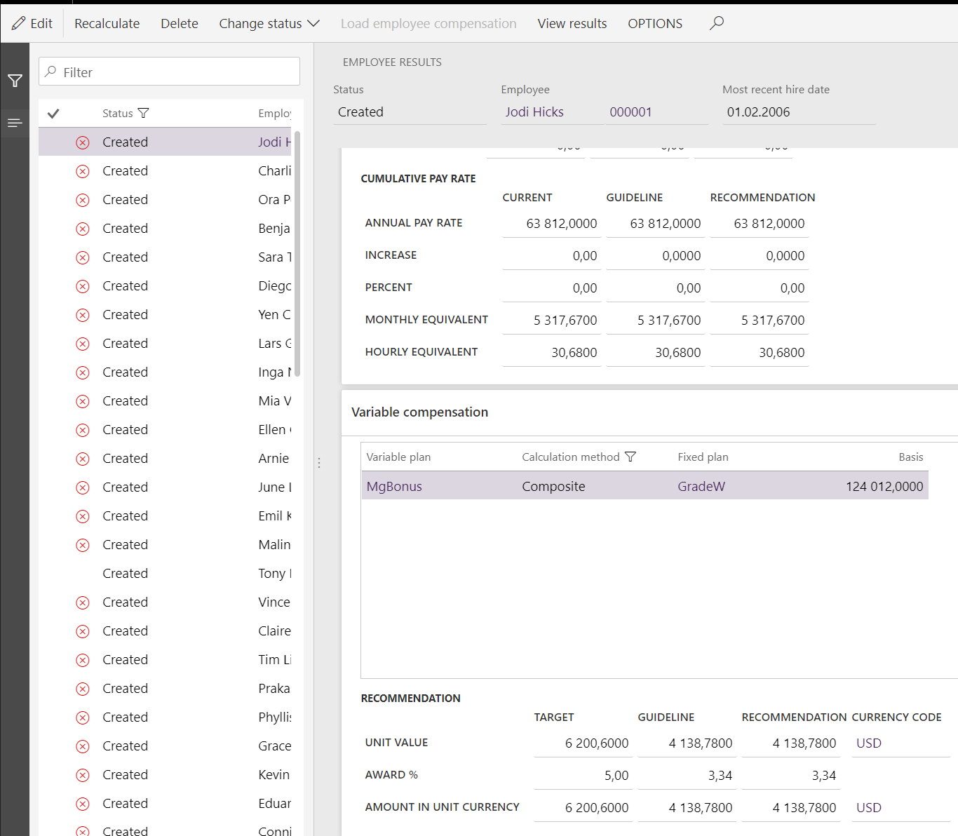
HR
Manager

Slide 39
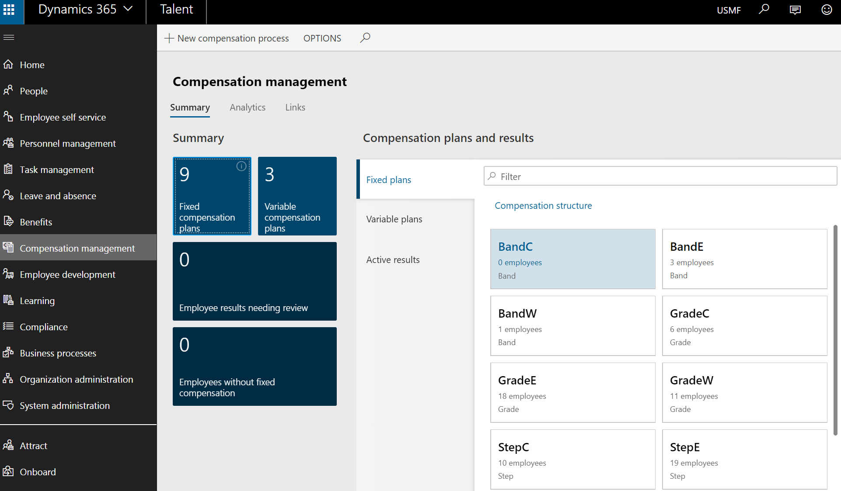
HR
Manager

Slide 40
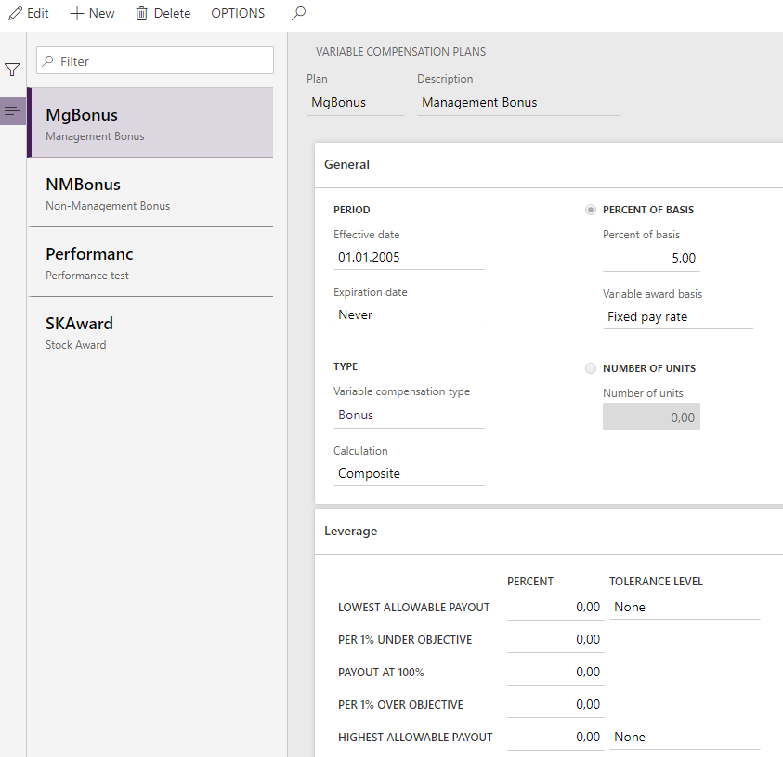
HR
Manager

Slide 41
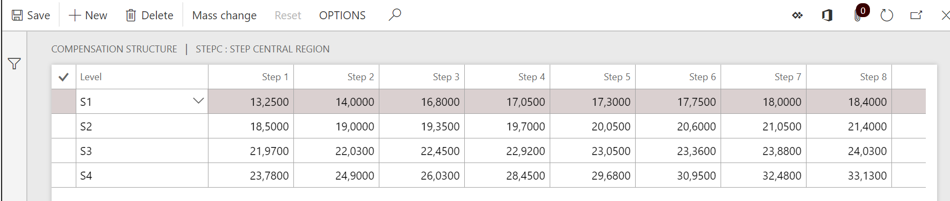
HR
Manager

Slide 42
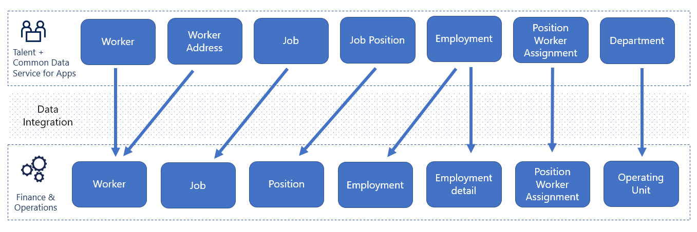
Integration

Slide 43
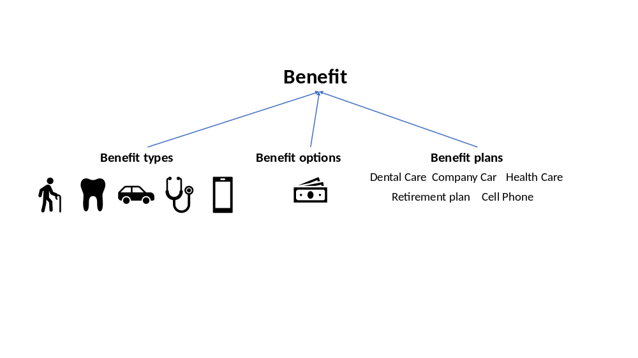
HR
Manager

Slide 44
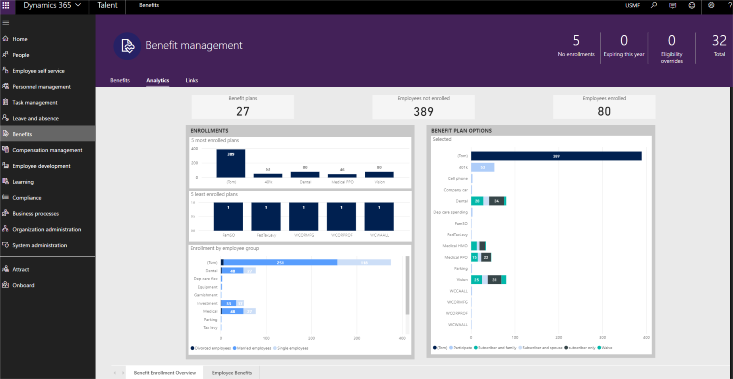
HR
Manager

Slide 45
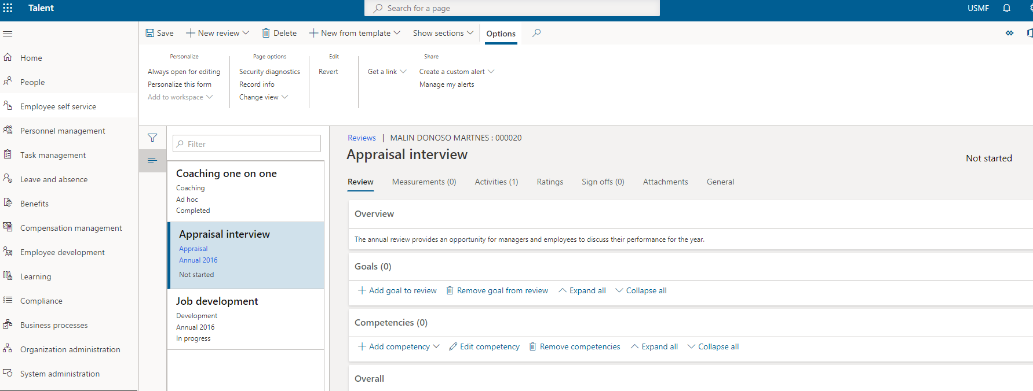
HR
Manager
Employee

Slide 46
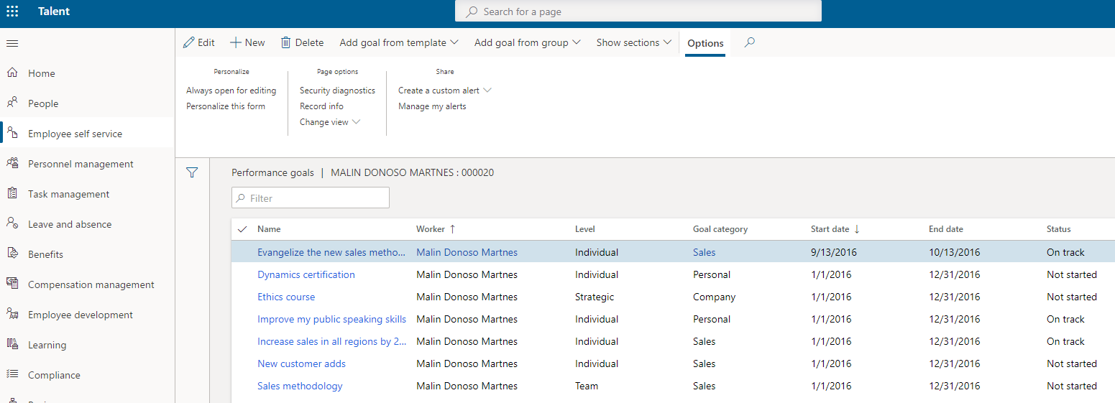
HR
Manager
Employee

Slide 47
Leave and absence

Slide 48
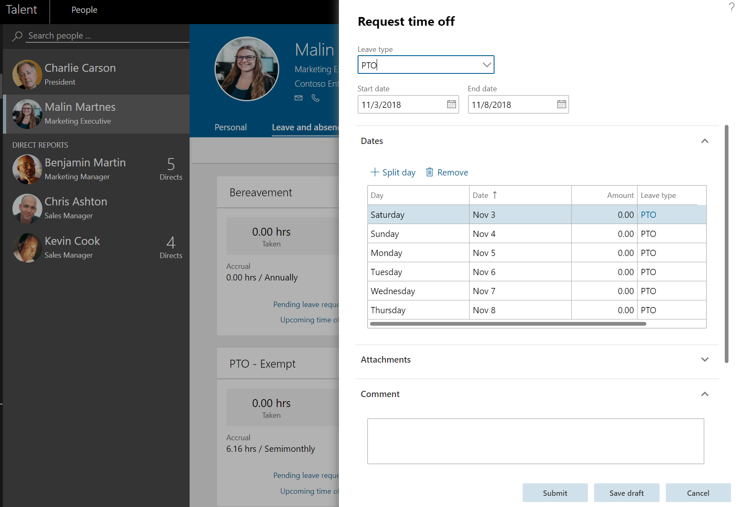
HR
Manager
Employee

Slide 49

HR
Manager
Employee

Slide 50


Slide 51
Social
365portal.org
Twitter: @Dyn365Community
Linkedin: @365-Saturday
Hashtags
#365Saturday #DynamicsPower
#LessCodeMorePower
Community
Community.Dynamics365.com
Powerusers.Microsoft.com

Slide 52
Feedback
We really value your feedback. Log-in to the 365portal event page and click on the session title.
Make sure you have added the session to your schedule and you have checked in.
You can now leave feedback which will help the speaker and improve our future events for the community.

Slide 53




Feedback

Slide 54







Contact information
https://malinsdynamics365fortalent.com/
https://www.linkedin.com/in/malinmartnes/
https://twitter.com/MalinMartnes - @MalinMartnes
Malin_martnes@hotmail.com
https://www.meetup.com/Women-in-Dynamics/
http://tiny.cc/MalinMVP

