Slide 1


HR killed Talent
Malin Donoso Martnes, Level 1 Auditorium 10.00
#SS2020

Slide 2












Sponsor
#SS2020

Slide 3
Agenda
Death of Talent
Top features
What's coming wave 1 ‘20

Slide 4
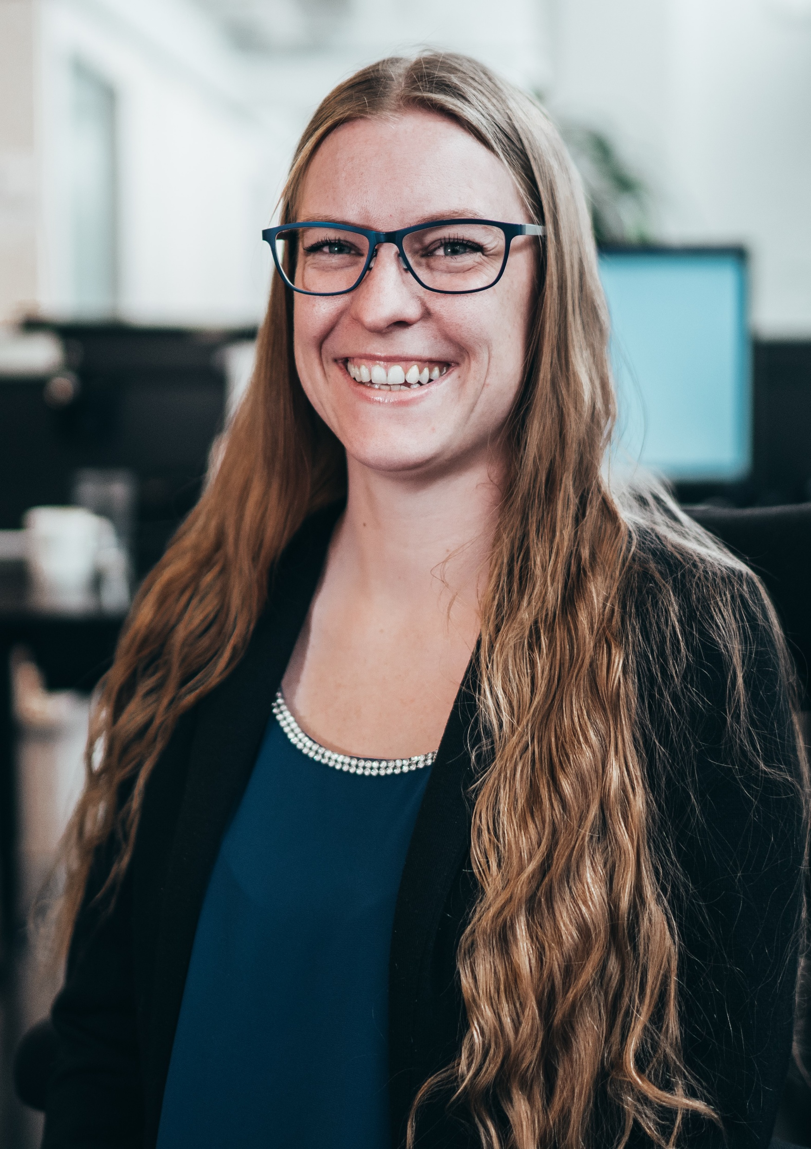
Speaker Intro
Started as a customer with CRM since 2009
Dynamics 365 Talent 2018
Worlds only MVP with a focus on HR
Laugh to often and to high
Love the community
Obsessive Liverpool-fan
Head of Dynamics 365 at Knowit Oslo
#SS2020

Slide 5
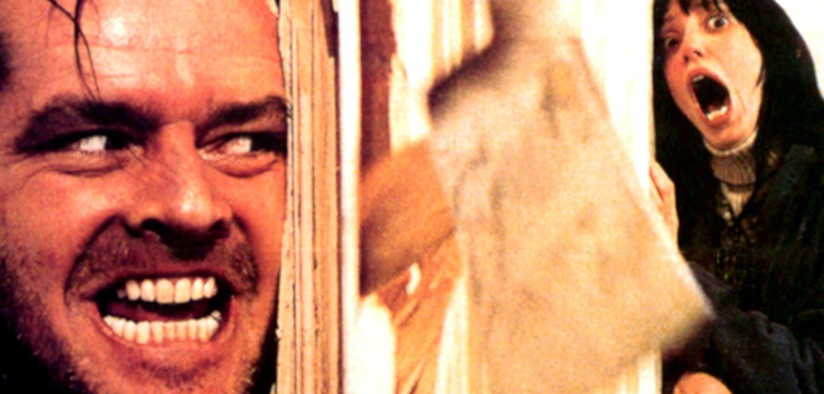









Death of Talent
Re-born
Dynamics 365 Human Resources

Slide 6
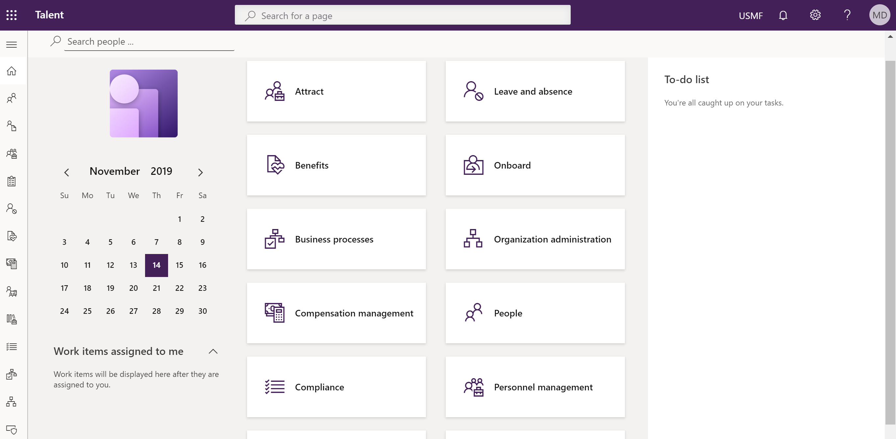

Top features

Slide 7
Company overview

Slide 8
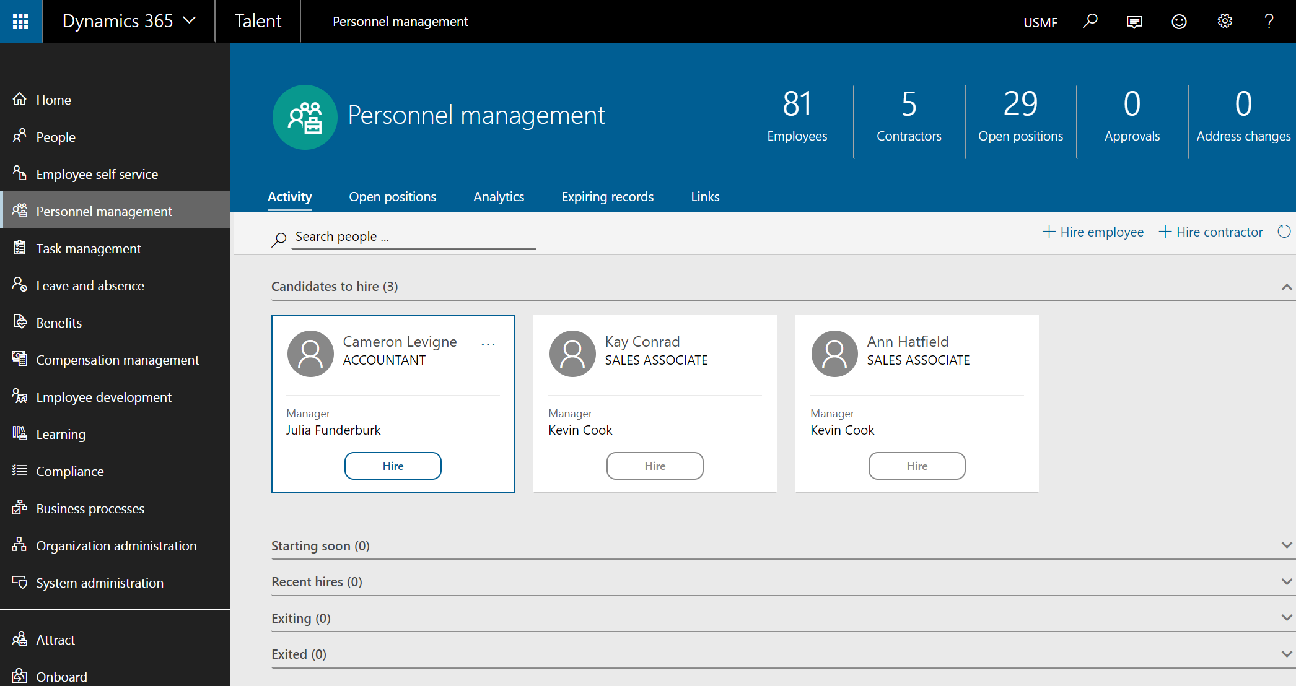

Slide 9
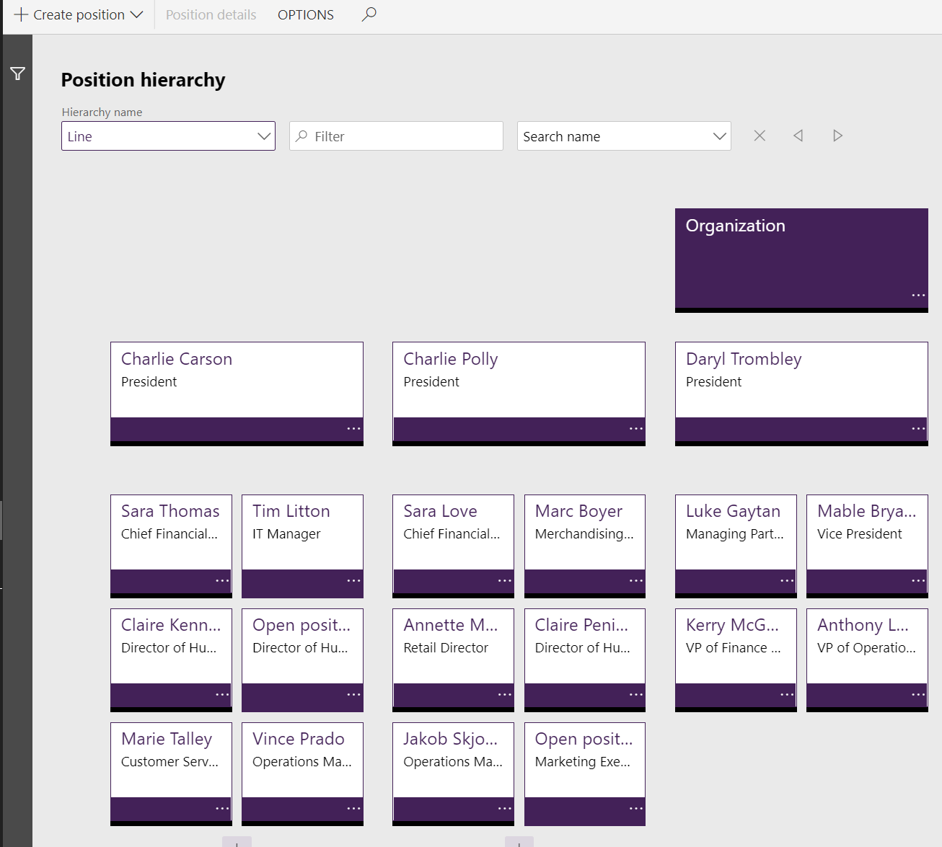
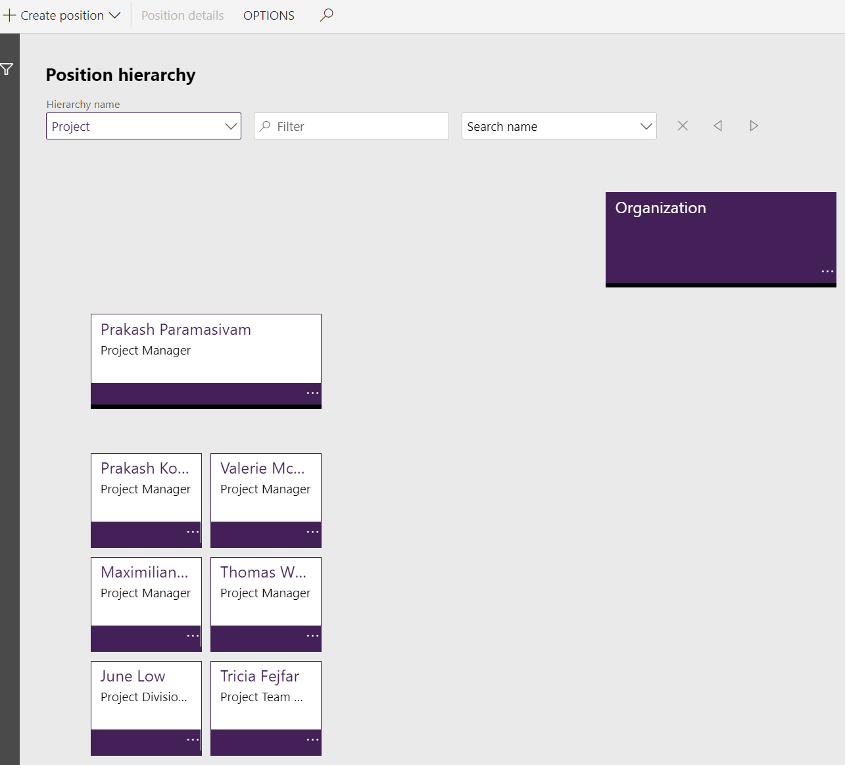

Slide 10
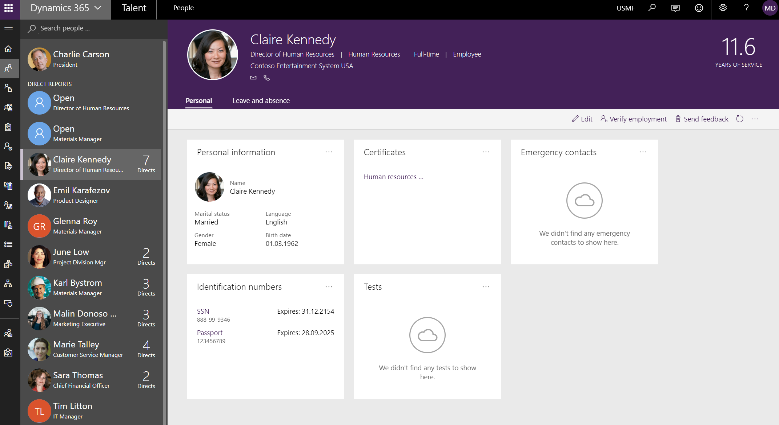

Slide 11
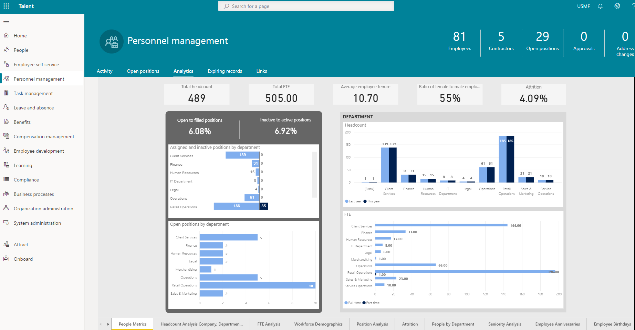

Slide 12
Onboarding, transition and offboarding

Slide 13
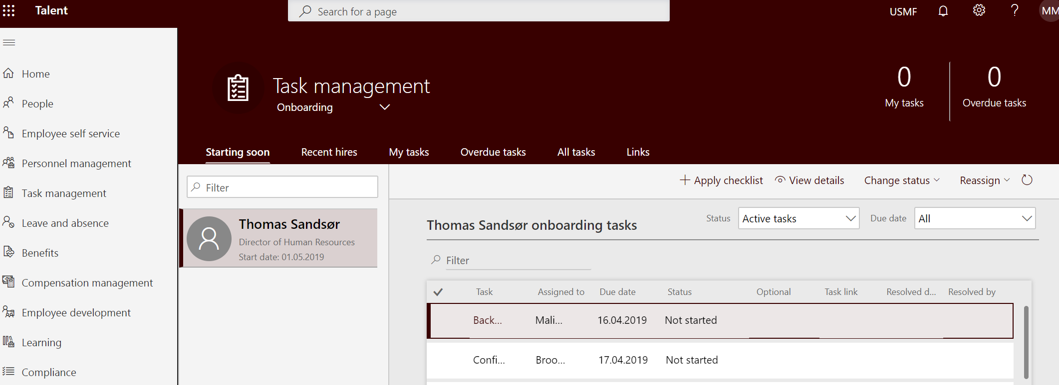

Slide 14
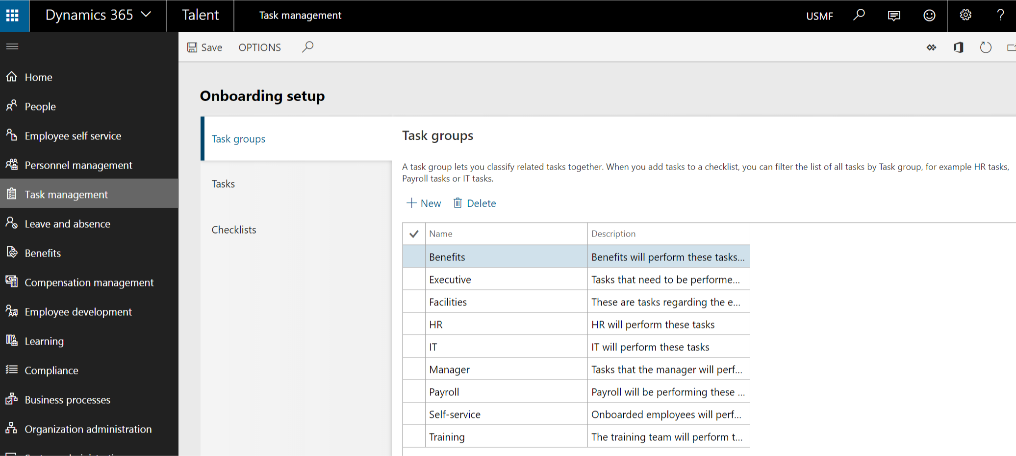

Slide 15
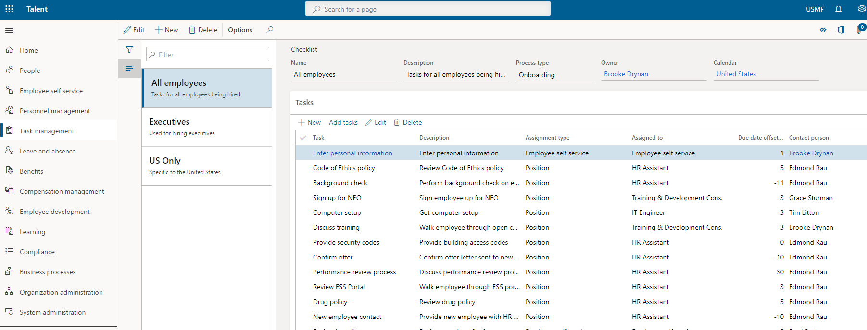

Slide 16
Self Service

Slide 17
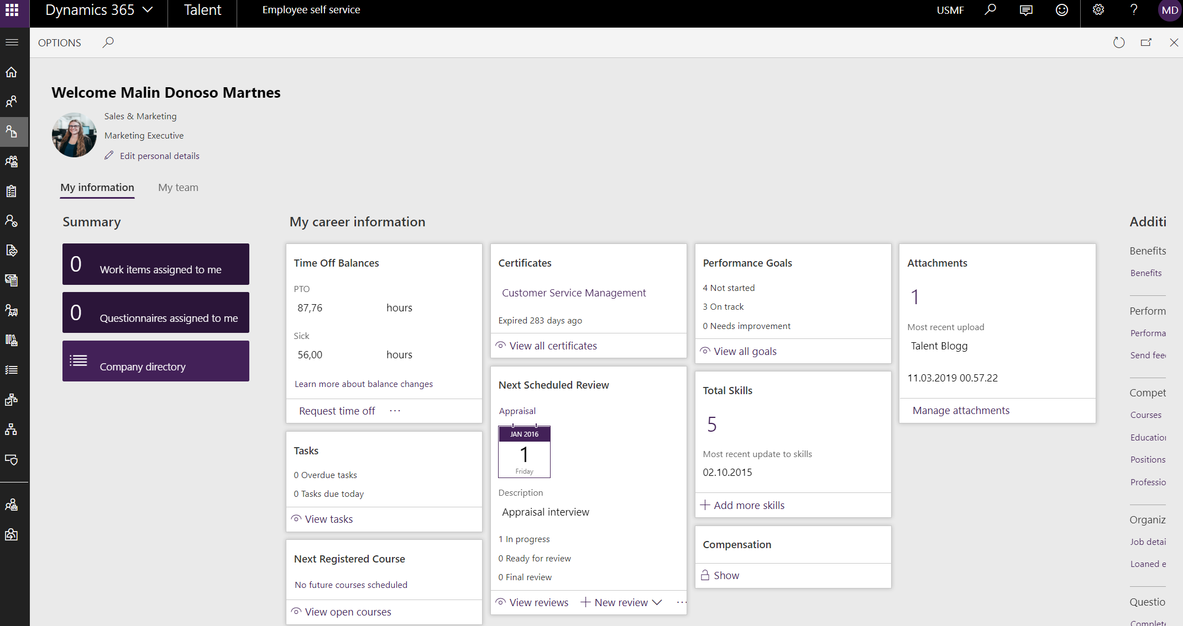

Slide 18
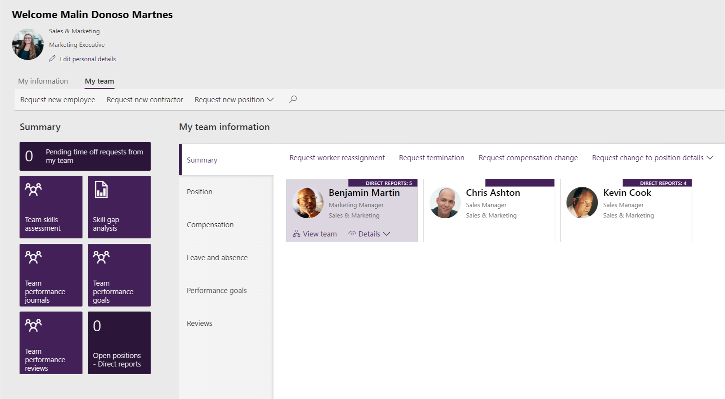

Slide 19
Employee development

Slide 20
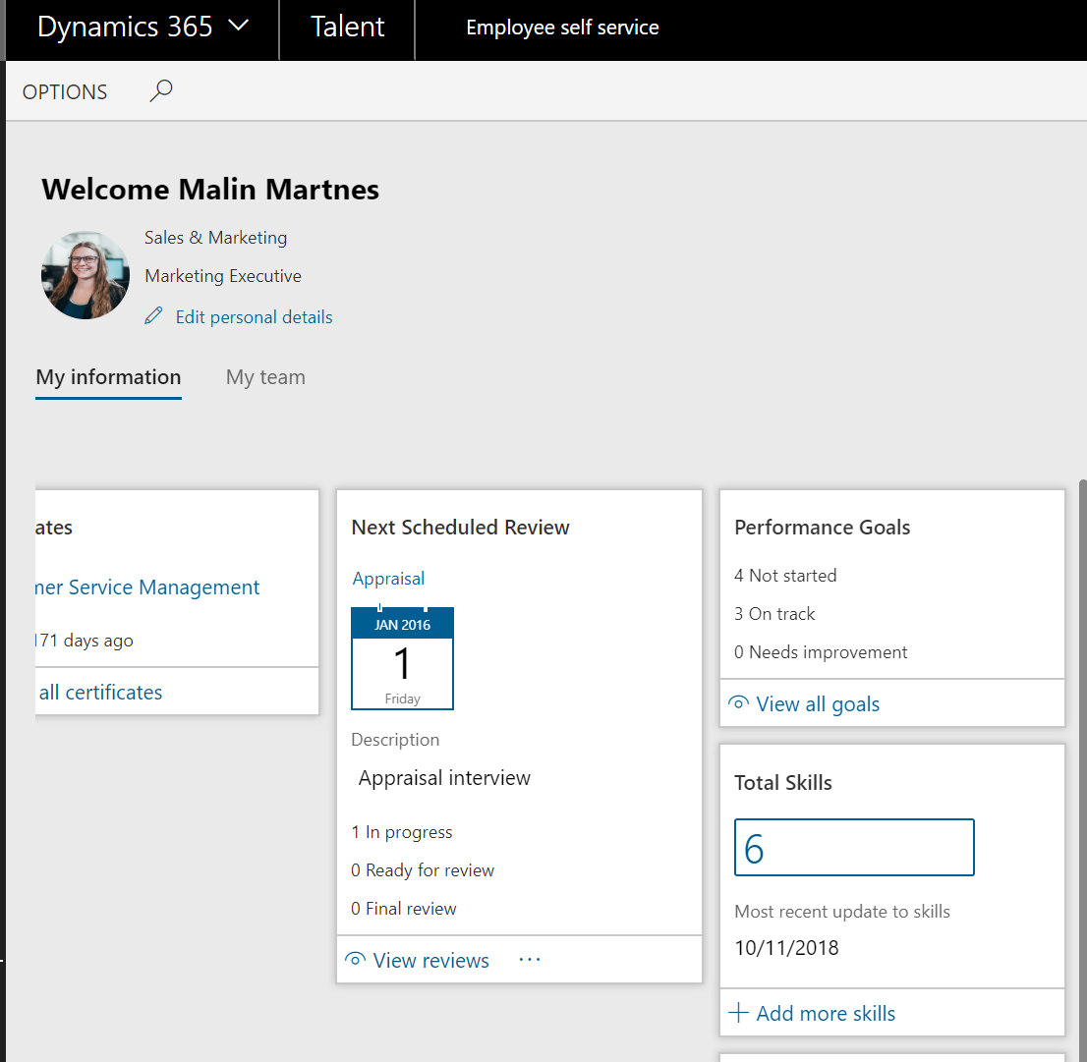
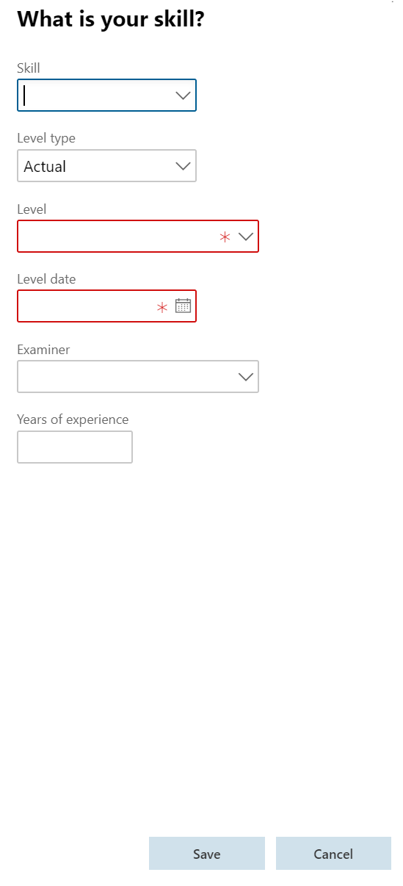

Slide 21
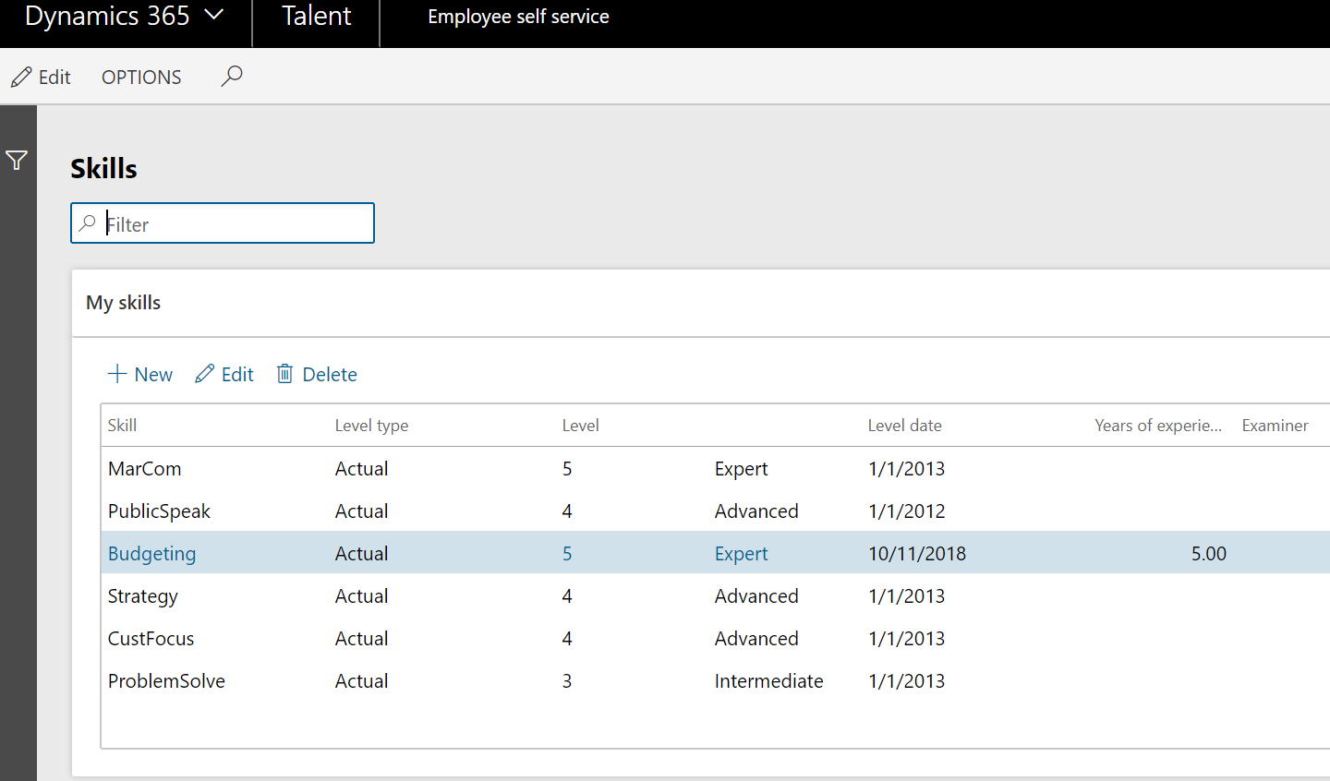

Slide 22
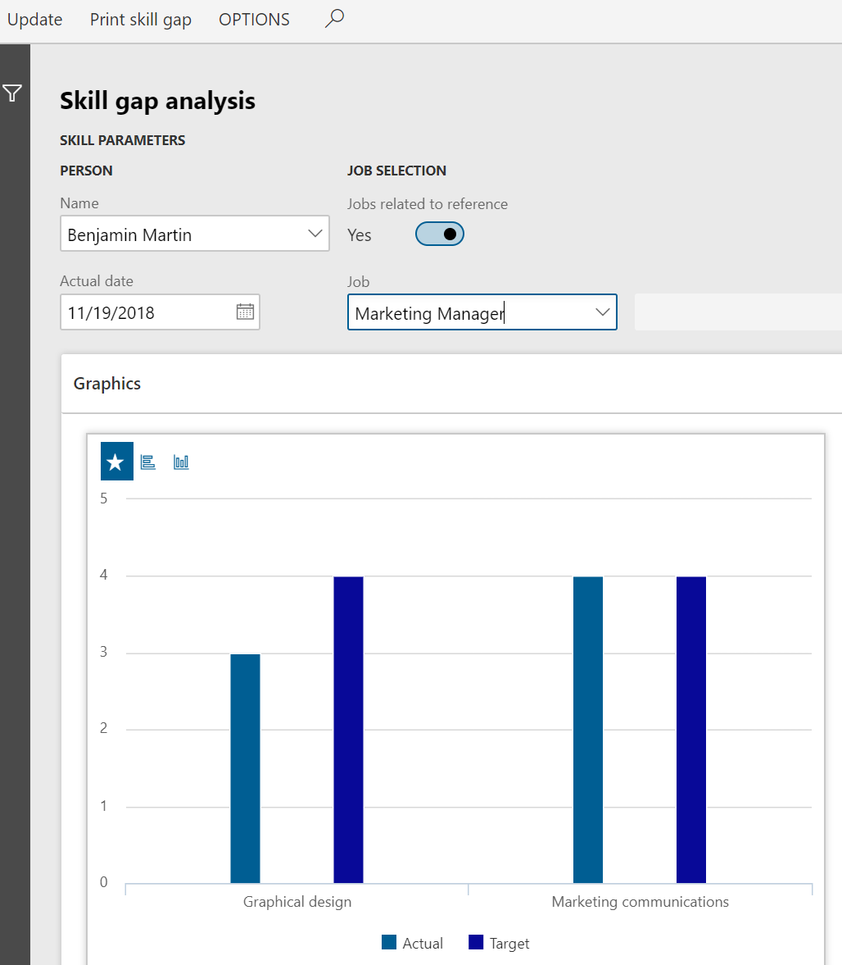
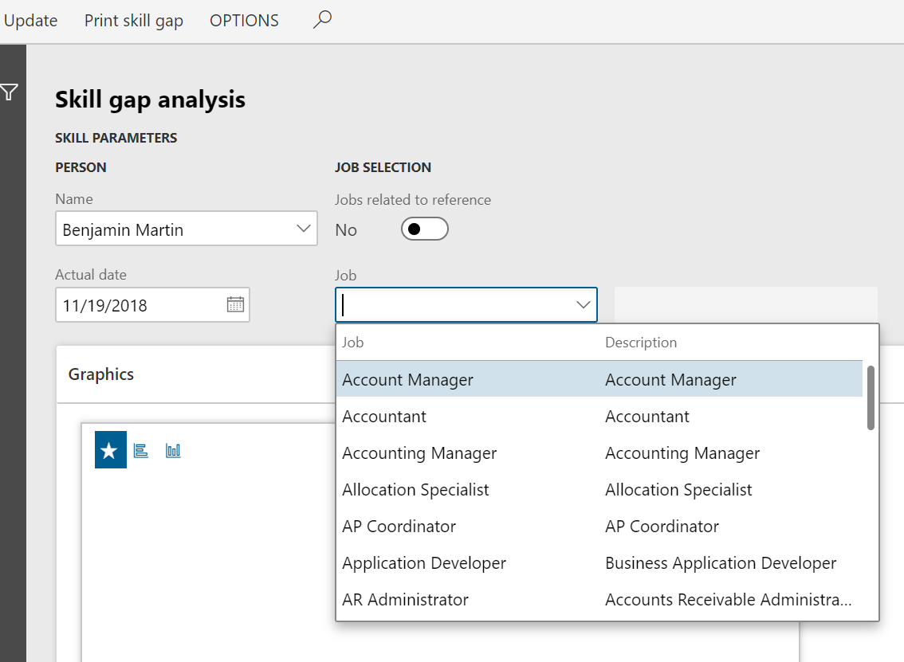

Slide 23
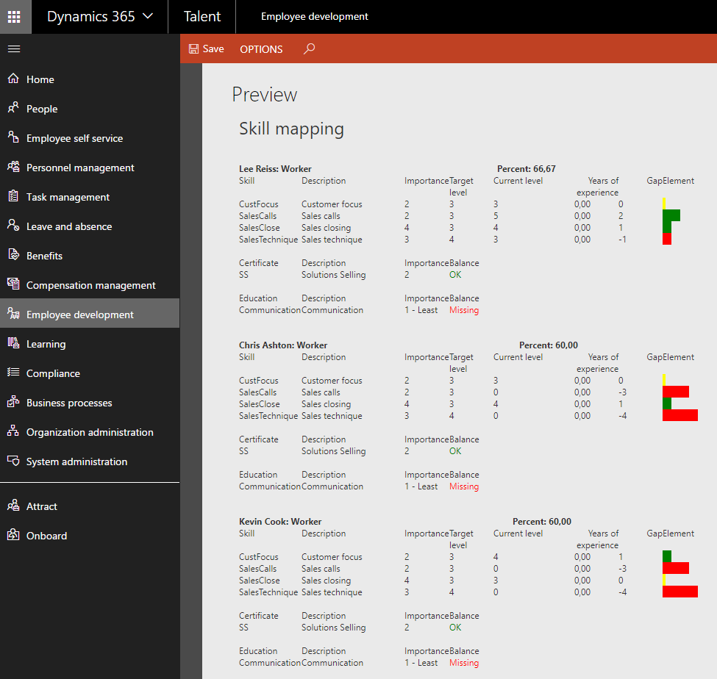

Slide 24
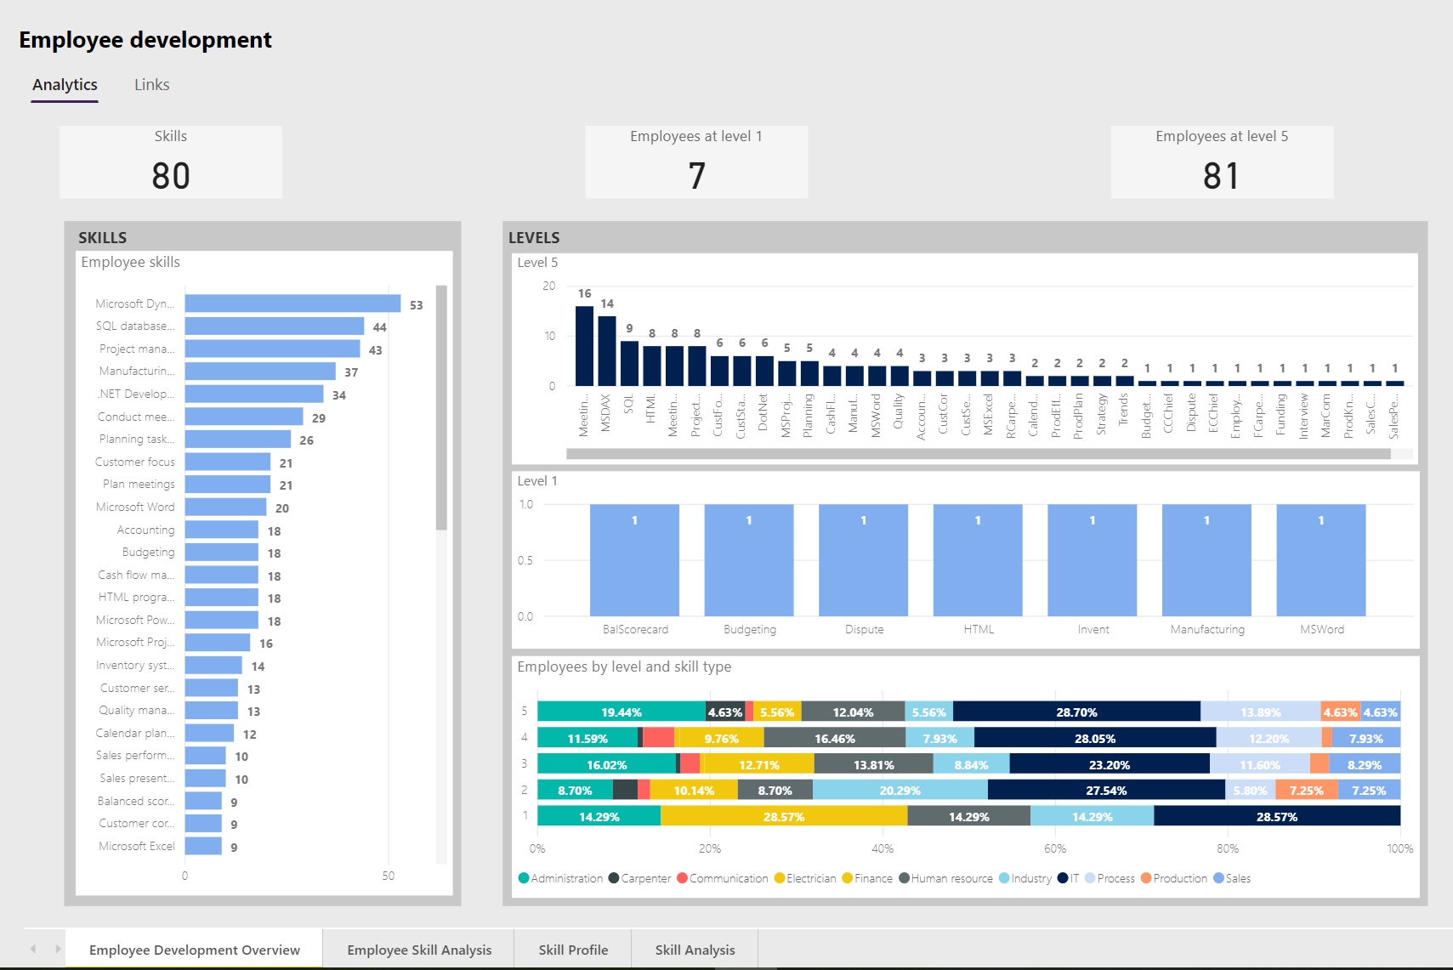

Slide 25
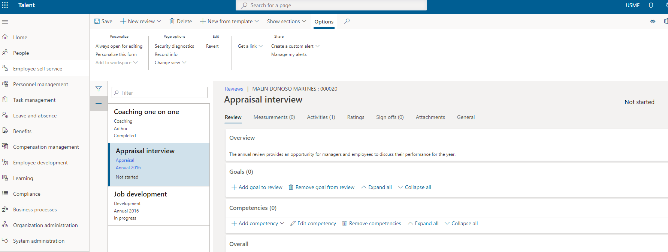

Slide 26
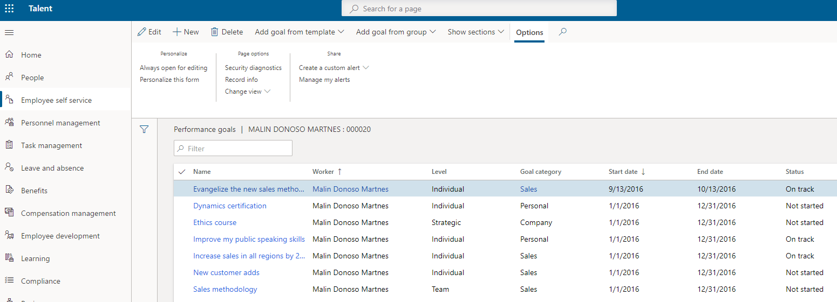

Slide 27
News in wave 1 ‘20

Slide 28
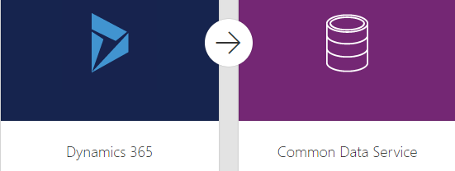


CDS – September 2020

Slide 29
Leave and Absence
Create leave rules to meet company and regulatory policies
Enhanced benefit plan configuration
Flex credit programs
Leave calendar views
Suspend leave for employees meeting certain criteria
Allow employees to buy and sell leave
Enable an absence manager to manage leave
Manage employee sick leave

Slide 30
Benefit
Enhanced benefit plan configuration
Enhanced worker benefit inquiry
Online benefit enrolment

Slide 31
Licence

Slide 32
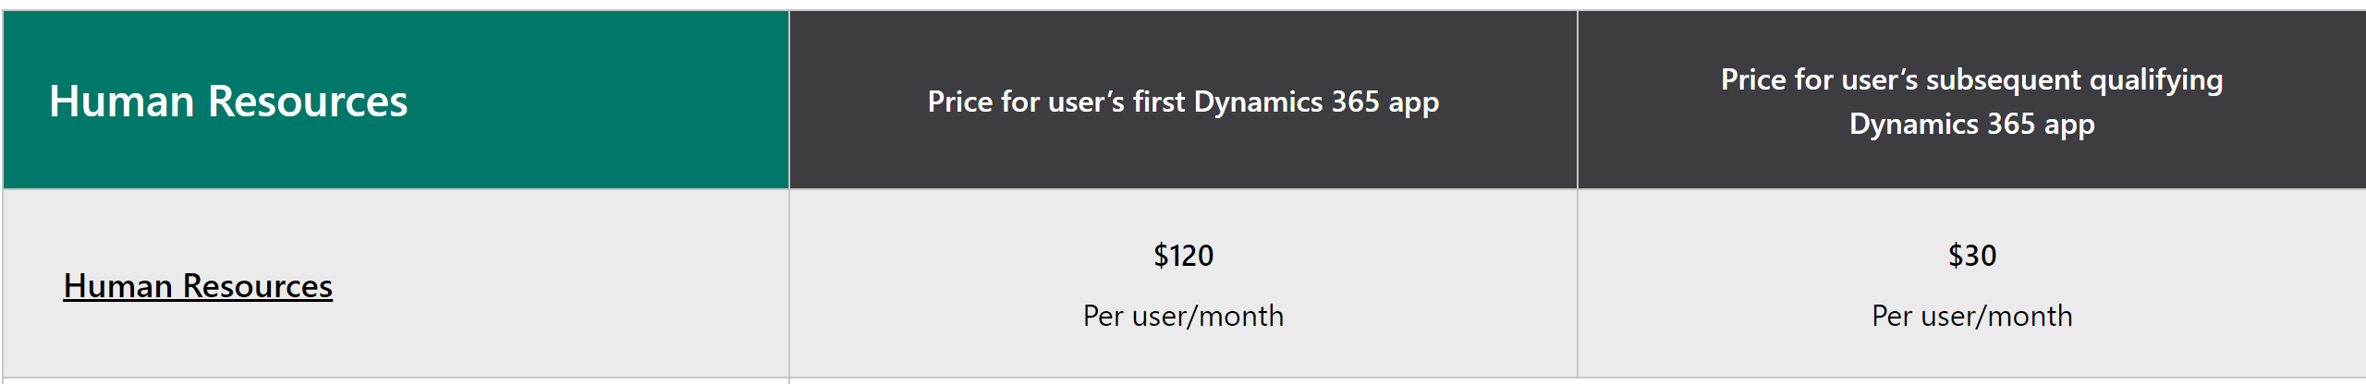
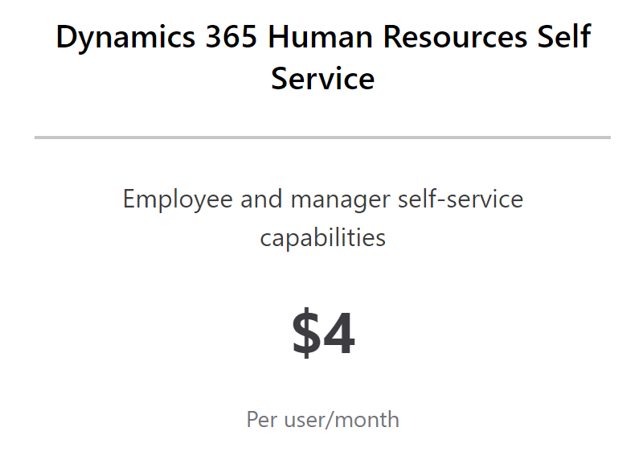

Slide 33
Questions?

Slide 34




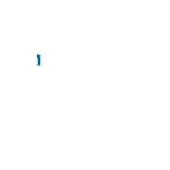
malin_martnes@hotmail.com
Oslo, Norway
@MalinMartnes
https://malindonosomartnes.com/
www.linkedin.com/in/malinmartnes
#SS2020

Slide 35
Sponsor
#SS2020

Slide 36
Thank You
#SS2020

